Slide 1

Trees
Rem Collier
Room A1.02
School of Computer Science and Informatics
University College Dublin, Ireland

Slide 2
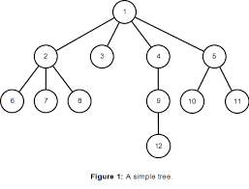
Trees: Introduction
A Tree is a hierarchical ADT where data is related in terms of parent-child relationships.
Each element (node) in the tree has at most 1 parent.
Each element (node) may have 0 or more children.
Each tree will include exactly one element (node), known as the root, which has no parent.
Trees can be defined recursively:
A tree T consists of a root node, r, plus a set of subtrees whose roots are children of r.

Slide 3
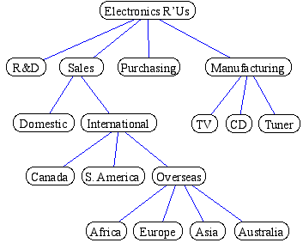
Trees: Introduction
A Tree is a hierarchical ADT where data is related in terms of parent-child relationships.
Each element (node) in the tree has at most 1 parent.
Each element (node) may have 0 or more children.
Each tree will include exactly one element (node), known as the root, which has no parent.
Trees can be defined recursively:
A tree T consists of a root node, r, plus a set of subtrees whose roots are children of r.
Trees occur throughout the real world:
Organisational Structures

Slide 4
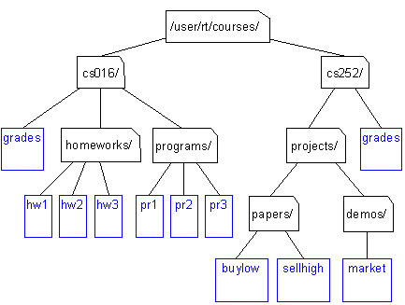
Trees: Introduction
A Tree is a hierarchical ADT where data is related in terms of parent-child relationships.
Each element (node) in the tree has at most 1 parent.
Each element (node) may have 0 or more children.
Each tree will include exactly one element (node), known as the root, which has no parent.
Trees can be defined recursively:
A tree T consists of a root node, r, plus a set of subtrees whose roots are children of r.
Trees occur throughout the real world:
Organisational Structures
File Systems

Slide 5
Trees: Terminology
Root of tree: A
The only node with no parent
A
B
C
D
E
F
G
I
H
J
K
L

Slide 6
Trees: Terminology
Root of tree: A
Parent of H: F
C is the parent of F
A is the parent of C
A
B
C
D
E
F
G
I
H
J
K
L

Slide 7
Trees: Terminology
Root of tree: A
Parent of H: F
Children of J: K and L
K is a child of J
L is a child of J
A
B
C
D
E
F
G
I
H
J
K
L

Slide 8
Trees: Terminology
Root of tree: A
Parent of H: F
Children of J: K and L
Sibling of F: G
Sibling of G: F
J does not have a sibling!
A
B
C
D
E
F
G
I
H
J
K
L

Slide 9
Trees: Terminology
Root of tree: A
Parent of H: F
Children of J: K and L
Sibling of F: G
Internal Nodes: A, B, I
Any node that has children
A
B
C
D
E
F
G
I
H
J
K
L

Slide 10
Trees: Terminology
Root of tree: A
Parent of H: F
Children of J: K and L
Sibling of F: G
Internal Nodes: A, B, I
External Nodes: D, H, L
Any node that has no children
Also known as leaves
A
B
C
D
E
F
G
I
H
J
K
L

Slide 11
Trees: Terminology
Root of tree: A
Parent of H: F
Children of J: K and L
Sibling of F: G
Internal Nodes: A, B, I
External Nodes: D, H, L
Ancestor of I: A, C, G, or I
A node u is an ancestor of v iff u = v or u is an ancestor of the parent of v (recursion!)
A
B
C
D
E
F
G
I
H
J
K
L

Slide 12
Trees: Terminology
Root of tree: A
Parent of H: F
Children of J: K and L
Sibling of F: G
Internal Nodes: A, B, I
External Nodes: D, H, L
Ancestor of I: A, C, G, or I
Descendent of I: I, J, K, or L
A node v is a descendent of u if u is an ancestor of v
A
B
C
D
E
F
G
I
H
J
K
L

Slide 13
Trees: Terminology
Root of tree: A
Parent of H: F
Children of J: K and L
Sibling of F: G
Internal Nodes: A, B, I
External Nodes: D, H, L
Ancestor of I: A, C, G, or I
Descendent of I: I, J, K, or L
Edge: pair (u,v) s.t. u is the parent of v
E.g. (A, B), (G, I)
(A, G) is not an edge!!!
A
B
C
D
E
F
G
I
H
J
K
L

Slide 14
Trees: Terminology
Root of tree: A
Parent of H: F
Children of J: K and L
Sibling of F: G
Internal Nodes: A, B, I
External Nodes: D, H, L
Ancestor of I: A, C, G, or I
Descendent of I: I, J, K, or L
Edge: pair (u,v) s.t. u is the parent of v
Path: sequence (n1, ..., ni) s.t. consecutive nodes are edges
E.g. (A, C, G, I)
(A, B, G) is not an path!!!
A
B
C
D
E
F
G
I
H
J
K
L

Slide 15
Trees: Terminology
Root of tree: A
Parent of H: F
Edge: (F, H)
Children of J: K and L
Sibling of F: G
Internal Nodes: A, B, I
External (leaf) Nodes: D, H, L
Ancestor of I: A, C, G, or I
Descendent of I: I, J, K, or L
A
B
M
C
D
E
F
G
I
H
J
K
L

Slide 16
Trees: Properties
Depth of a node, v: the number of ancestors of v excluding v itself.
Depth(A) = 0
Depth(G) = 2
Depth(E) = 2
Depth(K) = 5
Recursive definition for depth of a node, u:
u is the root: Depth(u) = 0
u is not the root: Depth(u) = 1 + Depth(Parent(u))
Depth is sometimes referred to as the level of the node in the tree.
Degree of a node, v: the number of children of v.
Degree(A) = 2, Degree(G) = 1, Degree(E) = 0
A
B
M
C
D
E
F
G
I
H
J
K
L

Slide 17
Trees: Properties
Height of a tree T: the maximum depth of an external node of T.
Height(T) = 5
Mathematically defined in terms of the height of a node, v:
v is external: Height(v) = 0
v is internal: Height(v) = 1 + max. Height of v’s children
Example:
Height(A) = 1 + max(Height(B), Height(C))
Height(B) = 1 + max(Height(D), Height(E))
Height(D) = Height(E) = 0
...
A
B
M
C
D
E
F
G
I
H
J
K
L

Slide 18
Tree ADT
Trees make use of the Position ADT and have the following operations:
root() returns the Position for the root
parent(p) returns the Position of p’s parent
children(p) returns an Iterator of the Positions of p’s children
isInternal(p) does p have children?
isExternal(p) is p a leaf?
isRoot(p) is p==root()?
size() number of nodes
isEmpty() tests whether or not the tree is empty
iterator() returns an Iterator of every element in the tree
positions() returns an Iterator of every Position in the tree
replace(p, e) replaces the element at Position p with e

Slide 19
Tree Interface
public interface Tree<T> extends Iterable<T> {
public Position<T> root();
public Position<T> parent(Position<T> p);
public Iterator<Position<T>> children(Position<T> p);
public boolean isInternal(Position<T> p);
public boolean isExternal(Position<T> p);
public boolean isRoot(Position<T> p);
public int size();
public boolean isEmpty();
public Iterator<Position<T>> positions();
public T replace(Position<T> p, T t);
}

Slide 20
Binary Trees

Slide 21
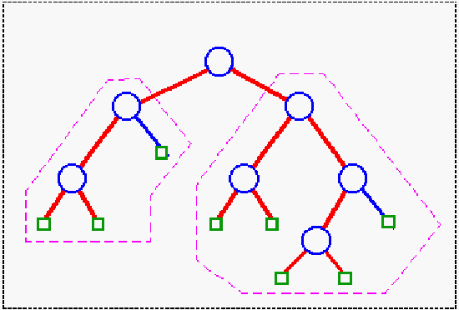
Binary Tree
A Binary Tree is a tree with the following properties:
Every node has at most 2 children (degree 2)
Each child node is labelled as being either a left child or a right child
A left child precedes a right child in the ordering of children of a node
A Binary Tree, T, is either empty or combines:
a node r, called the root of T, which stores an element
a binary tree, called the left subtree of T
a binary tree, called the right subtree of T
Level Property: Level d of a binary tree is the set of all nodes with depth d, of which there are at most 2^{d} nodes.

Slide 22
Example: Arithmetic Operations
(1 + 3) x (7 – (2 + 1))
↓
x
+
-
1
3
7
+
2
1

Slide 23
Binary Tree ADT
Binary Tree ADT = Tree ADT + 4 extra operations:
left(p) return the Position of p’s left child
right(p) return the Position of p’s right child
hasLeft(p) test whether p has a left child
hasRight(p) test whether p has a right child
The corresponding Java Interface mirrors this:
public interface BinaryTree<T> extends Tree<T> {
public Position<T> left(Position<T> p);
public Position<T> right(Position<T> p);
public boolean hasLeft(Position<T> p);
public boolean hasRight(Position<T> p);
}
Again, no update methods are provided – these depend on the type of binary tree you are creating…

Slide 24
Types of Binary Tree

Slide 25
Standard Binary Tree
For a “standard” binary tree:
addRoot(e) create and return a new root node storing e; an error should occur if the tree is not empty
insertLeft(v, e) create and return a new node storing e as the left child of v; an error should occur if v has a left child.
insertRight(v, e) create and return a new node storing e as the right child of v; an error should occur if v has a right child.
remove(v) remove node v and replace it with its child, if any, and return the element stored at v; an error occurs if v has two children.
attach(v, T1, T2) Attach T1 and T2 respectively, as the left and right subtrees of the external node v; an error occurs if v is not external.

Slide 26
Proper Binary Trees
Proper Binary Tree:
Every node, n, has degree 0 (external node) or 2 (internal node).
Build the tree by expanding external nodes to become internal nodes.
Start with one external node - the root node
Key Operations:
expandExternal(v) create two new null nodes and add them
the left and right children of v. An error
occurs if v is not external.
remove(v) v must be an internal node. If v has 1 external
child, remove v and the external child and
replace it with its internal child. If v has 2 external
children, remove both children and make v
external. An error occurs if v is external or
has 2 internal children.

Slide 27
Complete Binary Trees
A Binary Tree T, with height h, is complete if:
Levels 0 to h-1 have the maximum number of nodes possible
In level h-1, all the internal nodes are to the left of the external nodes, and there is at most one node that has only a left child.
When dealing with Complete Binary Trees, there are two important nodes:
The root node (the top of the tree)
The last node (the next insertion point for the tree).
Key Operations:
add(e) adds e to the tree and returns a new external node, v, such that the resulting tree is a complete binary tree with last node v.
remove() removes the last node of T and returns its element

Slide 28
Link-Based Binary Trees

Slide 29
Implementation: Link-Based
Mirrors approach used in linear data types:
Nodes contain data (the element)
Key Relationships: parent / child (not previous / next)
Entry point: The root node
Additional Issues: the number of nodes in the tree (size)
root
∅
parent
size
element (data)
“Albert”
3
left
child
right
child
“Betty”
“Chris”
∅
∅
∅
∅

Slide 30
Implementation of Binary Trees
Most of the implementations of the above types are the same.
This means that most of the code is the same.
Only the update operations differ….
We can handle this in OOP by defining an abstract base class that is common to all three implementations.
public abstract class AbstractBinaryTree<T> implements BinaryTree<T> {
protected class Node implements Position<T> { … }
…
}
public class StandardBinaryTree<T> extends AbstractBinaryTree<T> {
…
}

