Slide 1
Lecture 1: Introduction
COMP2013J: Databases and Information Systems
Dr. David Lillis (david.lillis@ucd.ie)
UCD School of Computer Science
Beijing-Dublin International College

Slide 2
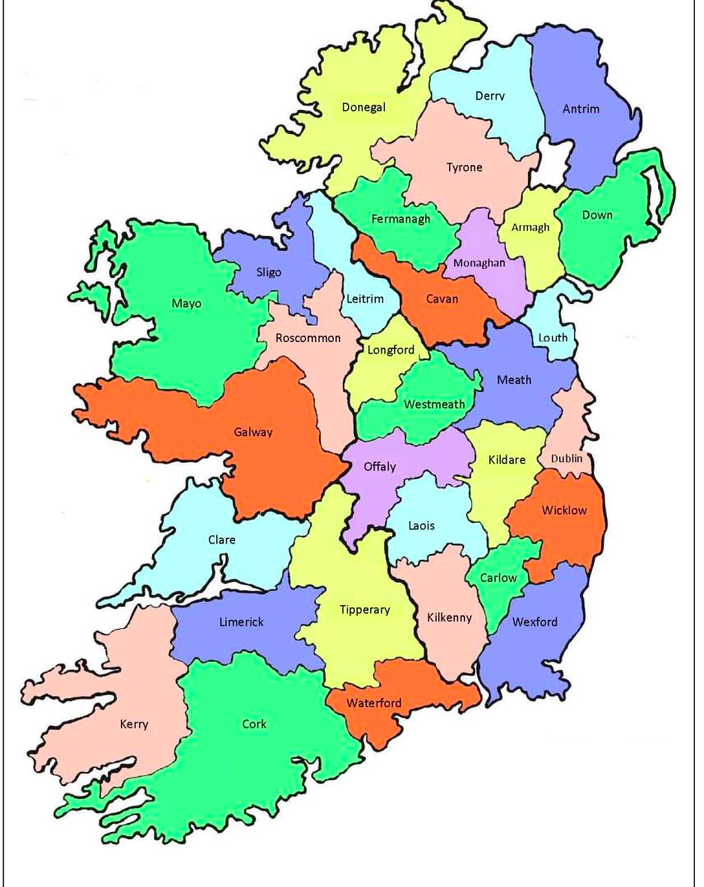
About Me
My name is David Lillis:
“Lillis” is my family name.
“David” is my given name.
You can call me “David”, or “Dr. Lillis” (if you prefer to be more formal): I don’t mind.
Originally from Ennis: a town with a population of 25,000 located in the west of Ireland

Slide 3
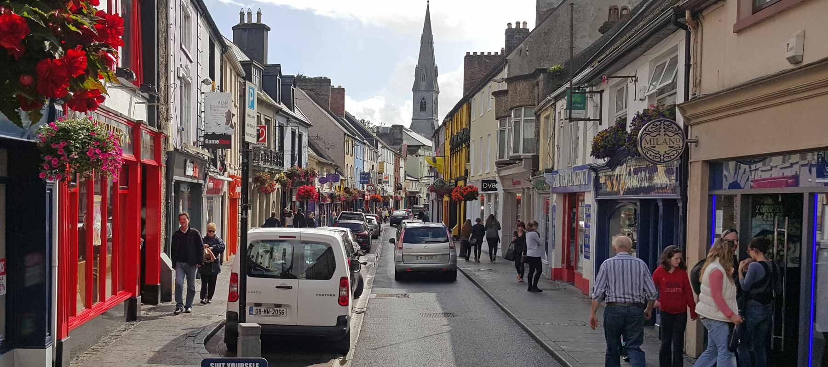

Slide 4
About Me
I live in Dublin: Ireland's capital city (and biggest city): population of 1,300,000
(The entire country of Ireland has about 4,700,000 people)

Slide 5
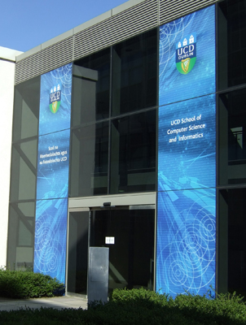
About Me
Assistant Professor in School of Computer Science in UCD
I did my PhD in UCD also, in the area of Multi Agent Systems.
I have also done research on Information Retrieval, Digital Forensics and Sensor Systems.
Previously taught in:
Griffith College Dublin.
Fudan University, Shanghai.
This is my 6th semester lecturing in BDIC, and my 9th semester in China.

Slide 6
Module Timetable
Lectures:
Mondays 08:00-09:35 in Room 502, Teaching Building 4
Labs:
Tuesdays 15:25-17:00 in Room 214, Teaching Building 4
Labs begin in Week 3.

Slide 7
Module Format
Lectures will run from Week 1 to Week 15 (inclusive).
Labs will run from Week 3 to Week 15 (inclusive).
If you have any questions about the module, please ask me or a teaching assistant.
After a lecture, during labs or by email:
My email address is david.lillis@ucd.ie
Assessment is split between
70% Final exam at end of term (Week 17/18)
30% Practical work during semester

Slide 8

Virtual Learning Environment (VLE)
We will use Moodle as the VLE for this module.
Located at: https://csmoodle.ucd.ie/moodle/course/view.php?id=747 (or scan the QR code)
Enrolment key:
BDIC-Data-2019

Slide 9
Assignments
Assignments are individual (not group assignments).
This means that you must submit your own work only. If you submit somebody else's work and pretend that you wrote it, this is called plagiarism.
Plagiarism is a very serious academic offence.

Slide 10
Plagiarism & UCD Computer Science
Plagiarism is a serious academic offence
[Student Code, sections 6.2 & 6.3] or [UCD Registry Plagiarism Policy] or [CS Plagiarism policy and procedures]
Our staff and demonstrators are proactive in looking for possible plagiarism in all submitted work
Suspected plagiarism is investigated by the CS Plagiarism subcommittee
Usually includes an interview with student(s) involved
1st offence: usually 0 or NG in the affected components
2nd offence: may be referred to the University disciplinary committee
Student who enables plagiarism is equally responsible
http://www.ucd.ie/students/guide/academicregs.html
http://libguides.ucd.ie/academicintegrity

Slide 11
Asking for help
If you find things difficult, help is available.
There is a lecturer and many TAs in every lab.
You can ask a question after class.
You can email a TA with a question outside class.
You can email me with a question outside class.
You can get help from your classmates.
Getting help to understand something is not the same as copying a solution!

Slide 12
Module Content
Based on sections of the book
Fundamentals of Database Systems (6th Edition) by Elmasri and Navathe
ISBN-10: 0136086209 | ISBN-13: 978-0136086208
Chinese version available from Amazon.cn
ISBN: 9787302260448, 7302260443
All materials will be covered in lecture notes
Practical work will using MySQL Relational DataBase Management System (RDBMS)
Free, cross platform, open source database management system

Slide 13
Topics
Introduction to Databases
Database Models
Relational Database Model
Structured Query Language
Database Design (Entity-Relationship Model)
Database Normalisation
Programmatic DB Use
NoSQL Databases

Slide 14
Introduction to Databases and information systems

Slide 15
Why Study Databases?
A huge amount of information being stored.
The College, Medical records, Employers, Companies, Government Agencies, etc.
Managing that data is a really big task
Data Base Management Systems (DBMS)
Storing is easy, managing is the issue
Notes:
In the course of a day, most of us encounter several activities that involve some interaction with a database. For example, if we go to the bank to deposit or withdraw funds, if we make a hotel or airline reservation or if we buy an item such as a book, toy, or computer from an Internet vendor through its Web page, chances are that our activities will involve someone or some computer program accessing a database.

Slide 16
What is a Database?
Initial Definition: A database is a collection of related data
For example, consider the names, telephone numbers, and addresses of the people you know
You may have recorded this data in an indexed address book (The contacts in your phone)
This is a collection of related data with an implicit meaning and hence is a database

Slide 17
More Specific Properties of a Database
A database represents some aspect of the real world
Changes to the real world are reflected in the database
A database is a logically connected collection of data with some meaning
A random assortment of data cannot correctly be called a database
A database is designed, built, and populated with data for a specific purpose
It has an intended group of users and some applications in which these users are interested

Slide 18
Database Management Systems
A database management system (DBMS) is a collection of programs that enables users to create and maintain a database
The DBMS is a general-purpose software system that allows the processes of defining, constructing, manipulating, and sharing databases among various users and applications
Notes:
Defining a database involves specifying the data types, structures, and constraints for the data to be stored in the database. Constructing the database is the process of storing the data itself on some storage medium that is controlled by the DBMS. Manipulating a database includes such functions as querying the database to retrieve specific data, updating the database to reflect changes in the world, and generating reports from the data. Sharing a database allows multiple users and programs to access the database concurrently.

Slide 19
DBMS Models
Nowadays most databases are relational.
This is a specific model and this module we will concentrate most on this model.
Other models that have been used are
Hierarchical
Network
Other models have been suggested in recent years
Object-Oriented
Trans-relational
NOSQL (Not Only SQL)

Slide 20
Managing Data
Businesses have always maintained data
For centuries this was done on paper
Huge files that had to be manually searched in order to find information
The advent of computers allowed electronic storage
First attempts stored electronic versions of documents
The first major problem was how to store financial information

Slide 21

Spreadsheets

Slide 22
Spreadsheets
Spreadsheets have been used by accountants for centuries.
Very early electronic versions of spreadsheets were developed for mainframe computers in the 1960s.
Modern computerised spreadsheets began with Daniel Bricklen and Bob Frankston.
They developed VisiCalc in 1978, which became the basis for all electronic spreadsheets since.

Slide 23
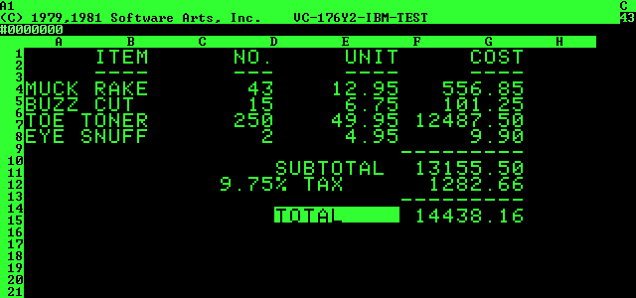
VisiCalc

Slide 24
Storing Data
Storing data as simply electronic copies of existing documents is not sufficient.
How do we search for information?
How many BSc II students do we have?
Is Sean Russell in the list?
What modules is he registered for?
This type of query requires that we change how things are done.
People then began to look at how to model data for electronic use.

Slide 25
File Based Database
Sales File
001-100-Staples
002-5000-Paper
003-1-Printer
Purchases File
101-10000-Paper
102-200-Staples
…
Program
Program

Slide 26
File Based Database Systems
Disadvantages
No query language
No scalability
Hard to update schema and modify data
Recovery?
Advantages
More lightweight than a DBMS
Might be good enough for small data, for example a personal address book

Slide 27
Hierarchical Database Model
The oldest DBMS model is the hierarchical model (Information Management System from IBM)
Developed in the 1960s to overcome the problems with file processing
The model was not standardised
It was based on a tree structure consisting of nodes, branches and roots
It allowed for 1 to many relationships
The best known implementation is IMS by IBM

Slide 28
Hierarchical Based Database
Course
Prerequisite
Session
Teacher
Student
Program
Program

Slide 29
Network Database System
The network model was developed by committee
The Database Task Group (DBTG) of CODASYL (COnference on DAta SYstems Languages) developed the model so that it could be standardised
CODASYL are the people who developed the COBOL programming language and much of the language of the network model looks like COBOL
The model allows the implementation of many-to-many (M:M) relationships, which ultimately get translated into one-to-many (1:M).

Slide 30
Network Based Database
Course
Prerequisite
Session
Teacher
Student
Program
Program

Slide 31
Relational Database Model
Formulated by Edgar Codd of IBM in 1970.
Commercial RDBMS in 80s.
“Codd's 12 Rules” (actually 13) that all RDBMSs should follow.
Most widely used model at present
Access, Oracle, MySQL, MariaDB, MS SQL Server, DB2, Sybase ASE, PostgresSQL etc.

Slide 32
Relational Concepts
Data is represented as collections of relations
Each relation is table of values
Each table consists of rows and columns
Each row represents an entity or record
Rows are unordered

Slide 33
Relational Concepts
No duplicate rows are allowed
Each relation has a primary key, the value of which uniquely identifies the record/entity
Each column represents an attribute
Table name and column name are used to help interpret the values

Slide 34
Database Terminology
Relation is a mathematical term for a table
Row is called a Tuple
Column is called an Attribute
Domain is used to describe the types of values that can appear in a column
Degree is the number of attributes
Cardinality – the number of tuples/rows in a relation
Atomic Value – precisely one value at each row intersection
Null Value – Missing, not known or irrelevant data (not the same as zero or blank)

Slide 35
Student Table/Relation
Attributes
Degree is 4
Relation Name
Primary Key
students
student_no | name | major | year_of_entry
1712345 | Xu Lina | Finance | 2017
1718999 | Sean Russell | Software Engineering | 2018
1618985 | Brett Becker | Internet of Things | 2017
Tuples
Domain of Major Attribute is = {Finance, Software Engineering, Internet of Things}
Cardinality is 3

Slide 36
Advantages of Database Approach
Redundancy happens when the same data is stored in 2 or more places
Data can be shared
Redundancy can be reduced
Integrity can be maintained
Security can be enforced
Conflicting requirements can be balanced
Standards can be enforced
Integrity means that the data in the database is accurate and consistent

Slide 37
NoSQL
NoSQL databases were invented in the 2000s to deal with some new challenges that traditional relational databases struggled with. Especially useful for large, unstructured data, and data that does not need to be updated instantly.
Different types:
Document databases pair each key with a complex data structure known as a document. Documents can contain many different key-value pairs, or key-array pairs, or even nested documents. Typical example: MongoDB
Graph stores are used to store information about networks of data, such as social connections. Graph stores include Neo4J and Giraph.
Notes:
(adapted from https://www.mongodb.com/nosql-explained)

Slide 38
NoSQL (continued)
Key-value stores are the simplest NoSQL databases. Every single item in the database is stored as an attribute name (or 'key'), together with its value. Examples of key-value stores are Riak and Berkeley DB. Some key-value stores, such as Redis, allow each value to have a type, such as 'integer', which adds functionality.
Wide-column stores such as Cassandra and HBase are optimized for queries over large datasets, and store columns of data together, instead of rows.

Slide 39
MySQL
We will mostly be using MySQL Community Server (latest version is 8.0.15)
Download from here: https://dev.mysql.com/downloads/mysql/
You need to install this before your first lab in Week 3.

