Slide 1
Lecture 7: Database Design (Conceptual Design)
COMP2013J: Databases and Information Systems
Dr. David Lillis (david.lillis@ucd.ie)
UCD School of Computer Science
Beijing-Dublin International College

Slide 2
Designing a database
Database design is just one of the many activities in the development of an information system within an organisation.
It should therefore be presented within the wider context of the information system life cycle.
An information system is a component of an organisation that manages (gets, processes, stores, communicates) the information of interest
usually, the information system operates in support to other components of the organisation.

Slide 3
Components of Computer-Based Information Systems (IS)
Database (DB)
Database software.
Application software.
Computer hardware (e.g., storage media).
Personnel using and developing the system.
NOTE: the DB is a fundamental component

Slide 4
Information System Life Cycle
^{Feasibility study}
The feasibility study is carried out to;
Define the costs of the various possible solutions
Establish the priorities for the creation of the various components of the system.

Slide 5
Information System Life Cycle
Collection and Analysis of requirements
^{Feasibility study}
Collection and analysis of requirements is the definition and study of the properties and functionality of the information system.
We work out what the system should be able to do.

Slide 6
Information System Life Cycle
Collection and Analysis of requirements
^{Feasibility study}
^{Design}
Design is generally divided into two tasks:
database design and
operational design.

Slide 7
Information System Life Cycle
Collection and Analysis of requirements
^{Feasibility study}
^{Design}
^{Implementation}

Slide 8
Information System Life Cycle
Collection and Analysis of requirements
^{Feasibility study}
^{Design}
Validation and Testing
^{Implementation}
Validation and testing is done to check the correct functioning and quality of the information system.

Slide 9
Information System Life Cycle
Collection and Analysis of requirements
^{Feasibility study}
^{Design}
Validation and Testing
^{Operation}
^{Implementation}
Finally in the operation phase, the information system becomes live and performs the tasks for which it was originally designed.

Slide 10
Information systems and databases
The database constitutes only one of the components of an information system, which also includes application programs, user interfaces and other service programs.
However, the central role that the data itself plays in an information system justifies an independent study of database design.
For this reason, we deal with only those aspects of information system development that are closely related to databases, focusing on data design and on the related activities of requirements collection and analysis.

Slide 11
A database design methodology
The most common database design methodology is based on a simple but highly efficient engineering principle: separate the decisions relating to ‘what’ to represent in the database, from those relating to ‘how’ to do it.
This methodology is divided into three phases to be followed consecutively.

Slide 12
The Phases of Database Design
Conceptual Design
1. Conceptual Design
The purpose of this is to represent the informal requirements of an application.
Focus on the concepts that should be modelled, NOT the way they will be stored in a database: this will come later.
Output is a conceptual schema, often using an Entity-Relationship Model.
Conceptual Schema

Slide 13
The Phases of Database Design
Conceptual Design
2. Logical Design
This consists of the translation of the conceptual schema into the logical schema of the database that refers to a logical data model.
This is the definition of the tables and attributes that will be created to store the data in our database.
Conceptual Schema
Logical Design
Logical Schema

Slide 14
The Phases of Database Design
Conceptual Design
3. Physical design
In this phase, the logical schema is completed with the details of the physical implementation (file organisation and indexes) on a given DBMS.
The product is called the physical schema and refers to a physical data model.
Conceptual Schema
Logical Design
Logical Schema
Physical Design
Physical Schema

Slide 15
Conceptual Design: The Entity Relationship (E-R) Model

Slide 16
The Entity Relationship model
The Entity-Relationship (E-R) model is a conceptual data model.
It is capable of describing the data requirements of an application in a way that is easy to understand and is independent of the criteria for the management and organisation of data on a database system.
An E-R model is normally shown as a graphical representation.
(See Chapter 3 of Elmasri and Navathe Book,7th Edition)

Slide 17
Entities
Entity:
An “entity” is some thing that we want to store data about.
It can be something that has;
physical existence (e.g. a person, building, car, etc.) or
conceptual existence (e.g. a university module, a job, etc.)
In the E-R model we define types of entities.
An “occurrence” of an entity is similar to an object that is an instance of a class.

Slide 18
Attributes
Attribute:
Entities are described by their “attributes”, which are the properties that describe an entity.
Each attribute has a “domain” (a set of allowed values)
For example, an “employee” entity might be described by the following attributes: identity number, name, date of birth, salary, address, etc.
Name
Address
Employee
Date of Birth
Identity Number
Salary

Slide 19
Attributes
A double oval indicates that an entity can have multiple values for the same attribute.
A dashed oval indicates that an attribute is a derived attribute (i.e. it can be calculated from the entity’s other attributes).
Department
Locations
Sale
PriceEach
Quantity
Total Value

Slide 20
Attributes
Sometimes, an attribute can be a composite attribute, made up of a number of component attributes.
Street No.
Employee
Address
Street
District
City

Slide 21
Attributes: Keys
If an attribute is the entity’s primary key (or is part of a composite primary key), then its name is underlined.
Name
Address
Employee
Date of Birth
Identity Number
Salary
Date
Order Number
Item
Order
Customer Number
Quantity

Slide 22
Relationships
Relationship:
A relationship is a meaningful association between two or more entity types. Some examples:
An employee WORKS IN a department.
A student is REGISTERED FOR a university module.
A car is OWNED BY a person.
A salesperson SELLS a product to a customer.
Employee
works in
Department

Slide 23
Relationships Examples
Works in
Employee
Lives in
City
Student
Sits
Exam
Course
Date
Relationships can have attributes too!
Result

Slide 24
Recursive Relationships Examples
Works with
Employee
Succeeds
King
Before
After

Slide 25
Ternary Relationships
Salesperson
Sells
Product
Customer
Ternary relationships (linking 3 entities) should not be left in the conceptual model.
They should be replaced with a series of binary relationships before the model is completed.

Slide 26
Ternary Relationships
General rule: replace the relationship with an entity type.
This entity type will have binary relationships with the other entity types that were in the original ternary relationship.
Sales
Person
makes
involves
Sale
Product
requests
Customer

Slide 27
Optionality of Relationships
A relationship can be optional or mandatory.
If a relationship is mandatory:
An entity occurrence at one end of the relationship must be related to another entity occurrence on the other end.
Also known as total participation.
If a relationship is optional:
An entity occurrence on one end of the relationship may exist without being related to another entity occurrence on the other end.
Also known as partial participation.
This can be different for opposite ends of the same relationship. For example:
A student must be registered for a course: this is mandatory.
But a course can exist before any students have enrolled: this is optional.

Slide 28
Optionality of Relationships
Mandatory participation in a relationship is shown with a double line.
Here, every department must have an employee that manages it: mandatory.
However, not every employee is required to manage a department: optional.
Employee
manages
Department

Slide 29
Cardinality of Relationships
The cardinality of a relationship refers to the number of entity occurrences that are involved in the relationship.
There are three main types of cardinality, in each case, we talk about the maximum number of other entities that an entity can be related to:
1-to-1 (1:1):
Each employee can manage one department at most.
Each department can be managed by one employee at most.
Employee
1
manages
1
Department

Slide 30
Cardinality of Relationships
1-to-Many (1:N):
Each employee works for one department at most.
Each department can have many employees working for it.
Many-to-Many (M:N):
Each employee can work on many projects.
Each project can have many employees working on it.
Employee
N
works for
1
Department
Employee
M
works on
N
Project

Slide 31
Strong and Weak Entities
Most entity types are strong entity types, they have their own primary key and can exist by themselves.
However, some entity types are weak entity types, which cannot exist without a relationship to another entity type.
An example:
Our company stores data about employee’s dependents (spouse and children) for insurance purposes.
We store the following information about each:
Name
Sex
Relationship to employee
Date of birth

Slide 32
Strong and Weak Entities
In this schema, the Dependent entity type has no appropriate key.
Two employees may have a dependent with the same name, sex, date of birth and relationship, even though they are two different people.
We only see them as distinct entities when we know which employee they are associated with (their owner entity).
For weak entities, we define a partial key. That is, something that can be used as a key if we know which owner entity it is related to.
If we assume that an employee will not have two dependents with the same name, we can use “name” as a partial key.

Slide 33
Strong and Weak Entities
An attribute that is part of a partial key has its named underlined with a dashed line.
The weak entity’s box has a double line.
The relationship that identifies its owner entity also has a double line.
Name
Relationship
DOB
Dependents of
Employee
1
N
Dependent
Sex

Slide 34
A summary of the meanings of the ER notation is on p. 83 of Elmasri and Navathe 7th Edition.

Slide 35
Enhanced Entity Relationship Model (EER)

Slide 36
Enhanced Entity Relationship Model
In terms of data modeling, much progress has been made since the original proposal of the Entity Relationship (E-R) model.
Particularly in the areas of knowledge representation and object modeling (e.g. for Object Oriented Programming).
This has led to the development of the Enhanced Entity Relationship Model (EER).
In particular, this adds the ability to define supertypes and subtypes.
See Chapter 4, Elmasri & Navathe 7th ed.

Slide 37
Supertypes and Subtypes
Some entity types have subsets or subtypes that should be represented separately.
This is most commonly seen where:
A subgroup/subtype has its own specific attributes that are not common to all instances of the entity type.
A subgroup/subtype has its own specific relationships that are not common to all instances of the entity type.

Slide 38
Supertypes and Subtypes
Example:
In a company, we store data about an EMPLOYEE entity type.
Employees can be paid per hour, or using an annual salary.
A salaried employee has a “salary” attribute that hourly employees do not have.
An hourly employee has a “hourly rate” attribute that salary employees do not have.
This suggests that the “employee” entity type should have two subtypes: SALARIED_EMPLOYEE and HOURLY_EMPLOYEE
Let’s see an example:

Slide 39
Supertypes and Subtypes
Name
SSN
Employee
Birth Date
Address
This symbol indicates that one entity type is a subtype of the other.
d
SALARIED_EMPLOYEE
HOURLY_EMPLOYEE
Salary
Hourly_Rate

Slide 40
Supertypes and Subtypes
Name
SSN
Employee
Birth Date
Address
The “d” stands for disjoint.
This means that an employee can be either salaried or hourly, but not both.
d
SALARIED_EMPLOYEE
HOURLY_EMPLOYEE
Salary
Hourly_Rate

Slide 41
Supertypes and Subtypes
Name
SSN
Employee
Birth Date
Address
Once again, the double line means mandatory participation: Every employee must be salaried or hourly
d
SALARIED_EMPLOYEE
HOURLY_EMPLOYEE
Salary
Hourly_Rate

Slide 42
Supertypes and Subtypes
Name
SSN
Employee
Birth Date
Address
We can also add a relationship that only applies to one subtype (only hourly employees are members of trade unions, in this example)
d
SALARIED_EMPLOYEE
HOURLY_EMPLOYEE
N
BELONGS_TO
Salary
1
TRADE_UNION
Hourly_Rate

Slide 43
Inheritance
Every occurrence of a subtype is also an occurrence of the supertype.
May seem strange: one particular person is represented both by an EMPLOYEE entity and a SALARIED_EMPLOYEE entity.
Every property of the supertype (attributes, keys, relationships, etc.) is also a property of the subtype.
This is known as inheritance (similar to OOP).

Slide 44
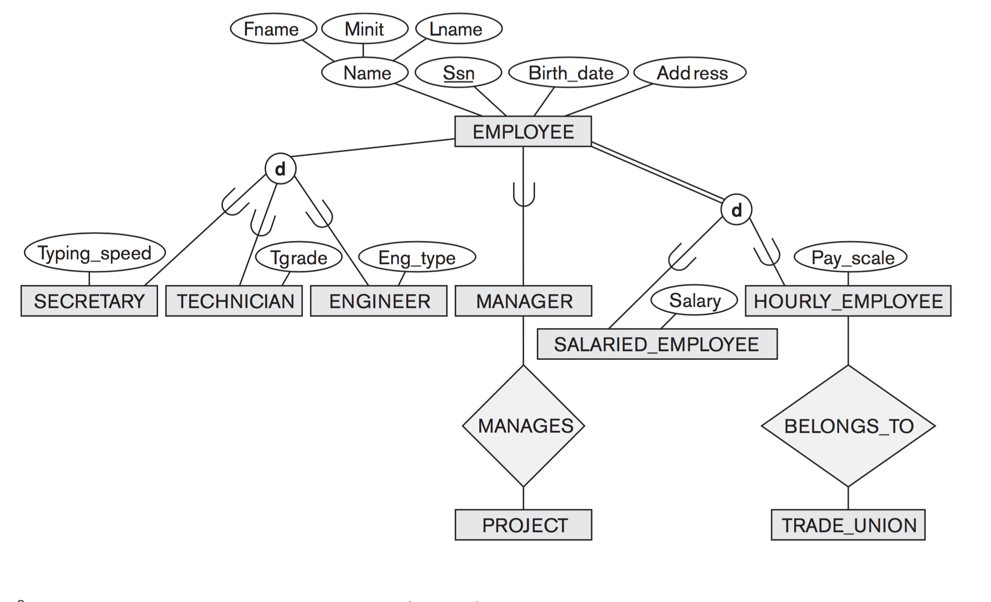
Here is a diagram showing a few types of supertype/subtype relationship.
For simplicity, some additional attributes, and the cardinality of relationships are not shown.

Slide 45
There are also subtypes for different types of employee, based on the job they do.
SECRETARY, TECHNICIAN and ENGINEER each have some additional attribute that not all employees have.

Slide 46
Again, the supertype/subtype relationship here is disjoint: an employee can be only one of secretary, technician or engineer.

Slide 47
However, this time it has optional participation (because of the single line from EMPLOYEE), which means that some employees might not be any of those subtypes.

Slide 48
Here is a different subtype. A MANAGER is a type of employee that can manage projects: a relationship that other employees do not share.

Slide 49
This time there are no alternatives: an employee is optionally a manager, or is not.
Not all employees are managers.

Slide 50
Disjoint and Overlapping Subtypes
The subtypes we have seen so far have all been disjoint: meaning that a particular entity (e.g. an employee) can only belong to one of a group of subclasses.
An alternative is to have overlapping subtypes, where an entity could be a member of multiple related entity types.
For example, a student who does work in a university may be a member of a PERSON supertype, but be both a STUDENT and an EMPLOYEE.
Here’s an example…

Slide 51
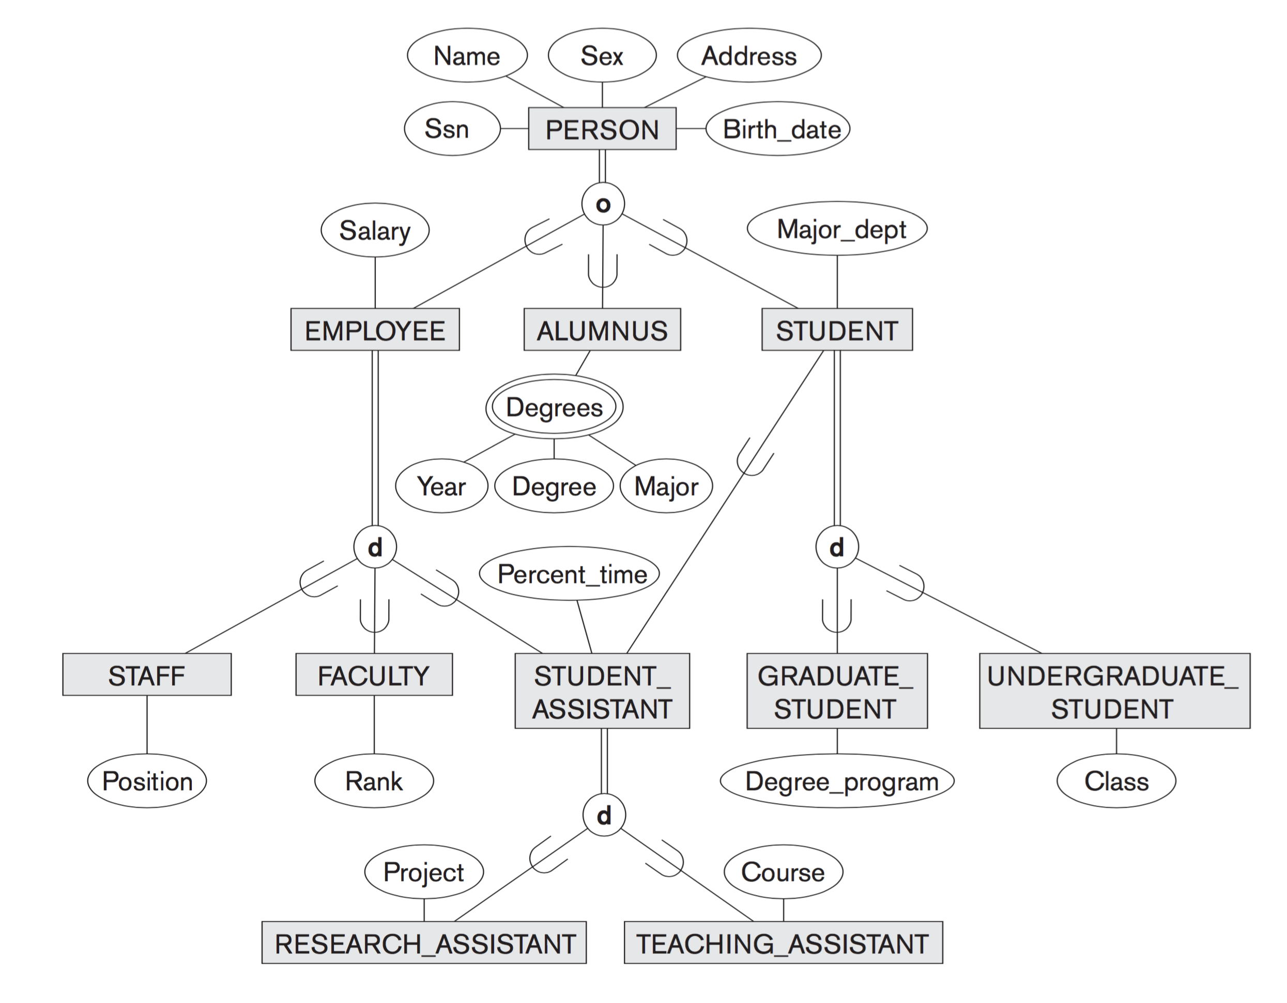

Slide 52
A PERSON can be an EMPLOYEE, and ALUMNUS or a STUDENT (overlapping subtypes).
But this relationship also has mandatory participation (double line), so every PERSON must be at least one of these.

Slide 53
Also note that the Enhanced E-R diagram allows for multiple inheritance.
A STUDENT_ASSISTANT is both a STUDENT and an EMPLOYEE.

Slide 54
Specialisation and Generalisation
Specialisation and Generalisation are processes that can be used to identify supertypes and subtypes.
For specialisation, we begin with a supertype, and find any attributes/relationships that are particular to certain members. Groups of members with common attributes/relationships become subtypes.
Generalisation is the opposite, where we begin with specific types, and identify attributes and relationships they have in common, so as to create a supertype.

Slide 55
Creating an E-R Model

Slide 56
Example of Requirements for a Database
We wish to create a database for a company that runs training courses. For this, we must store data about the trainees and the instructors. For each course participant (about 5000), identified by a code, we want to store the social security number, surname, age, place of birth, employer’ s name, address and telephone number, previous employers (and period employed), the courses attended (there are about 200 courses) and the final assessment of each course. We need also to represent the seminars that each participant is attending at present and, for each day, the places and times the classes are held. Each course has a code and a title and any course can be given any number of times. Each time a particular course is given, we will call it an ‘edition’ of the course. For each edition, we represent the start date, the end date, and the number of participants. If a trainee is a self-employed professional, we need to know his or her area of expertise, and, if appropriate, his or her title. For somebody who works for a company, we store the level and position held. For each instructor (about 300), we will show the surname, age, place of birth, the edition of the course taught, those taught in the past and the courses that the tutor is qualified to teach. All the instructors’ telephone numbers are also stored. An instructor can be permanently employed by the training company or can be freelance.

Slide 57
It can be useful to turn this natural language description into a glossary of terms, which helps to describe the concepts we want to store data about, and their relationships to one another.
Term | Description | Synonyms | Links
Trainee | Participant in a course. Can be an employee or self-employed | Participant, Student | Course, Employer
Instructor | Course tutor. Can be freelance. | Tutor, Teacher | Course
Course | Course offered. Can have various editions. | Seminar | Instructor, Trainee
Employer | Company by which a trainee is employed or has been employed. |  | Trainee

Slide 58
General criteria for data representation
If a concept has significant properties and/or describes classes of objects with an autonomous existence, it is appropriate to represent it by an entity.
If a concept has a simple structure, and has no relevant properties associated with it, it can be represented by an attribute of another concept to which it refers.
If the requirements contain a concept that provides a logical link between two (or more) entities, this can be represented by a relationship.
If one or more concepts are particular cases of another concept, it is appropriate to represent them by means of a supertype/subtype relationship.

Slide 59
Basic schema and strategy for a training company
Because E-R diagrams can get quite large, we do not need to squeeze everything into one diagram.
We can divide our work into three sections:
Trainee section.
Course section.
Instructor section.
After completing these, we can draw a diagram to connect these together.
We will finish with 4 diagrams in total
Trainee
Attends
Course
Instructor
Teaches

Slide 60
Trainee Section
For each course participant (about 5000), identified by a code, we want to store the social security number, surname, age, place of birth, employer’s name, address and telephone number, previous employers (and period employed), the courses attended (there are about 200 courses) and the final assessment of each course.
If a trainee is a self-employed professional, we need to know his or her area of expertise, and, if appropriate, his or her title. For somebody who works for a company, we store the level and position held.

Slide 61
Trainee Section
Name
Address
Phone
Employer
1
End Date
Start Date
N
Works
for
Worked
for
SSN
N
Surname
N
Age
Trainee
Place of Birth
Code
d
Employee
Professional
Position
Level
Title
Expertise

Slide 62
Instructor Section
For each instructor (about 300), we will show the name, age, place of birth, the edition of the course taught, those taught in the past and the courses that the tutor is qualified to teach. All the instructors’ telephone numbers are also stored. An instructor can be permanently employed by the training company or can be freelance.

Slide 63
Instructor Section
SSN
Age
Name
Place of Birth
Phone
Instructor
d
Freelance
Permanent

Slide 64
Course Section
We need also to represent the seminars that each participant is attending at present and, for each day, the places and times the classes are held. Each course has a code and a title and any course can be given any number of times. Each time a particular course is given, we will call it an ‘edition’ of the course. For each edition, we represent the start date, the end date, and the number of participants.

Slide 65
Course Section
Room
Time
Date
Class
N
made of
1
Participants
Course Edition
End Date
N
course type
Start Date
1
Course
Code
Title

Slide 66
Full Schema
Course Edition
course type
Trainee
Instructor
Course

Slide 67
Full Schema
We wish to create a database for a company that runs training courses. For this, we must store data about the trainees and the instructors. For each course participant (about 5000), identified by a code, we want to store the … the courses attended (there are about 200 courses) and the final assessment of each course. We need also to represent the seminars that each participant is attending at present and, for each day, the places and times the classes are held. For each instructor (about 300), we will show …the edition of the course taught, those taught in the past and the courses that the tutor is qualified to teach.

Slide 68
Full Schema
N
1
Result
teaches
N
attended
N
Course Edition
taught
N
1
course type
Trainee
Instructor
attends
qualified to teach
N
1
N
N
Course

