Slide 1
Lecture 8: Logical Design Mapping ER/EER Diagrams to Relations
COMP2013J: Databases and Information Systems
Dr. David Lillis (david.lillis@ucd.ie)
UCD School of Computer Science
Beijing-Dublin International College

Slide 2
The Phases of Database Design
Conceptual Design
An ER/EER diagram is a conceptual schema of the database.
Next, we need to map this to a logical schema: i.e. the tables and attributes that will be created to store the data in the database.
Conceptual Schema
Logical Design
Logical Schema
Physical Design
Physical Schema

Slide 3
Mapping to Relations
In this lecture, we will look at a method to convert an ER/EER diagram into a logical model (i.e. the relations that will be used to create a database).
This follows an 8-step algorithm.
Mapping Regular Entity Types
Mapping Weak Entity Types
Mapping 1:1 Relationships
Mapping 1:N Relationships
Mapping M:N Relationships
Mapping Multivalued Attributes
Mapping N-ary Relationships
Mapping supertypes/subtypes
Chapter 9 of Elmasri & Navathe Book (7th Edition)
Notes:
Note: there are actually more than 8 steps in the book, but the later ones deal with situations we do not study in this module.

Slide 5
1. Mapping Regular Entity Types
We begin with regular (strong) entity types.
Create a relation for each strong entity.
Include all simple attributes:
For any composite attributes, only include its component attributes.
For multi-valued attributes, leave these out until later.
Select a primary key (possibly a composite primary key consisting of multiple attributes).
We do not consider foreign keys and relationships until later in the process.

Slide 6
1. Mapping Regular Entity Types
Employee
Fname | Minit | Lname | Ssn | birth_date | address | sex | salary
Department
Dname | Dnumber
Project
Pname | Pnumber | Plocation
Notes:
Composite attribute “Name” from EMPLOYEE is not included: only its component attributes: Fname (first name), Minit (middle initial) and Lname (last name).
For DEPARTMENT, either Dname or Dnumber would be OK to choose as a primary key. We choose only one (primary keys are underlined).
We do not yet include the multi-valued attribute “Locations” for DEPARTMENT (we will do that later).
No relationships/foreign keys are included yet.

Slide 7
2. Mapping Weak Entity Types
For any weak entity types, create a relation.
As with step 1, include any simple attributes it has (including component attributes of composite attributes).
Include the primary key of the owner attribute as a foreign key.
The primary key of this relation is a combination of this key and the weak entity’s partial key.
If the owner is also a weak entity type, that should be mapped first (so that we know its primary key).
Usually, we use the CASCADE option for referential integrity, because the weak entity cannot exist without its owner.

Slide 8
2. Mapping Weak Entity Types
Employee
Fname | Minit | Lname | Ssn | birth_date | address | sex | salary
Department
Dname | Dnumber
Project
Pname | Pnumber | Plocation
Dependent
Essn | Dependent_name | Sex | Bdate | Relationship
Notes:
Essn is a foreign key to the ”Ssn” attribute in EMPLOYEE (and so we show it in italics).
The primary key of DEPENDENT is the combination of its owner’s primary key (Essn) and its own partial key (Dependent_name).

Slide 9
3. Mapping 1:1 Relationships
To map a 1:1 relationship, there are 3 approaches to choose from. The first is most common:
Foreign key approach: Choose one of the entity types, and include the primary key of the other as a foreign key.
It is best to include the foreign key in an entity type that has mandatory participation in the relationship (avoids storing many NULL values).
If the relationship has any simple attributes, they can be included in the same relation as the foreign key.
Merge the relations: if both entity types have mandatory participation in the relationship, they can be merged into one relation.
Relationship relation: Create a separate table to represent the relationship. This is rare for 1:1 relationships but very common for M:N relationships, as we will see later.

Slide 10
3. Mapping 1:1 Relationships
Employee
Fname | Minit | Lname | Ssn | birth_date | address | sex | salary
Department
Dname | Dnumber | Mgr_ssn | Mgr_start_date
Project
Pname | Pnumber | Plocation
Dependent
Essn | Dependent_name | Sex | Bdate | Relationship
Notes:
DEPARTMENT has mandatory participation in the MANAGES relationship (i.e. every department must have a manager).
Therefore it makes most sense to include a foreign key in DEPARTMENT that refers to the primary key of EMPLOYEE (i.e. ”Mgr_ssn” in DEPARTMENT refers to “Ssn” in EMPLOYEE).
If we instead included a foreign key in EMPLOYEE that referred to DEPARTMENT, then this would be NULL for all the employees that are not managers: because we wish to avoid too many NULL values, it’s better to include the foreign key in DEPARTMENT.
The “start_date” attribute of the MANAGES relationship can also be included as an attribute.
Because the participation is mandatory, we would use a NOT NULL constraint on the foreign key when we turn this into a database.

Slide 11
4. Mapping 1:N Relationships
In the entity type on the N side, include a foreign key that refers to the primary key of the attribute on the 1 side.
If the relationship has simple attributes, these can also be included in the same relation.
Alternatively, we could use a separate table to store the relationship, but again this is rare for 1:N relationships.
It might be more useful if only a few tuples participate in the relationship, to avoid many NULL values.

Slide 12
4. Mapping 1:N Relationships
Employee
Fname | Minit | Lname | Ssn | birth_date | address | sex | salary | Dno | Super_ssn
Department
Dname | Dnumber | Mgr_ssn | Mgr_start_date
Project
Pname | Pnumber | Plocation | Dnum
Dependent
Essn | Dependent_name | Sex | Bdate | Relationship
Notes:
In the EMPLOYEE relation, we include the foreign key of DEPARTMENT to show the department they work for (Dno should be NOT NULL to show that each employee must work for a department).
In the EMPLOYEE relation, we include the “Super_ssn” attribute to be a foreign key that refers to the “Ssn” attribute of each employee’s supervisor (who is also an employee). As this is an optional relationship, it can be NULL for employees that don’t have a supervisor.
In the PROJECT relation, we include the foreign key of DEPARTMENT to show which department controls a project. Again, this will be NOT NULL because every project must be controlled by a department.

Slide 13
5. Mapping M:N Relationships
For a M:N relationship, it is not possible to simply include a foreign key in one of the entity types involved.
A foreign key can only store one value, which would mean that each entity can only be related to one other entity. But here, all entities can be linked to many other entities.
Instead, we must create a new relation that represents the relationship.
Include foreign keys to refer to both of the entity types involved.
The primary key of this table will be the combination of both of these foreign keys.
If the relationship has any simple attribute, include them in this new relation.
We can also use this approach for 1:1 and 1:N relationships, but this is rarely done in practice.

Slide 14
5. Mapping M:N Relationships
Employee
Fname | Minit | Lname | Ssn | birth_date | address | sex | salary | Dno | Super_ssn
Department
Dname | Dnumber | Mgr_ssn | Mgr_start_date
Project
Pname | Pnumber | Plocation | Dnum
Dependent
Essn | Dependent_name | Sex | Bdate | Relationship
WORKS_ON
Essn | Pno | Hours
Notes:
The WORKS_ON relationship involves an EMPLOYEE and a PROJECT, so we include foreign keys that refer to both of these.
The primary key of WORKS_ON is a combined primary key that includes both of the foreign keys.
The attribute “Hours” is also added to this relation.
Because WORKS_ON depends on both, we would use a CASCADE option for referential integrity.

Slide 15
6. Mapping Multivalued Attributes
For each multi-valued attribute, create a new relation to represent it.
If the multi-valued attribute is a composite attribute, we include only its simple components.
This new relation contains:
An attribute to store the multi-valued attribute itself (or several attributes if it was a composite attribute).
A foreign key that refers to the entity type that the attribute belongs to.
The primary key of this relation is the combination of the foreign key and the attribute itself.

Slide 16
6. Mapping Multivalued Attributes
Employee
Fname | Minit | Lname | Ssn | birth_date | address | sex | salary | Dno | Super_ssn
Department
Dname | Dnumber | Mgr_ssn | Mgr_start_date
Project
Pname | Pnumber | Plocation | Dnum
Dependent
Essn | Dependent_name | Sex | Bdate | Relationship
Works_on
Essn | Pno | Hours
Dept_Locations
Dnumber | Dlocation
Notes:
DEPARTMENT has a multivalued attribute named “locations”, which we represent as a new relation.
This includes an attribute “Dlocation” to store the location itself.
It also includes a foreign key “Dnumber” that refers to the department this location belongs to.
The primary key of DEPT_LOCATIONS is the combination of both of these.
Again we would use a CASCADE option because the department location depends on the existence of the department it belongs to.

Slide 17
7. Mapping N-ary Relationships
If your model includes any relationships with more than 2 entity types, these must also be mapped to a new relation.
Include foreign keys to refer to all the participating entity types.
Include any attributes that the relationship has.
The primary key of this relation is usually the combination of the foreign keys.
There are no N-ary relationships with more than 2 entity types in this model.

Slide 18
8. Mapping Supertypes/Subtypes
There are a number of different options we can use for this mapping.
The most general is:
Create a relation for the supertype.
For each subtype, create a relation and include a foreign key that refers to the supertype’s primary key.
This foreign key attribute becomes the primary key of the subtype.

Slide 19
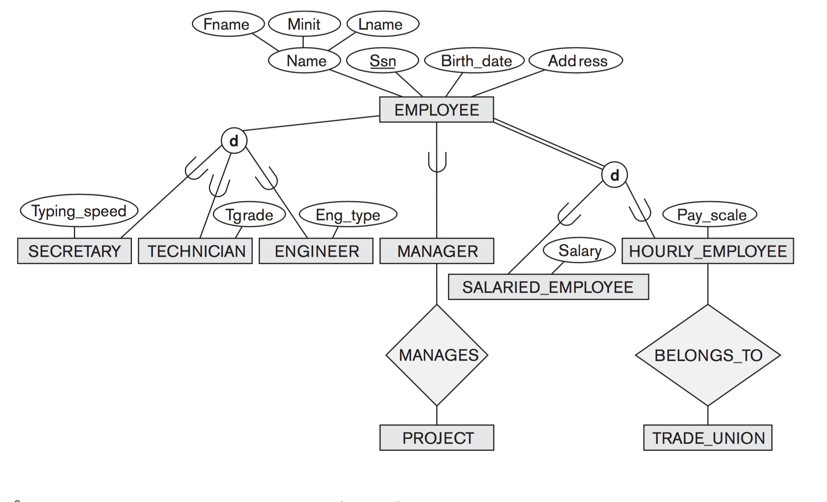
Secretary
Ssn | Typing_speed
Technician
Ssn | Tgrade
Engineer
Ssn | Eng_type
Employee
Fname | Minit | Lname | Ssn | birth_date | address

Slide 20
Summary
After creating an ER/EER diagram to represent a data model, the next step is to map this to a relational schema that can be stored in a database.
By following the 8-step algorithm above, this can be achieved using a well-defined method.
At this stage, we can also think about the constraints that we can use in the final database:
NOT NULL (when relationship participation is mandatory).
Options for ON DELETE and ON UPDATE to maintain referential integrity, depending on the nature of the relationships being modelled.

