Slide 1
Access Control & A5:2017 – Broken Access Control

Slide 2
Outline
Access Control Overview
Protection State, Security Policy and Access Control Matrix
Mandatory VS Discretionary Access Control
Role Based Access Control
ACLs, Capabilities and OSs
Broken Access Control
Real Life Examples
Example of Attacks
Is your system vulnerable to broken access control?
Hands-on Activities with WebGoat & ZAP
Countermeasures

Slide 3
Authentication VS Access Control
https://www.youtube.com/watch?v=P38at6Tp8Ms

Slide 4
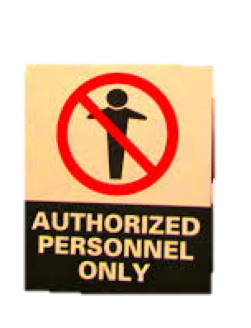

Authentication VS Access Control
Who are you?
Can you do it?
https://www.youtube.com/watch?v=P38at6Tp8Ms
Notes:
Access control: things that are put in place on a computer system that restrict what people and programs are allowed to do.

Slide 5
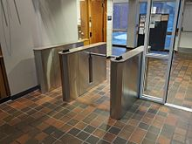
Access Control

Slide 6
Access Control
Physical security access controls
Physical enforcement of access to areas
Digital security access controls
Restricts access to resources and interactions

Slide 7
Access Control
Concerned with authorization: what a subject is allowed to perform
Mediates subject’s access to objects
Enforces a security policy, limiting which actions are allowed.
Notes:
First step is authentication: check who you are
Authentication : whether you are authorized to do it.
Mediator checks whether a subject is allowed to access an object (e,.g., static resources such as files or processes or network)
It is all about enforcing a security policy.
We aiming for a complete mediation

Slide 8
Complete Mediation
Trusted computing base (TCB): all the software and hardware that is responsible for enforcing policy
For example, the OS kernel, all privileged processes, and the PC hardware – a fault in one of these could compromise security
Complete mediation is important (if security can be subverted, it is of limited use)
Reference monitor concept: all access is via this
Subject
Reference monitor
Object
Notes:
TCB = al the hardware and software that goes together to enforce a policy
Take in consideration Linux for example, the kernel and every process that run on those system is root.
Corrupt bits in hardware that can result in privilege escalation.
It should not be possible to circumvent!
In Linux, a reference monitor is the kernel

Slide 9
Protection State
Security context: security identity information used to inform security authorization decisions
For example, the UID and GID associated with a process
The protection state of a system, is made up of the security sensitive actions every subject is able to do
When a program changes identity, for example, the protection state has changed
There are situations, like the above, where the protection state move from a state to another.
Notes:
The protection state can be subject to transitions when users are assigned a set of permissions.
What changes in permissions are allowed?
Someone may authorise transitions.

Slide 10
Access Control Matrix …
The simplest way of representing the protection state of a system is using an access control matrix.
A table showing every subject and every object, and the permitted types of access between them.
 | File 1 | File 2 | File 3
User A | Read, write, own | Read, write | Read, write , own
User B | Append | Read, write, own | Read
Notes:
Table describing access control that is possible and allowed

Slide 11
Access Control Matrix …
This is an abstract model, describing the association of rules
You would need an implementation (tool/mechanism) to actually enforce it and to define exactly what the permissions mean.
 | File 1 | File 2 | File 3
User A | Read, write, own | Read, write | Read, write , own
User B | Append | Read, write, own | Read
Notes:
It can become unmanageable as the number of users and resources increases

Slide 12
Access Control Matrix …
An access control matrix can express any security policy
Used for theoretical analyses
Not used directly: in real systems there are too many subjects and objects
 | File 1 | File 2 | File 3
User A | Read, write, own | Read, write | Read, write , own
User B | Append | Read, write, own | Read
Notes:
It can become unmanageable as the number of users and resources increases

Slide 13
Security Policy
Defines what “secure” is for a system, or in other words, a set of rules we want to enforce
For example, we may have confidentiality/integrity/availability requirements
Discuss: what are some practical examples of security policies? What are their goals?
Notes:
It can become unmanageable as the number of users and resources increases

Slide 14
Mechanisms & Models
As mentioned, a mechanism is something that enforces a policy.
A model is a way of representing a policy or types of policies
Lots of terminology, but it is important to know this if working in the field
Notes:
It can become unmanageable as the number of users and resources increases

Slide 15
Types of Access Control
Non-discretionary Access Control, AKA Mandatory Access Control (MAC)
Discretionary Access Control (DAC)
Descriptions follow …
Notes:
It can become unmanageable as the number of users and resources increases

Slide 16
Mandatory Access Control (MAC)
When a system/security administrator configures security rules that apply to users
Users cannot change the rules set by admins, and are not usually considered to “own” files
Notes:
Subjects don’t have a say about what they are allowed to access

Slide 17
Mandatory Access Control (MAC)
MAC is well suited when an organization owns the data, and wants to have control over what happens to the data
Military, government
Can prevent users from misconfiguring permissions
Predictable policy
Notes:
Predictable because who configures the policies have a lot of experience in relation to what types of operations should be allowed to be performed on different objects

Slide 18
Mandatory Access Control (MAC)
MAC models typically work by attaching security context labels (such as clearance) to objects (files)
A separate label (such as classification or domain) is attached to a subject (process)
Rules define what interactions are allowed
Notes:
For each file it is possible to stick a label and check which type of information each subject is allowed to access to

Slide 19
Traditional MAC
Models can be defined using math notation.
Seminal models such as the Bell La Padula model, and the Biba model are focused on providing strong confidentiality or strong integrity (repsectively).
Notes:
Bell La Padula: A subject at a certain security level cannot read an object at a higher security level
`read down – write up: a subject at a given security level cannot write on object at a higher security level,

Slide 20
MAC and OSs
Common consumers OSs have started having aspects of access control that is not configured by end users (MAC)
Windows 8 prevents any users from modifying files inside Windows 8 store programs installation directory (c:\Program Files\windowsapp)
SELinux
However, for the most part, most systems are based on DAC

Slide 21
Discretionary Access Control (DAC)
When users can configure who can access the resources that they “own”
Each user can control which other users can access the files that they create
Can grant permissions, without involving a system admin
This is the type of security that has traditionally been built into most consumer OSs such as Windows and Unix
Notes:
You could also give ownership of files

Slide 22
Role-based Access Control (RBAC)
RBAC is an access control model (typically) for non-DAC
Abstractions (roles) simplify access rules, which are assigned based on the roles the user is associated with.
Permissions
Operations
Objects
Users
Roles
Session

Slide 23
Access Control Lists
Remember the access control matrix: an ACL basically stores the rules based on the rows that apply to the object (i.e. a column of the access control matrix)
The rules are stored with the object
 | File 1 | File 2 | File 3
User A | Read, write, own | Read, write | Read, write , own
User B | Append | Read, write, own | Read
Notes:
Linux uses groups to define access control lists, on Windows there is a list of each independent user

Slide 24
Capabilities
An alternative approach, known as capabilities, allows processes to pass their permissions to other processes
Rules are kept with the process
Basically represents an access control matrix row
 | File 1 | File 2 | File 3
User A | Read, write, own | Read, write | Read, write , own
User B | Append | Read, write, own | Read
Notes:
Linux uses groups to define access control lists, on Windows there is a list of each independent user

Slide 25
ACLs, Capabilities, and OSs
Capabilities require applications to be aware of them and they are often considered hard to manage
ACL can be easily stored with files (within the filesystem), and are used by most OSs: Windows and Unix (including Linux/Mac)

Slide 26
Access Control Conclusions
Access control mediates actions based on what subjects are authorized to do
A security policy describes what is allowed
Unix/Linux has powerful and expressive file permissions which provide access control
Notes:
Linux uses groups to define access control lists, on Windows there is a list of each independent user

Slide 27
A5:2017 – Broken Access Control

Slide 28
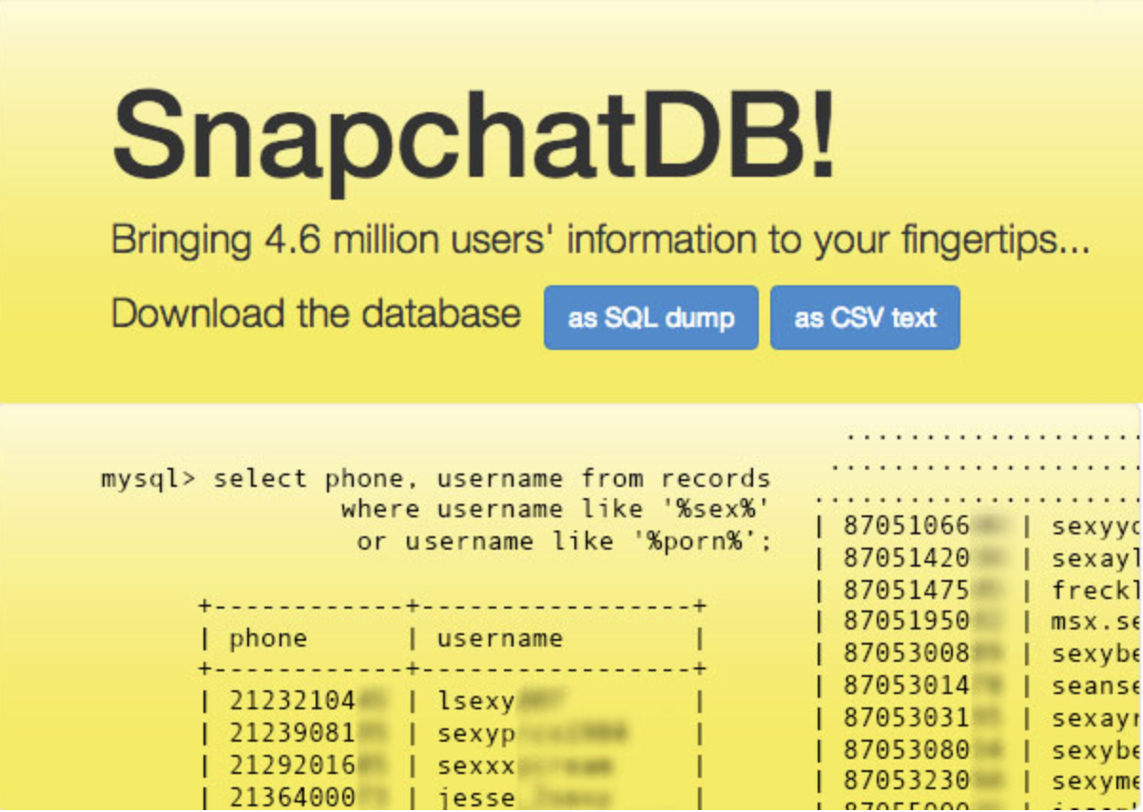
Real Life Examples (1/2)
A Vulnerability in the Snpachat Server allowed users to retrieve usernames associated with specific phone numbers
https://gibsonsec.org/snapchat/

Slide 29

Real Life Examples (2/2)
POST /<page_id>/userpermissions HTTP/1.1
Host : graph.facebook.com
Content-Length: 245
role=MANAGER&
user=<target_user_id>&
business=<associated_business_id>&
access_token=<application_access_token>
Notes:
It was possible for a malicious user to use a request to assign admin permissions to himself for a particular Facebook page.

Slide 30
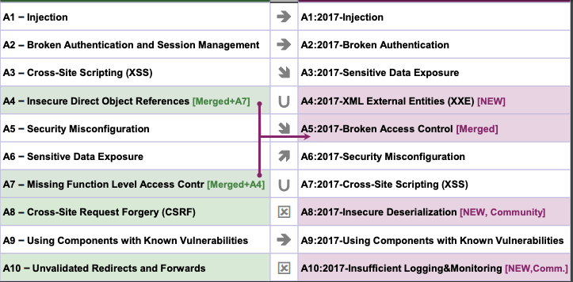
https://www.ionos.com/digitalguide/server/security/rainbow-tables/

Slide 31
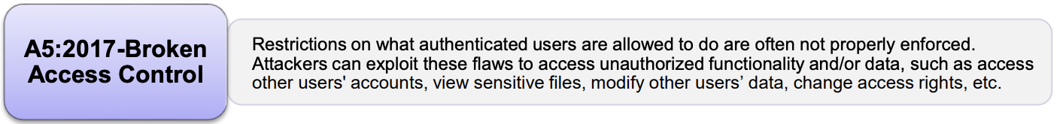
A5:2017 – Broken Access Control
https://www.owasp.org/index.php/Top_10-2017_A3-https://www.owasp.org/images/7/72/OWASP_Top_10-2017_%28en%29.pdf.pdf
Notes:
Whole scripts written in Perl, Python, and other languages can be injected into poorly designed applications and executed.

Slide 32
Example
Web App
Users
normal users
admin
audit
normal user
super users
audit
auditing
DAST and SAST tools can identify whether an access control mechanism is in place, but they cannot test how effective it is.
https://www.youtube.com/watch?v=P38at6Tp8Ms
Notes:
Whole scripts written in Perl, Python, and other languages can be injected into poorly designed applications and executed.

Slide 33
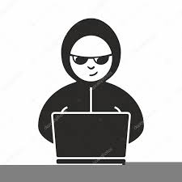
Example
Web App
Users
normal users
admin
audit
normal user
super users
audit
auditing
webapp.com/admin_info
webapp.com/account_info?acct=1234
https://www.youtube.com/watch?v=P38at6Tp8Ms
Notes:
Whole scripts written in Perl, Python, and other languages can be injected into poorly designed applications and executed.

Slide 34
Example - Remedies
Web App
Users
normal users
admin
audit
normal user
super users
audit
auditing
Place access control features in trusted server side code
Implement access control 1 time and then reuse it
Apply the “Least privilege principle” for the minimum amount of time
https://www.youtube.com/watch?v=P38at6Tp8Ms
Notes:
Whole scripts written in Perl, Python, and other languages can be injected into poorly designed applications and executed.

Slide 35
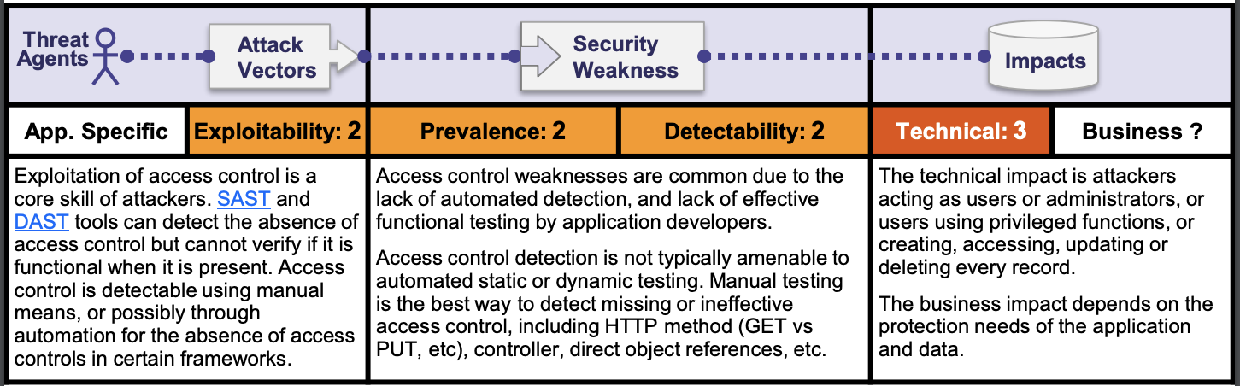
A5:2017 – Broken Access Control
https://www.owasp.org/index.php/Top_10-2017_A5-Broken_Access_Control
Notes:
Whole scripts written in Perl, Python, and other languages can be injected into poorly designed applications and executed.

Slide 36
A5:2017 – Broken Access Control
https://www.owasp.org/index.php/Top_10-2017_A5-Broken_Access_Control
Notes:
Whole scripts written in Perl, Python, and other languages can be injected into poorly designed applications and executed.

Slide 37
A5:2017 – Broken Access Control
https://www.owasp.org/index.php/Top_10-2017_A5-Broken_Access_Control
Notes:
Whole scripts written in Perl, Python, and other languages can be injected into poorly designed applications and executed.

Slide 38
A5:2017 – Broken Access Control
https://www.owasp.org/index.php/Top_10-2017_A5-Broken_Access_Control
Notes:
Whole scripts written in Perl, Python, and other languages can be injected into poorly designed applications and executed.

Slide 39
Examples Attack Scenarios

Slide 40
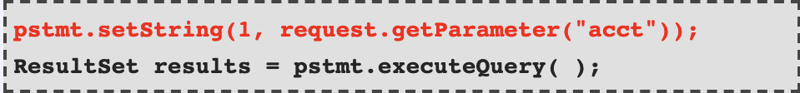
Scenario 1
Imagine you can retrieve information about your account through the following query:
http://example.com/app/accountInfo?acct=2388
Server side:
http://example.com/app/accountInfo?acct=2399
Direct Object Reference
https://www.owasp.org/index.php/Top_10-2017_A5-Broken_Access_Control
Notes:
Whole scripts written in Perl, Python, and other languages can be injected into poorly designed applications and executed.

Slide 41
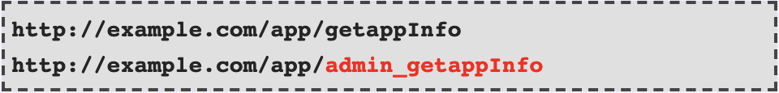
Scenario 2
An attacker simply forces browsers to target URLs.
If an unauthenticated user or a user who does not have access rights to the admin page can access it, it is a flaw.
https://www.owasp.org/index.php/Top_10-2017_A5-Broken_Access_Control
Notes:
Whole scripts written in Perl, Python, and other languages can be injected into poorly designed applications and executed.

Slide 42
Is The Application Vulnerable?
For Direct Object Reference
Does the application fail to verify whether the user is authorized to access the exact resource they have requested?
For Indirect Object Reference
If the reference is an indirect reference, does the mapping to the direct reference fail to limit the values to those authorized for the current user?
Automated Tools Do Not Look for Such Flaws
Notes:
Whole scripts written in Perl, Python, and other languages can be injected into poorly designed applications and executed.

Slide 43
Exercises on WebGoat Client side 1) Bypass front-end restrictions (1-2) 2) Client-side Filtering 1-3 3) HTML Tampering 1-3 Access Control Flaws 1) Insecure direct object references (1-6)

Slide 44
Solution for Client-side Filtering (3) 1) Inspect the webpage and identify the function that is executed 2) Identify the script that is executed when the coupon code changes 3) Inspect the script and identify the request that is performed to access the coupon parameter

Slide 45
Solution for Insecure Direct Object Reference (5 – Part 2) 1) Use ZAP to intercept the GET request performed when you click on “View Profile”. You will identify the GET from the following URL: http://127.0.0.1:8080/WebGoat/IDOR/profile/%7BuserId%7D

Slide 46
Solution for Insecure Direct Object Reference (5 – Part 2) 2) Edit the request as follows:
substitute method GET with PUT
change content type as Content-Type: application/json; charset=UTF-8
Set Content-Length: 87
Change the payload as follows (Note that the content length is = to the number of characters in the payload)
{“role”:”1”, “color”:”red”, “size”:”large”, “name”:”Buffalo Bill”, “userId”:”2342388”}

Slide 47
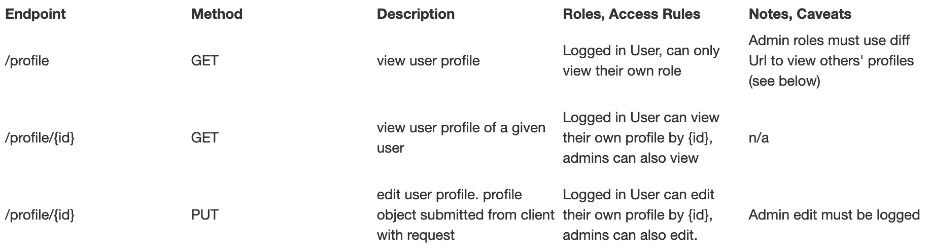
How To Prevent
Document your access control
Audit Access: For example record other users’ profile views and modifications made by admin or user users.
Use Indirect References
Notes:
Whole scripts written in Perl, Python, and other languages can be injected into poorly designed applications and executed.

Slide 48
Is The Application Vulnerable?
Missing function level access control, i.e. important functionality is exposed.
Unexposed functionality can often be found in the UI in the form of:
HTML or javascript comments
Commented out elements
Items hidden via ccs control/classes
Example on WebGoat
Missing Functional Level Access Control (1-2)
Notes:
Whole scripts written in Perl, Python, and other languages can be injected into poorly designed applications and executed.

Slide 49
Conclusions

Slide 50
Is The Application Vulnerable? (1/2)
Bypassing access control checks by modifying the URL, internal application state, or the HTML page.
Allowing the primary key to be changed to another user’s record, permitting editing or viewing someone else account.
Elevation of privilege. Acting as a user without being logged in or acting as an admin when logged in as a user.
https://www.owasp.org/images/7/72/OWASP_Top_10-2017_%28en%29.pdf.pdf
Notes:
Whole scripts written in Perl, Python, and other languages can be injected into poorly designed applications and executed.

Slide 51
Is The Application Vulnerable? (2/2)
Metadata manipulation, such as replaying or tampering with a Jason Web Token access control token or a cookie
CORS (Cross-Origin Resource sharing) misconfiguration allows unauthorized API access.
Forse browsing to authenticated pages as an unauthenticated user or to provileged pages as a standard user. Accessing API with missing access controls for POST, PUT, DELETE.
https://www.owasp.org/images/7/72/OWASP_Top_10-2017_%28en%29.pdf.pdf
Notes:
Cross-Origin Resource Sharing (CORS) is a mechanism that uses additional HTTP headers to tell a browser to let a web application running at one origin (domain) have permission to access selected resources from a server at a different origin. A web application executes a cross-origin HTTP request when it requests a resource that has a different origin (domain, protocol, and port) than its own origin.

Slide 52
How To Prevent
Deny by default
Implement access control mechanisms once and re-use them throughout the application
Disable web server directory listing and ensure file metadata (e.g., git) and backup files are not present within web roots.
Log access control failures
Rate limit API and controller access
JWT tokens should be invalidated on the server after logout.
https://www.owasp.org/images/7/72/OWASP_Top_10-2017_%28en%29.pdf.pdf

Slide 53
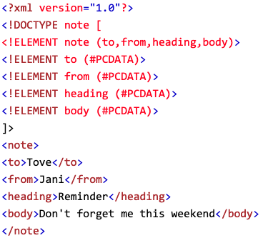
DTD Example
Notes:
Whole scripts written in Perl, Python, and other languages can be injected into poorly designed applications and executed.

Slide 54
DTD Example
PCDATA: (Parsed Character Data): XML parsers are used to parse all the text in an XML document.
PCDATA stands for Parsed Character data. PCDATA is the text that will be parsed by a parser.
Tags inside the PCDATA will be treated as markup and entities will be expanded.
Notes:
Whole scripts written in Perl, Python, and other languages can be injected into poorly designed applications and executed.

Slide 55
Is The Application Vulnerable? (2/2)
If your application uses SAML processing within federeted security or single sign on purposes. SAML uses XML for identify assertions and may be vulnerable
If our application uses SOAP prior version 1.2
Notes:
Whole scripts written in Perl, Python, and other languages can be injected into poorly designed applications and executed.

