Slide 1
Tutorial E-Shop Case Study (Part 2)

Slide 2
Objectives
Guidelines about how to implement a Web Application using the Java Enterprise Edition (JEE) Framework
JavaBeans
Database Communication
Session Management
Servlet Filters
Servlets & Dynamic Web Pages

Slide 3
?
User_Account
index.html
Product
Presentation
Layer
Database
Layer
Application Layer
Tomcat
MySQL

Slide 4
Dynamic JSP Pages
Session Management
homeView.jsp
SessionUtils.java
Servlets
DB
Communication
Servlet Filters
User_Account
Java Beans
index.html
Product
UserAccount
Product
Presentation
Layer
Database
Layer
Application Layer
Tomcat
MySQL

Slide 5
JavaBeans
JavaBeans has been proposed to represent re-usable software components.
A JavaBean is just a standard Java class that adopts the following conventions:
All properties are private and can be accessed/modified using getters/setters
It has a public no-argument constructor
Implements the java.io.Serializable interface
Serializable objects can be converted into a stream of bytes. Thus serializable objects can be written to streams, and hence files, and object databases.
Notes:
In a web application, the user is typically on the same web page for long periods of time, even though the display may change as they interact with the page. Rather than having the web browser generate HTTP requests and reload the page, JavaScript code is used to interact with the server in the background and update the display as needed

Slide 6
JavaBeans
JavaBeans have been used to provide an object based representation of the data stored in the database.
In our example we will have to create 2 JavaBeans:
1 to represent a Product and the other to represent a UserAccount.
Notes:
In a web application, the user is typically on the same web page for long periods of time, even though the display may change as they interact with the page. Rather than having the web browser generate HTTP requests and reload the page, JavaScript code is used to interact with the server in the background and update the display as needed

Slide 7
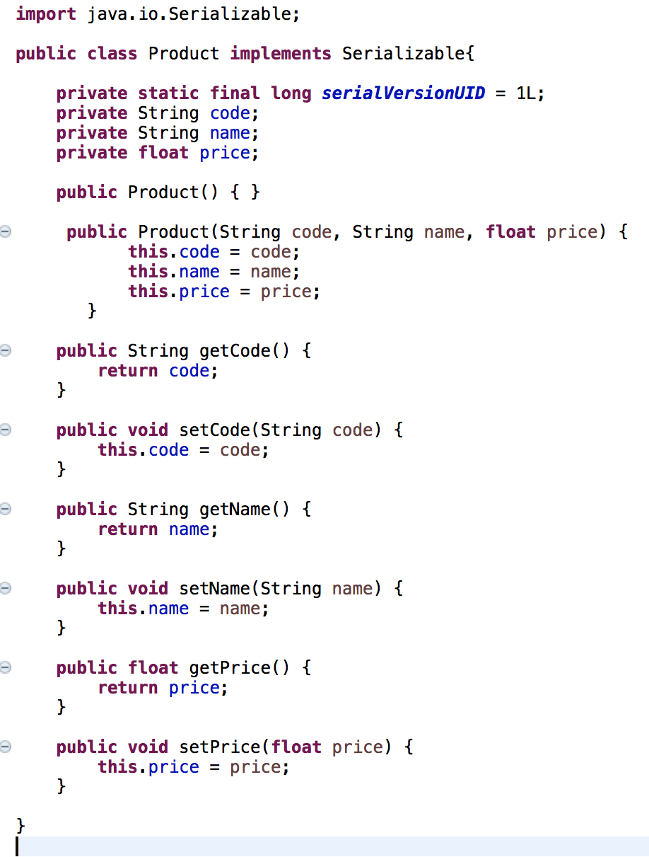
Example JavaBean
Notes:
In a web application, the user is typically on the same web page for long periods of time, even though the display may change as they interact with the page. Rather than having the web browser generate HTTP requests and reload the page, JavaScript code is used to interact with the server in the background and update the display as needed

Slide 8
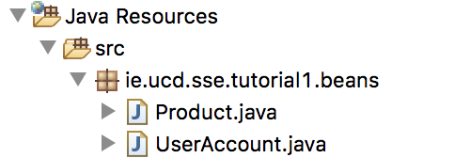
Try It Yourself!
Inside your web application create a new package (e.g., ie.ucd.tutorial1.beans)
Create the JavaBeans necessary to represent the information in the database.

Slide 9
Dynamic JSP Pages
Session Management
homeView.jsp
SessionUtils.java
Servlets
DB
Communication
Servlet Filters
User_Account
Java Beans
index.html
Product
UserAccount
Product
Presentation
Layer
Database
Layer
Application Layer
Tomcat
MySQL

Slide 10
DB Communication
Include DBConnectivity and DBUtil classes.
DBConnectivity classes are necessary to establish and close a connection with the database.
DBUtils classes will include the functionalities to get, modify and delete elements in the database.
It constructs and executes MySQL queries on the database.
Notes:
In a web application, the user is typically on the same web page for long periods of time, even though the display may change as they interact with the page. Rather than having the web browser generate HTTP requests and reload the page, JavaScript code is used to interact with the server in the background and update the display as needed

Slide 11

Try It Yourself!
In Lab Material decompress DBConn-DBUtils.zip
You will find 3 files:
DBConnectivity classes: MySQLConnUtils.java and ConnectionUtils.java
DBUtils classes: DBUtils.java
Create a new package in your web application and add these classes in it.
Re-run the application

Slide 12
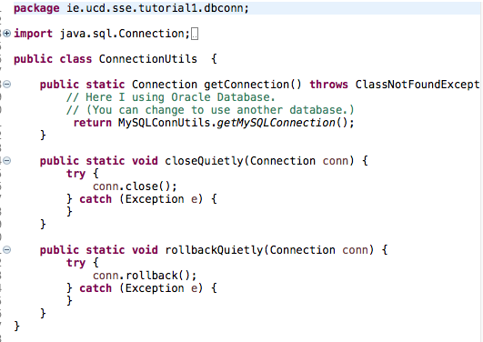
ConnectionUtils
Get and close a connection with a Database
Notes:
In a web application, the user is typically on the same web page for long periods of time, even though the display may change as they interact with the page. Rather than having the web browser generate HTTP requests and reload the page, JavaScript code is used to interact with the server in the background and update the display as needed

Slide 13
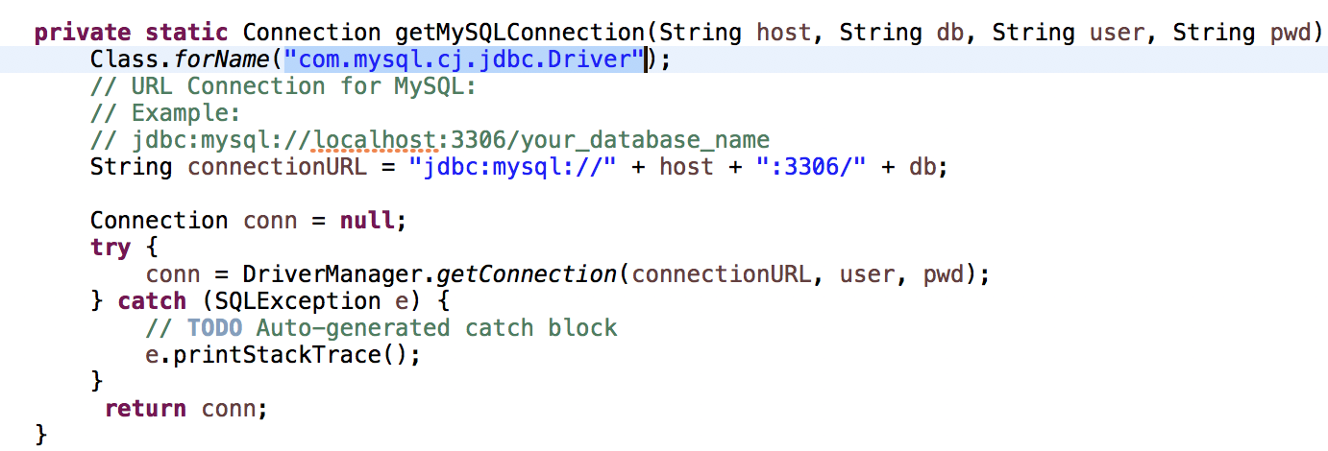
MySQLConnectionUtils
Load drivers to communicate to MySQL server
Notes:
In a web application, the user is typically on the same web page for long periods of time, even though the display may change as they interact with the page. Rather than having the web browser generate HTTP requests and reload the page, JavaScript code is used to interact with the server in the background and update the display as needed

Slide 14
MySQLConnectionUtils
Establish a connection
Notes:
In a web application, the user is typically on the same web page for long periods of time, even though the display may change as they interact with the page. Rather than having the web browser generate HTTP requests and reload the page, JavaScript code is used to interact with the server in the background and update the display as needed

Slide 15
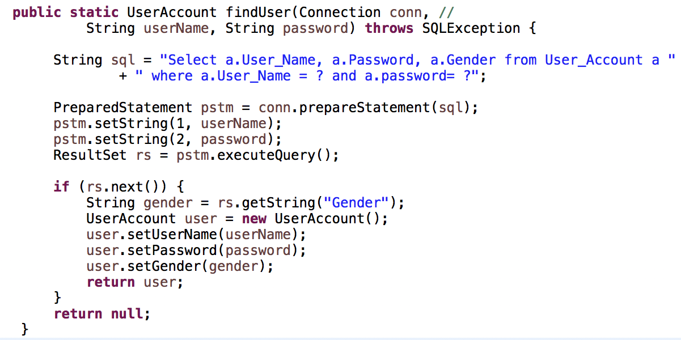
DBUtils
It constructs and execute MySQL queries on the database
Notes:
In a web application, the user is typically on the same web page for long periods of time, even though the display may change as they interact with the page. Rather than having the web browser generate HTTP requests and reload the page, JavaScript code is used to interact with the server in the background and update the display as needed

Slide 16
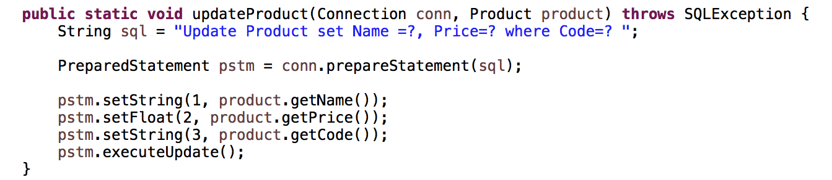
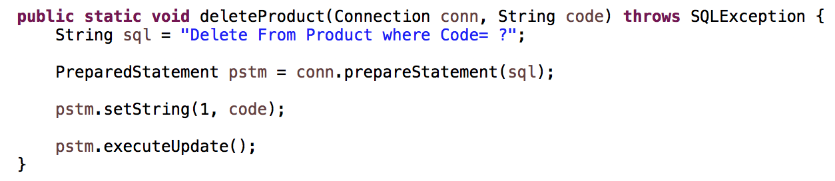
DBUtils
It constructs and execute MySQL queries on the database
Notes:
In a web application, the user is typically on the same web page for long periods of time, even though the display may change as they interact with the page. Rather than having the web browser generate HTTP requests and reload the page, JavaScript code is used to interact with the server in the background and update the display as needed

Slide 17
Dynamic JSP Pages
Session Management
homeView.jsp
SessionUtils.java
Servlets
DB
Communication
Servlet Filters
User_Account
Java Beans
index.html
Product
UserAccount
Product
Presentation
Layer
Database
Layer
Application Layer
Tomcat
MySQL

Slide 18
Session Management
Web Application are generally stateless. As soon as a response is sent to the client they forget who the clients were.
In many cases it is necessary to maintain a conversational state between client and server
For example, imagine a shopping cart:
Mostly users select multiple things to buy before proceeding to checkout.
In such scenarios the web server should be smart enough to remember what all products the user selected.

Slide 19
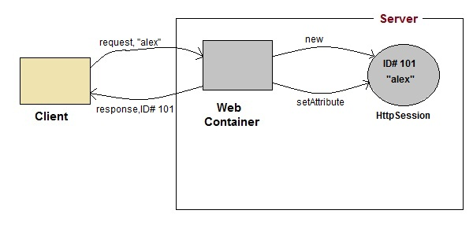
HTTPSession

Slide 20
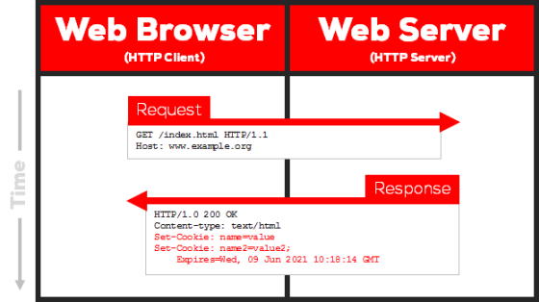
Cookies
A HTTP cookie (web cookie, browser cookies) is a small piece of data that a server sends to the user’s web browser. The browser may store it and send it back with the next request to the same server.

Slide 21
Cookies
For example, it is used to tell if two requests came from the same browser – keeping a user logged-in, for example

Slide 22
Cookies
Cookies are mainly used for 3 purposes:
Session management
logins, shopping carts, game scores
Personalization
user preferences, themes, and other settings
Tracking
Recording and analyzing user behaviour

Slide 23
Try it Yourself
Create a new package in your web app and place class SessionUtil.java

Slide 24
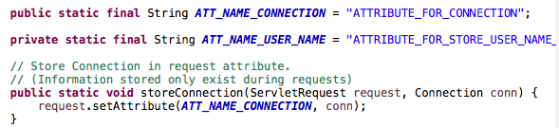
SessionUtil
When a new request is made to the web app the request is associated with an object allowing connectivity with the database.

Slide 25
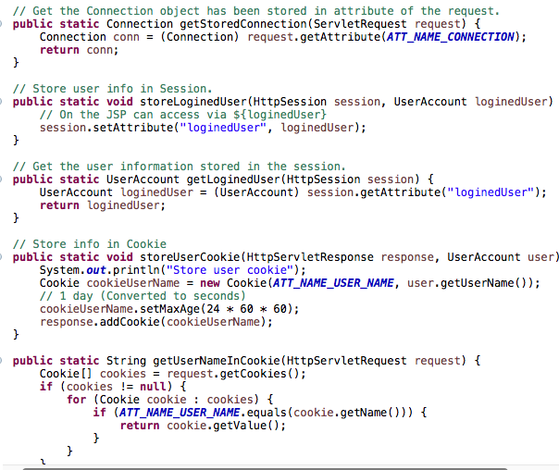
SessionUtil
Retrieves a connection that was previously stored with a user request

Slide 26
SessionUtil
Stores in the session an object of type UserAccount representing the user who has made the request.

Slide 27
SessionUtil
Identifies an object of type UserAccount associated with the user who has made the request.

Slide 28
SessionUtil
Creates a new cookie associated with the user

Slide 29
SessionUtil
Returns a String representing a value stored in the cookie

Slide 30
Dynamic JSP Pages
Session Management
homeView.jsp
SessionUtils.java
Servlets
DB
Communication
Servlet Filters
User_Account
Java Beans
index.html
Product
UserAccount
Product
Presentation
Layer
Database
Layer
Application Layer
Tomcat
MySQL

Slide 31
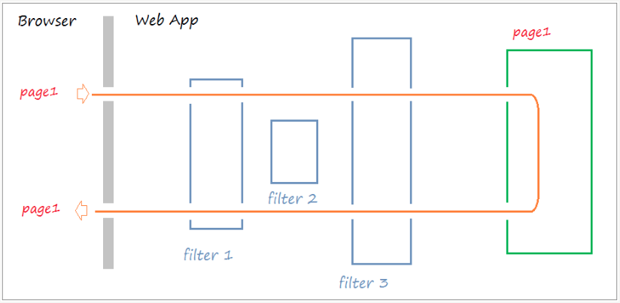
Servlet Filters
Allow perform some pre-processing before a request is sent to a servlet.

Slide 32
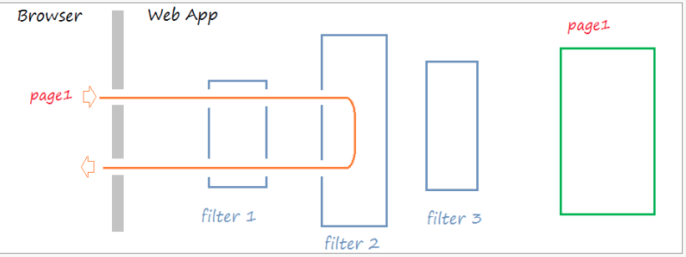
Servlet Filters
However there are situations when a user request does not pass the filters (e.g., unauthorized user)

Slide 33
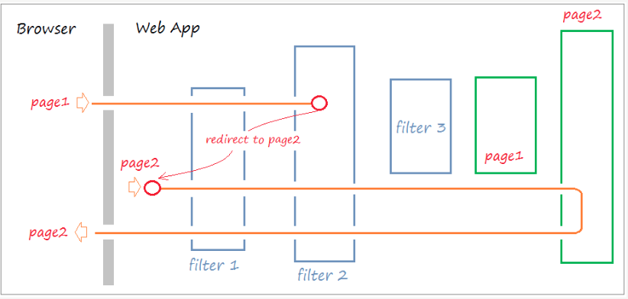
Servlet Filters
Requests can get redirected to different pages
submit request for personal info
User is redirected to login page

Slide 34
Servlet Filters
Servlet Filters can also be used to encoding web pages. For example, setUTF-8 encoding for the page.
They can also be used for opening and closing the connection to the database and preparing JDBC transactions.

Slide 35

Try it Yourself
Decompress Filters.zip
Create a new package in your web app
Add classes CookieFilter, JDBCFilter and EncodingFilter to your package

Slide 36

Servlet Filter
The class has annotation @WebFilter indicating the name of the filter (filterName) and the url requests (urlPatterns) that this filter has to listen to.
Implement interface javax.servlet.Filter;
They need to implement methods init(), doFilter(), and destroy()

Slide 37
JDBCFilter.java
Checks whether the specified path in the user request refers to an existing servlet.
If that is the case it associates the HTTPServerRequest with an object that ensures connectivity with the database.

Slide 38
CookieFilter.java
Checks whether the session is associated with a username
If not it creates a new cookie by storing information about the user stored in the HTTP session
EncodingFilter.java
Sets the page encoding to UTF-8

Slide 39
CookieFilter.java
Checks whether the session is associated with a username
If not it creates a new cookie by storing information about the user stored in the HTTP session
EncodingFilter.java
Sets the page encoding to UTF-8

Slide 40
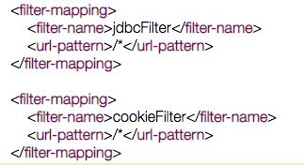
Filters Ordering
If all filters have the same urlpattern, how is it possible to establish an order among them?
In web.xml you will need to specify the following

Slide 41
Dynamic JSP Pages
Session Management
homeView.jsp
SessionUtils.java
Servlets
DB
Communication
Servlet Filters
User_Account
Java Beans
index.html
Product
UserAccount
Product
Presentation
Layer
Database
Layer
Application Layer
Tomcat
MySQL

Slide 42

Design a Dynamic Home Page
When entering the default path (e.g., enter the site’s domain name) it will display the home page
In web.xml you will need to specify the following

Slide 43
Java Servlet
It is a Java software compoenent that extends the capability of a server
A software developers may use a servlet to add dynamic content to a web server using the Java platform.
To deploy and run a servlet a web container must be used. It is responsible for managing the lifecycle of servlets, mapping a URL to a particular Servlet request.

Slide 44
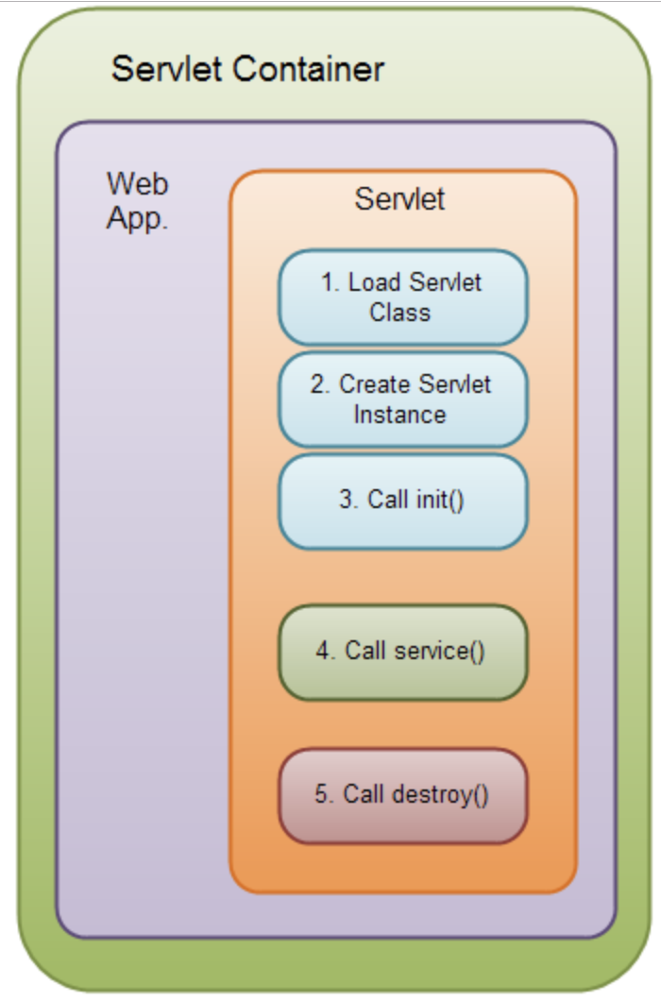
Servlet
Lifecycle
Step 1, 2 and 3 are executed only once, when the servlet is initially loaded. By default the servlet is not loaded until the first request is received for it.
Step 4 is executed multiple times – once for every HTTP request to the servlet
Step 5 is executed when the servlet container unloads the servlet.

Slide 45
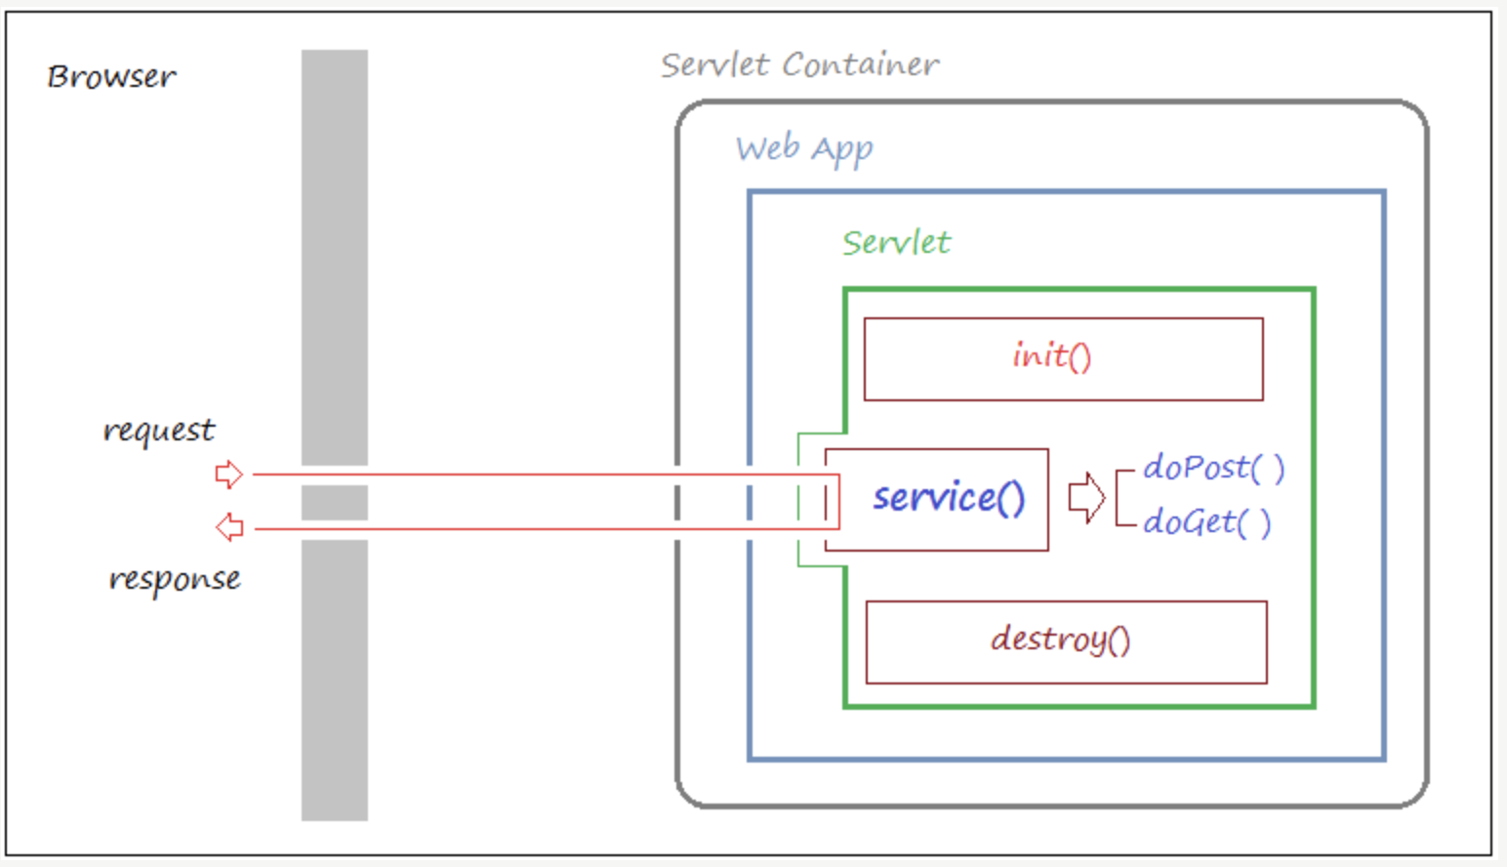
Servlet Lifecycle
Notes:
When a user requests a Servlet, the servlet will call the method service().
To serve the requirements of the user the service will call either doGet() or doPost
Thus, when users request a Servlet, the servlet will be created at the time of the first request and will simultaneously call the init() method of servlet to initialize it; init() method is called only one time. Method of destroy is used to destroy the servlet; it will be called only once when removing deployment of web application or stop the web server.

Slide 46
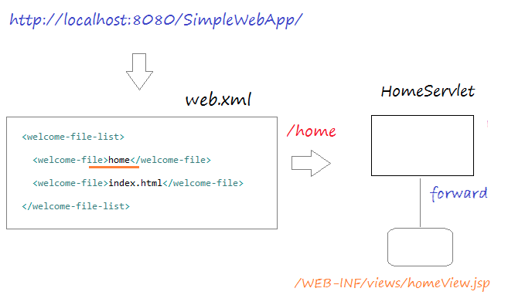
Design a Dynamic Home Page
You need to design a homepage as a JSP page to display dynamic information

Slide 47
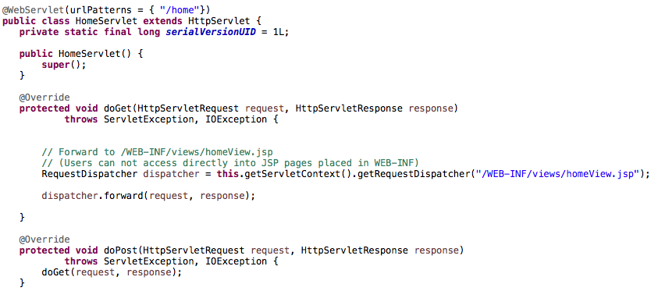
HomeServlet
urlPattern to match a servlet
Forwards the request to a dynamic page homeView.jsp

Slide 48
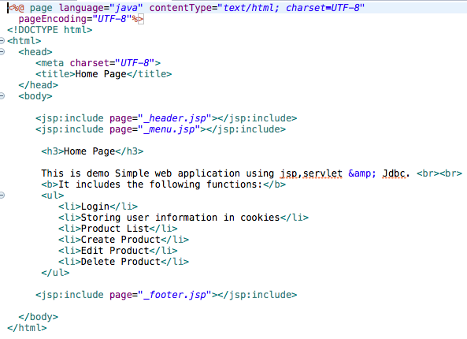
homeView.jsp
Contains hidden pages

Slide 49
Try it Yourself
Servlets.zip and JSPPages.zip contain respectively the servlets and the dynamic web pages.
Place HomeServlet.java in a new package that you will use to include all the servlets
Pace homeView.jsp, _header.jsp, _menu.jsp, and _footer.jsp in WebContent/WEB-INF/views
Rerun your application

Slide 50
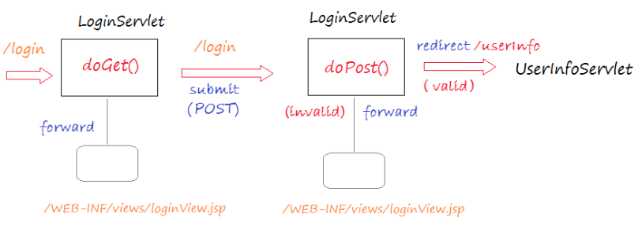
Perform the Login

Slide 51
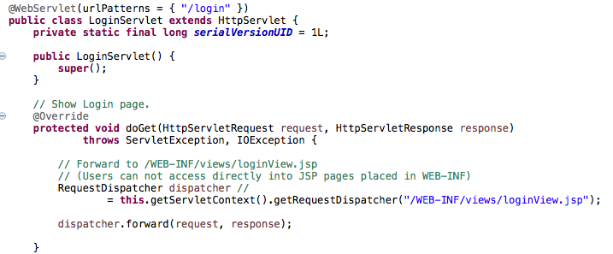
LoginServlet

Slide 52
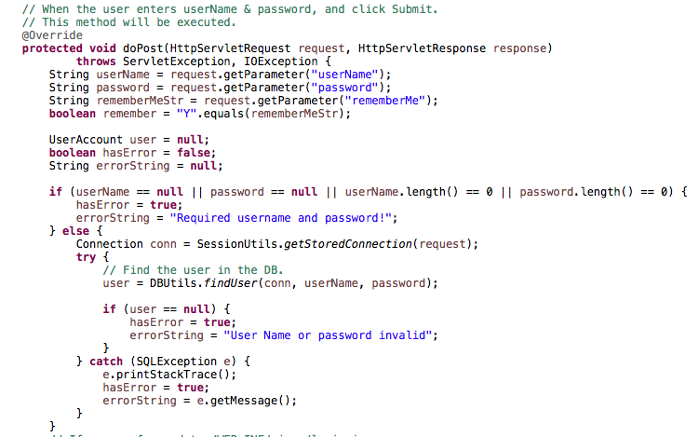
LoginServlet

Slide 53
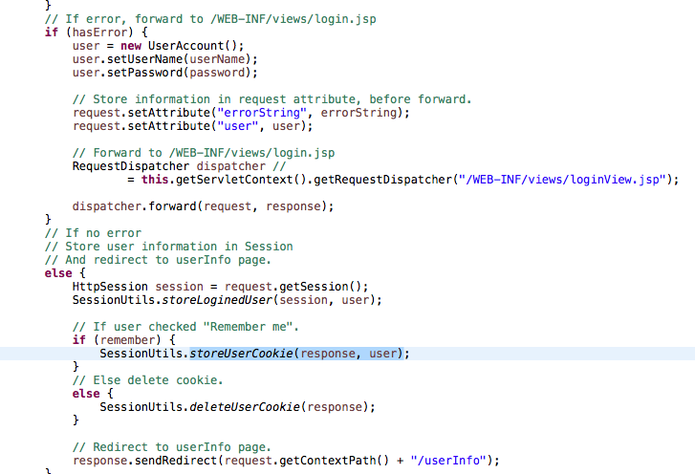
LoginServlet

Slide 54
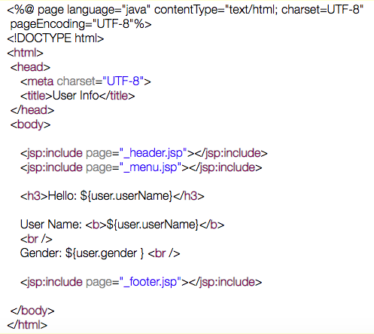
userInfoView.java

Slide 55
Try it Yourself
Place LoginServlet.java in the servlet package
Pace loginView.jsp, _header.jsp, _menu.jsp, and _footer.jsp in WebContent/WEB-INF/views
Rerun your application

Slide 56
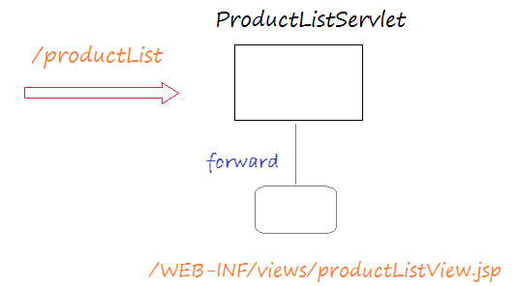
List Products

Slide 57
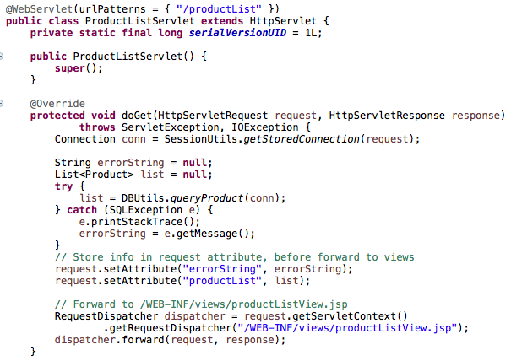
ProductList Servlet

Slide 58
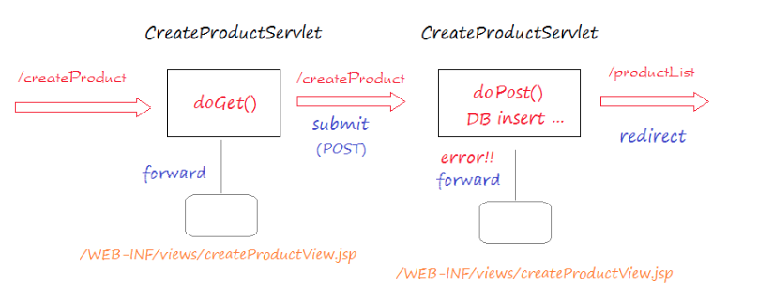
Add Product

Slide 59
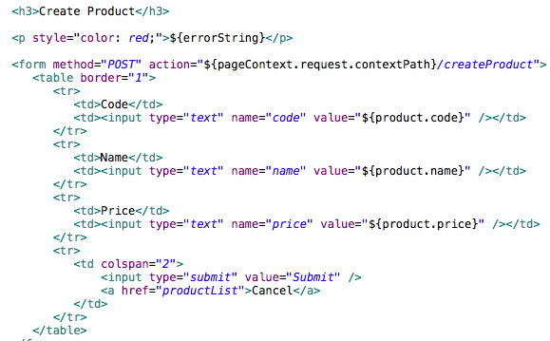
createProductView.jsp

Slide 60
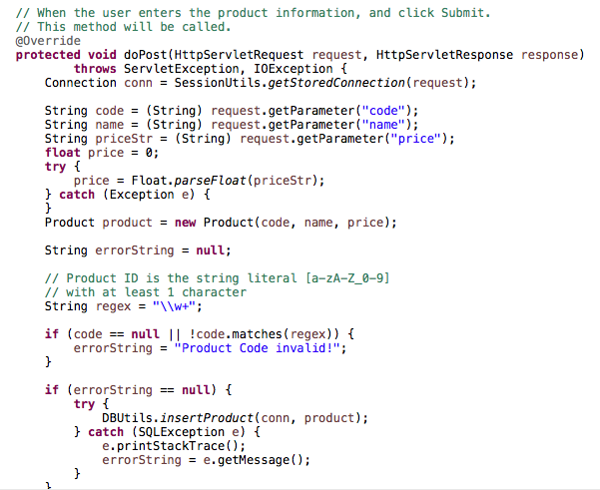
CreateProductServlet

Slide 61
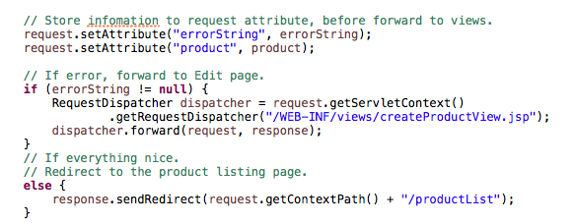
CreateProductServlet

Slide 62
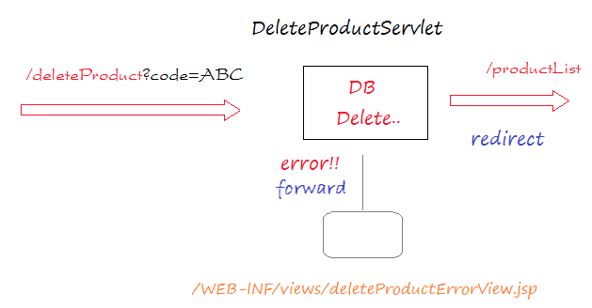
Delete Product

