Slide 1
FINAL YEAR PROJECT PROPOSAL | SEECS, NUST ISLAMABAD | 2026
Computer-Vision-Based Emergency Vehicle Preemption for Traffic Intersections in Pakistan
A simulation-based study: detect with a camera, grant the green, hand control back safely
Syed Muhammad Abdur Rehman
Abdullah Salim Nizami
Abdul Hadi Sheikh
467471
457223
454448
Computer vision & model
Simulation & signal control
Scenarios, experiments & analysis
Advisor: Sir Khurram Shahzad Co-Advisor: Maam Sana Qadir

Slide 2
PROBLEM STATEMENT
Ambulances lose minutes at red lights
+5%
THE PROBLEM
Pakistani cities have no low-cost, vehicle-independent way of giving emergency vehicles priority at signalised intersections, so time-critical emergencies suffer avoidable delays.
odds of on-scene death per extra minute of EMS response, elderly road-traffic-injury patients
AOR 1.05; Rescue 1122 data, 2025 [3]
~20%
of the Lahore study area reachable by fire-brigade vehicles within 7 minutes
Geospatial analysis, Lahore [8]
30.9%
Why imported EVP does not fit: infrared, RF and GPS/GSM units go on every vehicle, which assumes one centrally funded fleet. Pakistan's response is split across Rescue 1122, charities and private hospitals.
of 978 Karachi trauma patients reached the emergency room within one hour
Law: Section 112AA grants right of way only to vehicles with active warning devices.
Trauma-registry study [4]
Computer-Vision-Based EVP for Pakistan | NUST SEECS
2 / 16

Slide 3





PROPOSED SOLUTION
A camera-only EVP: see it, don't tag it
Camera 150-200 m upstream
YOLOv8n detects the vehicle
Tracker confirms it
Controller grants green
Signal reverts safely
Criterion | GPS / IoT approach | Camera-only CV (this project)
Vehicle-side hardware | GPS+GSM unit on every ambulance and fire truck | None; zero equipment on any vehicle
Recurring per-vehicle cost | About PKR 2,250 per vehicle | PKR 0; one-time cost per intersection
Network dependency | Live cellular uplink | Autonomous per intersection
Fleet coordination | Buy-in across Edhi, Rescue 1122, private fleets | Not required
Positioning | GPS drift and multipath in dense corridors | Camera confirms physical presence
Everything at the intersection
No GPS, no cellular link, no central server, nothing on the vehicle.
Trade-off
Shorter range than GPS; rain, fog and low light reduce detection. Modelled in simulation first.
Computer-Vision-Based EVP for Pakistan | NUST SEECS
3 / 16

Slide 4



LITERATURE REVIEW
Existing EVP approaches and their limits
Infrared emitters (e.g. 3M Opticom)
Radio-frequency priority systems
How: An emitter on each emergency vehicle is read by a receiver at every intersection.
How: The vehicle broadcasts a priority request over a dedicated RF channel.
Limit: Emitter on every vehicle; line-of-sight only; fleet-wide fitting and maintenance.
Limit: On-board transmitter on every vehicle; coordination across independent fleets.
GPS / GNSS-based systems
Camera / YOLO prototypes [11], [12]
How: A central platform computes vehicle proximity to intersections from reported coordinates.
How: YOLOv8 on a Raspberry Pi detects emergency vehicles; some also switch the signal to green.
Limit: GPS+GSM unit per vehicle (about PKR 2,250), live cellular link, GPS drift and multipath in dense corridors.
Limit: Not adapted to Pakistani liveries; little on lead time, false-trigger handling or fail-safe reversion.
NTCIP 1211 [1] defines how a priority unit talks to a signal controller. It is the reference model for our controller logic.
Computer-Vision-Based EVP for Pakistan | NUST SEECS
4 / 16

Slide 5


LITERATURE REVIEW
What the literature says about detection
Camera + YOLO prototypes
Audio siren detection
Dataset landscape
[11] YOLOv8 on a Raspberry Pi: 31 FPS, 95% accuracy, alerts to emergency services.
[12] YOLO on a Raspberry Pi 5 switches the matching signal to green and syncs across intersections.
[14] CNN on MFCC features separates sirens from traffic noise, even in poor conditions.
[15] Lightweight pre-trained CNN detects sirens in real time on embedded hardware.
[16] Karachi make-and-model: 3,847 images, 48 classes.
[17] Pakistani traffic: 129,000 images, 94 classes.
[18], [19] Bangladesh (DhakaAI, Poribohon-BD): ambulance class and a method to adapt detectors to South Asian traffic.
Feasible on cheap hardware, but silent on local liveries, camera placement and false or lost detections.
A siren is audible when the vehicle is hidden, a natural second channel (our future work).
No public Pakistani emergency-vehicle dataset exists.
Computer-Vision-Based EVP for Pakistan | NUST SEECS
5 / 16

Slide 6






GAPS IN THE LITERATURE
Six gaps this project targets
GAP
GAP
GAP
Prototypes are not adapted to Pakistani vehicle liveries.
Little is reported on how much lead time the camera placement buys.
False triggers from one-off misclassifications go unaddressed.
OUR ANSWER
OUR ANSWER
OUR ANSWER
Two-stage dataset strategy: public data now, local fine-tuning once a dataset is obtained.
Camera-placement study: lead time vs latency and clearance budget, in simulation.
Multi-frame confidence gating: preemption starts only on a sustained detection.
GAP
GAP
GAP
Lost or failed detections are not handled safely.
Triggers are not tied to the law on right of way.
Results are rarely checked against stated targets.
OUR ANSWER
OUR ANSWER
OUR ANSWER
Fail-safe controller plus exit-zone tracking for automatic, safe reversion.
Trigger requires active warning devices, in line with Section 112AA.
SUMO validation against explicit targets and a no-preemption baseline.
Computer-Vision-Based EVP for Pakistan | NUST SEECS
6 / 16

Slide 7


COMPUTER VISION
The detector: YOLOv8n
Why YOLOv8n
FROM MODEL TO SIMULATION
Real-time, edge-deployable and gives up little accuracy for its speed. Mature tooling; exports to ONNX / NCNN for Raspberry Pi.
Fine-tune YOLOv8n
public emergency-vehicle datasets
What it detects
Benchmark
precision, recall, mAP, latency
Ambulances, fire trucks and rescue vehicles, from livery colour and markings, the roof light-bar signature and silhouette. Separates them from vans, buses and delivery trucks.
Detector-performance profile
detection probability vs distance and apparent size; false-positive rate; latency
How we measure it
Fine-tuned on public data, evaluated on a held-out split with a low-light subset: precision, recall, mAP and per-frame inference time on CPU.
Drives the simulated camera
inside the SUMO intersection model
Computer-Vision-Based EVP for Pakistan | NUST SEECS
7 / 16

Slide 8


COMPUTER VISION
Datasets: public now, Pakistani next
29,759
IEEE "Vehicle Dataset" [13]
Stage 1: this phase
Includes ambulance and fire truck. Published YOLOv7 baseline: 85% precision, 85% mAP@0.5. Primary Stage 1 baseline.
images, 7 classes
Fine-tune YOLOv8n on the IEEE and Roboflow sets, with Kaggle negatives. Establish baseline mAP and the detector-performance profile.
1,800+
Roboflow "Emergency Vehicles" [20]
Focused on ambulance and fire-truck classes. Actively maintained; supplements class balance.
images, YOLO format
Stage 2: future work
150-300 locally annotated images of Rescue 1122, Edhi and fire-brigade liveries by day, night and in the wet. Augmentation (brightness jitter, motion blur, synthetic rain/fog). Needs a Pakistani dataset.
556
Kaggle "Vehicle Detection" [21]
Ambulance, bus, car, truck. Supplies negative-class examples so look-alikes are not detected as emergency vehicles.
images per class
Computer-Vision-Based EVP for Pakistan | NUST SEECS
8 / 16

Slide 9
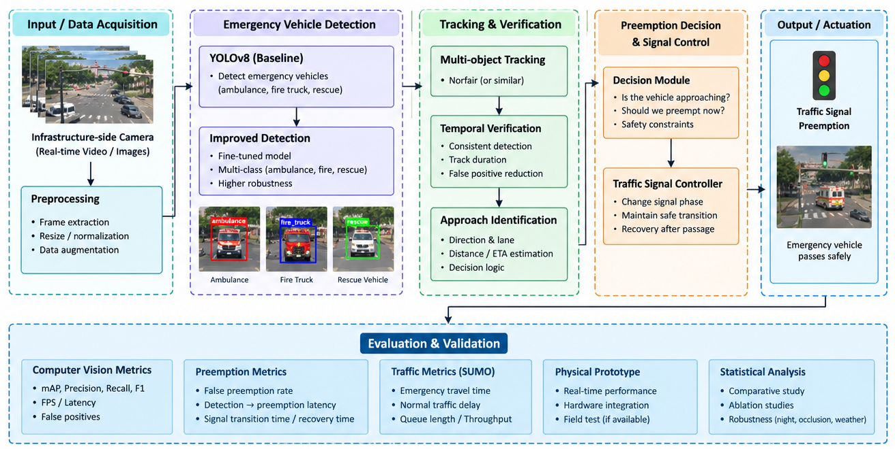
SYSTEM DESIGN
System architecture: from video to green light
Computer-Vision-Based EVP for Pakistan | NUST SEECS
9 / 16

Slide 10

SYSTEM DESIGN
From detections to a trustworthy trigger
Track
YOLOv8n detection
A lightweight centroid / IoU tracker (Norfair or similar) follows each vehicle frame to frame and watches an exit zone beyond the stop line.
class + confidence
Held over several frames?
multi-frame gating
Confirm
Preemption is issued only after a high-confidence detection holds across several consecutive frames, filtering one-off misclassifications.
Warning devices active?
Section 112AA trigger
Approaching, ETA in threshold?
lane, direction, distance
Respect the law
Request only for an emergency vehicle that is also signalling (Section 112AA). Look-alikes and silent ambulances must not trigger.
Request preemption
hand to signal controller
Computer-Vision-Based EVP for Pakistan | NUST SEECS
10 / 16

Slide 11


SYSTEM DESIGN
Camera placement buys the lead time
50 m is too close
Under 4 s of warning, almost all consumed by system latency.
150-200 m works
Roughly 11-14 s: covers the <3 s latency target plus cross-traffic clearance.
Sweep in SUMO
Distance and approach speed are swept; an optional second camera rechecks the class near the stop line.
Computer-Vision-Based EVP for Pakistan | NUST SEECS
11 / 16

Slide 12
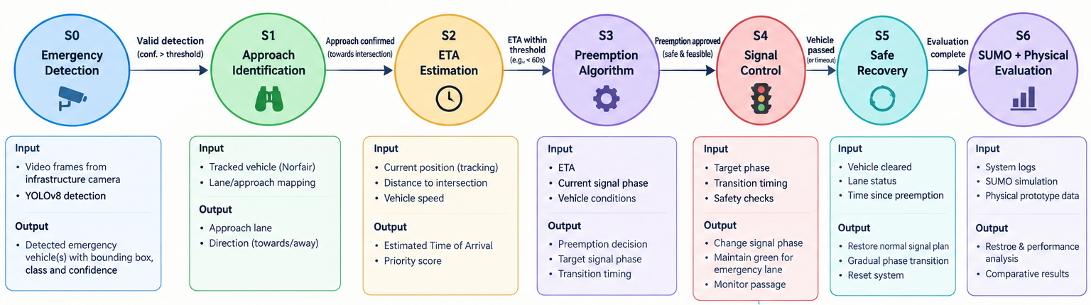

SIGNAL CONTROL
Signal processing: the time-state machine
Perceive (S0-S2)
Decide (S3)
Act and recover (S4-S5)
Detection, approach lane and direction, then ETA from position, distance and speed.
ETA, current signal phase and vehicle conditions yield a preempt decision, target phase and timing.
Change the phase, hold green for passage, then restore the normal plan.
Computer-Vision-Based EVP for Pakistan | NUST SEECS
12 / 16

Slide 13
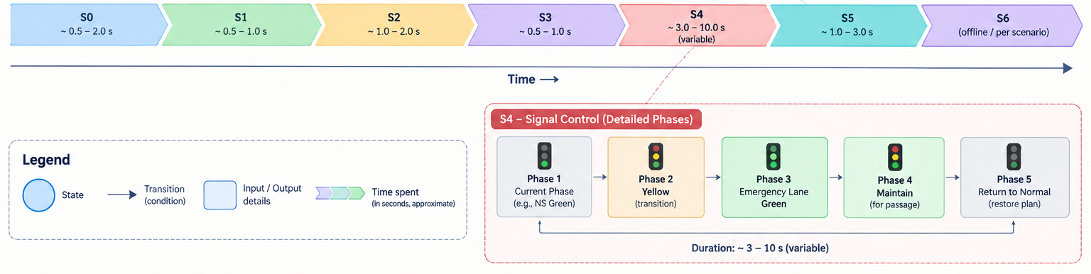


SIGNAL CONTROL
Preemption: clear, hold, hand back
Clear
Hold
Hand back
Fail safe
Current phase ends through yellow and all-red; pedestrians held safe; emergency approach turns green, cross-traffic stays red.
Green held while the tracker monitors passage; the exit zone past the stop line marks that the vehicle has gone through.
Normal cycle restored with a gradual phase transition, within 2 s of the vehicle leaving the detection zone.
Camera lost, detection timeout or unrenewed preemption: fall back to the normal cycle. Each intersection runs independently.
Computer-Vision-Based EVP for Pakistan | NUST SEECS
13 / 16

Slide 14
VALIDATION AND NEXT STEPS
Validation in SUMO against clear targets
>95%
<3 s
<2%
<2 s
preemption accuracy
response latency, detection to green
false-trigger rate
reversion after the vehicle leaves
Provisional targets, all measured in simulation against a no-preemption baseline
What the experiments measure
Beyond this phase
Emergency-vehicle travel time vs a no-preemption baseline
Cross-traffic delay and throughput
Robustness: night and weather, missed detections, look-alikes, closely spaced emergency vehicles
Repeated over multiple random seeds; shortfalls reported as measured
Local Pakistani dataset and Stage 2 fine-tuning
Raspberry Pi 4 prototype, about PKR 15,250 in parts
Field validation, then a pilot with traffic authorities
Warning-light and siren verification
Supports SDG 3, SDG 9 and SDG 11
Computer-Vision-Based EVP for Pakistan | NUST SEECS
14 / 16

Slide 15
SUSTAINABLE DEVELOPMENT GOALS
Three SDGs this project supports
CLOSEST FIT
3
Good Health and
Well-being
11
Sustainable Cities and Communities
9
Industry, Innovation and Infrastructure
TARGET 3.6
TARGET 11.2
TARGET 9.1
Reduce road traffic deaths and injuries.
Safe and sustainable transport systems.
Reliable and resilient infrastructure.
OUR CONTRIBUTION
OUR CONTRIBUTION
OUR CONTRIBUTION
Removes delay at intersections for ambulances and fire trucks, supporting faster response to crashes and time-critical medical emergencies.
Makes signalised intersections more responsive to emergency traffic at low cost, deployable one intersection at a time with no equipment on vehicles.
Delivers smart-infrastructure capability from commodity hardware and open-source software that can be built and maintained locally.
Computer-Vision-Based EVP for Pakistan | NUST SEECS
15 / 16

Slide 16
Thank you
Questions?
We welcome your questions and feedback.
Syed Muhammad Abdur Rehman | Abdullah Salim Nizami | Abdul Hadi Sheikh
Advisor: Sir Khurram Shahzad | Co-Advisor: Maam Sana Qadir | SEECS, NUST Islamabad

