Slide 1


Slide 2
IPL Auction Analysis
Content
Dataset consists of auction prices for the players in the season of 2022-23.
Dataset Variables
Season – Year
Name – Player name
Nationality – Player belongs to nationality
Type – Type of player
Team – Player belongs to ipl team
Price – Price of the player during the auction

Slide 3
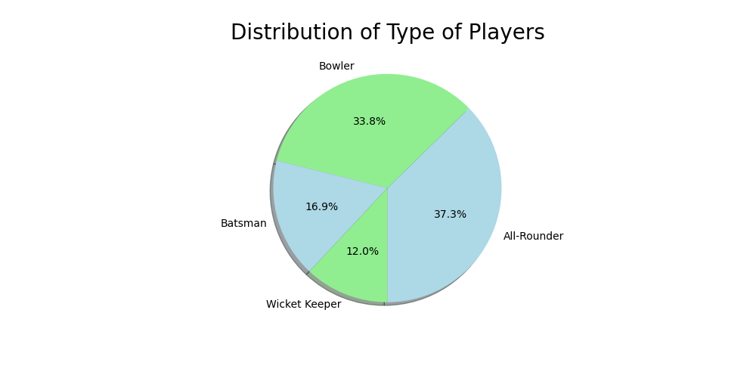
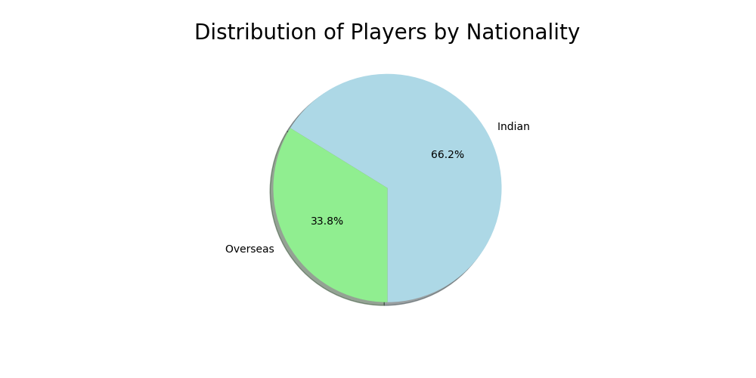
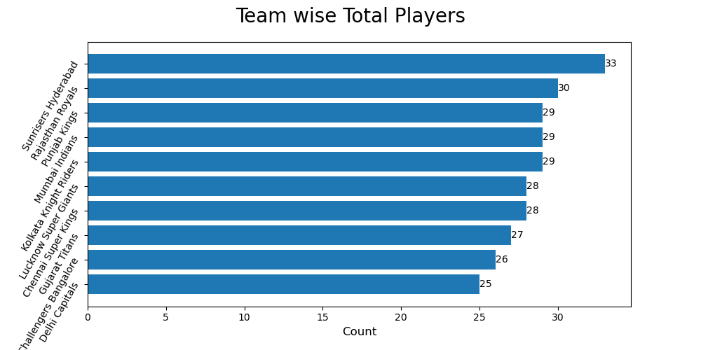

Slide 4
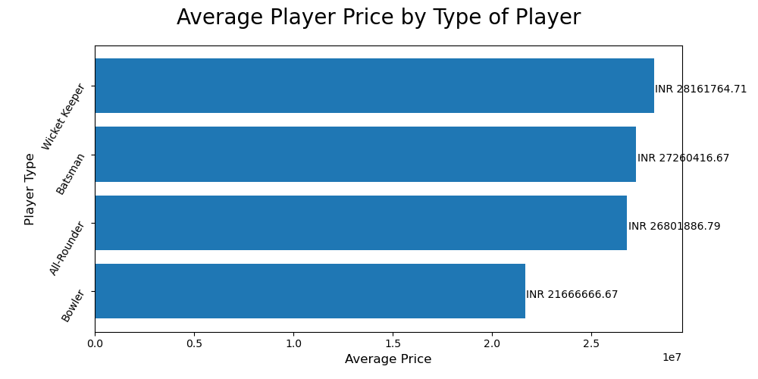
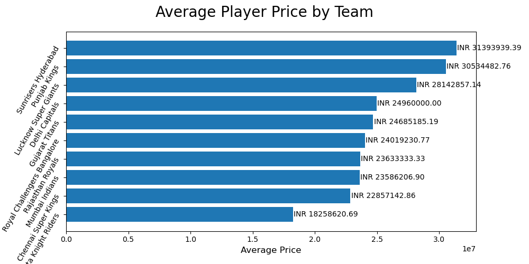
Wicket Keeper, Batsman and All Rounder Players has the similar average price by the type of player.
Bowler has the least average price.
Sunrisers Hyderabad and Punjab Kings team players has the highest paid average price.
Kolkata Knight Riders team players has the least paid average price.

Slide 5
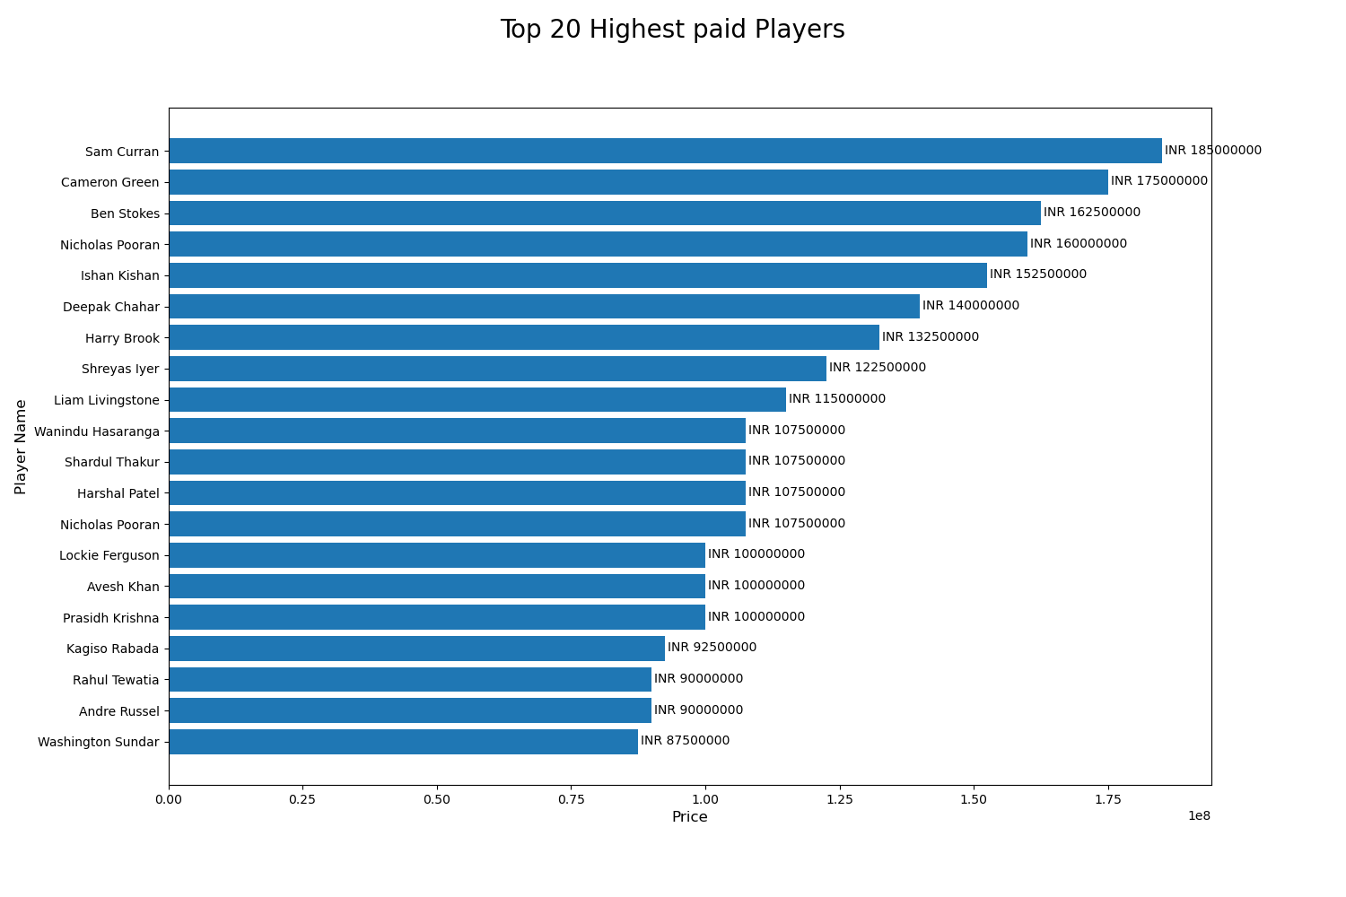

Slide 6
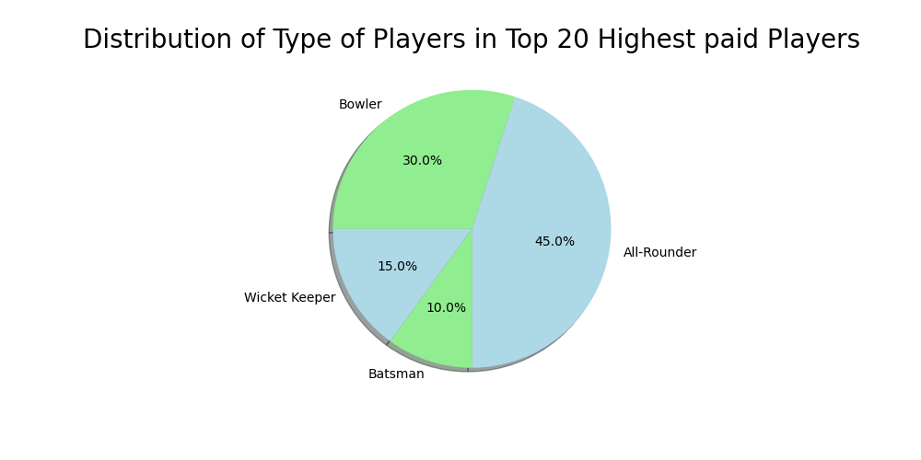
All-Rounders and Bowlers are the highest number of players in top 20 highest paid players.

Slide 7
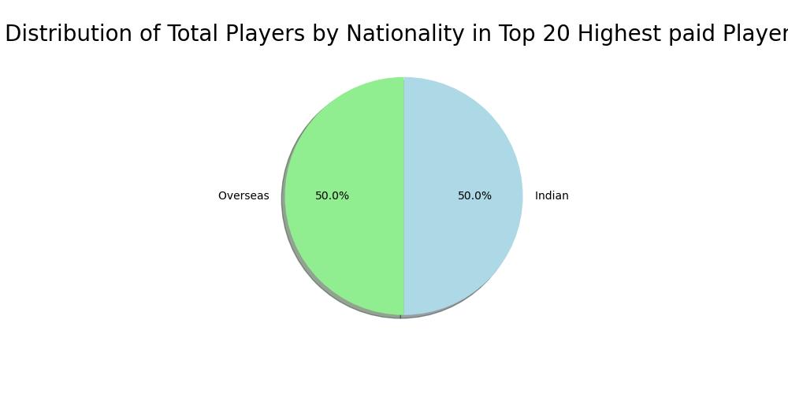
In top 20 highest paid players, nationality preferences are equal.

Slide 8
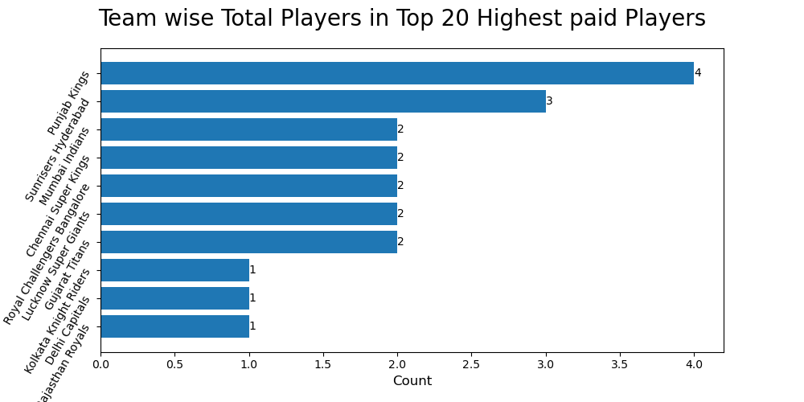
Punjab Kings and Sunrisers Hyderabad have the highest number of players in top 20 highest paid players.

Slide 9
Thank You

