Slide 1

CV BUILDER APPLICATION
A Desktop Resume-Building Tool Built with Python & PyQt5
Programming Fundamentals • First Semester

Slide 2



Introduction
A CV is a vital professional document
It's often the first impression a candidate makes on an employer.
Manual CV creation is difficult
Aligning text, sections and spacing by hand is slow and error-prone.
Users frequently face formatting issues
Inconsistent fonts, spacing, and layout problems are common.
This project automates CV creation
A guided desktop app turns raw input into a polished, ready CV.
CV Builder Application
2

Slide 3



Problem Statement
Many users struggle to create a professional CV on their own.
Formatting Issues
Time Consumption
Lack of Design Skills
Repetitive Editing
Spacing and alignment break easily when edited by hand.
Manually building a CV from scratch takes significant time.
Not everyone can lay out a visually balanced document.
Small content updates often mean redoing the whole layout.
CV Builder Application
3

Slide 4






Objectives & Architecture
Create a user-friendly GUI
Application Architecture
Generate a professional CV
User
Provide a live preview
Save and load user data
GUI
Export the CV as a PDF
Data Processing
Support multiple templates
Live Preview
JSON / PDF Output
CV Builder Application
4

Slide 5




Technologies Used
Python
PyQt5
Qt Designer
JSON
ReportLab
Core programming language
GUI framework for the desktop app
Visual drag-and-drop UI design
Lightweight data save/load format
Generates the exported PDF
CV Builder Application
5

Slide 6




Major Features
Live Preview
Save Data
Load Data
See the CV update as you type
Store entries locally as JSON
Reopen and continue editing later
Upload Photo
Export PDF
Templates
Add a personal photo to the CV
Generate a ready-to-send PDF file
Switch between Classic and Modern
CV Builder Application
6

Slide 7
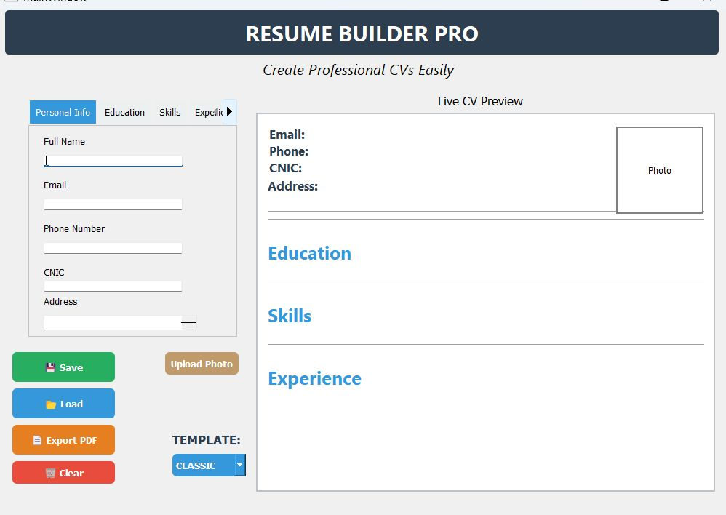
Classic Template
A clean, traditional resume layout with a tabbed input panel.
Tabbed sections: Personal Info, Education, Skills, Experience
Live preview updates instantly as fields are filled
Photo slot reserved beside contact details
CV Builder Application
7

Slide 8
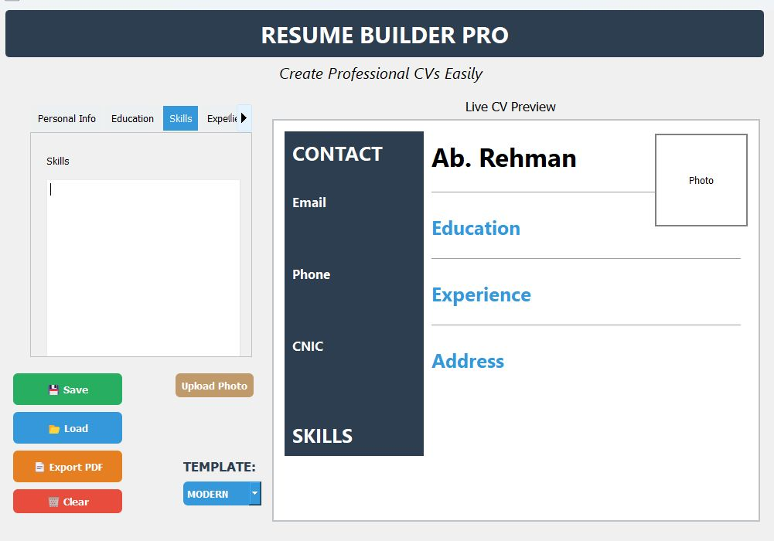
Modern Template
A sidebar-style layout for a sharper, contemporary look.
Dark contact sidebar with Email, Phone, CNIC and Skills
Main panel highlights Education and Experience
Same live data — only the visual layout changes
CV Builder Application
8

Slide 9
Testing
Each core feature was tested manually to confirm it works as expected.
Test Case
Result
Save
Pass
Load
Pass
Template Change
Pass
Upload Photo
Pass
Export PDF
Pass
CV Builder Application
9

Slide 10


Challenges Faced
Learning Qt Designer
Connecting Widgets
Designing Templates
Implementing PDF Export
Integrating Image Upload
Getting comfortable with a new visual design tool
Wiring up signals and slots between UI elements
Building two visually distinct, clean layouts
Structuring content correctly with ReportLab
Handling, scaling and displaying user photos
CV Builder Application
10

Slide 11

Conclusion
Successfully developed a complete CV Builder application
Supports multiple templates — Classic and Modern
Supports profile image upload
Supports one-click PDF export
Delivers a user-friendly end-to-end experience
CV Builder Application
11

Slide 12

Thank You!
For supporting this journey.

