Slide 1
Welcome to the World of Assembly Language Programming
Prepared by Madhusudan Basak
Lecturer Department of CSE, BUET

Slide 2
Course Outline
Week No. | Tentative Coursework
Week 1 | Class on Chapter 1,2,3
Week 2 | Class on Chapter 4,5
Week 3 | Class on Chapter 6+ Code Demo + Assigning Offline
Week 4 | Evaluation of offline + Online
Week 5 | Class on Chapter 7, 9 + Assigning Offline
Week 6 | Evaluation of Offline + Online
Week 7 | Class on Chapter 8, 17+ Assigning Offline
Week 8 | Evaluation of Offline + Online
Week 9 | Class on Chapter 10, 11+ Assigning Offline
Week 10 | Evaluation of Offline + Online
Week 11 | Class on Graphics + Project Allocation
Week 12 | Reserved Class
Week 13 | Quiz
Week 14 | Project Checking + Evaluation by Giving Online

Slide 3
References
Assembly Language Programming and Organization of the IBM PC
--- Ytha Yu and Charles Marut
Assembly Language for the IBM-PC
--- Kip R. Irvine

Slide 4
The Beginning !
What is Assembly Language?

Slide 5
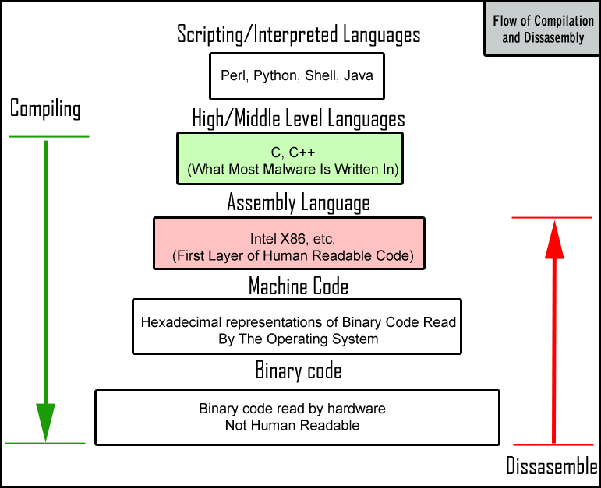

Slide 6
About Assembly
Assembly is human-readable machine code
Gives you complete control over the system's resources

Slide 7
Why use it ?
Direct hardware manipulation
Access to specialized processor instructions
Performance and efficiency
Speed optimization
Control the code behavior

Slide 8
Disadvantages ☹
Hard and tedious
Bug-prone
Non-portable(machine dependent)
Difficult to debug

Slide 9
A question ?
In what kind of situations, assembly language will be the only solution?
An Operating System
Drivers and communication with custom hardware/electronics.
An Compiler
Optimizations

Slide 10
Definition from wiki
An assembly language is a low-level programming language for a computer, or other programmable device, in which there is a very strong (generally one-to-one) correspondence between the language and the architecture's machine code instructions. Each assembly language is specific to a particular computer architecture, in contrast to most high-level programming languages, which are generally portable across multiple architectures, but require interpreting or compiling.

Slide 11
Chapter 1 Microcomputer Systems

Slide 12
The Components of a Microcomputer System
Typical components
System unit
Keyboard
Display Screen
Disk drives
Functionally three parts
CPU
Memory circuits
I/O circuits

Slide 13
Memory
Bytes and Words
Bit position
Memory operations
RAM and ROM
Buses

Slide 14
CPU
Two main components
Execution Unit(EU)
Bus Interface Unit(BIU)

Slide 15
I/O Ports
Serial Ports
Parallel Ports

Slide 16
Instruction Execution
Fetch
Execute

Slide 17
Instruction Execution
The Process of executing an instruction
00000001 00000110 00000000 00000000
ADD operation
AX Register
Memory Address 00000000
Memory Address 00000000

Slide 18
I/O Devices
Magnetic Disks
Keyboard
Display Monitor
Printers

Slide 19
Programming Languages
Machine Language
Assembly Language
High-Level Languages

Slide 20
Representation of numbers and characters
Chapter 2

Slide 21
Number Systems
Binary Number System
Hexadecimal Number System
Decimal Number System

Slide 22
Conversion Between Number Systems
Converting Binary and Hex to Decimal
Converting Decimal to Binary and Hex
Conversions between Hex and Binary

Slide 23
Addition and Subtraction
Hexadecimal Addition Table

Slide 24
How integers are represented in the Computer
Unsigned integers
Signed integers
One’s complement
Two’s complement
Decimal Interpretation

Slide 25
Character Representation
ASCII ( American Standard Code for Information Interchange) code
Normally 128 ASCII Codes
32-126 are printable
0 to 31 and 127 for control purposes
For Extended set, there are 256 characters

Slide 26
Organization of the ibm personal computers
Chapter 3

Slide 27
The Intel 8086 Family of Microprocessors
The 8086 and 8088 Microprocessors
The 80186 and 80188 Microprocessors
The 80286 Microprocessor
The 80386 and 80386SX Microprocessors
The 80486 and 80486SX Microprocessors

Slide 28
Organization of the 8086/8088 Microprocessors
Registers
3 Types of registers
Data Registers
Address Registers
Status Register

Slide 29
Data Registers
AX (Accumulator Register)
BX (Base Register)
CX (Count Register)
DX (Data Register)
Each one has two parts like AX(AH+AL)

Slide 30
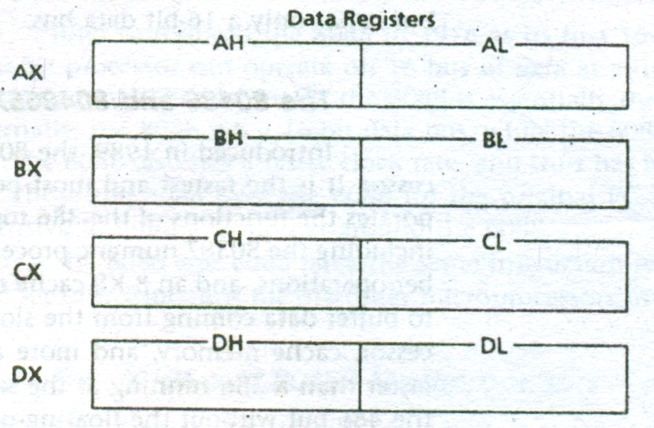
Data Registers

Slide 31
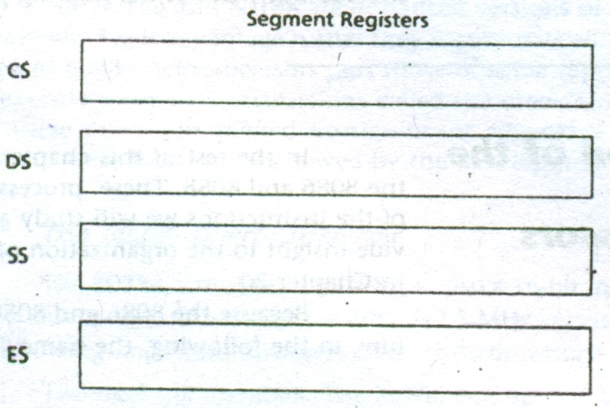
Segment Registers(Address Registers)

Slide 32
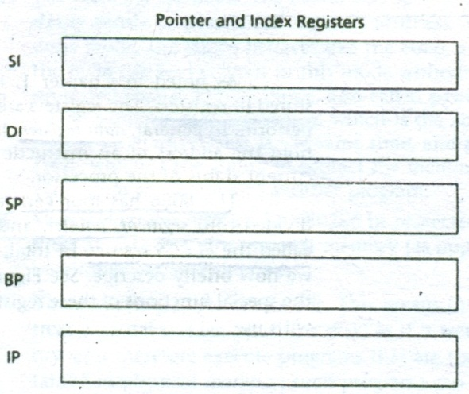
Pointer and Index Registers, Instruction pointers (Address Registers)

Slide 33
Segment Registers
Memory Segment
Segment: Offset Address
Location of Segments
Task | Segment Registers | Pointer and Index Registers
Code | CS | IP
Data | DS | SI
 | ES | EI
Stack | SS | SP
 |  | BP

Slide 34
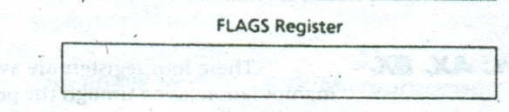
FLAGS Register(Status Register)

Slide 35
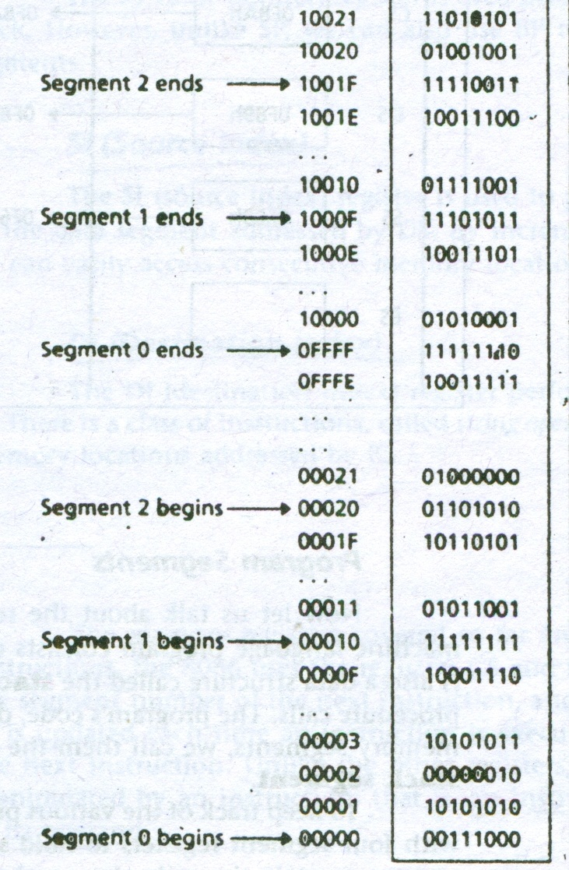
Overlapping Scenario

Slide 36
If you have a segment A4FBh and offset 4872h. Then what is the 20 bit physical address?
A4FB0h
+4872h
-------------
A9822h ( 20 bit physical address)

Slide 37
Organization of the PC
The Operating System
DOS (Disk Operating System)
BIOS (Basic Input/Output System)

Slide 38
Memory Organization of the PC
8086/8088 has only 1MB of memory
Not all memory for application programs
Interrupt Vector, Video Display Memory etc are needed
IBM fixed all the positions and allowed all to live happily

Slide 39
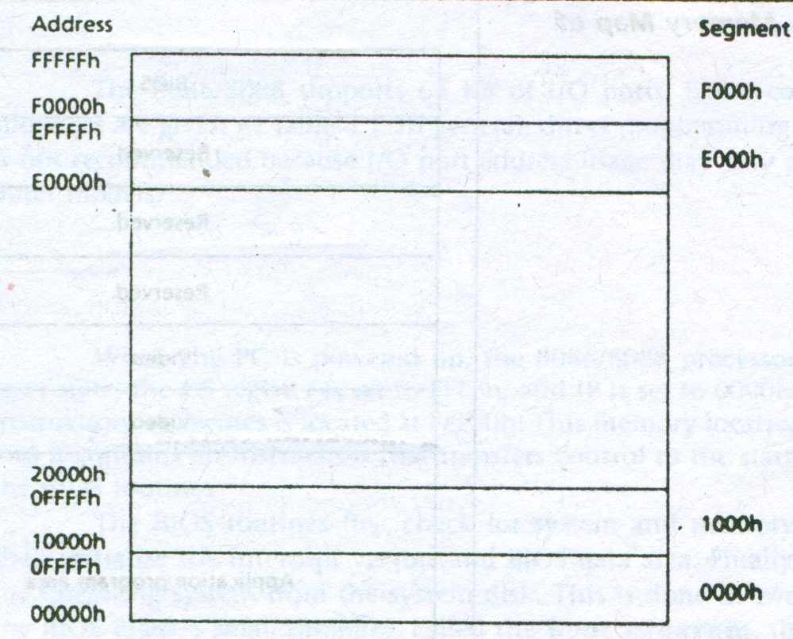

Slide 40
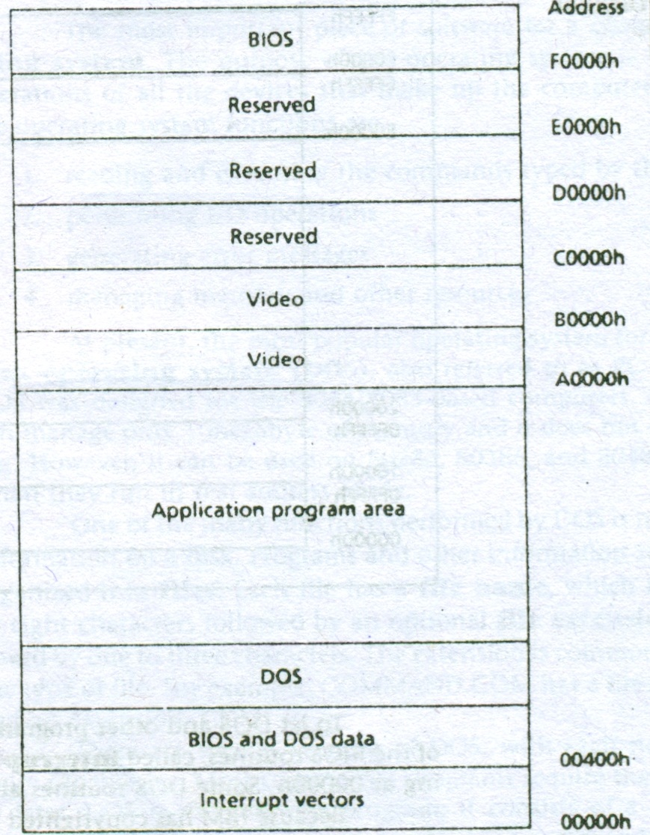

Slide 41
I/O ports addresses
Interrupt controller (20h-21h)
Keyboard controller (60h-63h)
etc...

Slide 42
Start-up Operation
Boot program

Slide 43


