Slide 1

Welcome to the World of Assembly Language Programming
Base Slide Prepared by Madhusudan Basak
Lecturer Department of CSE, BUET
Modified by
Abdus Salam Azad, Assistant Professor, CSE, BUET

Slide 2
References
Assembly Language Programming and Organization of the IBM PC
--- Ytha Yu and Charles Marut
Assembly Language for the IBM-PC
--- Kip R. Irvine

Slide 3
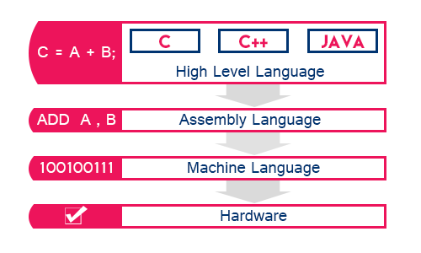
What Is Assembly Language ?

Slide 4
Definition (Simplified) from wiki
a low-level programming language for a computer, in which there is a very strong (generally one-to-one) correspondence between the language and the architecture's machine code instructions.
Each assembly language is specific to a particular computer architecture --- Platform Dependent

Slide 5
Why use it ?
Direct hardware manipulation
Gives you complete control over the system's resources
Performance and efficiency
Access to specialized processor instructions

Slide 6
Disadvantages ☹
Hard and tedious
Non-portable(machine dependent)
Bug-prone
Difficult to debug

Slide 7
A question ?
In what kind of situations, assembly language will be the only/best solution?
Drivers and communication with custom hardware/electronics.
An Compiler
Optimizations

Slide 8
Chapter 1 Microcomputer Systems

Slide 9
The Components of a Microcomputer System
Functionally three parts
CPU
Memory circuits
I/O circuits

Slide 10
Bus
A set of wires or connections with which a processor communicates with memory and l/O circuits
There are three kind of buses:
address bus
data bus,
control bus

Slide 11
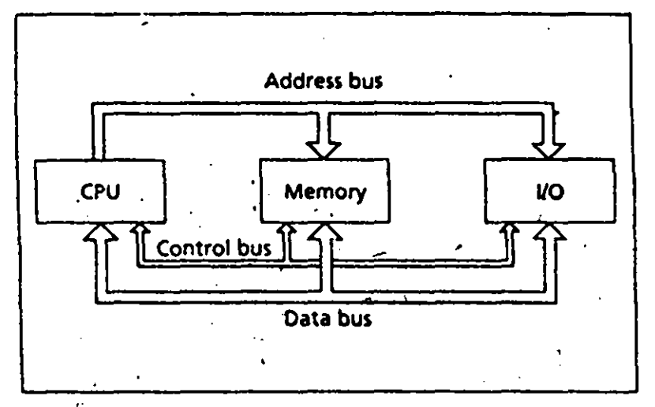
Bus Connections

Slide 12
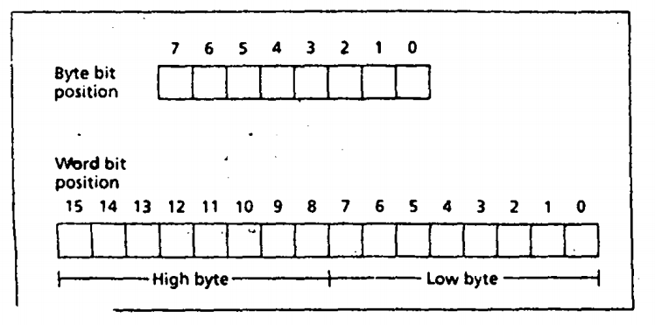
Memory - Bytes and Words

Slide 13
CPU
Two main components
Execution Unit(EU)
Bus Interface Unit(BIU)

Slide 14
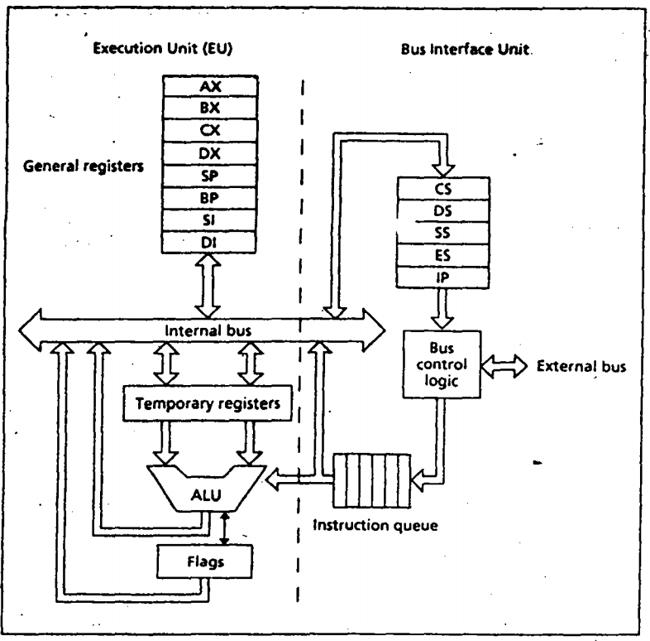
Intel 8086 Microprocessor Organization

Slide 15
Execution Unit
The purpose of the execution unit (EU} is to execute Instructions.
It contains a circuit called the arithmetic and logic unit (ALU).
The ALU can perform arithmetic (+, - , x ,I) and logic (AND, OR, NOT} operations.
The data for the operations are stored in registers
A register is like a memory location except that we normally refer to it by a name rather than a number.
The EU has eight registers for storing data; their names arc AX, BX, CX, DX, SI, DI, BP, and SP.

Slide 16
Bus Interface Unit
The Bus Interface unit (BIU) facilitates communication between the EU and the memory or I/0 circuits.
It is responsible for transmitting addresses, data, and control signals on the buses.
Its registers are named CS, DS, ES, SS, and IP.
They hold addresses of memory locations.
The IP (instruction pointer) contains the address of the next instruction to be executed by the EU.

Slide 17
Instruction Execution
Fetch
Fetch an instruction from memory.
Decode the instruction to determine the operation.
Fetch data from memory if necessary.
Execute
4. Perform the operation on the data.
5. Store the result in memory if needed

Slide 18
Organization of the ibm personal computers
Chapter 3

Slide 19
Organization of the 8086/8088 Microprocessors
Registers
There are fourteen 16 bit registers
3 Types of registers
Data Registers – holds data for operation
Address Registers – holds addresses of instruction or data
Status Register – holds current status of processor

Slide 20
Data Registers
AX (Accumulator Register)
BX (Base Register)
CX (Count Register)
DX (Data Register)
Each one can be used by parts
e.g., AX has two equal parts
The higher part (8 bit) is referred as AH and
The lower part – AL
both of them can be used independently

Slide 21
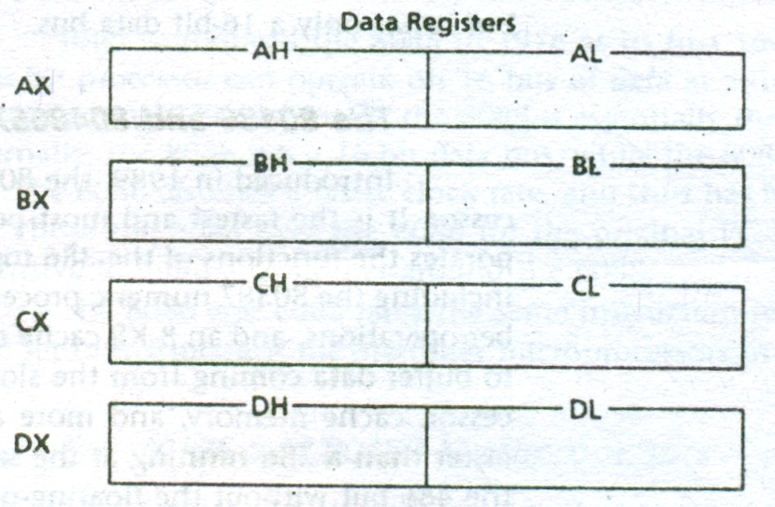
Data Registers

Slide 22
Memory Organization
8086 features 1 20 bit physical address for memory
2^20 == 1MB Memory is supported
However, all registers are of 16 bit
The memory is divided (non-disjoint) into segments

Slide 23
Segment
Each segment consists of a block of 2^16 consecutive bytes in the memory
64KB in size
Each memory location in a memory segment is addressable by a 16 bit offset
Each segment is identified with a 16 bit segment number
Hence there are 2^16 segments
Numbered from 0000h to FFFFh

Slide 24
Logical Address and Physical Address
Each Location in memory can be addressed by specifying a segment number and and offset within the segment
Written as segment:offset
Called the logical address
To find the physical address from a logical address
Shift left the segment number by four bit, then add offset
segment*10h + offset

Slide 25
If you have a segment A4FBh and offset 4872h. Then what is the 20 bit physical address?
A4FB0h
+4872h
-------------
A9822h ( 20 bit physical address)

Slide 26
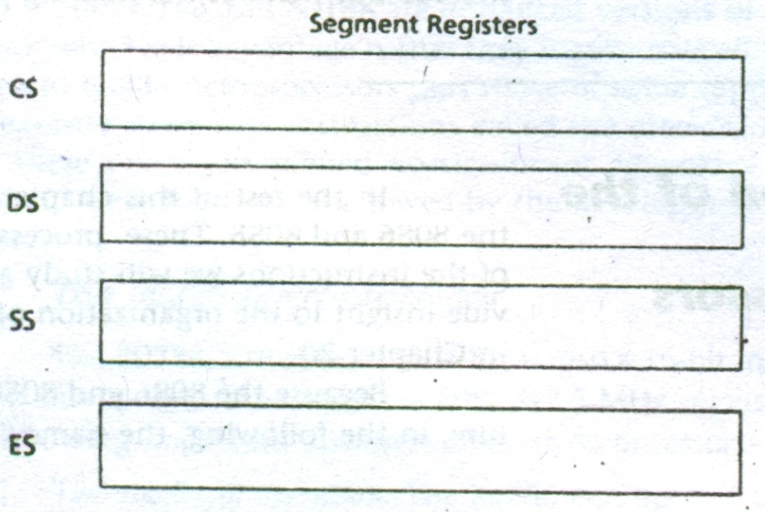
Segment Registers(Address Registers)

Slide 27
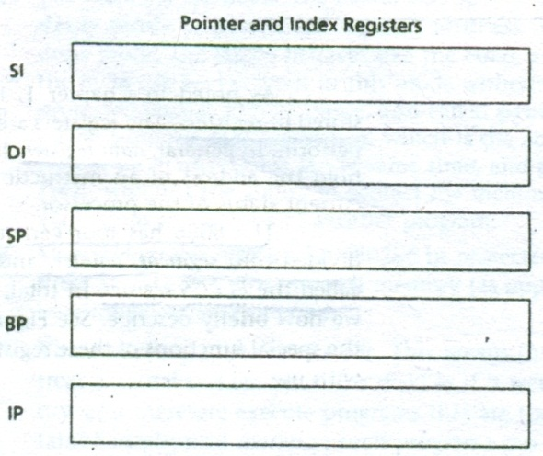
Pointer and Index Registers, Instruction pointers (Address Registers)

Slide 28
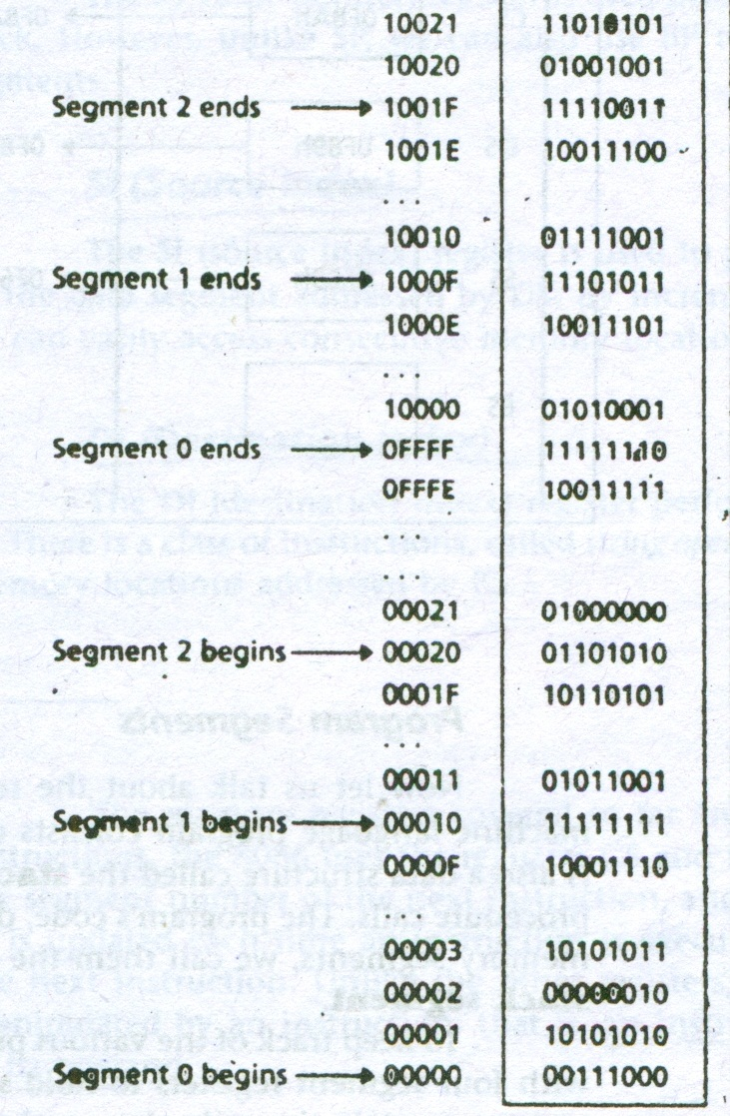
Overlapping Scenario

Slide 29
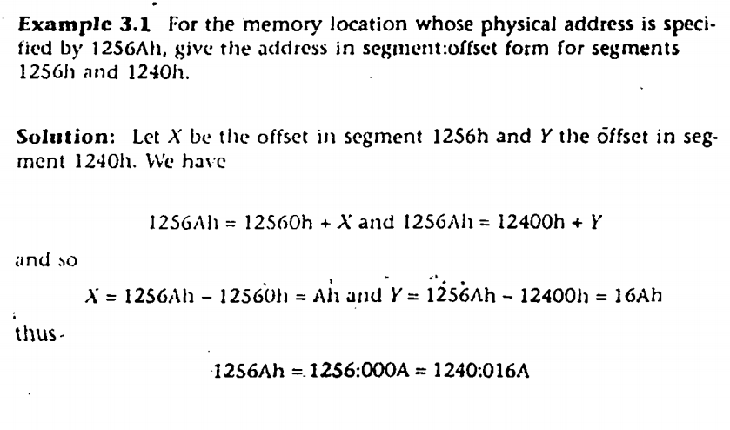
Overlapping Scenario

Slide 30
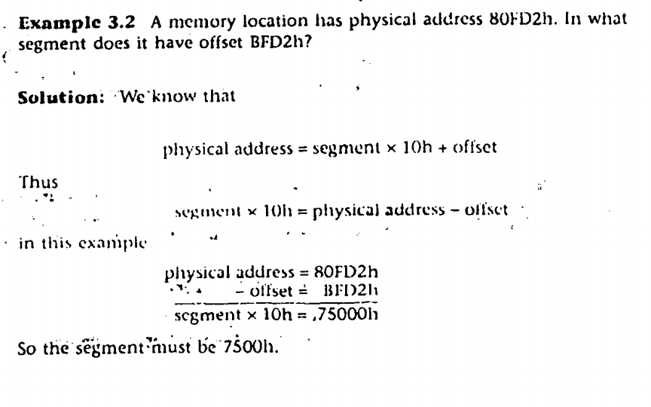
Physical and Logical address calculation

Slide 31
Segment Registers
Code, Data, and Stack are maintained in different segments
Stack is used by the processor to implement procedure calls.
Task | Segment Registers | Pointer and Index Registers
Code | CS | IP
Data | DS | SI
 | ES | EI
Stack | SS | SP
 |  | BP

Slide 32
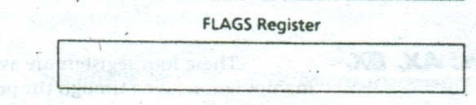
FLAGS Register(Status Register)

Slide 33
Memory Organization of the PC
8086/8088 has only 1MB of memory
Not all memory for application programs
Interrupt Vector, Video Display Memory etc are needed
IBM fixed all the positions and allowed all to live happily

Slide 34
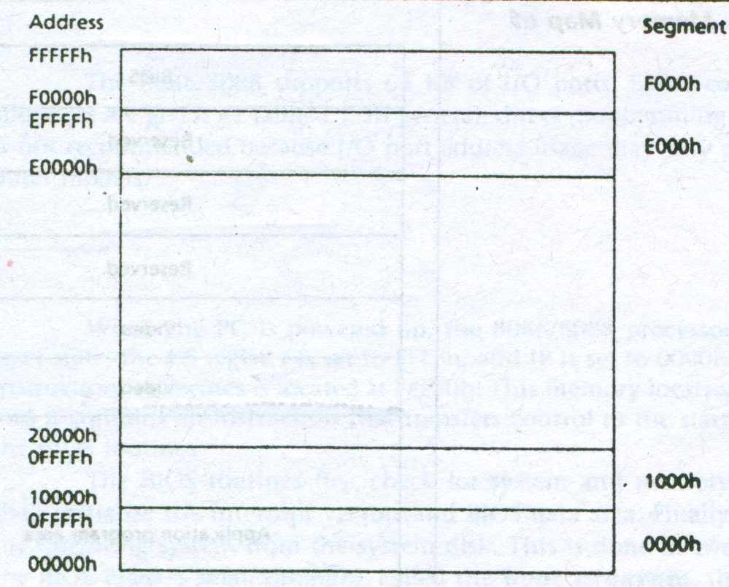

Slide 35
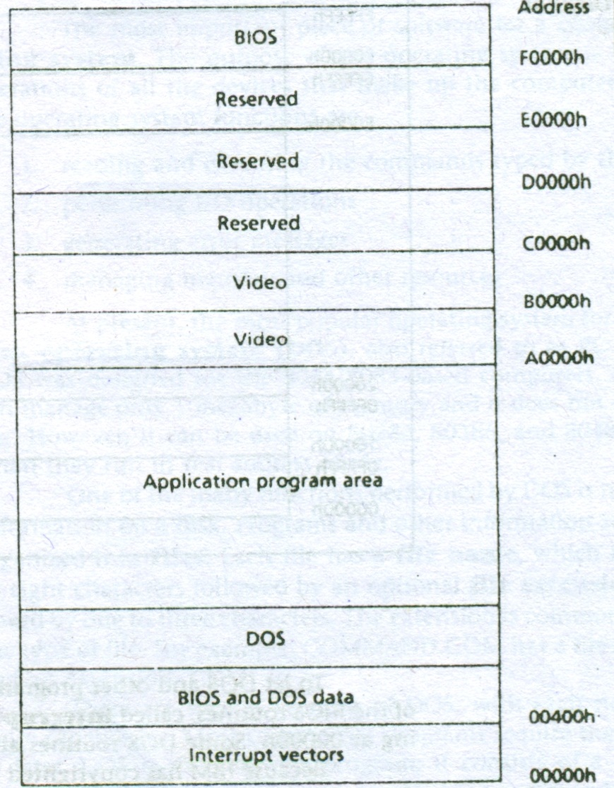

Slide 36
I/O ports addresses
The 8086/8088 supports· 64 KB of I/0 ports
Interrupt controller (20h-21h)
Keyboard controller (60h-63h)
etc...

Slide 37


