Slide 1
Chapter 4
Introduction to IBM PC Assembly Languages

Slide 2
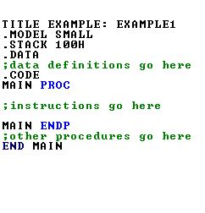
Program Title (Optional)

Slide 3
Details in 4.7.1 (Table 4.4)
SMALL-> code in one segment data in one segment MEDIUM ->code in more than one
data in one
COMPACT-> code in one
data in more than one
Similarly LARGE and HUGE

Slide 4
Details in 4.7.3 .STACK size_of_the_stack if not specified, then the default size is 1KB

Slide 5
Details in 4.7.2
Data Segment
Variable and Constant declarations are done here

Slide 6
Details in 4.7.4
Inside a code segment, Instructions are organized as procedures.

Slide 7
Details in 4.7.4
The program instructions are packed inside procedures.
The definition of a single procedure is name PROC ; body of the procedure name ENDP
Here it is an example of main procedure

Slide 8
Details in 4.7.4
Other procedure declarations are done here

Slide 9
Details in 4.7.4
Write this at the end of all procedures (that means at the end of the code segment)

Slide 10
Assembly Language Syntax
Assembly language code is generally not case sensitive
Program consists of statements, one per line.
Each statement is of two type
Type1: instruction
name operation operand(s) comment
An Example:
START: MOV CX,5 ;initialize counter
Type2: Assembler directive
An Example:
MAIN PROC
Details are in 4.1
4.1.1 to 4.1.4

Slide 11
Let’s now give focus on it !!

Slide 12
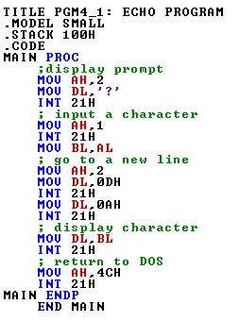
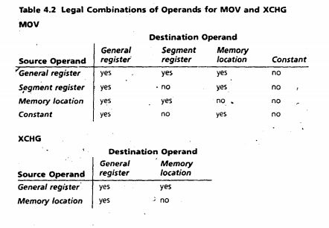
A sample instruction The format of MOV instruction is MOV destination, source
XCHG instruction is also like MOV
Details of MOV and XCHG are in 4.5.1

Slide 13
There are other instructions like ADD, SUB, INC, DEC and NEG
Details are in 4.5.2 and 4.5.3

Slide 14


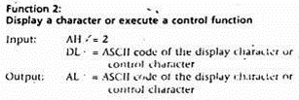
INT 21H
Details are in 4.8 and 4.8.1

Slide 15
Time to run our first program on our own!!

Slide 16
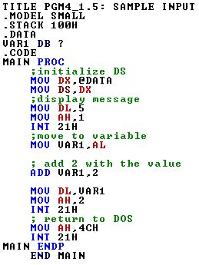
The format of variable declaration
variable_name DB initial_value
variable_name DW initial_value
See the table 4.1 for more
Example:
var1 DB 4
var2 DW ‘A’
If we want keep the variable uninitialized then we use a question mark (?)
var1 DB ?
For Details see Section 4.2 and 4.3

Slide 17
DS must be initialized to use the data segment
For Details Section 4.11(Page 74)

Slide 18
Time for the second one

Slide 19
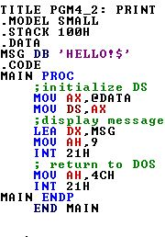
Working with Array:
MSG DB ‘HELLO!$’
If the address of variable MSG is 100h then
Symbol Address Contents
MSG 100h 48h
MSG+1 101h 45h
MSG+2 102h 4Ch
MSG+3 103h 4Ch
MSG+4 104h 4Fh
MSG+5 105h 24h
The dollar character($) is used to indicate the end of a string
The alternate representation of
MSG DB ‘HELLO!$’
is
MSG DB 48h, 45h, 4Ch, 4Ch, 4Fh, 24h
For details see Section 4.3.3

Slide 20
Displaying a String
INT 21h, Function 9:
Display a String
Input: DX = offset address of string.
The string must end with a ‘$’ character.
To load the offset address into DX we need to use
LEA(Load Effective address)
For details see Section 4.11

Slide 21
Problem 1
Write an assembly program that will take a lower case letter and convert it to an upper case letter

Slide 22
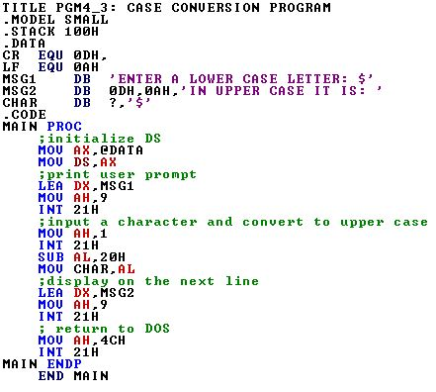

Slide 24
Problem 2
Write an assembly program that will take two small digits (one is less than 5 and another is less than 6), add these and display the output.

Slide 25
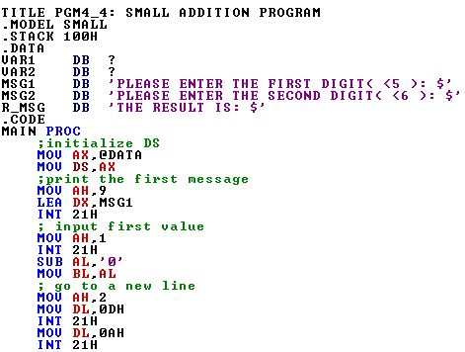
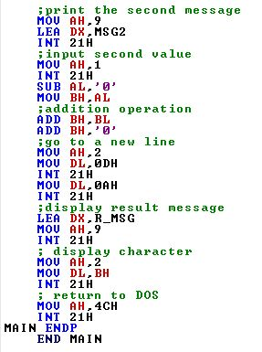

Slide 26
Chapter 5
The Processor Status and the FLAGS Register

Slide 27

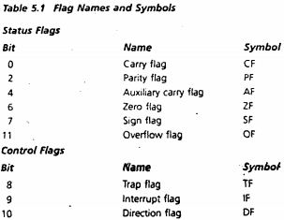
The FLAGS Register

Slide 28
Overflow
Example of only unsigned overflow
IF AX=FFFFh and BX=0001h
ADD AX,BX
1111 1111 1111 1111
+ 0000 0000 0000 0001
------------------------------------------
10000 0000 0000 0000
AX
BX
AX

Slide 29
Overflow
Example of only signed overflow
IF AX=7FFFh and BX=7FFFh
ADD AX,BX
0111 1111 1111 1111
+ 0111 1111 1111 1111
------------------------------------------
1111 1111 1111 1110
AX
BX
AX

Slide 30
Overflow
Example of both signed and unsigned overflow
IF AX=8000h and BX=8000h
ADD AX,BX
1000 0000 0000 0000
+ 1000 0000 0000 0000
------------------------------------------
10000 0000 0000 0000
AX
BX
AX

Slide 31
Unsigned Overflow
Causes Carry Flag to become 1
When occurs?
If the result of addition is more than the limit
If a big number is subtracted from a small number

Slide 32
Signed Overflow
Causes Overflow flag(OF) to become 1
When occurs?
The result of addition has two different signs
The result of subtraction has two different signs

Slide 33
How Instructions Affect the Flags
Instructions | Affects Flags
MOV/XCHG | none
ADD/SUB | all
INC/DEC | all except CF
NEG | All(CF=1 unless result is 0, OF=1 if word operand is 8000h Or byte operand is 80h)

Slide 34
Go through 5.1 to 5.3 for all the details of chapter 5

Slide 35


