Slide 1
First Person Shooting Game
1505097-Abdur rouf
1505098-Shabuj sarker
1505120-Aditya chakma

Slide 2
Contents
* ER Diagram
* Class Diagram

Slide 3
ER Diagram

Slide 4
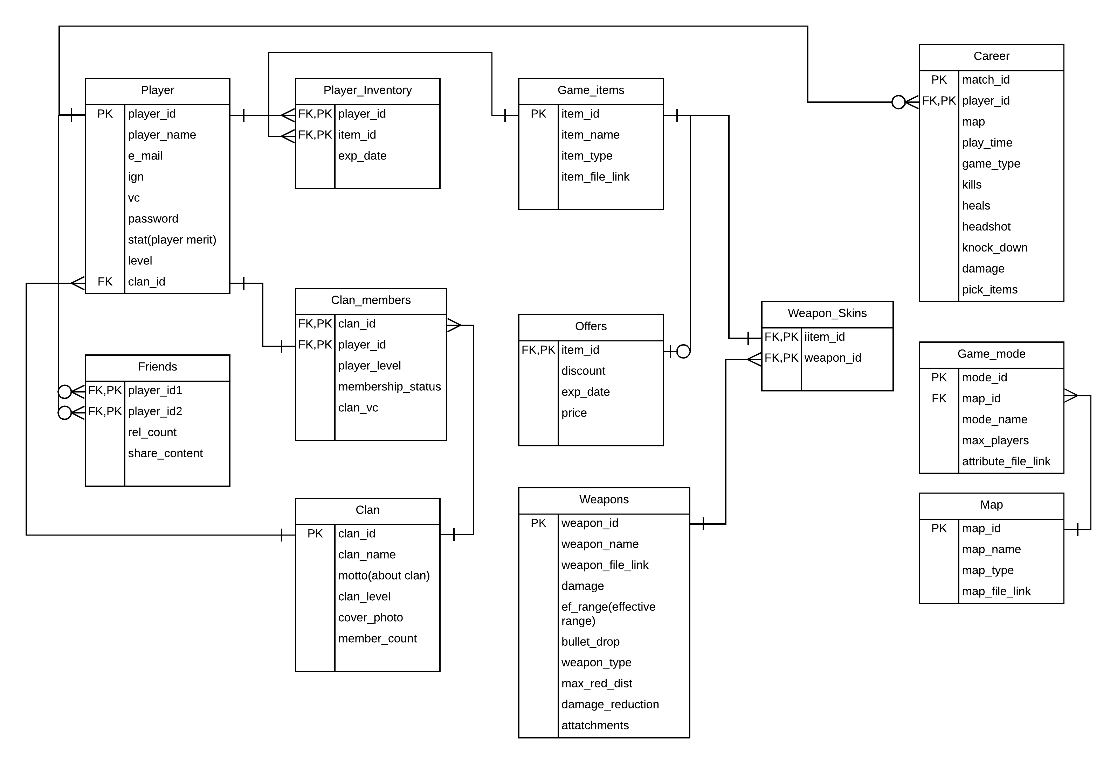

Slide 5
Class Diagram
We actually have two sub systems
1. Market Place
2. Game Controller

Slide 6
1.Market Place

Slide 7
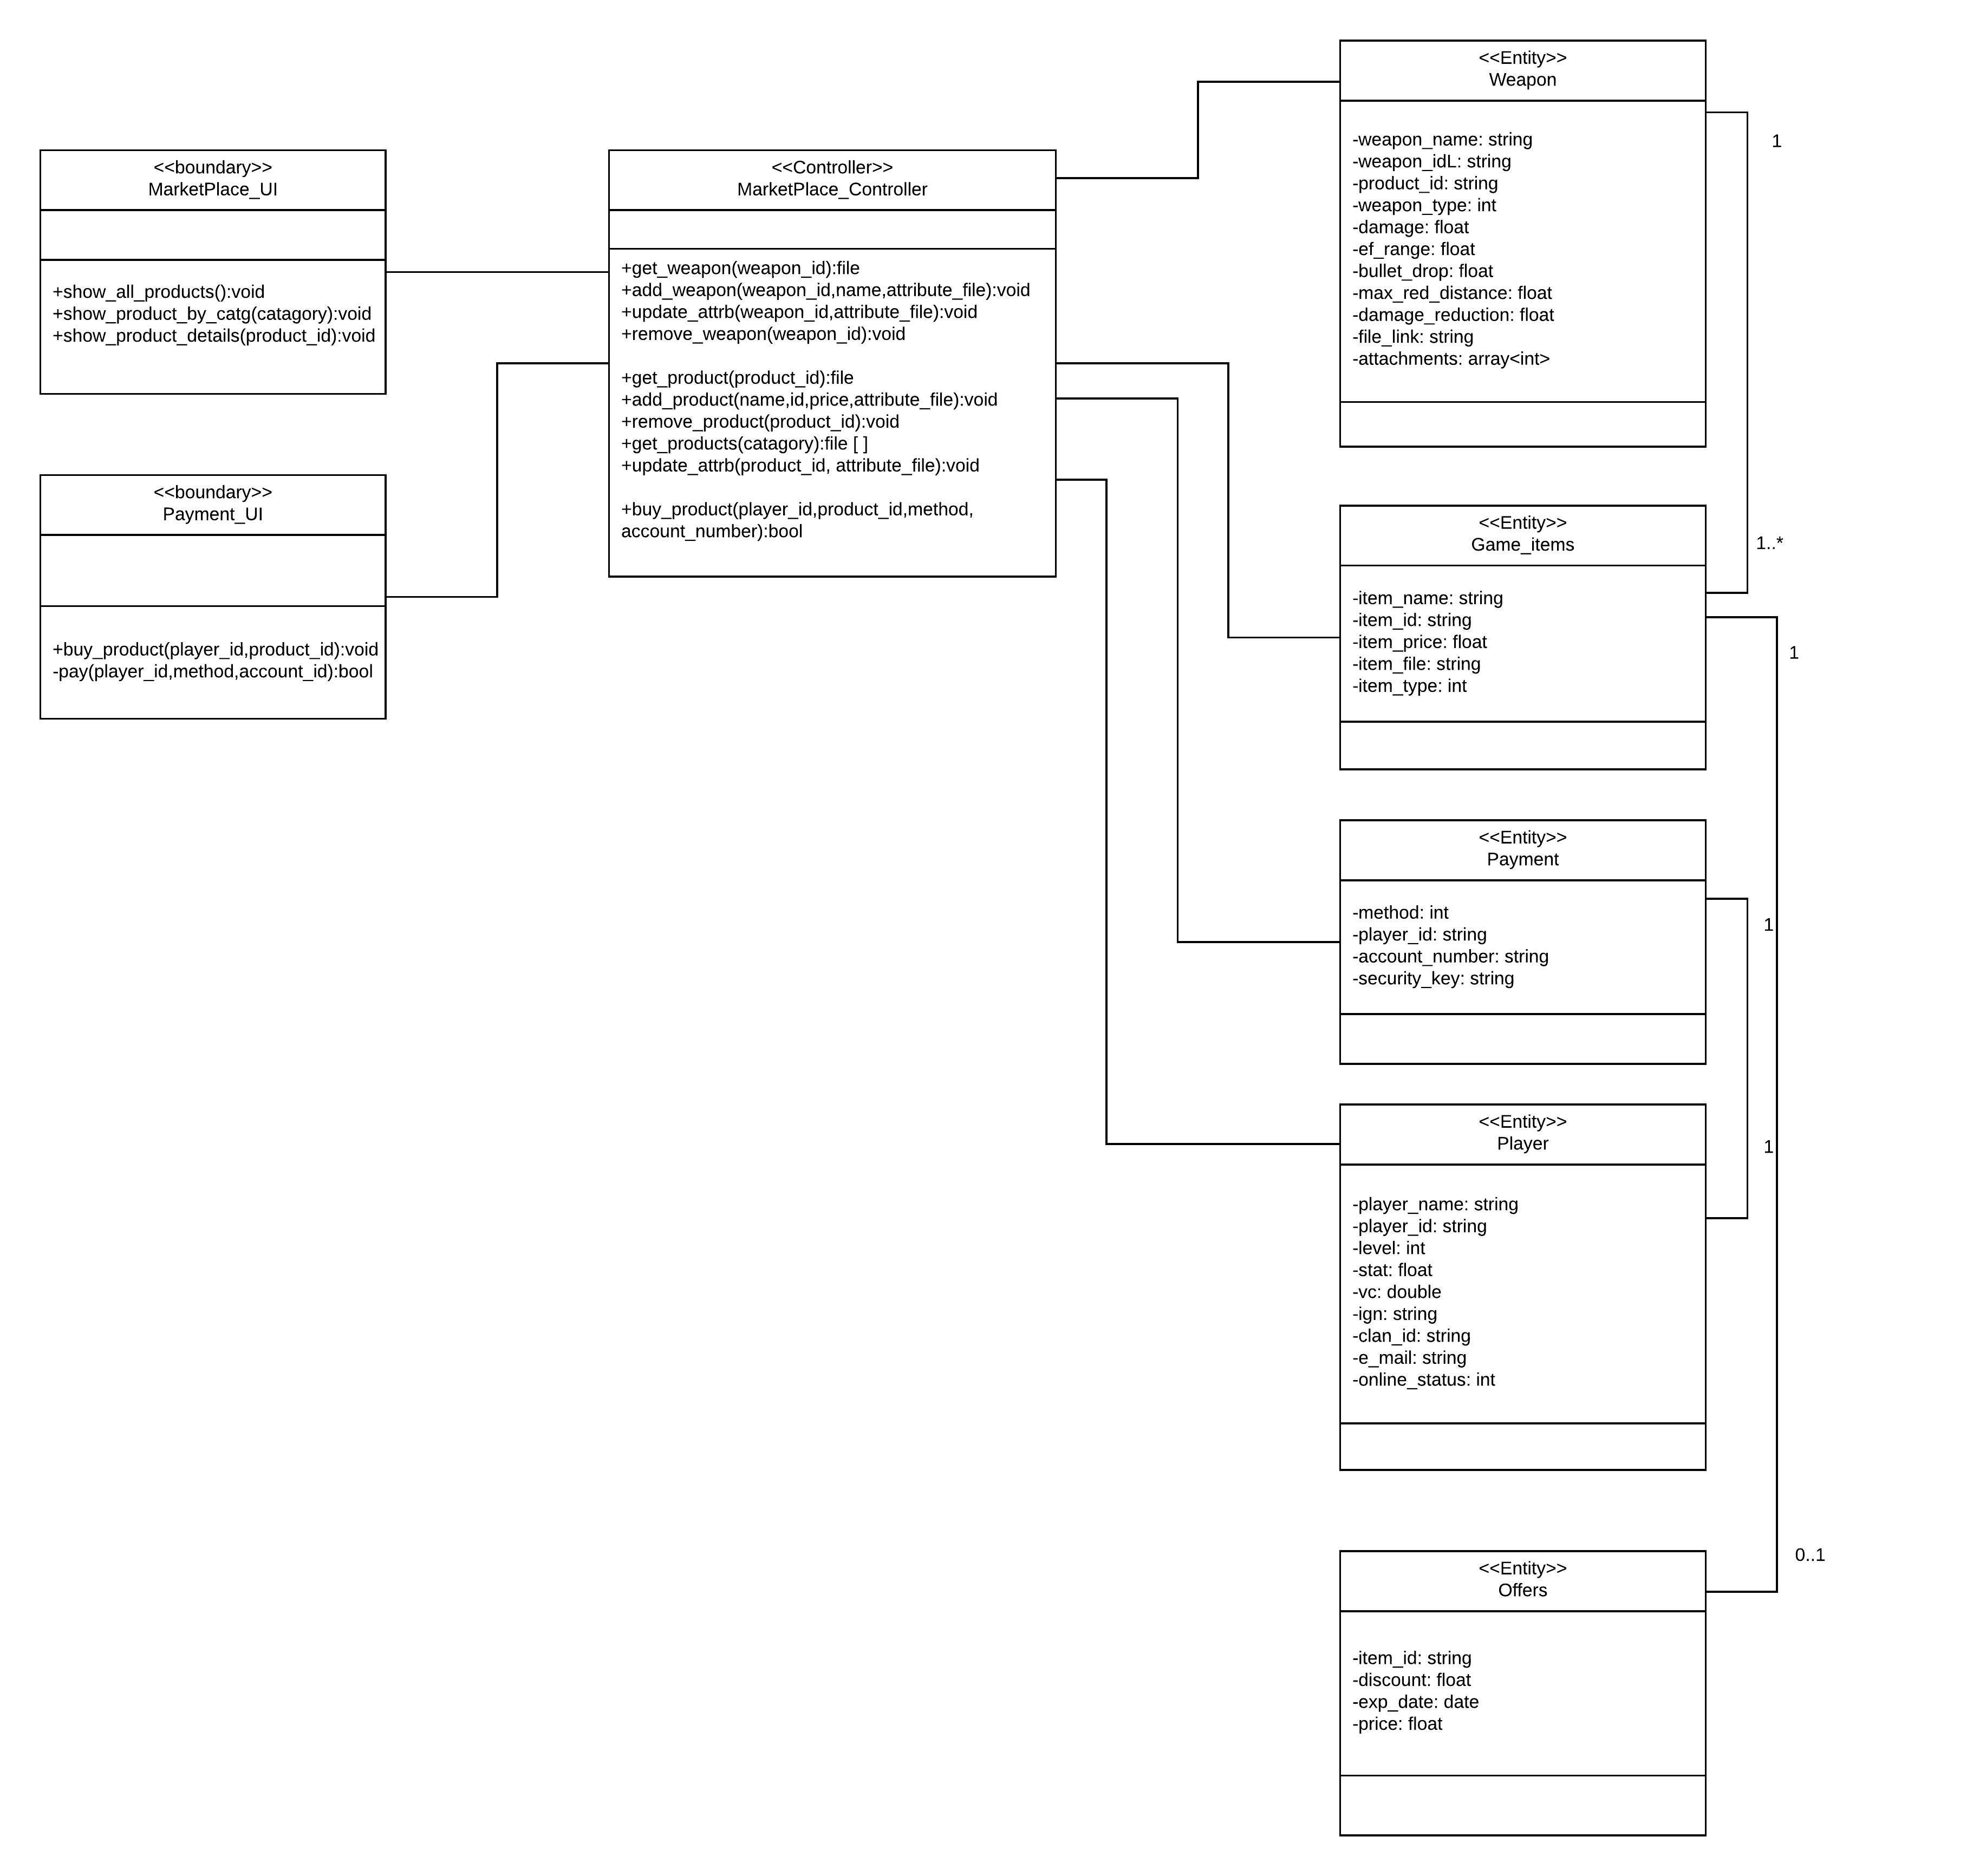

Slide 8
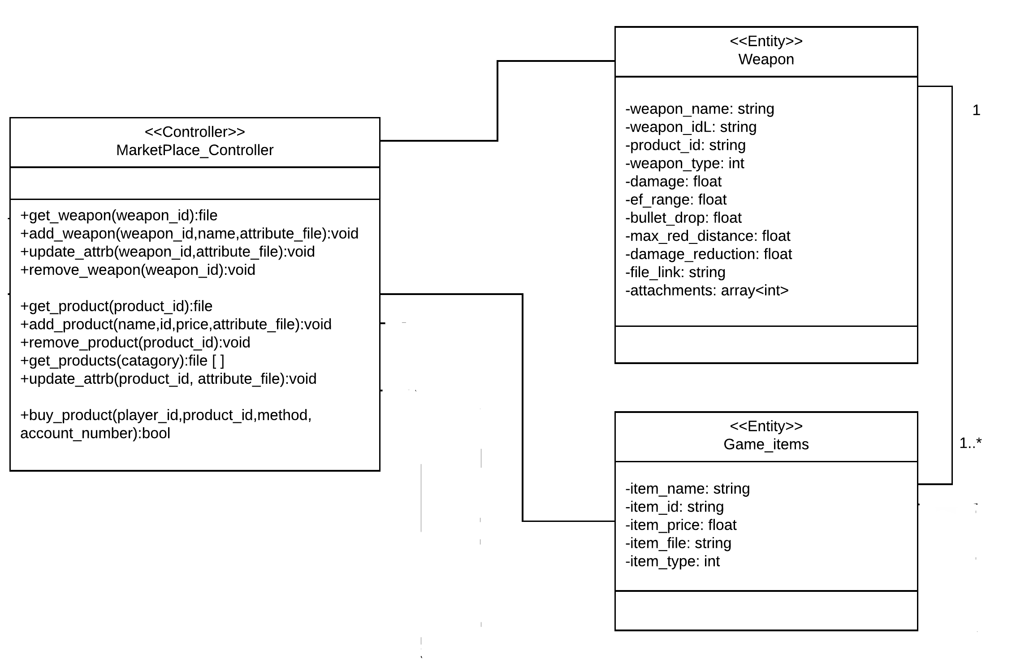

Slide 9
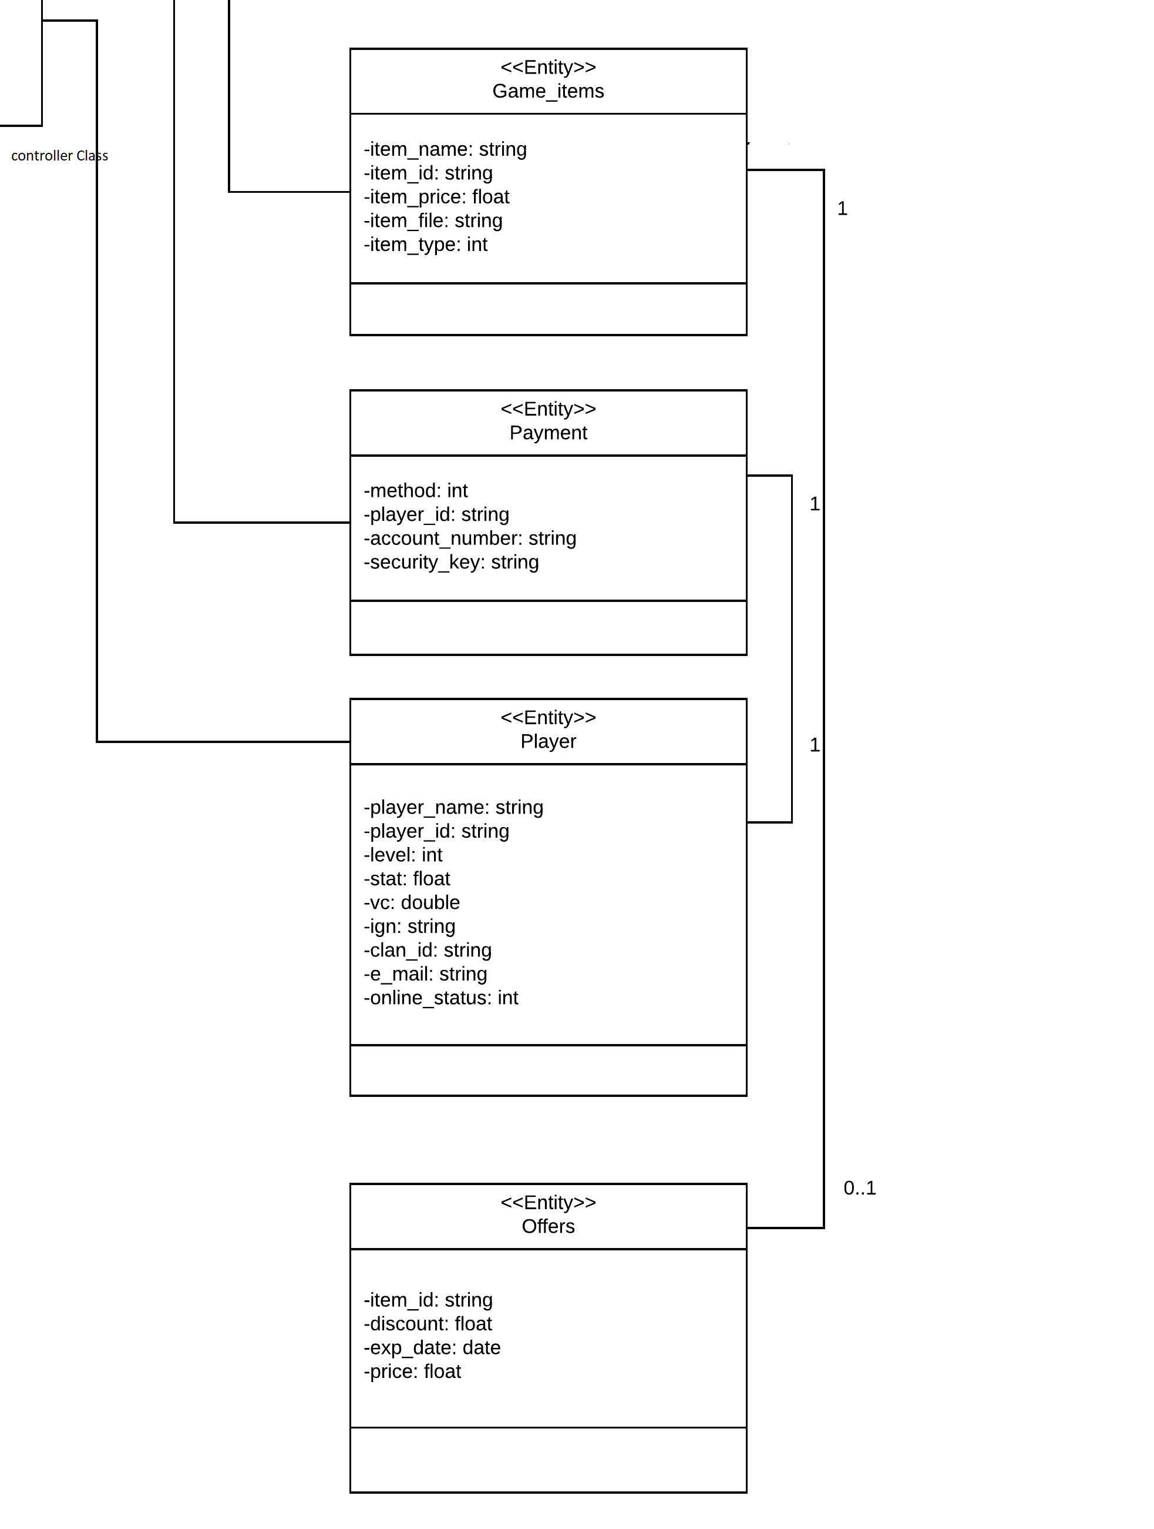

Slide 10
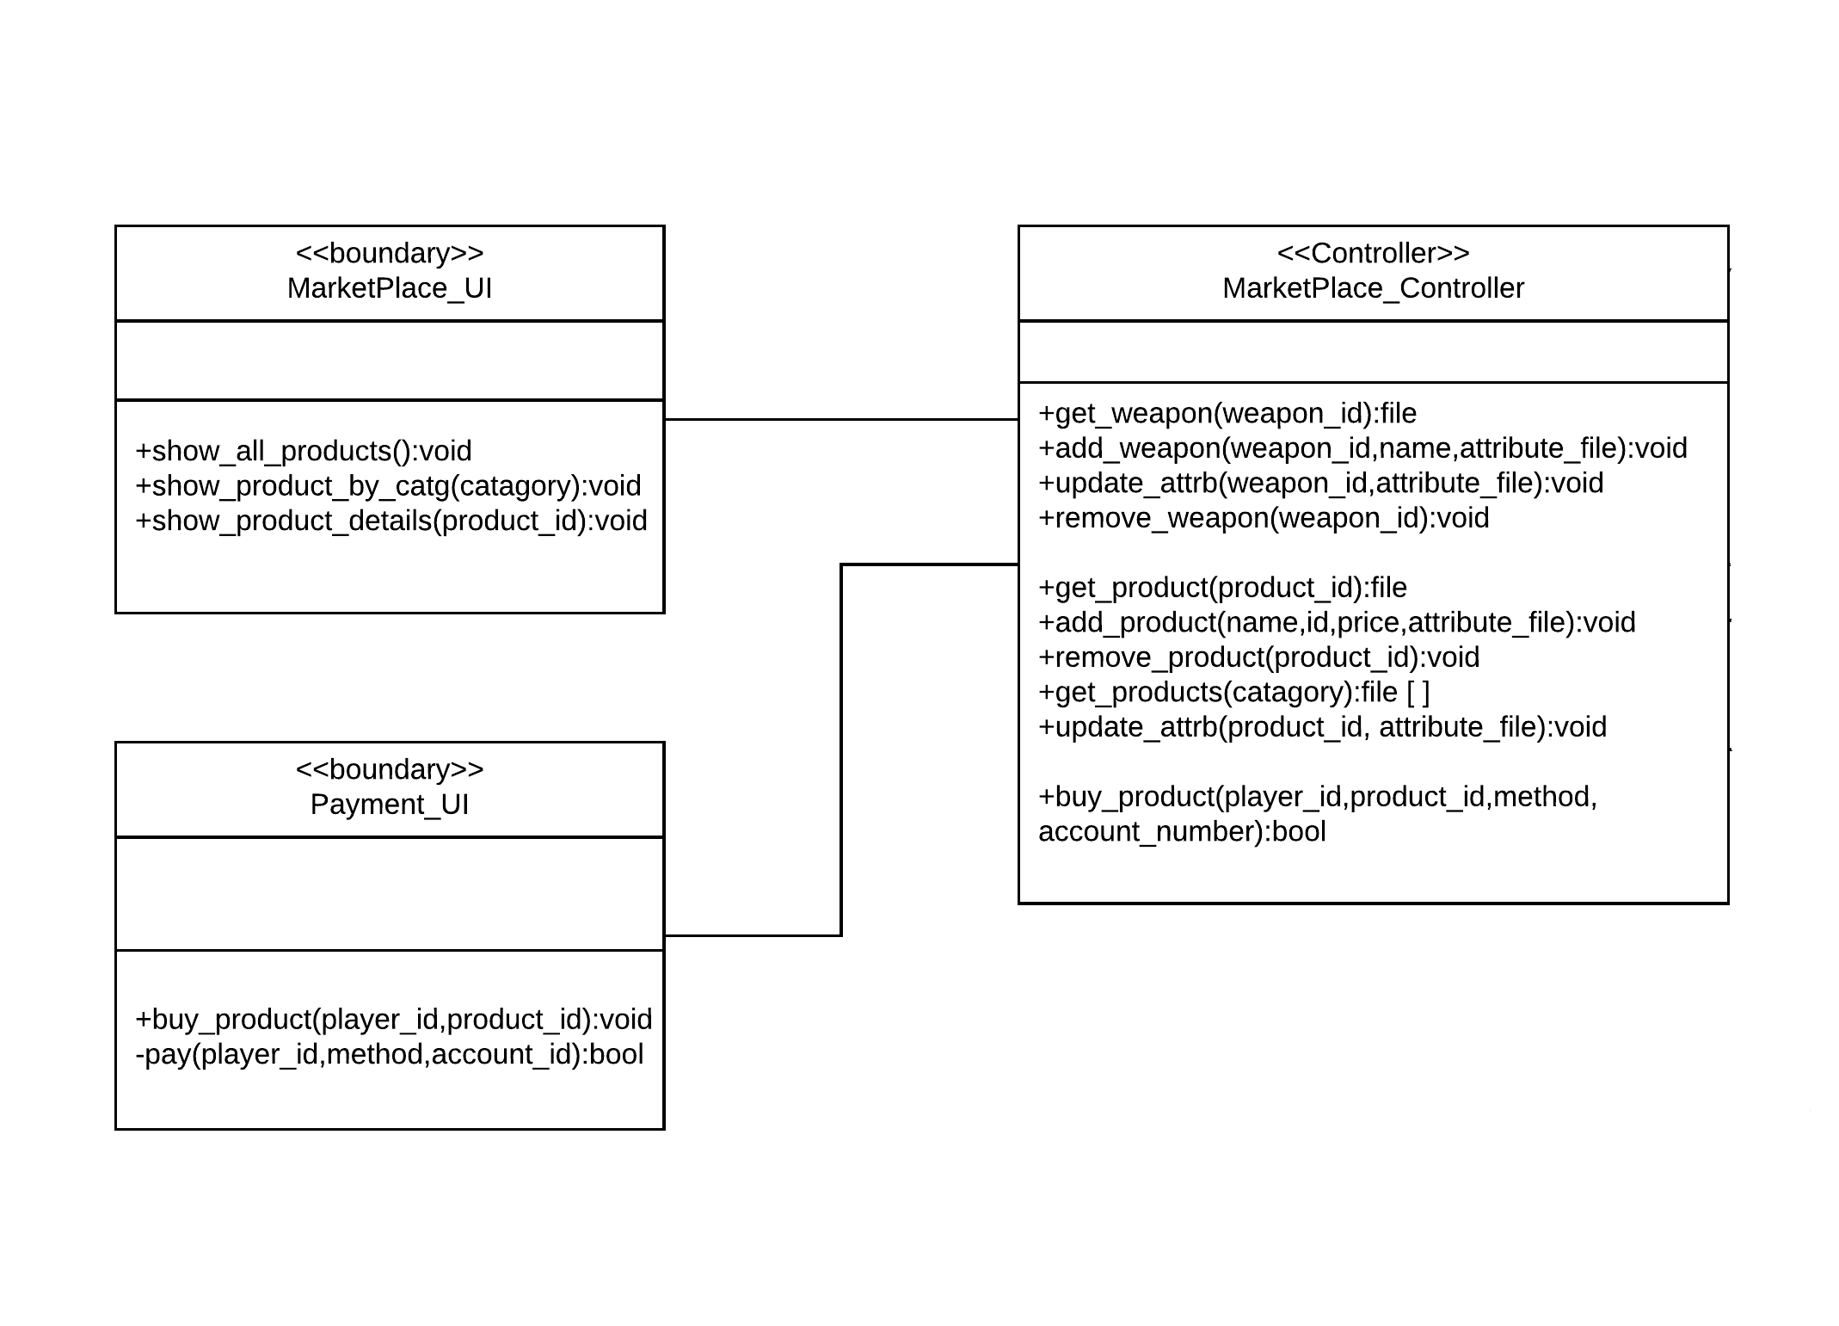

Slide 11
2.Game Controller

Slide 12
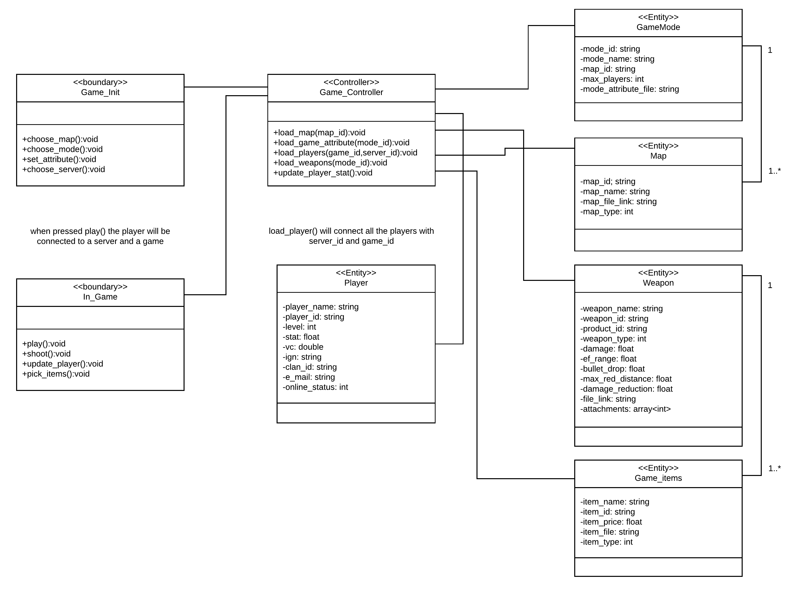

Slide 13
Thank You ☺

