Slide 1

FPS Game Using Unreal Engine 4
Aditya Chakma: 1505120 Abdur Rouf: 1505097 Shabuj Sarkar: 1505098

Slide 2
Objectives
Making a First Person shooting Game for Professional Competitive Gamers.
Creating a better Community. Like, JackFrag’s community for Battlefield Game.
Catching up with Next gen. VR [Virtual Reality] world.

Slide 3
Short coming
Player may use Cheat/Hack
Connection lost, during playing mp
Game might be cracked
Game lag due to client machine’s performance

Slide 4
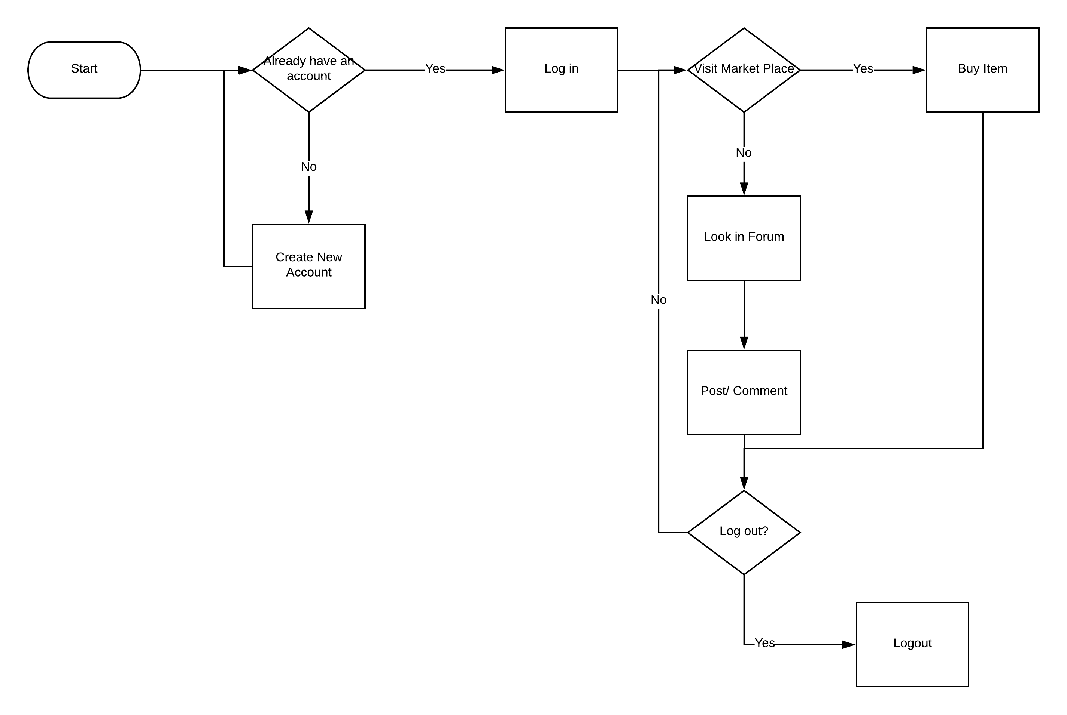
Flow chart

Slide 5
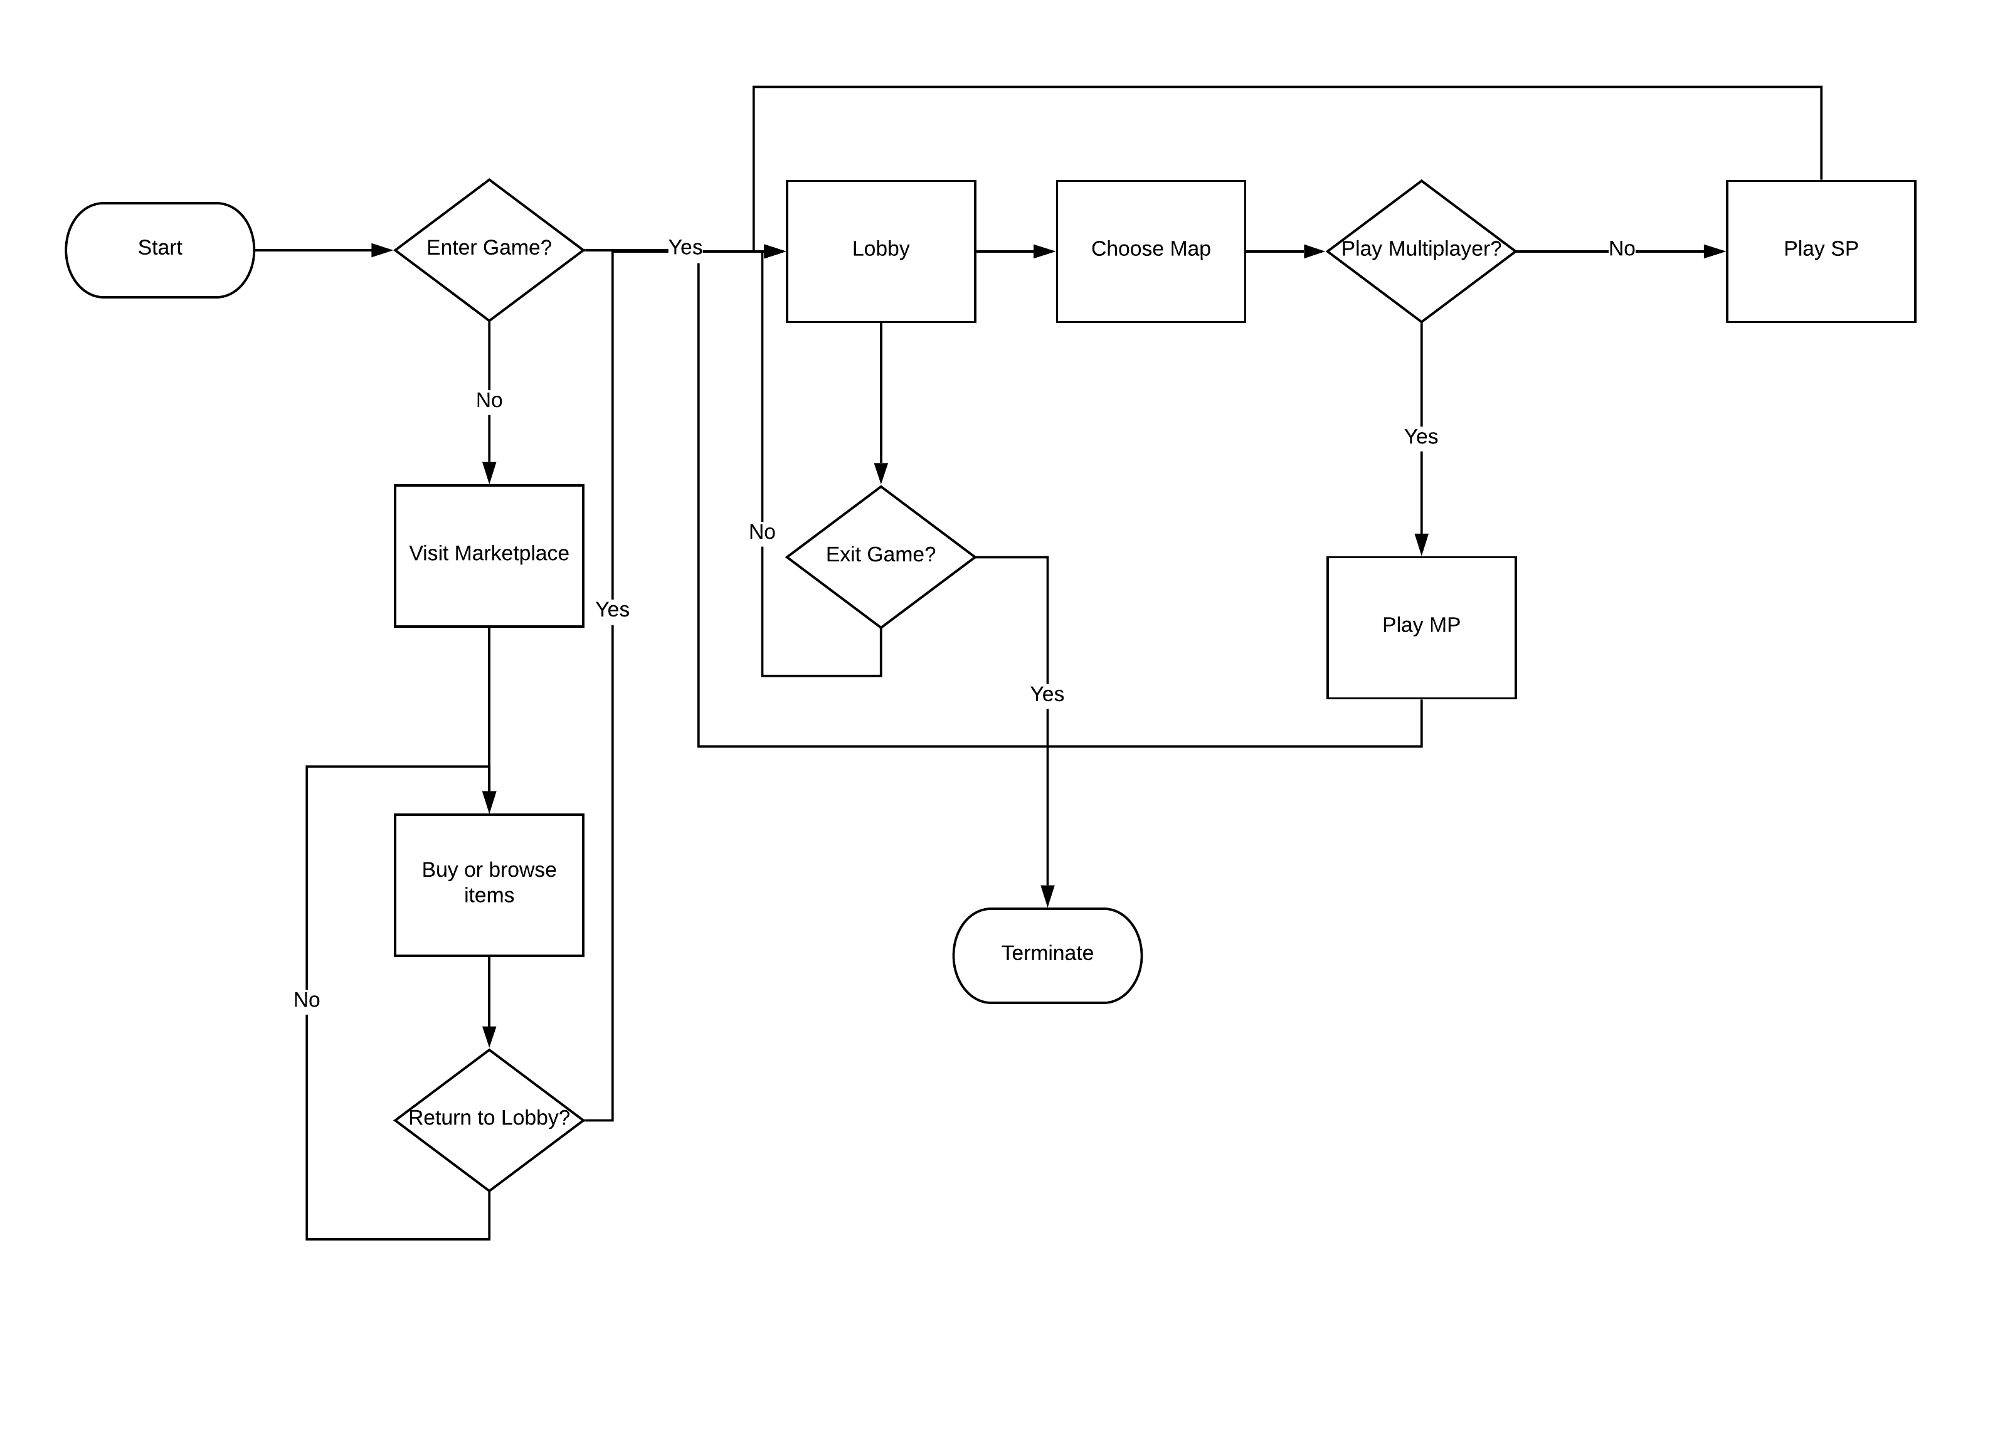

Slide 6
Requirement description
Signup and Login System for Community.
Posting In Community Blog.
Discussing upcoming features of the game.
Reporting Bugs.
Sharing Ranking System/Score among the community.
Buying components/DLC’s from game marketplace.
Managing tournament for MP’s

Slide 7
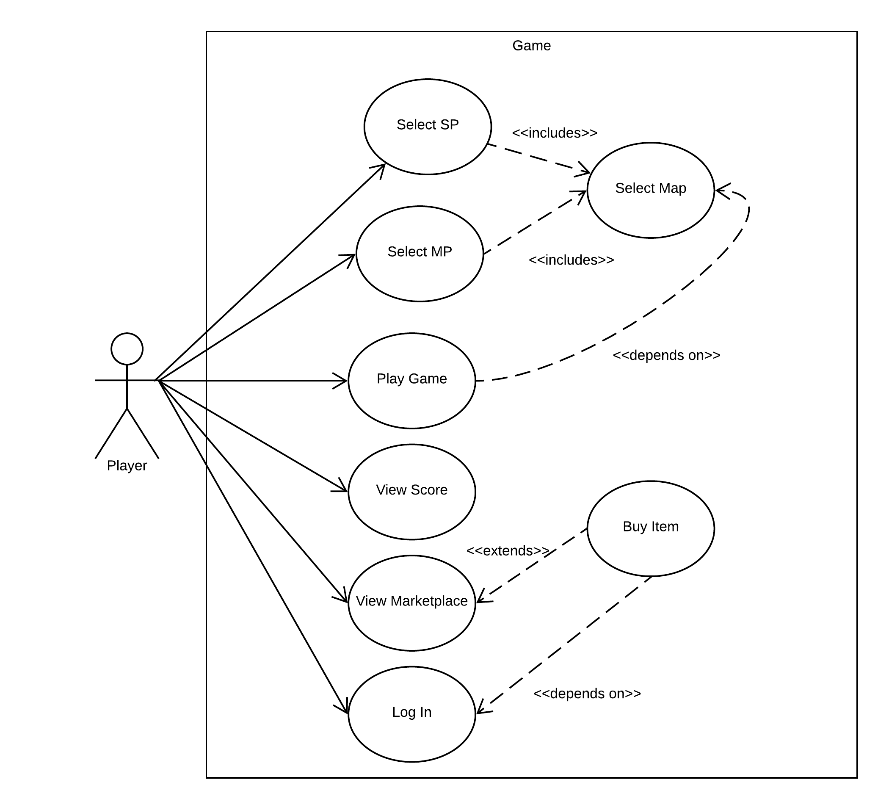

Slide 8
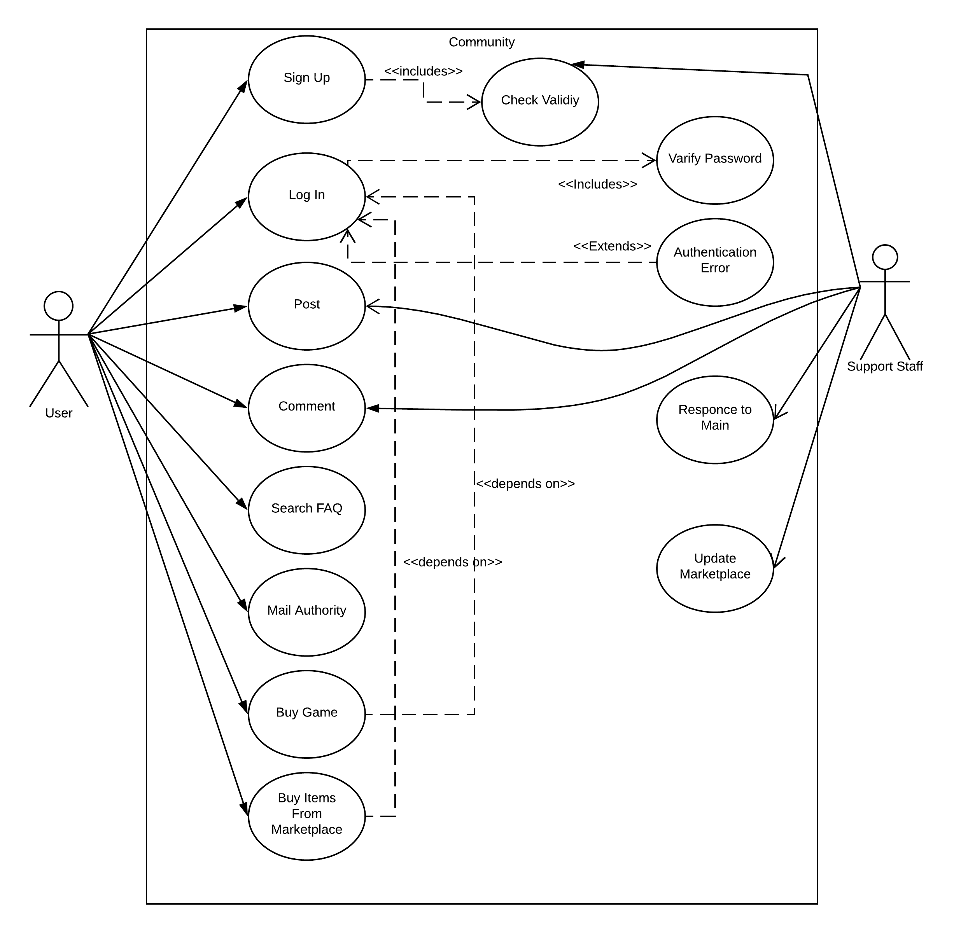

Slide 9
Thank You

