Slide 1
Battle of Neighborhoods in Los Angeles
Applied Data Science Capstone Project by IBM via Coursera
Aimaiti Rehemanjiang

Slide 2

Outlines
The Business Problem
Data Loading and Preparation
Methodology
Data Analysis
Result and Discussion
Conclusion

Slide 3
The Business Problem
Let us imagine that one of the largest coffee shops in Europe MeinCoffee is planning to expand its business to North Ameria. They are planning to open their very first five Coffee Shops in Los Angeles, California, USA. Since there are lots of coffee shops in Los Angeles, the stakeholders must have some reliable information about the best or optimal locations / neighbourhoods. Here optimal neibourhood might be neighborhood or neiborhoods with less or no number of existing coffee shops in certain near area e.g. 3 km range. The data science team must be able to deliever a fast report about the necessray location information, then the stakeholder can make safer decision that in which neighbourhoods are more suitable to open their new coffee shops.

Slide 4
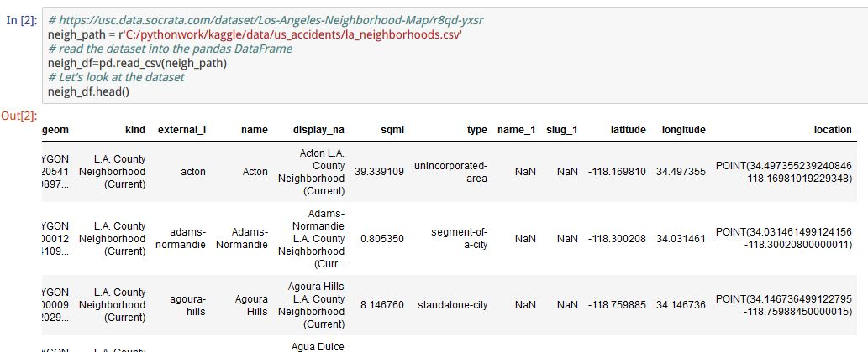
Data Loading and Preparation
Using data from online source

Slide 5
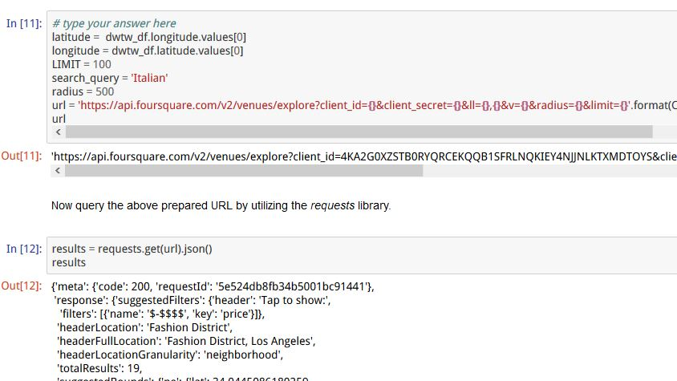
Data Loading and Preparation(cont.)
Using data via Foursquare API

Slide 6
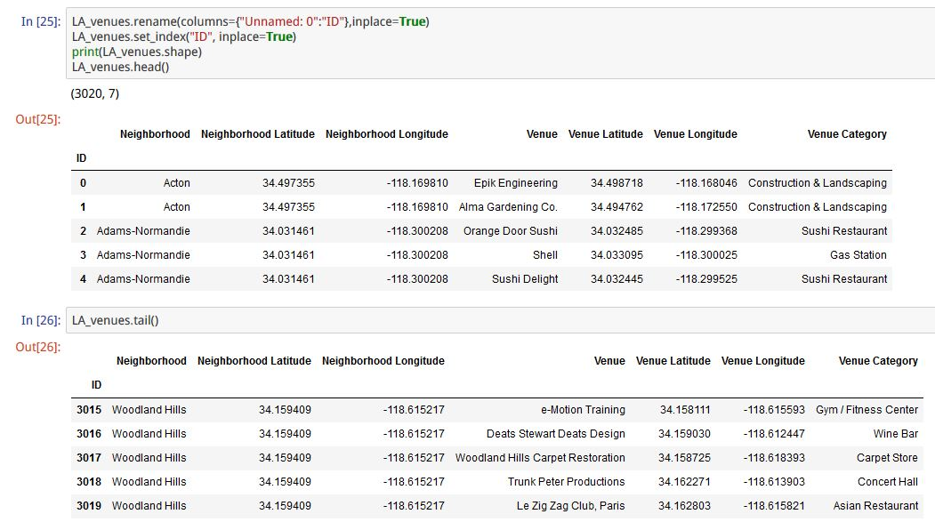
Data Loading and Preparation(cont.)
Analyse friendly prepared dataset

Slide 7
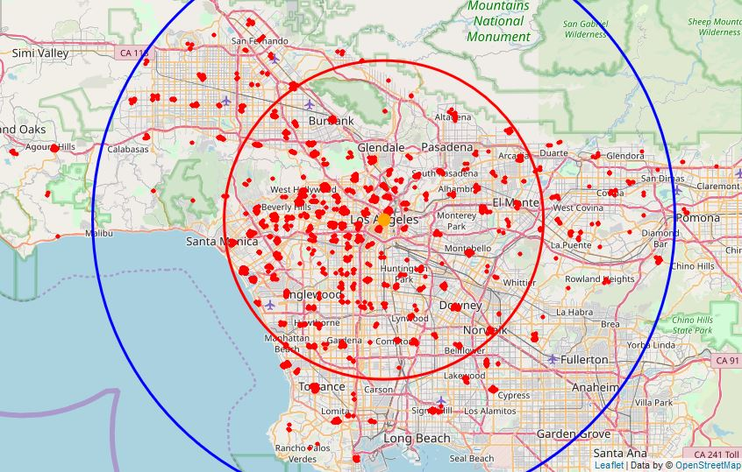
Data Loading and Preparation(cont.)
Overview of Los Angeles venues on map
Red circle shows the 23 km distance range
Blue circle shows the 42 km distance range

Slide 8
Methodology
Foucus my analysis on locations within the range of 42 km from the center of Los Angeles
Find out all venues of coffee shops from the prepared dataset in previous step.
Filter out those venues such that there are at least one coffee shop in 2 km range (by assuming that most residents have their own cars and feel the 2 km is not too far in such a large city like Los Angeles)
According to previous result, find out those neighborhoods and venues without any coffee shops within 2 km distance.
Classify these venues into reasonable number of clusters and show corresponding cluster centers.
Show how far these locations, namely these cluster centers

Slide 9
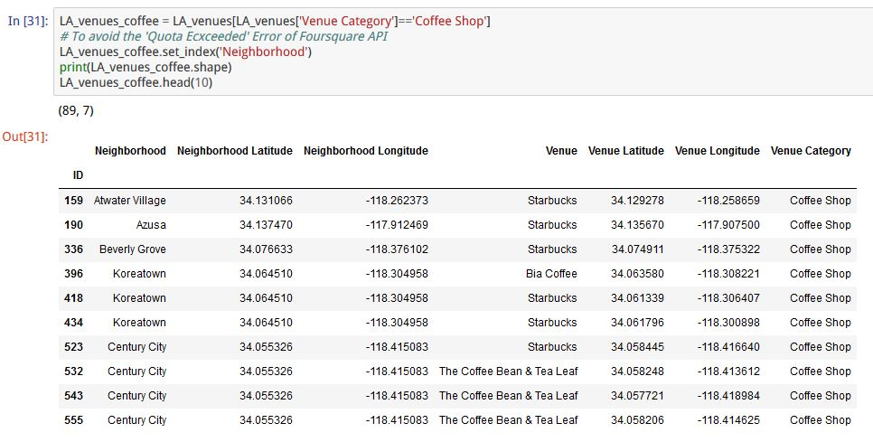
Data Analysis
Coffee Shops

Slide 10
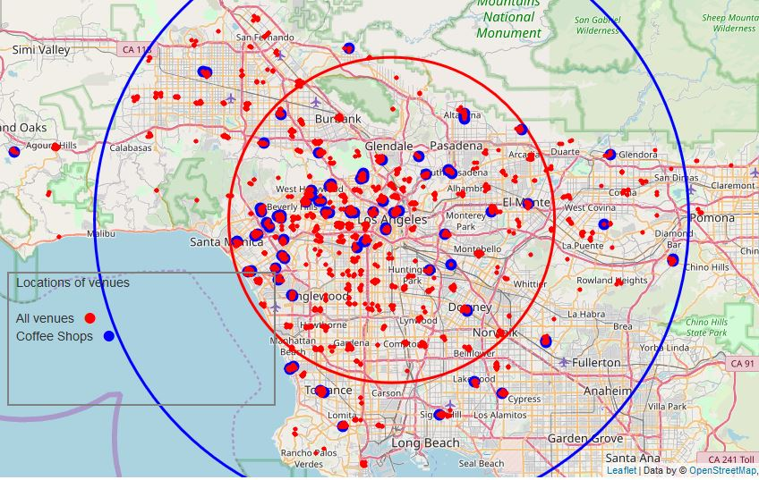
Data Analysis(cont.)
Coffee Shops on map

Slide 11
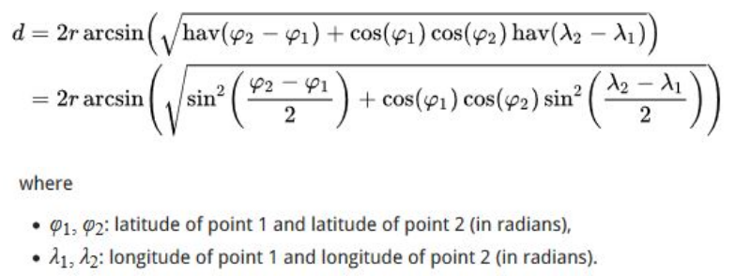
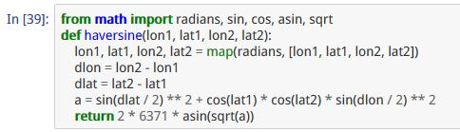
Data Analysis(cont.)
Distance between two geolocations

Slide 12
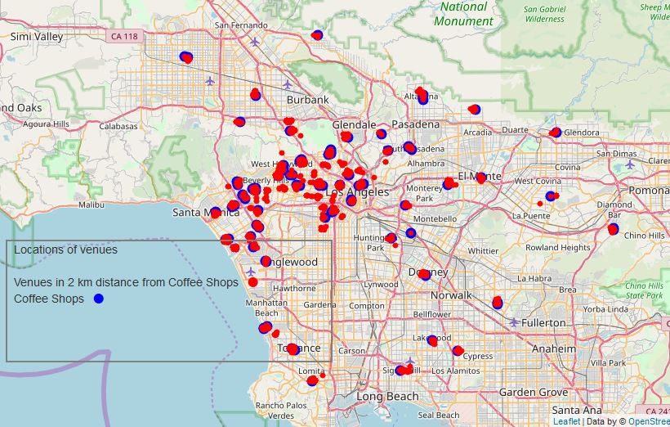
Data Analysis(cont.)
Venues nearby Coffee Shops in 2 km range

Slide 13
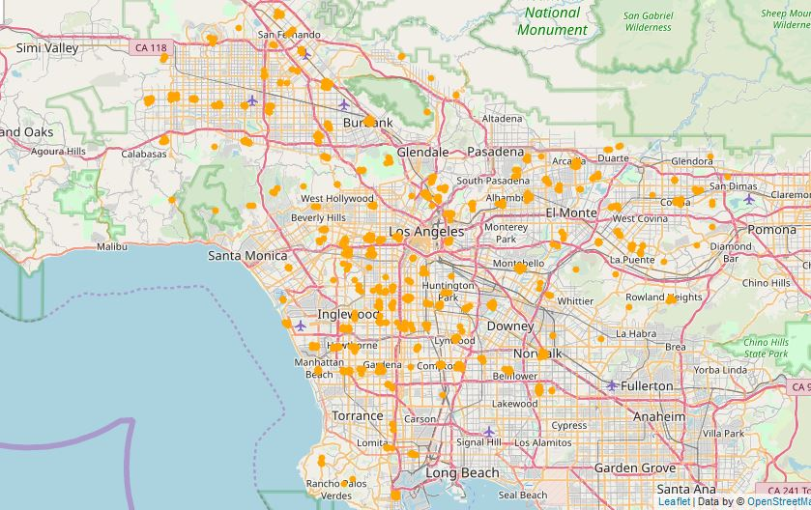
Data Analysis(cont.)
Venues without Coffee Shops in 2 km range

Slide 14
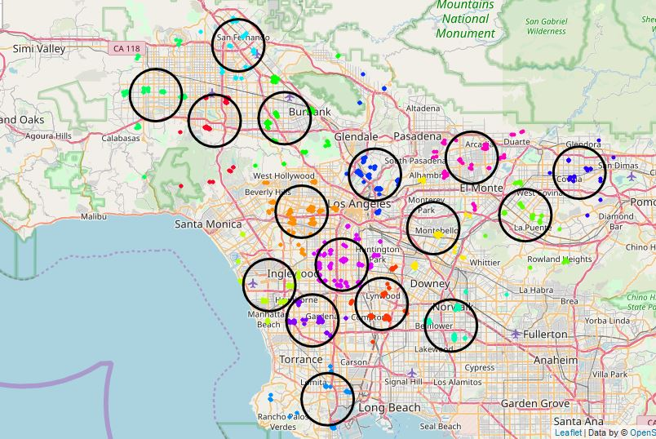
Result and Discussion
Clustering of Venues without Coffee Shops in 2 km range

Slide 15
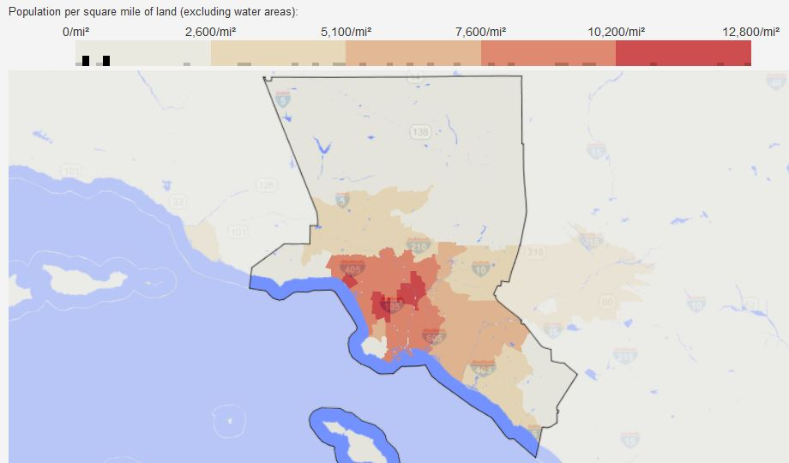
Result and Discussion
Consider population density of Los Angeles

Slide 16
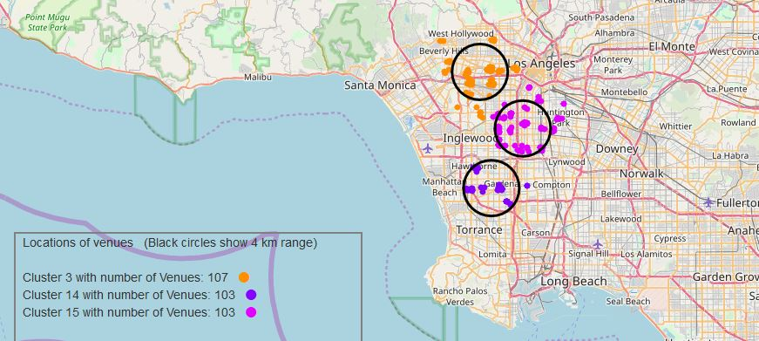
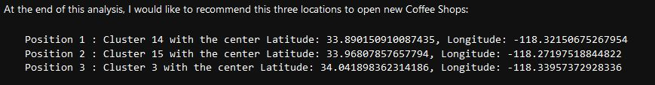
Conclusion
The most suitable three locations are

Slide 17
Thank you IBM!
Thank you Coursera!

