Slide 1

CST2550 Coursework 1
Library Management System
By Abdurahmon Kamariddin M00914818

Slide 2
Project Description:
Report Overview:
This presentation will cover the Unified Modeling Language diagrams (use case, activity and class) to represent the implementation of classes and the flow of actions in the program.
We will also touch upon certain limitations of this program and how they could be rectified for future use by other libraries.
(FYI for marking, I wasn’t too sure what was required either a power-point presentation or just regular document as the updated rules were that a report was needed but the coursework handbook remained that we need a power-point discussing details so this power-point should cover both bases by showing UMLs, implementation whilst also addressing the possible limitations and oversights of my program and shedding light on certain aspects of the program..
This library management program is designed for use by the librarian to manage the members and the loaning of books. They will be able to view all the members that are registered to the library, along with all their details such as name, email and address (details that the librarian will clarify with the prospective member before entering into the program for member creation). The database of books will be parsed in for use from a .csv file, each book has a book ID, name, page count, author names and book types which will all be processed into separate book objects in our program.

Slide 3
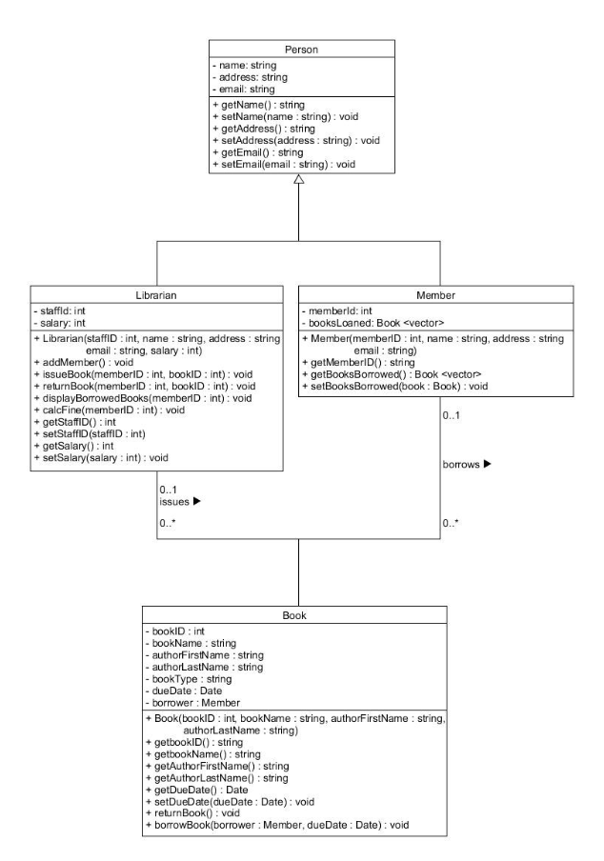
UML:
The class diagram shown on the left was used to implement the following classes and class attributes and functions. With the addition of a date class to aid in calculating fines for overdue books, the following classes were implemented according to the classes shown.
We can see here that the Person class is the superclass and the Librarian and Member, both being a ‘Person’ are sub classes of the person class with the Book class being an associated class as it is not a ‘Person’ per say but both the Librarian and Member class has access to it.
After parsing all the book information from the comma separated file, we create book objects with their corresponding book attributes and feed them into a vector (not shown in diagram) called all books.
Since in the database, book IDs are starting from 1 and onwards, we can access a specific book, if we know its book ID, through the allbooks vector (shown in video) using allbooks[bookID – 1] and we can call any appropriate book function or feed it into a function that requires a book as a parameter.

Slide 4
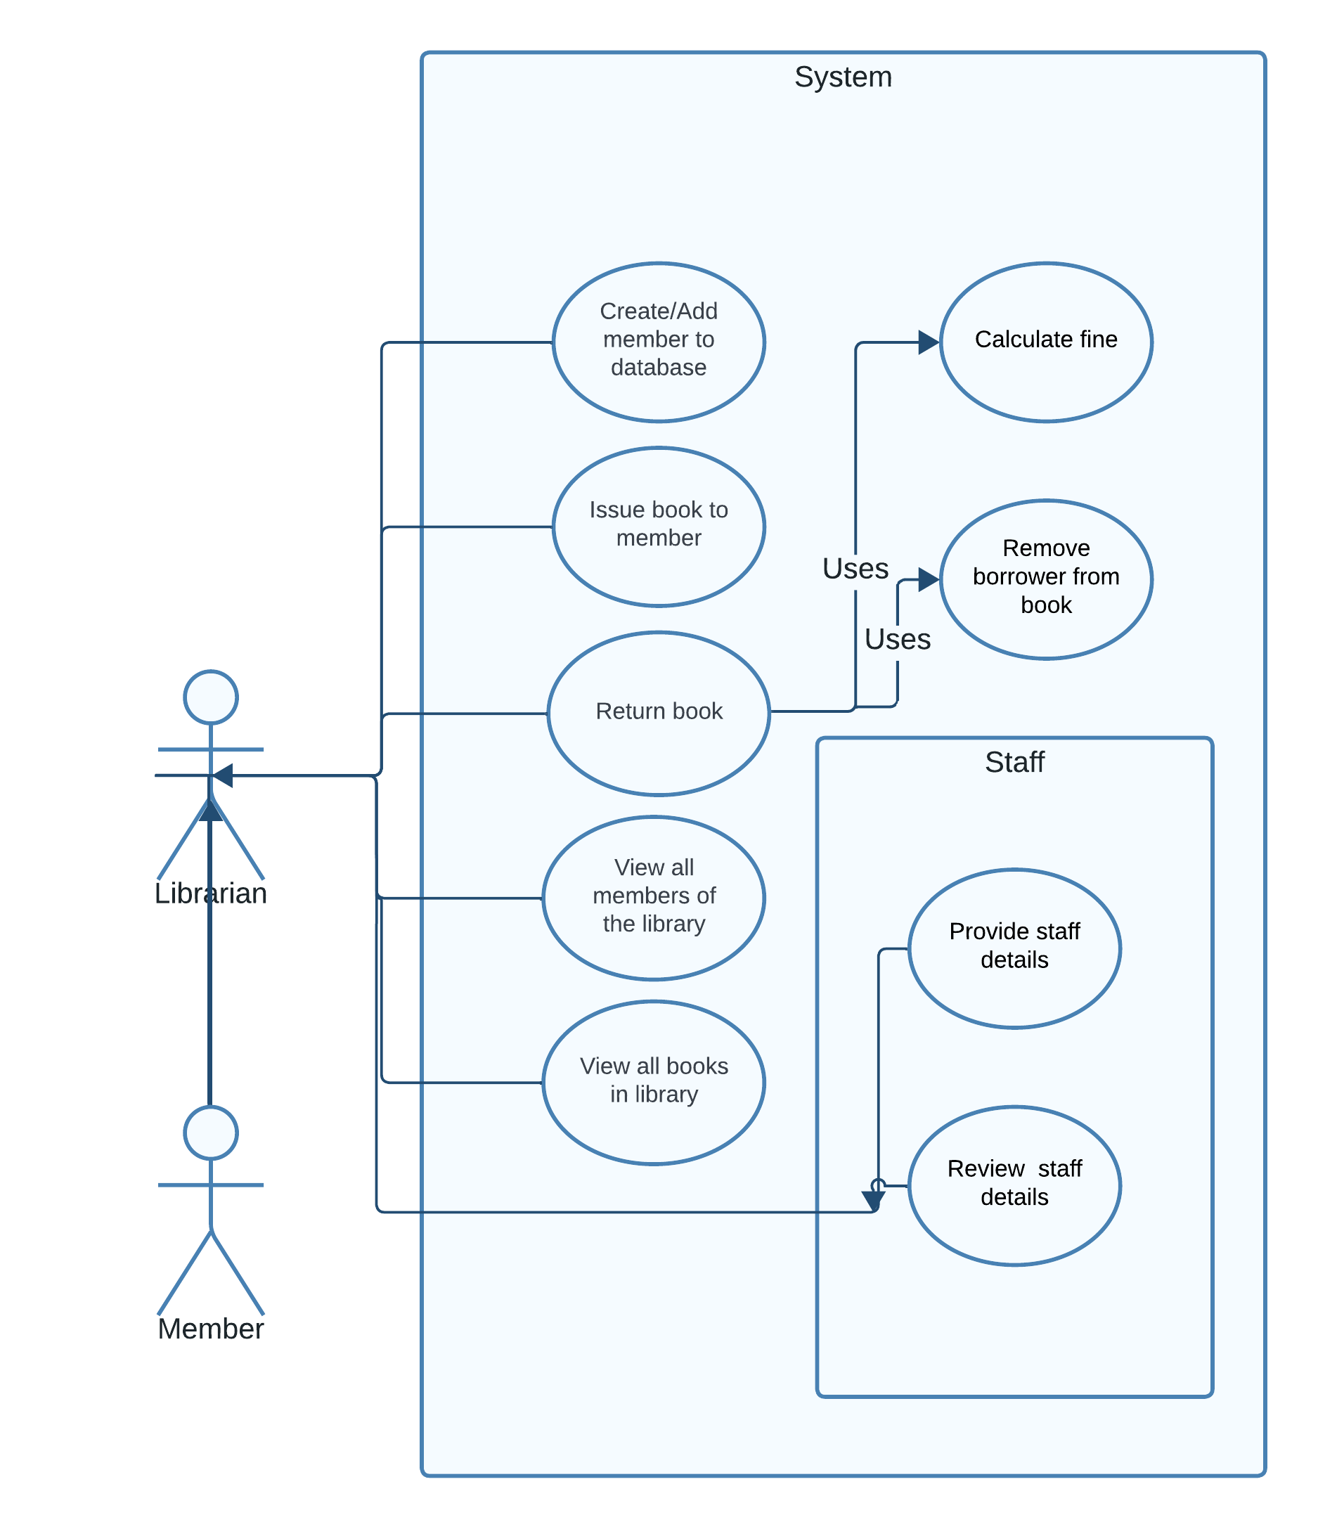
Use case diagram:
The use case diagram shown on the left, depicts each use case of the library management program. As we can see the system is purely operated by the librarian alone, with information being fed to the Librarian by the member, be it for adding a member (where before adding the member to the database, their details will be confirmed by the librarian with the prospective member in person) , loaning a book (where the member will come wanting to borrow a book , and should the book be available they will be able to borrow it for 3 days) or returning a book . This program is not designed for front of house ( meaning for use by customers or members) but for the librarian only.
All the use cases are options that will be presented to the user (our librarian) in the home page.

Slide 5
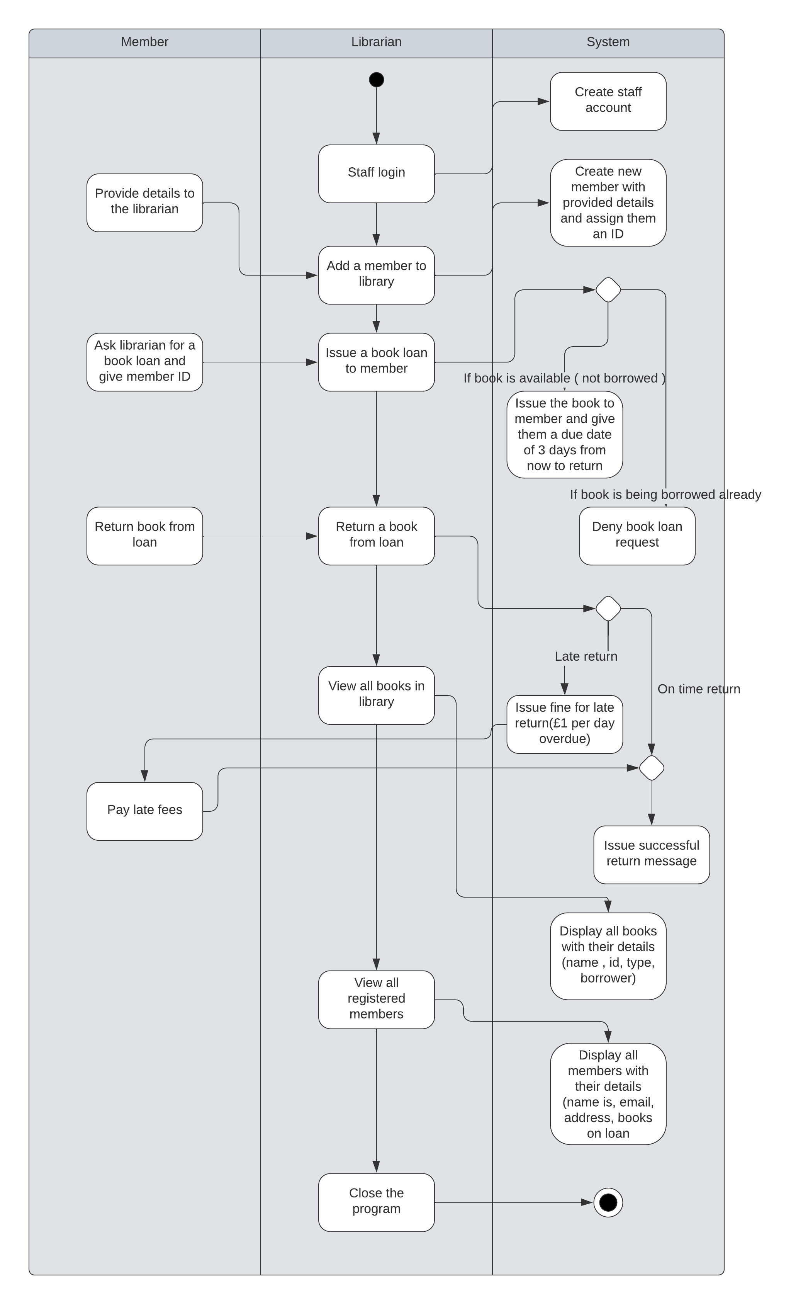
Activity diagram:
The activity diagram shown the left, shows the exact flow of actions (or activity) by the member/s , librarian and the system.
Any actions where the members action is pointing to the librarian's action, is where outside of the program itself, the member is providing the librarian with information or responding to the outcome of a system action, be it giving their personal information to add them into the member database, giving their member ID and the book ID of the book they wish to borrow or paying late fees for returning their borrowed book too late.
The system determines whether certain actions are allowed, such as when a member asks to borrow a book which is already being borrowed, the system denies the book loan request, and when the member returns their borrowed book, the system checks the due date on that book and if it is being returned past it’s due date then a fine is issued at £1 for every day the book is overdue.
There is no limit as to how much the librarian can do on the program (meaning the program only closes when the user chooses to) so the user can freely navigate through the program from the main home page.

Slide 6
Implementation:
The first steps were to implement the classes, shown previously in the class diagram, and make the getter and setter functions for each class. Once doing this it was clearer to see the order in which certain functions were to be called. For example, the returnBook() function under the Librarian class seems quite straight forward, but inside this function alone we need to modify the booksBorrowed vector of the member that is returning their book before calling another function calcFine() in which we can pass in only the member ID as a parameter. Within that function, print whether the book was returned on time or late and return an amount that is owed by the member and then restore the booksBorrowed vector removing the book that was just returned (this process of modifying the member’s booksBorrowed vector is to make sure that a fine is only calculated for the book being returned).
An important part of our library is our book database, where we have the program iterate through the directory of which our program file is in, and find a csv file (by searching for the extension .csv) and open said file (there is a limitation to this which will be discussed later), which afterwards we would parse each row into different fields which represented different attributes of the book (id, name, author name, page count and type) and create a book object with these attributes, which we push into the allbooks vector that stores all our books in our library. What seemed to be a smart idea was to make a home page where all options for the librarian were listed and that once an action was finished, we’d have the user return to the home page. This was done by putting pretty much all our function calls into a function named home(), which houses a switch case that leads the user to whichever action they wish to achieve. The order in which I coded the program (and also the way the user/librarian is urged to use the program) was to first ask for user details to make a Librarian object with the relevant details (because any functions such as issuing books and returning books requires the librarian to do), then to add members to the member database by asking for member details (name, email, address) to make a new member object to push into our allmembers vector, housing all our library members. After doing so the user can choose to add more members or to issue books to members. When issuing books, its checked that the member ID and book ID are valid and that the book that the member is trying to borrow is not already on loan ( which is checked by checking the borrower member attribute of the book object, if member ID for borrower is 0 then we know that it is not on loan, whereas if it is any number other than zero, then that would be the member ID of whoever has borrowed the book). If the member ID and book ID is valid and the book is not on loan, then we can issue the book and set its due date to be 3 days from issue (this has limitations which will be discussed also).
When returning books, to stick to the rigid class diagram and the parameters of the functions we had, I made it so that before calculating any fines (using calcFine(memberID) ) we temporarily only allow the book that’s being returned to be in the member’s booksBorrowed vector. Then after the fines are calculated (if any due to overdue return) then we restore all other books that the member could’ve had borrowed ( a clear explanation will be given in the video demonstration).
As it is impossible for the user to remember who is borrowing what and what books is held by the library, in the home page there are options to search member details by inputting a member ID which will bring up their profile and list if they’re borrowing any books, and the user can choose to list all books and book details to check specific details like author names, or book types and genres or to also see who is borrowing what book.

Slide 7
Reasons for certain implementations and potential limitations:
As mentioned before to stick to the class diagram provided, I had to work around certain functions for example, the calcFine function which only takes in a member ID as a parameter. This means that there isn’t much specific fine calculation for the book we are trying to return unless there is only one book in the member’s bookBorrowed vector at the time.
This is done by storing all the members borrowed books in a temporary vector, then adjusting the member’s booksBorrowed vector so that only the book being returned is remaining, then after the fine is calculated, we equate the booksBorrowed vector to the temporary vector then take out the book we just returned.
Regarding the books, a choice had to be made between whether to have an infinite number of books available to borrow (which wouldn’t be very realistic) or to have one of each book available to loan out, which was the choice I went with. Now seeing as we have 168 books in the current provided library of books it shouldn’t pose any problems as that is plenty of books however if we had less books and had a large number of members then we wouldn’t have an efficient borrowing and lending system as there wouldn’t be very many books available to borrow at any given time. Now one way to work against that could be to decrease the loan period from 3 days or to increase stock on books ( maybe to have 5-10 of each book ).
The method to processing the library data file (.csv file) can bring about problems and processing of incorrect information if there happens to be more than one csv file in the directory, as we are checking across the directory for the extension “.csv” and opening the first file that matches that extension. To work around this, we need to make sure only one csv data file exists at any time in the same directory as the program. Additionally, that csv file must have the same layout of the current data file where the book IDs increment from 1 upwards and each column contains the same type of information.

Slide 8
References:
UMLs created using Lucid.app (for drawing frameworks and diagrams).
Class diagram provided by Ahmed Eissa as per the specification.
End of report.
Please see directory for video explanation and demonstration.
By Abdurahmon Kamariddin M00914818.

