Slide 1
ANTARCTICA
Made by : Abdurahmon

Slide 2
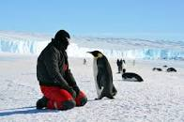
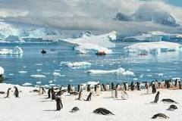
Images , daily life

Slide 3
Peoples also lives here
There a lot of pinguins and peoples lives with penguins here .

Slide 4

Flag of Antarctica

Slide 5
Area of Antarctica
Antarctica’s area is 14,200,000 km²

Slide 6
Capital
There are no capital citys here .

Slide 7
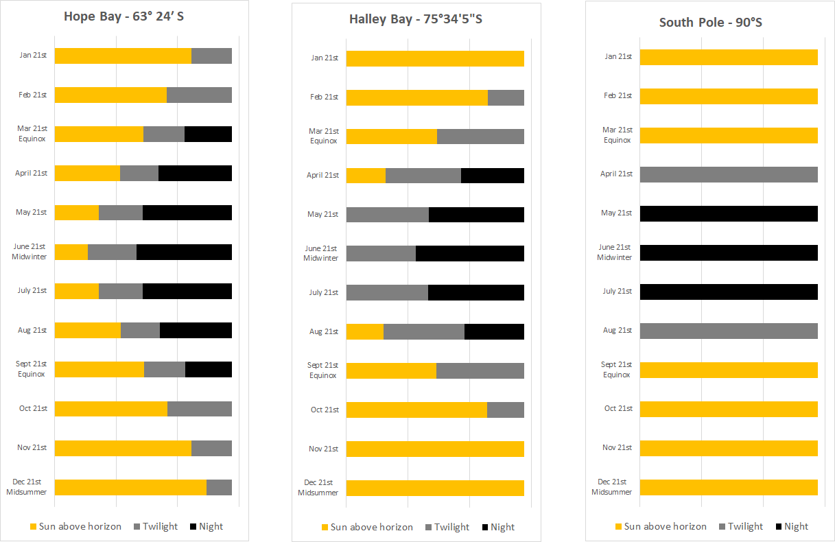
Day length in Antarctica

Slide 8
Thank you for your attention

