Slide 1

Desktop And Presentation Impact On Hardware Design
Kam VedBrat
Lead Program Manager
Windows Client
Microsoft Corporation

Slide 2

Today
Windows Graphics Strategy
Windows Vista features using
graphics hardware
Windows Aero
Graphics usage and System Design
Future usage

Slide 3
Windows Vista
Graphics Strategy
Increase stability of the desktop
with WDDM
Deliver user experience improvements enabled by desktop composition
Windows Presentation Foundation developer platform designed for
modern graphics hardware
Console-like simplicity for PC gaming
via Direct3D

Slide 4
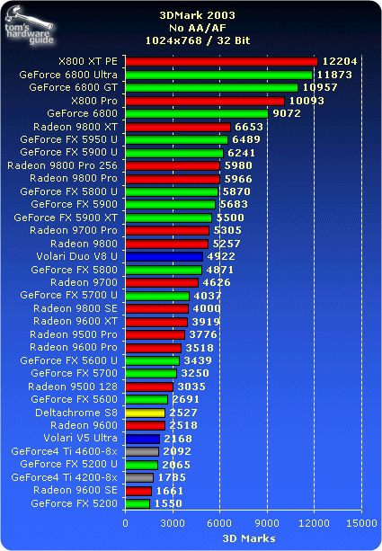
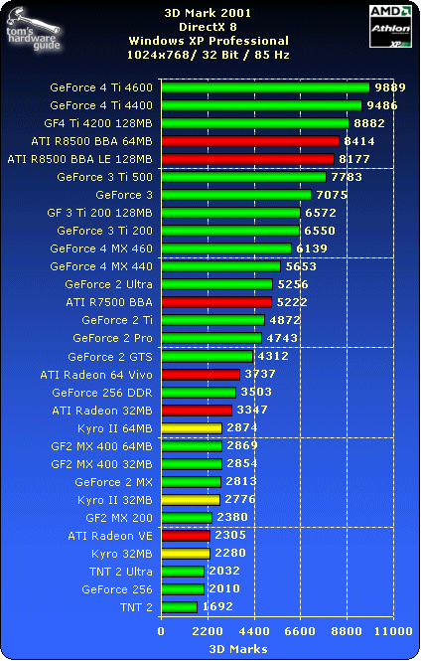
Built On Direct3D
October 2004
April 2002
April 2002
Source: http://www.tomshardware.com

Slide 5
The $399 Benchmark
April 2002
3DMark ’03 Score: 2092
October 2004
3DMark ’03 Score: 12204
6X increase
March 2006
3DMark ’03 Score: 21880
10X increase
http://graphics.tomshardware.com/graphic/20020418/vgacharts-05.html
http://graphics.tomshardware.com/graphic/20041004/vga_charts-04.html#3dmark_2003
http://www.tomshardware.com/2006/03/09/ati_and_nvidias_same_day_mega_launch_mayhem/page11.html

Slide 6
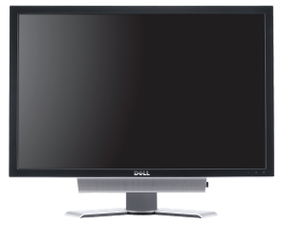
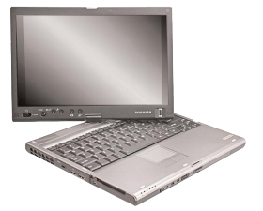
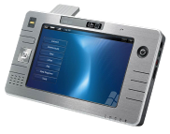
All Shapes And Sizes
UMPC
7”
800x480
Toshiba M400
12”
1400x1050
Dell UltraSharp 3007WFP
30”
2560x1600

Slide 7
Graphics In Windows Vista
Windows OS Usage
Aero
Terminal Services
High DPI
XPS Viewer
Movie Maker
Photos and Imaging
Media Center
In-box Games
ISV Usage Scenarios
Games
Pro Tools
WPF (“Avalon”)

Slide 8

Graphics In Windows Vista

Slide 9

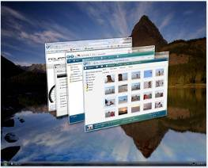
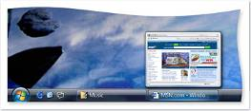

Windows Aero
Visual Quality
Programs don’t need to be called to update
their contents when overlapped or revealed
Programs appear more responsive
Less cycles spent on repaints
Productivity
High-DPI Scaling
Immersive Windows Flip 3D for window switching
“Live previews” of windows improve usability
of Taskbar and Alt-Tab
Style
Focus on appearing professional, streamlined,
and efficient
Transparent borders allow users to focus
on content
Larger window frames make mouse-targeting
for move and resize easier without feeling
big or clumsy

Slide 10

Windows Aero
Desktop Composition
GDI Windows render to software surfaces
DX Windows render to HW surfaces
Window frames are created in HW
DWM.exe composes these together
  Dirty region and occlusion optimizations
  Present-time information available

Slide 11
Windows Aero
Typical resource usage
Full Screen buffers in video memory
  2 buffers required for composition
  2 more buffers as intermediates and scratch area for blur
    These may be reduced further
Each window has a system memory surface
and a hardware surface as well
  DWM manages updating the hardware surface efficiently using dirty regions and occlusion information
Different Scenarios have different resource
usage characteristics
  Simple window updates are very efficient
  Move + Resize are more expensive

Slide 12
When Is Aero Enabled?
Graphics bandwidth is assessed after setup
  Can be re-assessed in the Performance Center
DWM uses the following measures to determine how to compose
  Bandwidth Measured
  Local graphics memory size (as reported by DX)
  Display Resolution
Bandwidth alone is not sufficient information
  Logo requirements are based on “typical” scenarios

Slide 13



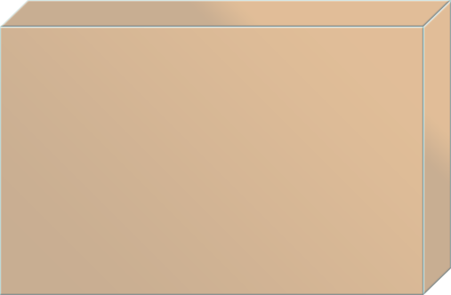


All Windows Vista
User Experiences
Ultimate
Enterprise
Business
Home Premium
Requirements
Former (Code)
Name
Home Basic
Features
Starter
Windows Aero
“Premium visuals, highest level of performance and polish”
Transparent Glass
Taskbar Thumbnails
Windows Flip
Windows Flip 3D
Smooth window animations
WDDM
Display
Adapter ^{1,2}
Aero
Glass
Standard
“The Basic UI with increased performance”
Desktop Composition (smooth window re-draw)
Increased Stability
Minor Visual Polish
WDDM
Display
Adapter ^{1,2}
Aero
Express
Each version includes the features of the lower version
Basic
“Upgraded, streamlined”
Redesigned Start Menu
Streamlined Explorers
Live Icons
Preview/Reading Pane
New Wizard/Dialogs
Any
Display
Adapter
Aero
To Go
Any
Display
Adapter
Windows Classic
Windows 2000 look and feel
1) Display adapter must pass WinSAT Assessment for Aero
2) Systems with a unified memory architecture must reserve at least 512 MB for operating system use after allocating graphics memory

Slide 14
Scaling With Better Hardware
Differentiate graphics hardware
on performance
  Increased graphics memory
  Increased graphics memory bandwidth
  More GPUs and more powerful GPUs
Why go beyond in your design points?
  Desktop has baseline requirements
  Mainstream applications and content
  will drive graphics needs farther
  Games will go even farther

Slide 15
Graphics In Windows Vista
Windows OS Usage
Aero
Terminal Services
High DPI
XPS Viewer
Movie Maker
Photos and Imaging
Media Center
In-box Games
ISV Usage Scenarios
Games
Pro Tools
WPF (“Avalon”)
Notes:
© 2006 Microsoft Corporation. All rights reserved. Microsoft, Windows, Windows Vista and other product names are or may be registered trademarks and/or trademarks in the U.S. and/or other countries.
The information herein is for informational purposes only and represents the current view of Microsoft Corporation as of the date of this presentation. Because Microsoft must respond to changing market conditions, it should not be interpreted to be a commitment on the part of Microsoft, and Microsoft cannot guarantee the accuracy of any information provided after the date of this presentation.
MICROSOFT MAKES NO WARRANTIES, EXPRESS, IMPLIED OR STATUTORY, AS TO THE INFORMATION IN THIS PRESENTATION.

Slide 16
ISV Graphics Usage
Notes:
© 2006 Microsoft Corporation. All rights reserved. Microsoft, Windows, Windows Vista and other product names are or may be registered trademarks and/or trademarks in the U.S. and/or other countries.
The information herein is for informational purposes only and represents the current view of Microsoft Corporation as of the date of this presentation. Because Microsoft must respond to changing market conditions, it should not be interpreted to be a commitment on the part of Microsoft, and Microsoft cannot guarantee the accuracy of any information provided after the date of this presentation.
MICROSOFT MAKES NO WARRANTIES, EXPRESS, IMPLIED OR STATUTORY, AS TO THE INFORMATION IN THIS PRESENTATION.

Slide 17
System Design Considerations
Software and hardware platform
  WDDM and DX9 have become baseline
Design for throughput
  Composition can be memory intensive
  RAM, Memory Controller, and graphics memory speed
New Thermal Considerations
  CPU, GPU, Memory
  Design for graphics system “always on”
Plan for simultaneous graphics usage
  Desktop, Decode/Encode, Playback, Applications
  WDDM 2.1
Hardware invocation for Flip3D
  Enabled through WM_APPCOMAND
  Bezel-button on tablet systems
  Mice and Keyboards

Slide 18



Windows Futures
Redirection and Composition System
New scenarios
  End-user enhancements
  HDR Color
  Greater use of geometry versus texturing
    Build on parallelism in graphics hardware
    Align with where hardware is going
  High DPI
  Broader use of ClearType
WDDM 2.1 and DX10.1
  Advanced Scheduling with page level context switching
  Direct impact on desktop scenarios
Call To Action
  Having a DX10.1 baseline is critical for “Vienna”
  High DPI and HDR Displays

Slide 19
Call To Action
Windows Vista redefines the operating systems usage of graphics hardware
  End user value scales with graphics capabilities
  Developer platforms enable deeper graphics usage than ever before
Hardware support must be there
  Direct3D 9 and WDDM baseline for Windows Vista
  Direct3D 10 and WDDM for 2007
  Direct3D 10.1 and WDDM 2.1 for 2008
  Design for “always on” graphics

Slide 20
Additional Resources
Related Sessions
PRI034 Future Directions in Graphics
PRI022 DirectX Graphics: Direct3D 10 and Beyond
PRI103 WDDM v2 and Beyond
PRI023 Display Driver Logistics and Testing
CPA101 Windows Vista System Requirements and WinSAT
Web Resources:
Kam VedBrat:
http://blogs.msdn.com/kamvedbrat
Greg Schechter:
http://blogs.msdn.com/greg_schechter

Slide 21

© 2006 Microsoft Corporation. All rights reserved. Microsoft, Windows, Windows Vista and other product names are or may be registered trademarks and/or trademarks in the U.S. and/or other countries.
The information herein is for informational purposes only and represents the current view of Microsoft Corporation as of the date of this presentation. Because Microsoft must respond to changing market conditions, it should not be interpreted to be a commitment on the part of Microsoft, and Microsoft cannot guarantee the accuracy of any information provided after the date of this presentation.
MICROSOFT MAKES NO WARRANTIES, EXPRESS, IMPLIED OR STATUTORY, AS TO THE INFORMATION IN THIS PRESENTATION.

Slide 22


