Slide 1


























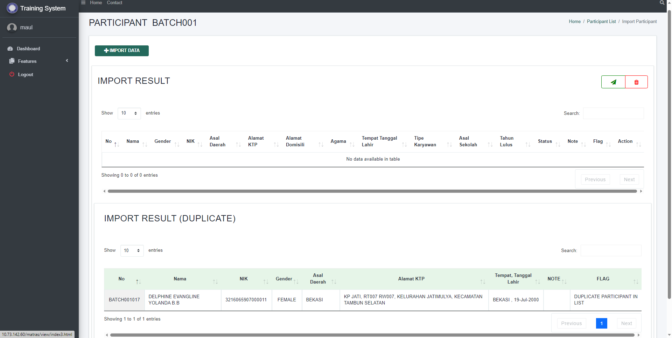
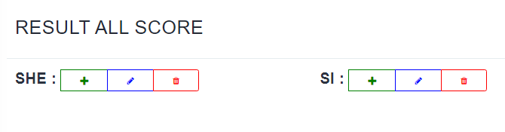
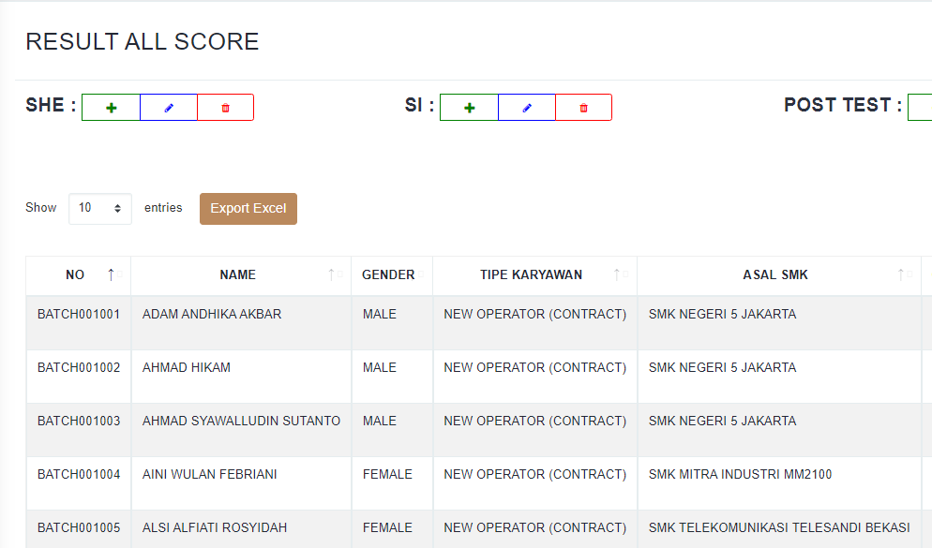
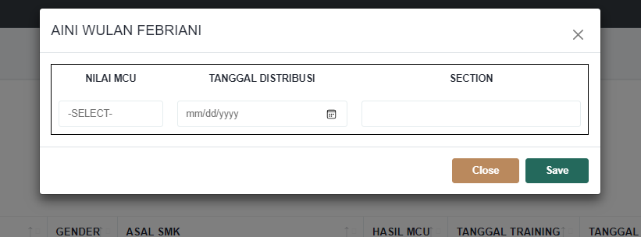
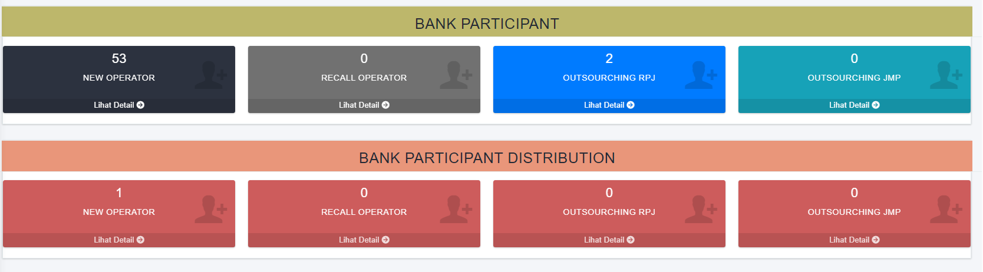
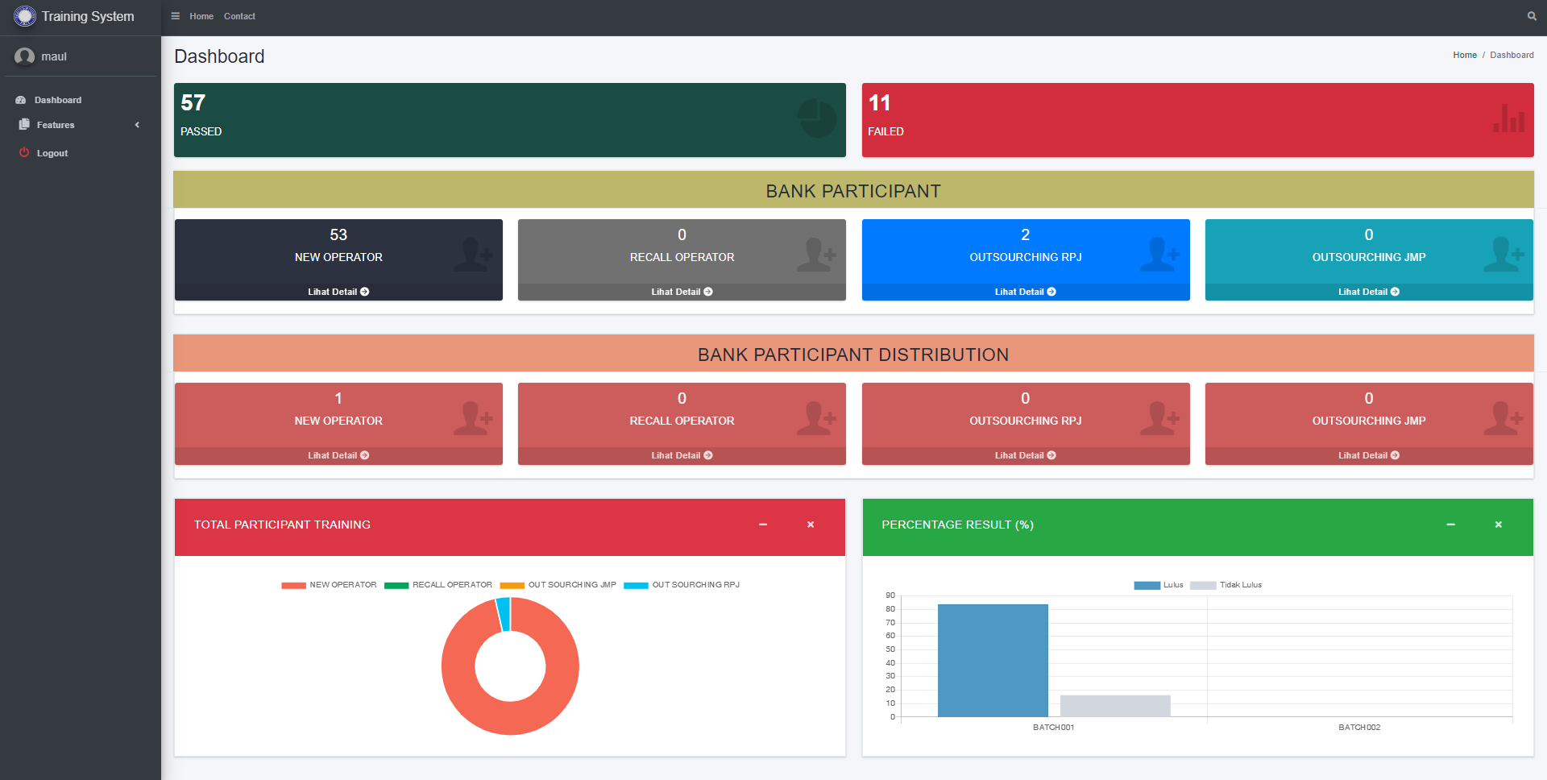
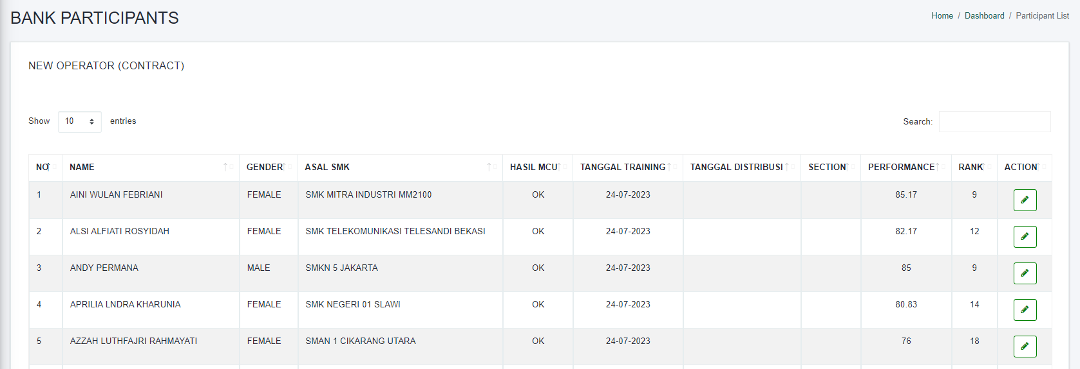
Before Improve
VS
After Improve
Excel
Form
"Accurately assessing
scores from
Microsoft Forms."
Copy
1 X Import File to Web
Paste
Copy from Excel
There is bank participant in Dashboard
BANK PARTICIPANT
"Efficiently managing participant data transfers to participant banks."
Transfer Data
Monitoring Directly
Dojo
HRD
Dojo
Web System
HRD
DOJO
Dashboard
with Current
Add Batch,
Import Participants
Import All Score
Input IK
& SCW
Send to
Bank Participant
Bank Participant
Distribution
Registration user
account with
admin code
Login based on registered
HR
Dashboard with
Current Condition
Export
Result
Update
MCU Result
Identifying User Needs that Align With Our Capabilities Can be a Challenging Task.
Features
Import Detect participant retraining
Import score each subject
Export to excel
HR Feature
Bank participant automatically
Dashboard as MEIRUKA

Slide 2
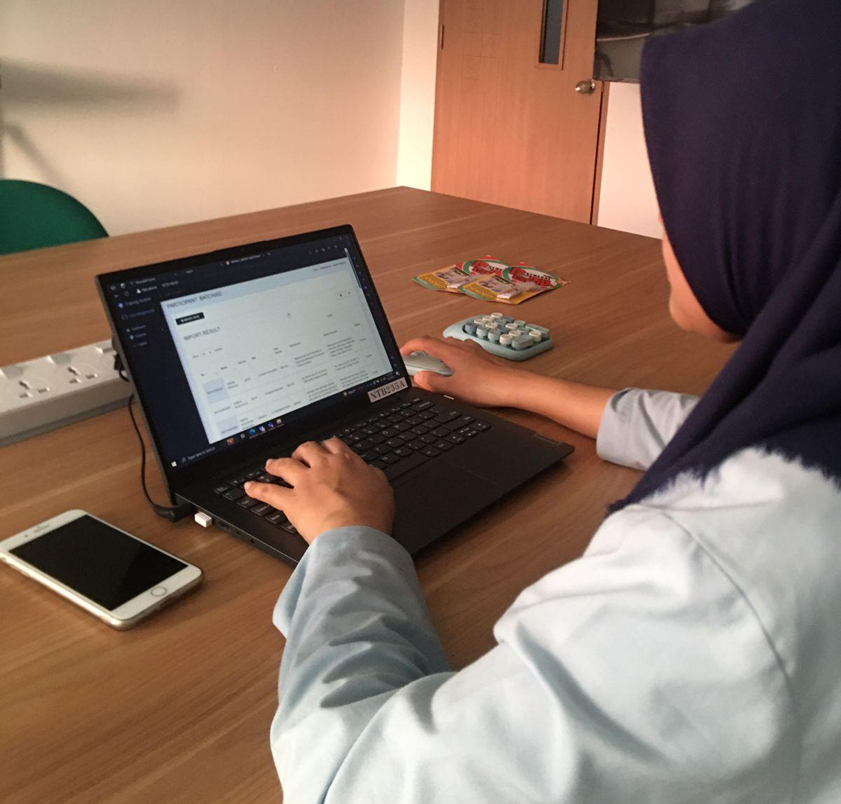
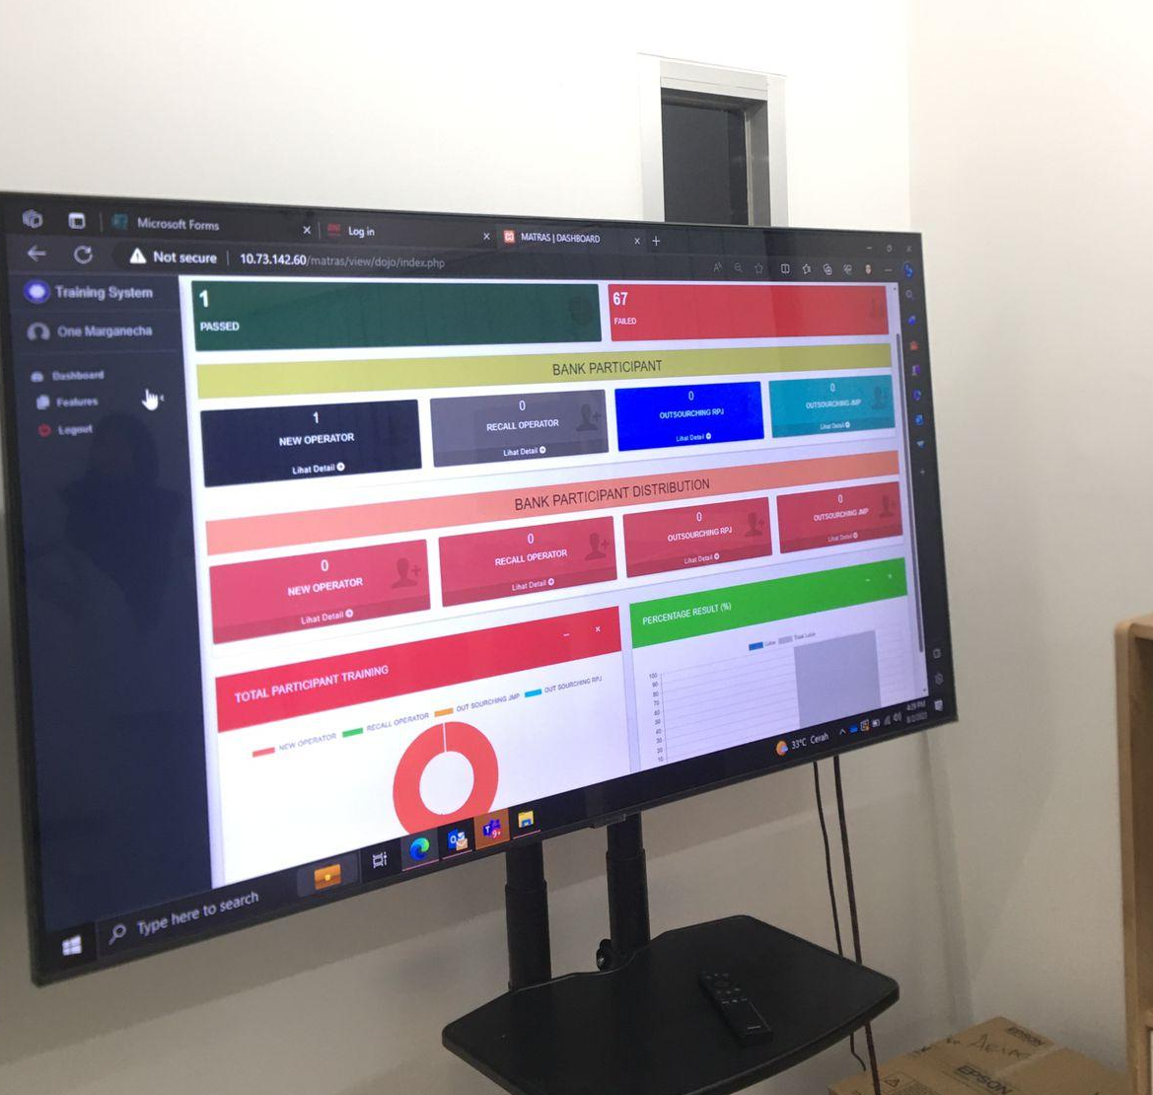








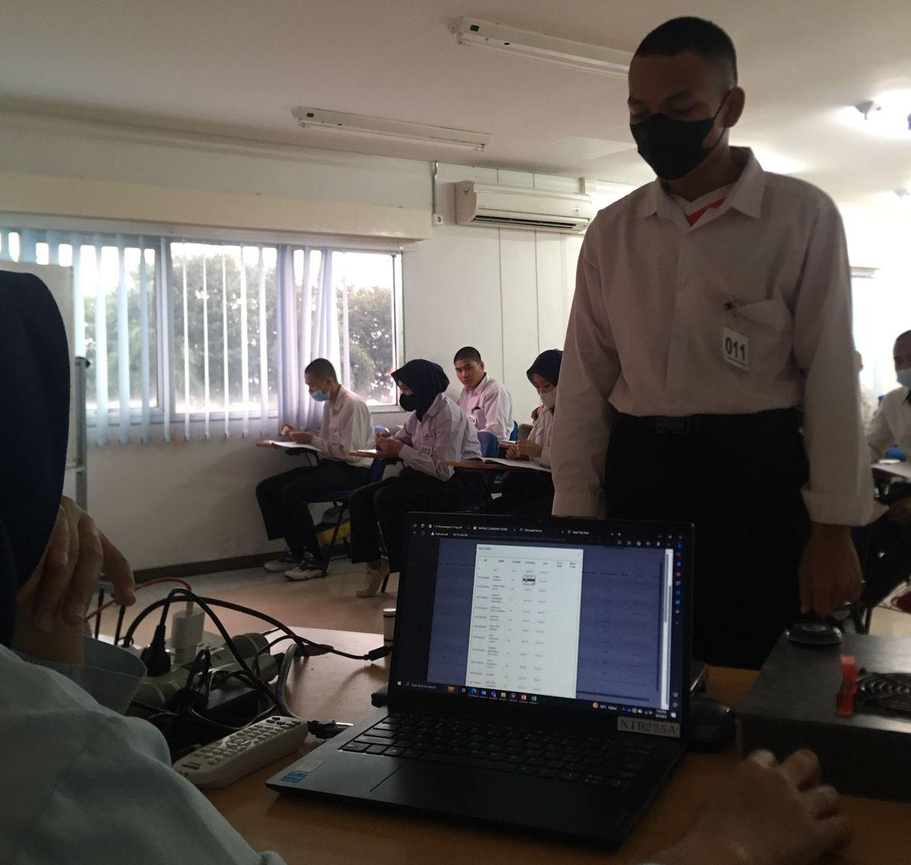
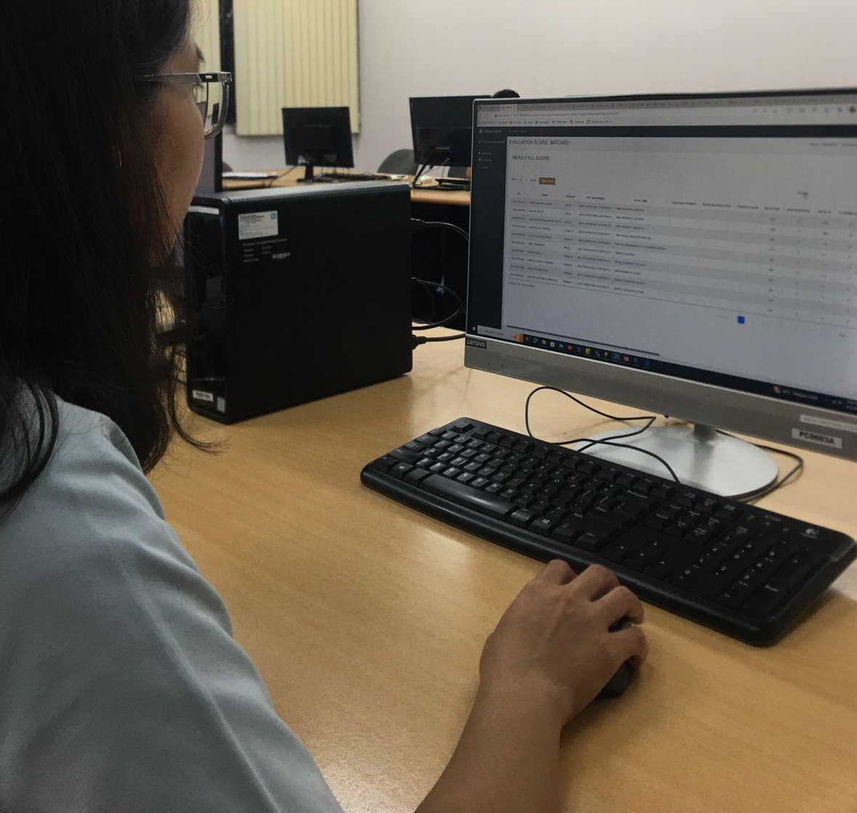



IMPLEMENTATION
ACTUAL BENEFIT
TARGET
IMPLEMENTATION
1
2
Efficiency work time up to 5 minutes
Actual Cycle Time
05,00,54 Min
05,50,90 Min
01,00,57 Min
01,00,57 Min
02,00,80 Min
BEFORE
MANUAL
INPUT
Input personal data
Copy Paste
Sport Score and each Subject Score
Input Participant Passed to Bank Participant
Send Summary Score to
HR by E-Mail
Update MCU result From HR
Import Data by Excel
Meiruka Dojo Training
INPUT BY
WEBSITE
Import
Personal Data
Import Daily Sport score and Subject score
Send to
Bank Participant
Export Summary score by HR directly
Update
MCU result by HR directly
AFTER
3
4
01,30,57 Min
03,24,04 Min
00,20,60 Min
00,30,00 Min
01,00,00 Min
993,56 Sec
1
(Reduce 9 Min)
REDUCE
50%
CYCLE TIME
PROCESS
ACCURACY DATA
99%
ACTUAL
REDUCE
CYCLE TIME
405.89 Sec
with
2
Input data directly
HR Monitoring
EFFICIENCY WORK
Before
After
CAN REDUCE SIGNIFICANT CYCLE TIME 9 MINUTES

Slide 3









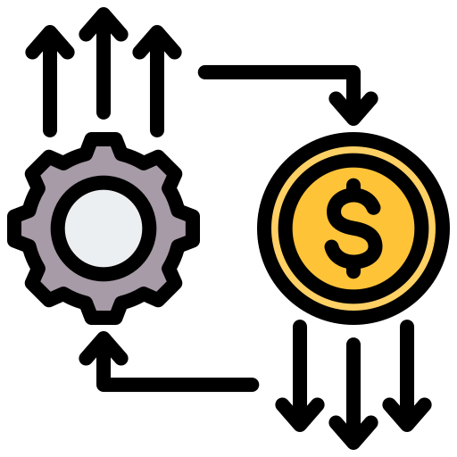



LEARNING POINT
FUTURE PLAN
Soft Skill
REDUCE MAN HOUR
Communication
Hard Skill
How to communication
with user for project
REDUCE
MAN POWER
Concept
Export to Excel
How to Create concept correctly
Export table website to Excel
VISUALIZE
INFORMATIVE SYSTEM
New Understanding
REDUCE
COST
REDUCE
MUDA PROCESS
DNIA
DMIA
Import Fitur
2 Features
4 New Features
Bank Participants
New feature import each subject
Manage Participants Passed
1 team (4p)
1 team (2p)
Send to Database
Input data to Database from table HTML
+- 5 months
+- 1 month
OUR SKILLS ARE INCREASED DURING THIS PROJECT
Notes:
"The next feature not only reduces man-hours but also supports all aspects, including reducing man power, material costs, streamlining processes, and other supporting factors for DMIA excellent factory."

Slide 4


