Slide 1

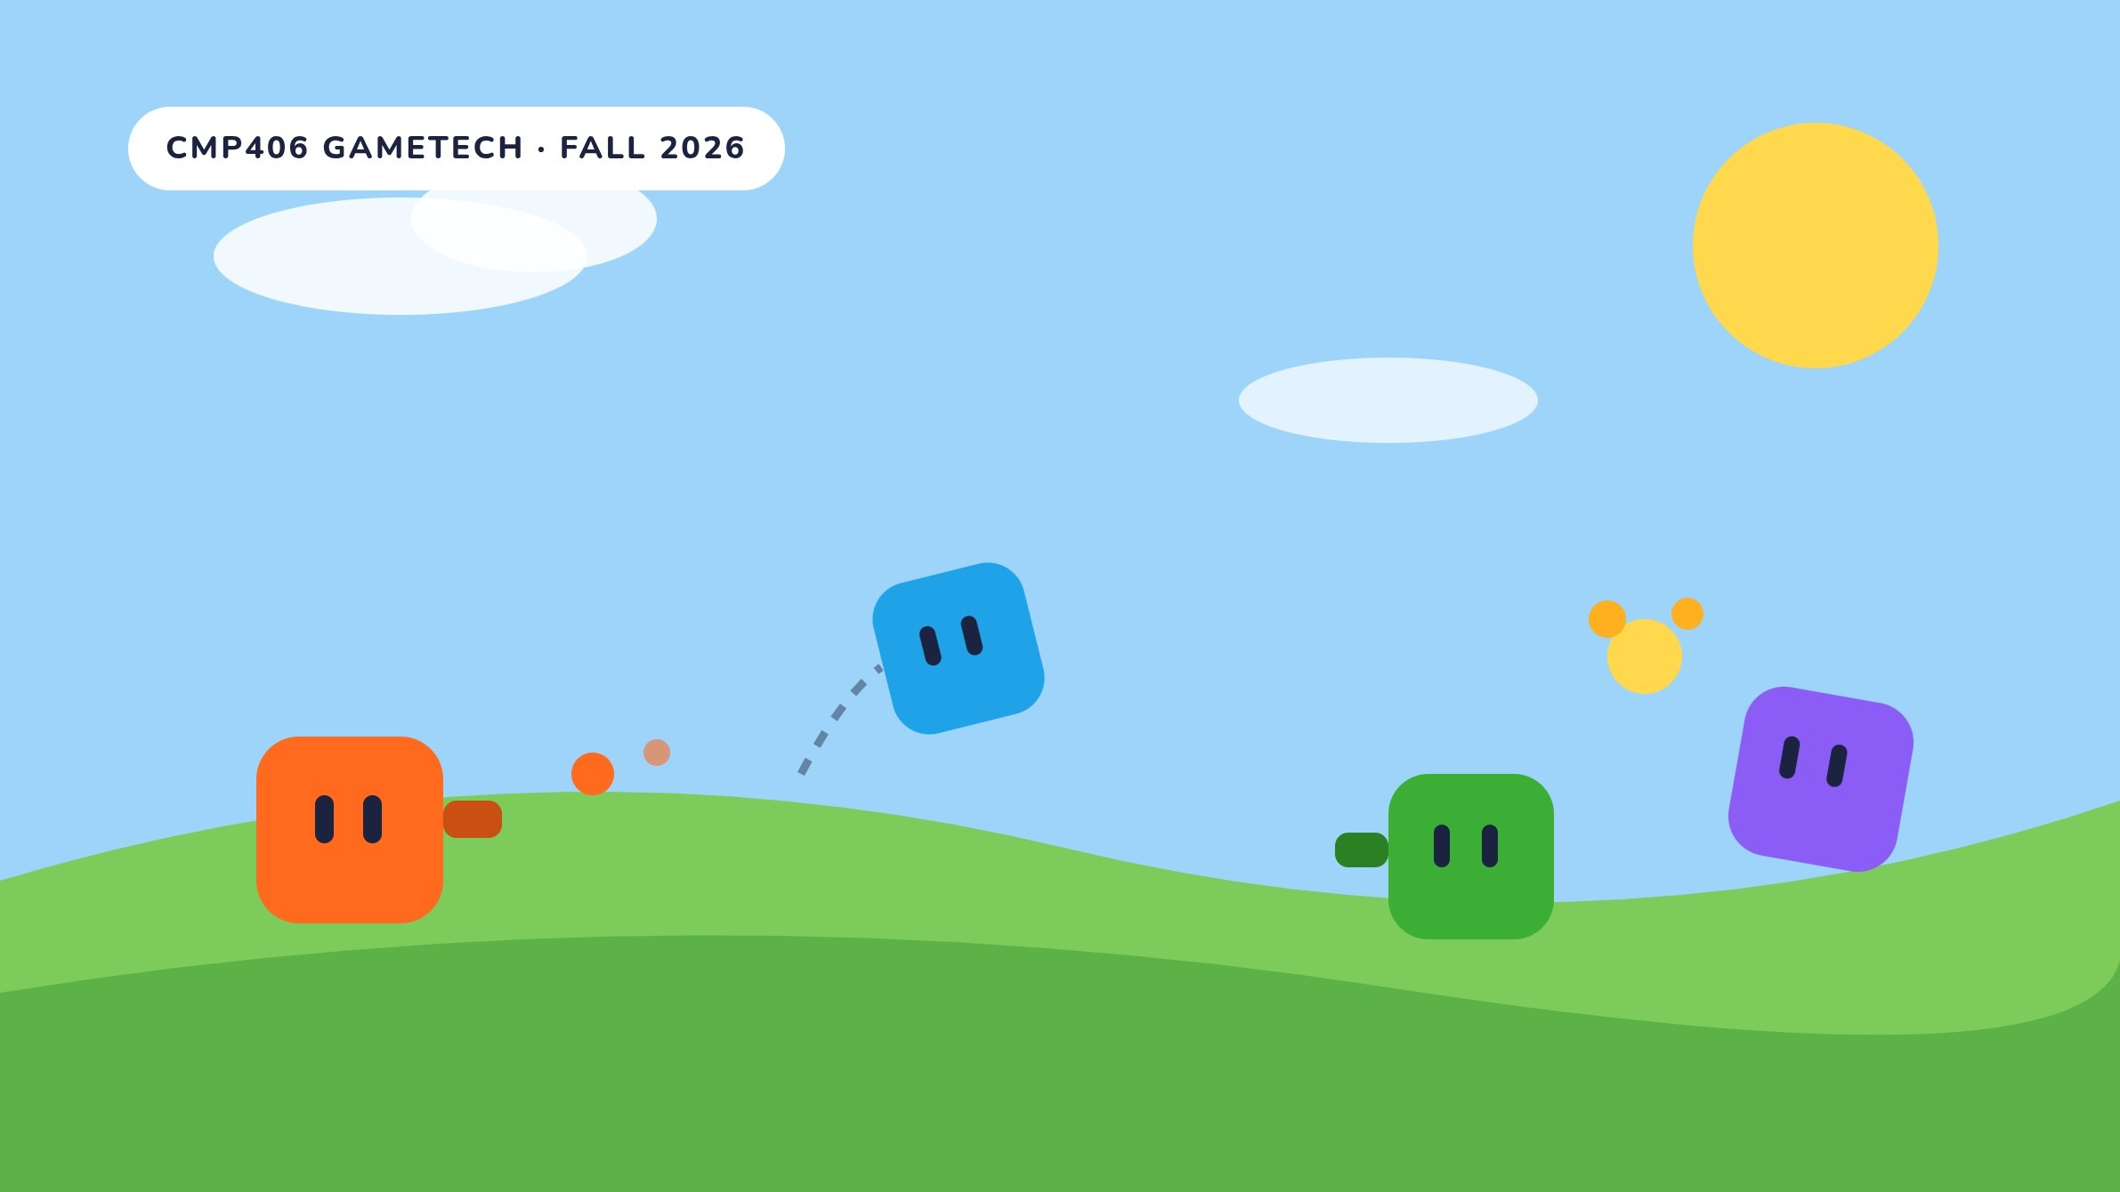
GAME PROPOSAL · CMP406 GAMETECH · FALL 2026
Shooter Party
WORKING TITLE
October 2026
A LAN party game for 2–4 players. Shoot, push and blast your friends through short mini-games; one shared scoreboard decides the winner.
Ezel Bayraktar
Abdurrahim Özağaç
Kürşat Hürkan Aydın
Ardıl Bilal Ülkü
2220356197
2220356033
2230356008
2230356051
Network, build
Shots, mini-game rules
Movement, levels
Art, UI, session
Notes:
Shooter Party is a working title. It is a LAN party game for two to four players: shoot, push and blast your friends through short mini-games, and one shared scoreboard decides the winner. The four of us are at the bottom, with the roles we propose. The illustrations in this deck were made for our pitch; the 3D images are AI concept renders. None of them show gameplay.

Slide 2



Shooter Party
CMP406 GameTech · Fall 2026
01 · THE GAME
Game description
Every round is a new mini-game, and placement turns into points.
Shooter Party is a party game for 2–4 friends in one room, each at their own PC. One player hosts and the others join over the local network. Everyone controls a small shooting cube. The mini-games change what a shot does: one pushes, one damages, one lifts you with a blast. After the last mini-game, the player with the most points wins.
1
Lobby
2
Pick
3
Play
4
Place
5
Standings
Host sets the session rules. Others join over LAN.
The playlist picks the next mini-game. Everyone loads the same arena.
Some mini-games have their own rounds inside.
Final placement becomes points.
Scoreboard updates. Repeat until the session ends.
SESSION SETTINGS
PLACEMENT POINTS · PROPOSED
END CONDITION
After a set number of mini-games, or when a player reaches a target score.
1st
4 PTS
2nd
3 PTS
PLAYLIST
Random or custom. Unwanted mini-games can be excluded, and one mini-game can be played many times.
3rd
2 PTS
INNER ROUNDS
A mini-game can run its own rounds, like Hole Grab losing one hole each round.
4th
1 PTS
Only points carry over between mini-games.
Shooter Party · Game proposal
02 / 25
Notes:
Plain-language summary. Two to four friends, each on a PC, in one room; one hosts. Every round is a new mini-game, and the shot does something different in each. A session runs lobby, pick, play, place, standings, and repeats. The host sets the rules: the session ends after a set number of mini-games or when someone reaches a target score; the playlist is random or custom, mini-games can be left out or repeated; and a mini-game can run rounds of its own, like Hole Grab losing one hole each round. Placement points 4, 3, 2, 1 are a proposal.

Slide 3
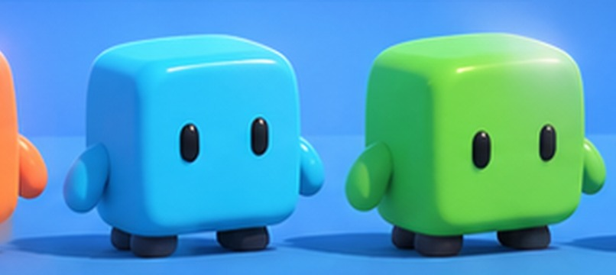
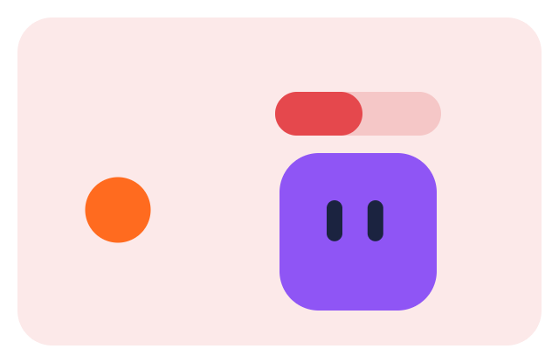
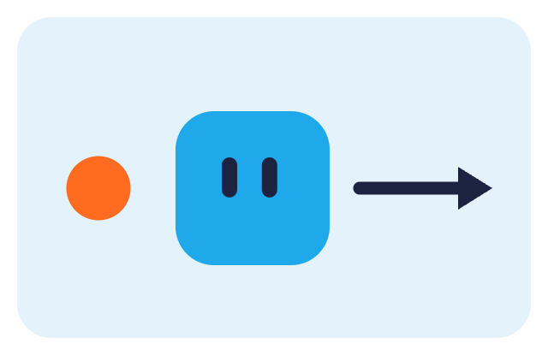
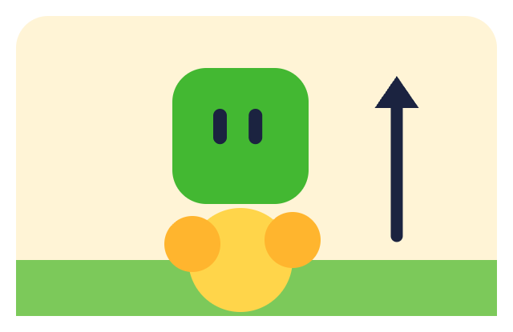
Shooter Party
CMP406 GameTech · Fall 2026
02 · GAMEPLAY MECHANICS
Core mechanics
One shooting cube. Every mini-game changes what a shot does.
The player. A small character with a barrel that fires real projectiles: physics objects, not instant hits. It does not have to be a cube, but its proportions should stay close to 1:1:1. Four colours: orange, cyan, lime, purple.
Concept render, AI-generated. Not gameplay.
ONE TRIGGER, THREE EFFECTS
Damage
Knockback
Blast
The shot lowers the target’s health.
The target is pushed away from the direction the shot came from.
The shot explodes. Fired at the ground, it lifts the shooter up.
MOVEMENT
CAMERA
MECHANIC IDEAS WE WANT TO TRY
WASD to move. Jumping is allowed in some mini-games and not in others.
A third-person shooter camera by default. A mini-game can change it, like the 2.5D side view in Blast Parkour.
Shoot the ground to jump. Steer with recoil: on ice, firing forward pushes you back.
Shooter Party · Game proposal
03 / 25
Notes:
One shooting cube everywhere: a small character with a barrel that fires real physics projectiles. What a shot does depends on the mini-game. Damage lowers the target's health. Knockback pushes the target away from the direction of the shot. Blast explodes, and fired at the ground it lifts the shooter. WASD to move; jumping is on in some mini-games and off in others. The camera is a third-person shooter camera by default, and a mini-game can change it, like the 2.5D side view in Blast Parkour. Two mechanic ideas we want to try: shoot the ground to jump, and steer with recoil on ice.

Slide 4
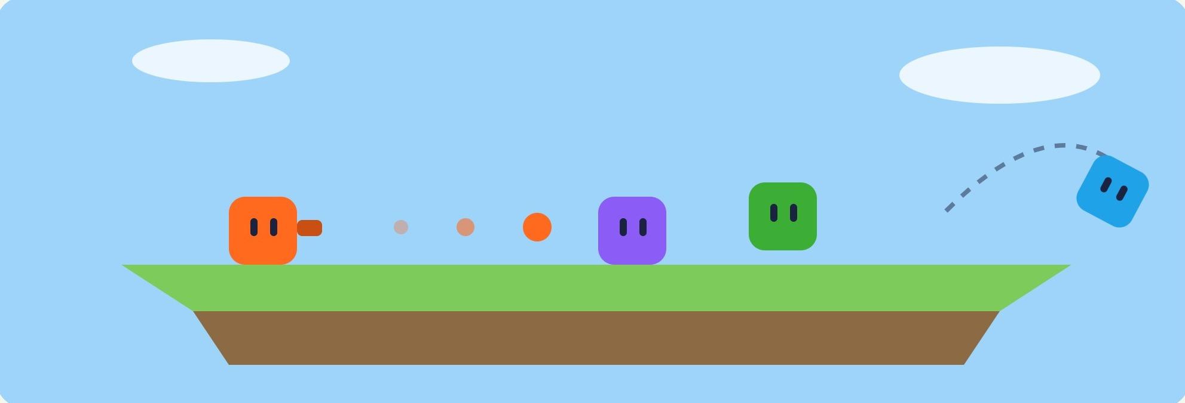



Shooter Party
CMP406 GameTech · Fall 2026
MINI-GAME 01 · WORKING NAME
Knockback Arena
Shoot the others off a flat floor. Every hit makes them lighter.
MVP
SHOOTING
Free, with a fire-rate limit. Shots are real thrown objects and have no effect on the shooter.
GETTING HIT
A force from the shot’s direction, and a drop in mass. Volume stays the same.
Illustration, not gameplay. Arena theme and size are not set.
MASS, NOT SIZE: THE SAME SHOT, A LONGER FLIGHT
OUT AND PLACEMENT
Falling off means you are out. Proposed: placement by order of elimination, last cube standing wins.
Full mass. A hit pushes a little.
After a few hits. Same size, less mass, a longer push.
Many hits. One more shot sends it off the edge.
Shooter Party · Game proposal
04 / 25
Notes:
Knockback Arena. A flat floor with open edges. Shooting is free with a fire-rate limit; shots are real thrown objects and do nothing to the shooter. A hit pushes the target from the shot's direction and lowers its mass, while its size stays the same. So the same shot pushes a weakened player further: at full mass a hit pushes a little; after a few hits it is a longer push; after many, one more shot sends it off the edge. Falling off means you are out. Our proposal: placement by order of elimination, last cube standing wins.

Slide 5
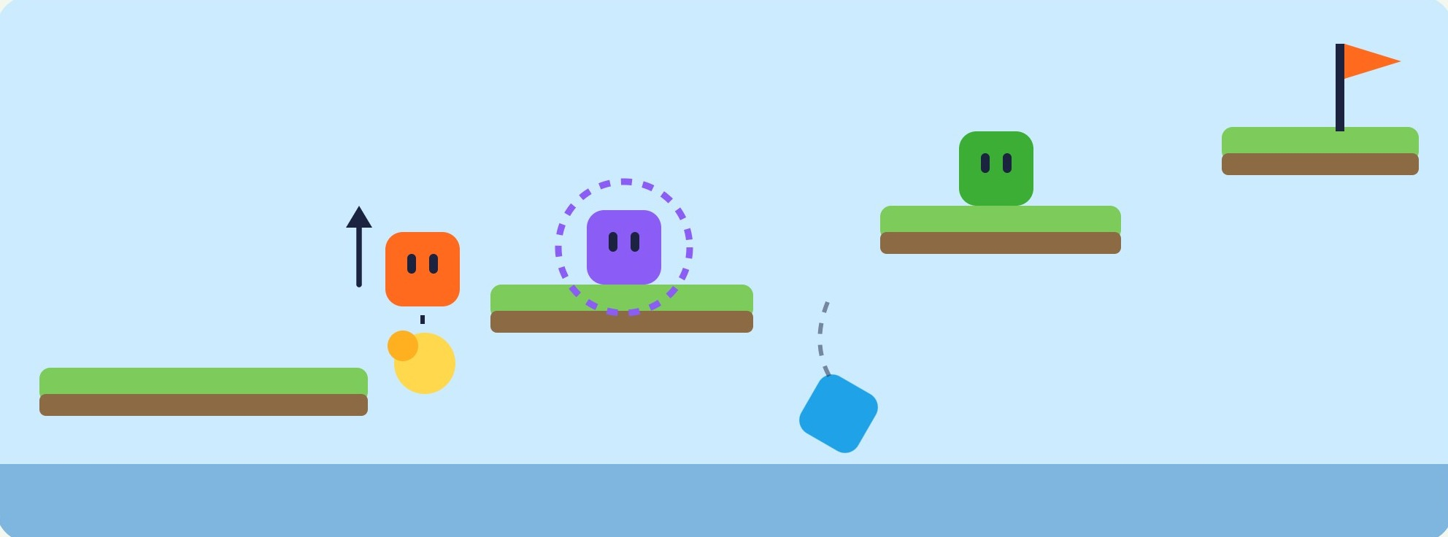
Shooter Party
CMP406 GameTech · Fall 2026
MINI-GAME 02 · WORKING NAME
Blast Parkour
A 2.5D obstacle course: spit, blast and climb while knocking the others into the void.
STRETCH GOAL
2.5D COURSE
Built side-on, so there is nowhere to hide. Everyone is always in someone’s line of fire.
CHARGED BLAST
Hold to fire a strong explosion. While charging you cannot move, so you are open to attack.
BLAST TO CLIMB
Illustration, not gameplay. Orange blasts the ground to jump; purple charges a strong shot; cyan has been knocked into the void.
A shot at the ground lifts you up. The same blast can push a nearby rival off a ledge.
IF HITTING IS TOO EASY
FALL = OUT
We make shots fall with gravity, so players have to read the arc to land a hit. We decide this in playtests.
Whoever drops below the course is out. Placement rule: to be decided after the first tests.
Shooter Party · Game proposal
05 / 25
Notes:
Blast Parkour, a 2.5D obstacle course. It is built side-on, so there is nowhere to hide and everyone is always in someone's line of fire. Holding the button fires a strong explosion, but while charging you cannot move, so you are open to attack. A shot at the ground lifts you up, and the same blast can push a nearby rival off a ledge. Whoever drops below the course is out; the placement rule comes after the first tests. If hitting turns out too easy, shots fall with gravity. This one is our stretch goal for the final phase.

Slide 6
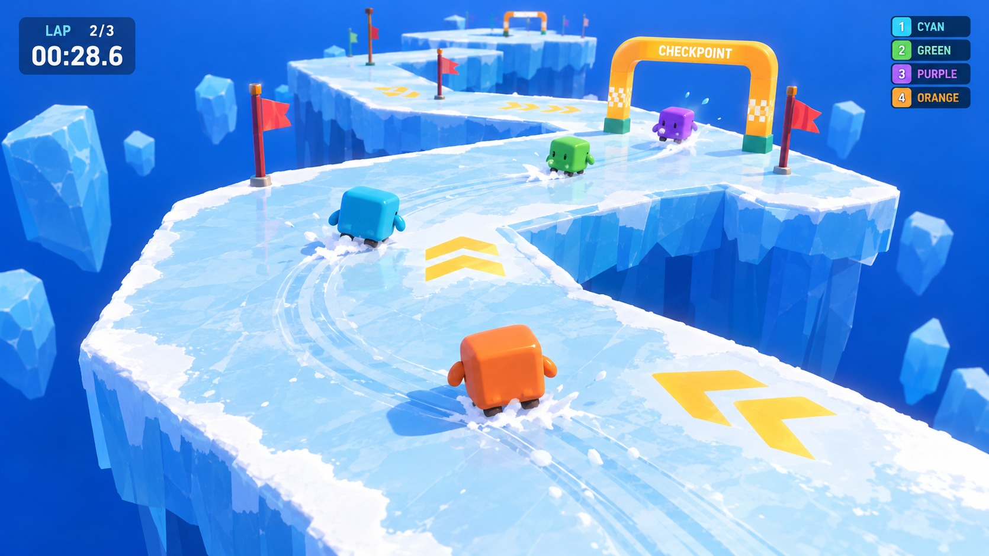
Shooter Party
CMP406 GameTech · Fall 2026
MINI-GAME 03 · WORKING NAME
Ice Loop
Most checkpoints before the timer runs out wins. The ice does not help.
LOOPED TRACK
When the track ends it starts again, and every checkpoint you pass counts +1. The count, not the lap, decides the placement.
PUSH TO WIN
The ice is slippery. Push rivals off it into the water and they restart from their last checkpoint.
STEER WITH RECOIL (IDEA)
MVP
Firing forward while sliding pushes you back, so a shot can also correct your line.
Concept render, AI-generated. Not gameplay. Ice is the theme of this one mini-game only.
Shooter Party · Game proposal
06 / 25
Notes:
Ice Loop. The goal is to pass the most checkpoints before the timer runs out. When the track ends it starts again, and every checkpoint you pass counts plus one; the count, not the lap, decides the placement. The ice is slippery: push rivals off it into the water and they restart from their last checkpoint. One idea we want to try: firing forward while sliding pushes you back, so a shot can also correct your line. Ice is the theme of this one mini-game, not of the whole game.

Slide 7
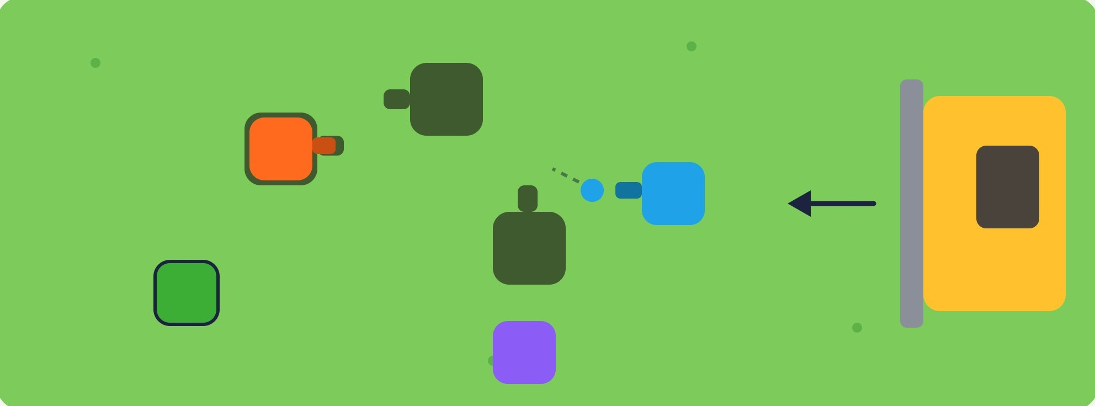
Shooter Party
CMP406 GameTech · Fall 2026
MINI-GAME 04 · WORKING NAME
Hole Grab
Musical chairs with holes. No hole, and the bulldozer gets you.
MVP
PLAYER-SHAPED HOLES
Holes open in the ground in the player’s shape, with the barrel’s angle marked. You have to line up to drop in.
SHOOT TO PUSH
Illustration, not gameplay. Each hole has the player's shape and a fixed barrel angle. Orange is already in a hole; the bulldozer moves in from the right.
Shots push other players away from the holes. A player already inside a hole cannot be pushed out.
ROUNDS INSIDE THE MINI-GAME (4 PLAYERS)
Round 1
Round 2
Round 3
4 players, 3 holes. One is crushed.
3 players, 2 holes. One is crushed.
2 players, 1 hole. The one inside wins.
Shooter Party · Game proposal
07 / 25
Notes:
Hole Grab: musical chairs with holes. Holes open in the ground in the player's shape, with the barrel's angle marked, so you have to line up to drop in. Every round there is one hole fewer than players: four players and three holes, then three and two, then two and one. Whoever is left without a hole is crushed by the bulldozer. Shots push other players away from the holes, but a player already inside a hole cannot be pushed out.

Slide 8
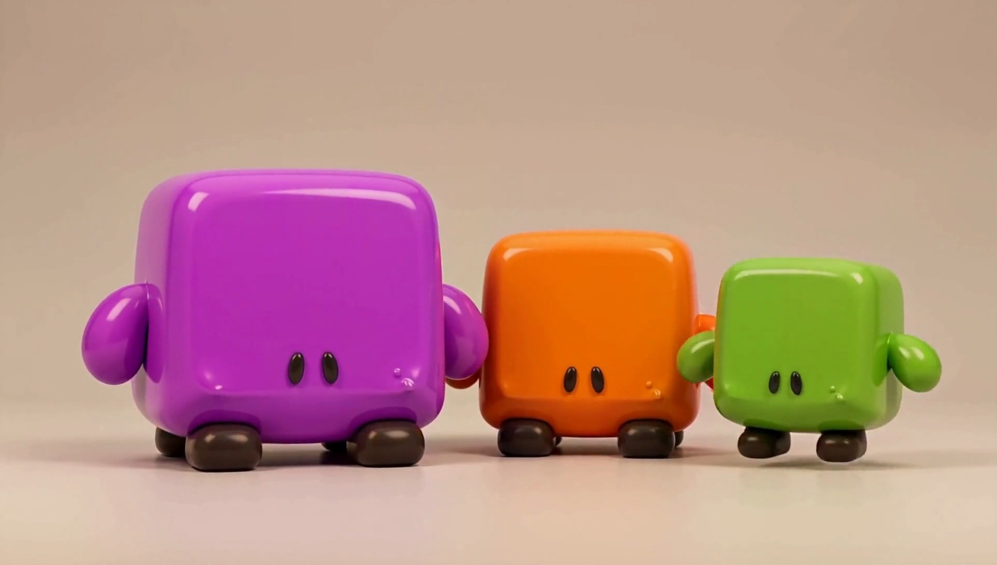
Shooter Party
CMP406 GameTech · Fall 2026
02 · GAMEPLAY · NOT YET COMMITTED
Ideas in progress
The playlist is built to grow. These are next in line once the core four work.
MORE MINI-GAMES, IN DESIGN
Versus battle
Hard battle
The Monster
A classic free-for-all shoot-out. Rules: to be designed.
A tougher battle variant. Rules: to be designed.
One player is the monster and the rest play against them, with rounds inside. Rules: to be designed.
Owner: Abdurrahim. Each one plugs into the same shared core as the first four.
FUTURE FEATURES
Character types
Rage meter
Players pick a type with its own strengths. Because mass drives knockback, weight is the natural first stat.
A meter that builds up across mini-games. Once it fills over a few rounds, the player can spend it in a later mini-game.
Heavy
MASS
SPEED
Balanced
MASS
SPEED
Light
MASS
SPEED
Character types. Concept render, AI-generated.
Example only. Pips are relative; stats are not designed.
Shooter Party · Game proposal
08 / 25
Notes:
Ideas that are not committed yet. Three more mini-games are in design, owned by Abdurrahim: a classic versus battle, a harder battle variant, and The Monster, where one player is the monster and the rest play against them, with rounds inside. Two future features: character types, where weight is the natural first stat because mass drives knockback, and a rage meter that builds up across mini-games and can be spent later.

Slide 9
Shooter Party
CMP406 GameTech · Fall 2026
02 · GAMEPLAY & TECH
Technical design
One shared core; every mini-game plugs into it.
MINI-GAMES
Knockback Arena
Blast Parkour
Ice Loop
Hole Grab
Next one
CONTRACT
Setup(players, settings) → Run() → Results() : placement
SHARED GAMEPLAY
Cube controller
TPS camera
Shot system
WASD, jump
per-game override
effect set per game
Session & playlist
Scoreboard
Lobby & UI
end rules, exclusions
placement to points
join, settings, HUD
NETWORK
LAN · one player hosts, the others are clients · Unity Netcode (candidate)
ENGINE
Unity · built-in rigidbody physics
Shooter Party · Game proposal
09 / 25
Notes:
Architecture. The four mini-games, and the next one, sit on a shared core. Each implements the same small contract: set up with the players and the session settings, run, report placement. Below that is shared gameplay: the cube controller with WASD and jump, the third-person camera that a mini-game can override, the shot system whose effect each mini-game sets, the session and playlist with end rules and exclusions, the scoreboard, and the lobby and UI. Then the LAN layer, where one player hosts and the others are clients; Unity Netcode is our candidate, not a final choice. The engine is Unity with built-in rigidbody physics.

Slide 10


Shooter Party
CMP406 GameTech · Fall 2026
02 · GAMEPLAY & TECH
One shot in Knockback Arena, over the LAN
The host decides; every screen agrees.
Client A
Host
Client B
shooter
runs the physics
target
1
Fire input and aim direction
2
Check the fire-rate limit and spawn the projectile. The shooter is not affected.
3
Physics step: the projectile reaches B.
4
Apply this mini-game’s effect: B loses mass and is pushed from the shot’s direction.
Snapshot: positions, mass, scores
5
5
The same snapshot to everyone
6
Clients interpolate between snapshots and draw.
6
Your own movement is predicted locally, so it feels instant. Everything that decides a result runs on the host, so every screen agrees. Main risk: keeping physics smooth on clients; LAN latency is low, and we tune the snapshot rate.
Shooter Party · Game proposal
10 / 25
Notes:
One shot end to end. Client A sends fire input and aim direction. The host checks the fire-rate limit and spawns the projectile; the shooter is not affected. The physics step carries it to B. The host applies this mini-game's effect: B loses mass and is pushed from the shot's direction. The host sends the same snapshot, with positions, mass and scores, to every client, and clients interpolate between snapshots. Own movement is predicted locally for feel.

Slide 11
Shooter Party
CMP406 GameTech · Fall 2026
03 · MARKET
Market potential & target audience
Social PC play is growing; LAN party games are rare.
Our audience is groups of 2–4 friends who play together in one room, each on their own PC: students, LAN parties and game nights. They want short, readable rounds, a session they can shape themselves, and a game that works without an internet connection.
$43.6B
$4.1B
70%
≈8%
PC games revenue in 2025, up 12% year on year.
Steam revenue of games with co-op in H1 2025, an all-time high (estimate).
of US players aged 8+ play with other people.
of ~3,490 Steam “Party Game” titles list LAN PvP.
Newzoo [1]
Alinea [2]
ESA 2026 [3]
Steam, Oct 2026 [4]
STEAM “PARTY GAME” TITLES BY MULTIPLAYER TAG
Steam store search, 17 Oct 2026 [4]. Tags are user-applied.
Online PvP
1,870
Shared / split-screen PvP
1,017
LAN PvP
292
RISK, STATED PLAINLY
An estimated 65.9% of 2025 Steam releases earned under $1,000 [5], while 5,863 games passed $100K in 2025 (Valve) [6]. LAN is our differentiator, not a demand driver.
Shooter Party · Game proposal
11 / 25
Notes:
Market and audience. We aim at groups of two to four friends in one room, each on their own PC: students, LAN parties and game nights. PC is a 43.6 billion dollar market that grew 12 percent in 2025; games with co-op made an estimated 4.1 billion on Steam in the first half of 2025; most players play with others. Only about 8 percent of Steam party games list LAN. Revenue is very uneven, so LAN is how we stand out, not why people buy.

Slide 12
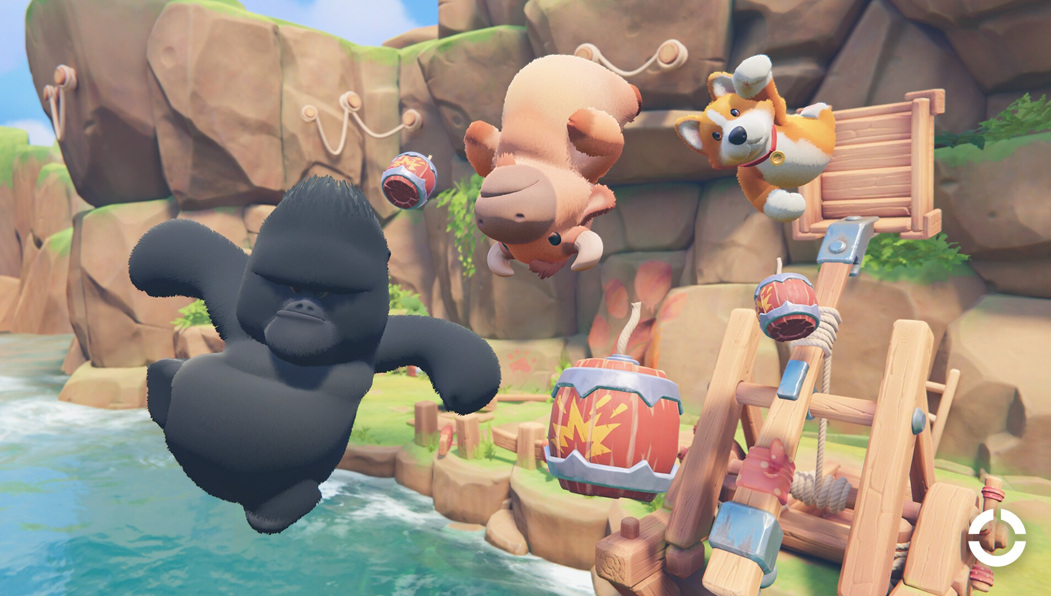
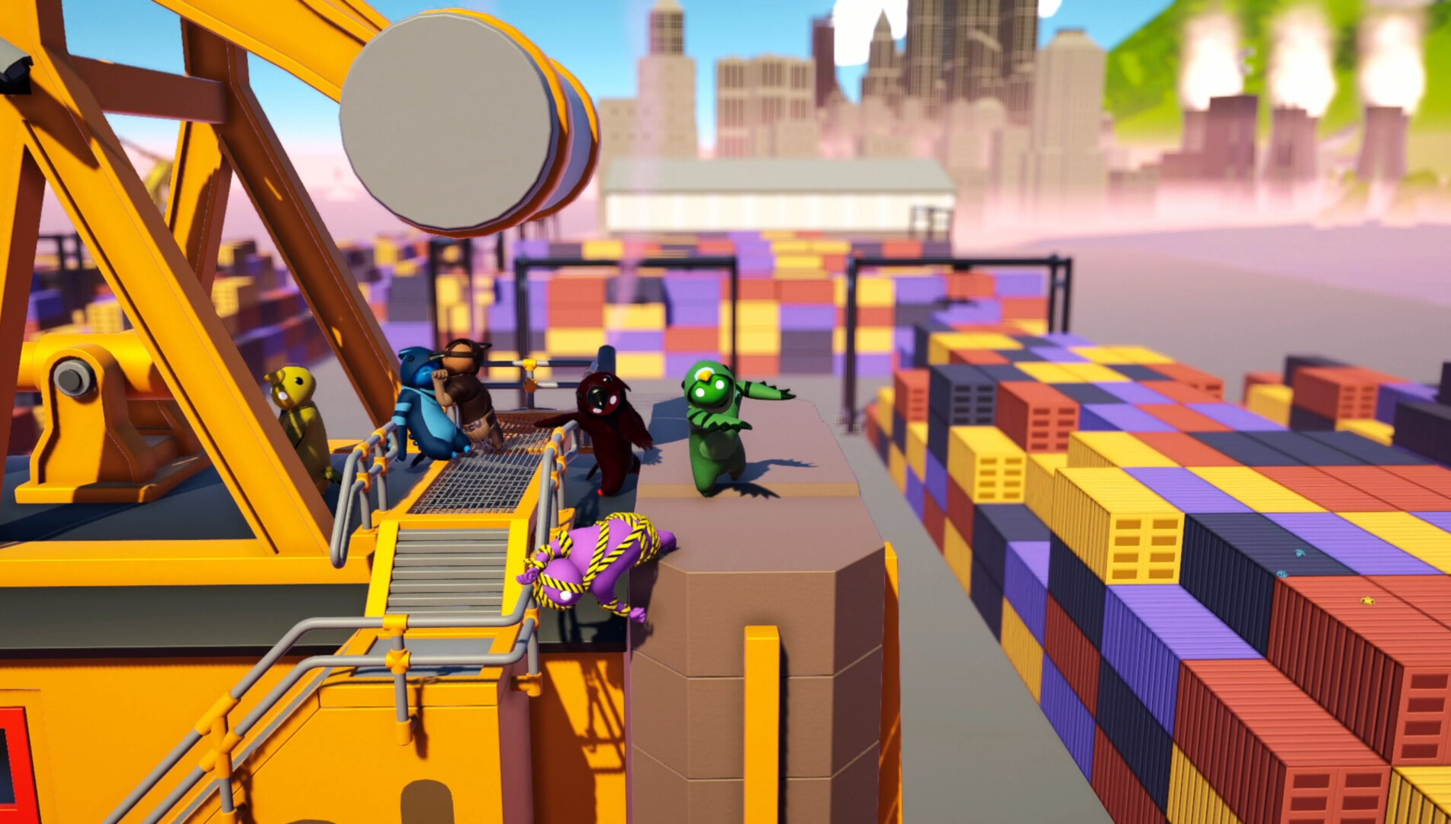
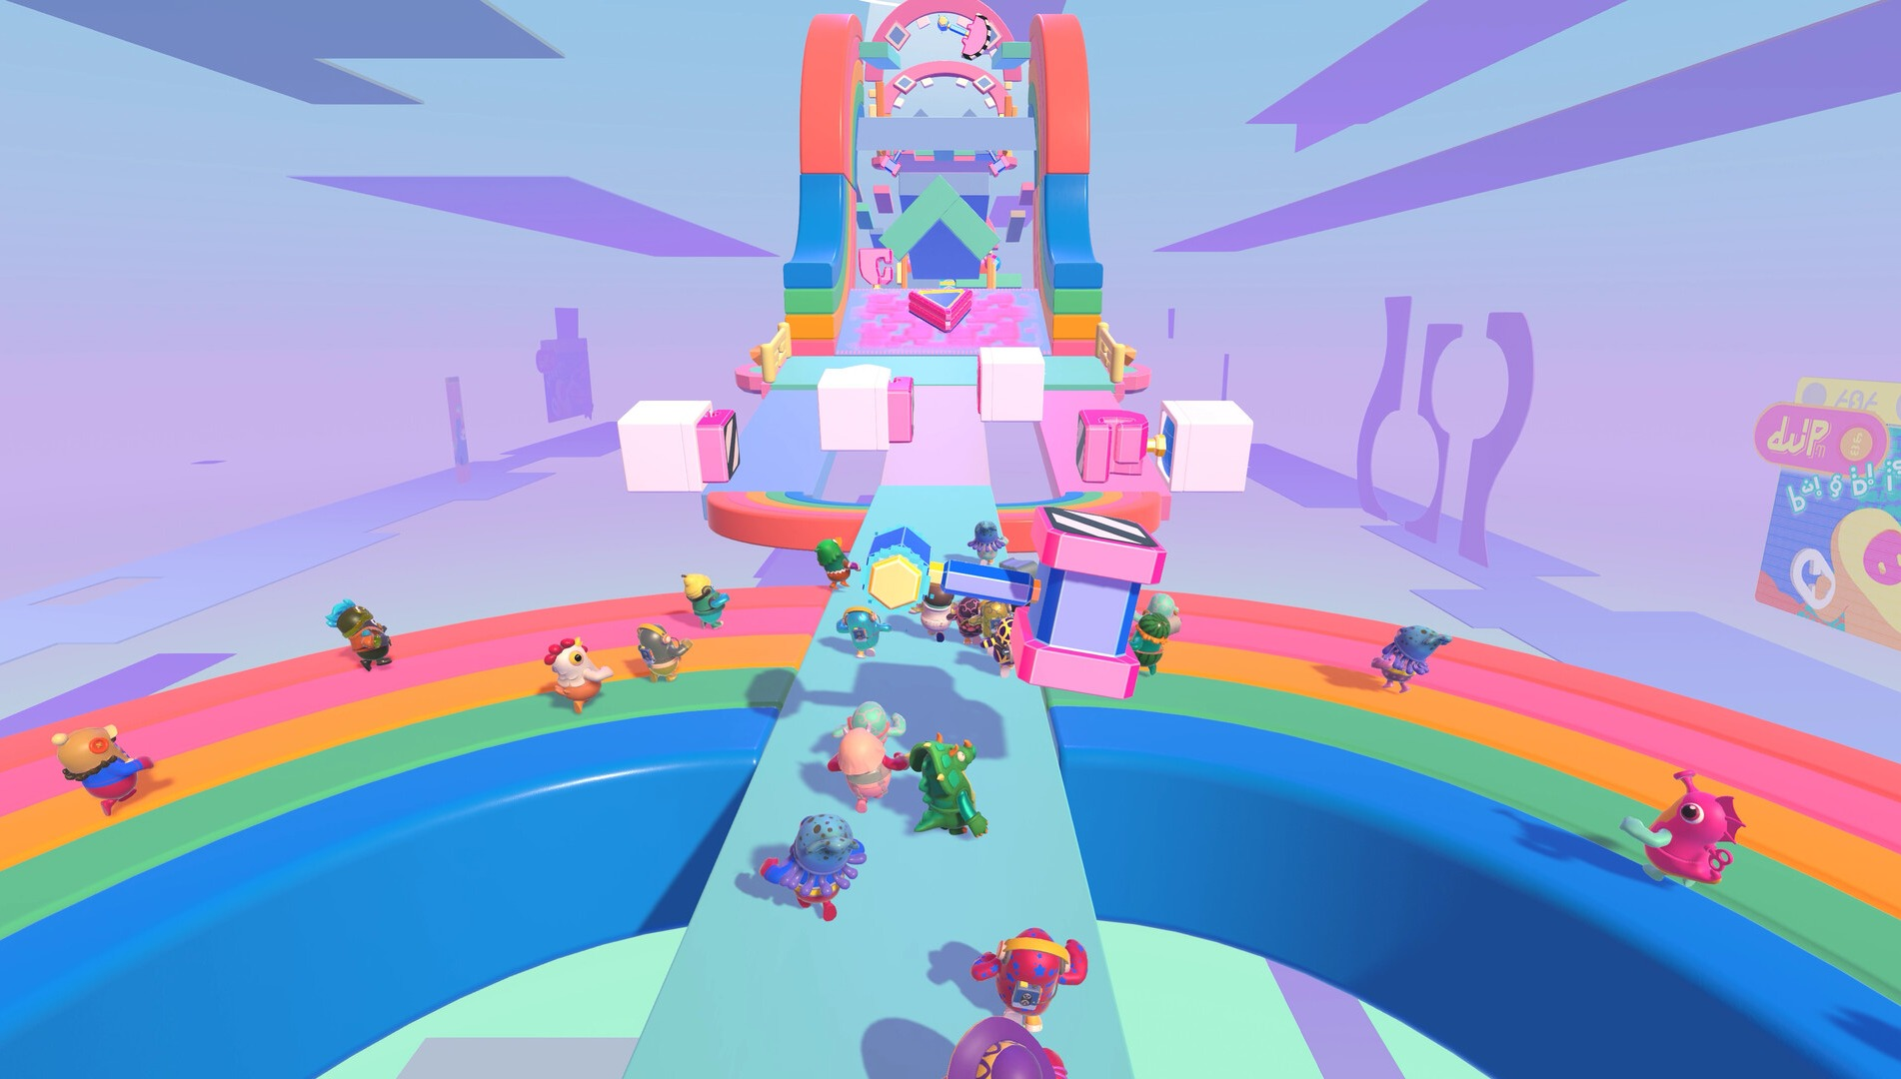
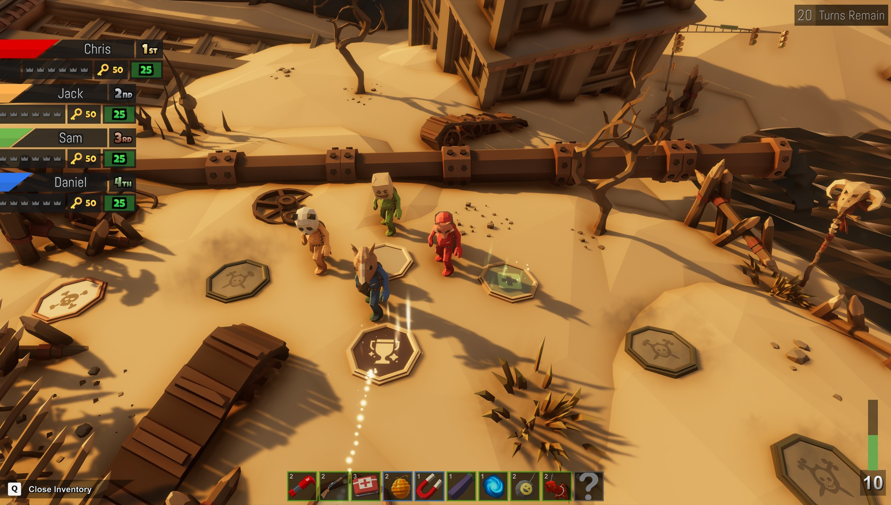
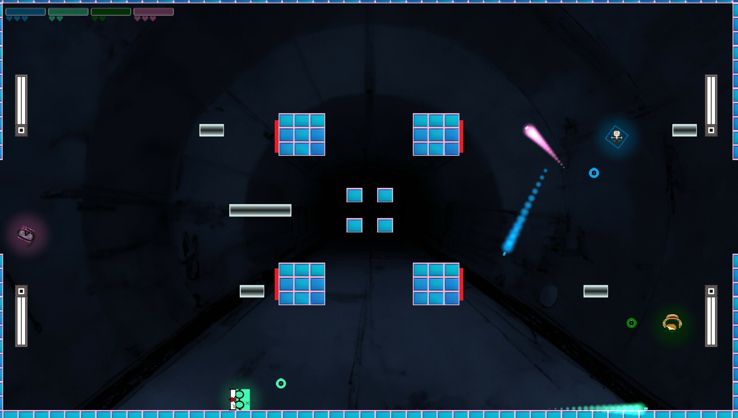
Shooter Party
CMP406 GameTech · Fall 2026
03 · MARKET
Competitors
Five games we are measured against.
AUDIENCE
PHYSICS
FORMAT
FORMAT
MECHANIC
Party Animals
Gang Beasts
Fall Guys
Pummel Party
Squarena
Recreate Games · 2023
Boneloaf · 2017
Mediatonic / Epic · 2020
Rebuilt Games · 2018
Codeaclysm · 2022
MECHANIC
MECHANIC
MECHANIC
MECHANIC
MECHANIC
Physics brawling: grab, punch, throw rivals out.
Ragdoll brawling into stage hazards.
Short race and survival rounds in a playlist.
Board game with short competitive mini-games.
Minimal 2D arena shooter: low health shrinks you; small bodies feel more recoil.
MULTIPLAYER
MULTIPLAYER
MULTIPLAYER
MULTIPLAYER
MULTIPLAYER
Online and same-screen. No LAN listed.
Same-screen and online. No LAN listed.
Online, cross-platform only.
4–8 online and local. No LAN listed.
Up to 6 local. No LAN listed.
FINANCIALS
FINANCIALS
FINANCIALS
FINANCIALS
FINANCIALS
Launch peak 104,174 players. Owner est. 2.5M–6.0M.
85% positive. Owner est. 4.6M–5.8M.
Free-to-play. Legacy Steam peak 172,213. Metacritic 80.
$14.99. Peak 20,957. Owner est. 1.5M–7.6M.
$4.99. Sales not disclosed.
Screenshots: official Steam media, © publishers. “Owner est.” = third-party estimates via SteamDB, not sales. 17 Oct 2026 [7].
Shooter Party · Game proposal
12 / 25
Notes:
Five comparables, each chosen for one reason. Party Animals and Gang Beasts share our audience and physics comedy. Fall Guys and Pummel Party share our session format of short rounds. Squarena is the closest mechanic: it weakens you by shrinking you, in 2D. Owner numbers are third-party estimates and we label them that way.

Slide 13























Shooter Party
CMP406 GameTech · Fall 2026
03 · MARKET
Where we sit among them
PARTY ANIMALS
GANG BEASTS
FALL GUYS
PUMMEL PARTY
SQUARENA
SHOOTER PARTY
3D characters
Ranged attacks
Hits weaken your body
Less mass, further knockback
Several mini-games, one result
Official LAN play
Plays with no internet
Yes
Partly
No
Planned (Shooter Party)
“Official LAN: No” = not advertised in the game's Steam features. “Partly”: Party Animals and Pummel Party have some weapons or items; Fall Guys' playlist eliminates rather than scores. Squarena weakens you by shrinking your size; we lower mass instead. Party Animals needs internet even on one screen [8].
Shooter Party · Game proposal
13 / 25
Notes:
Positioning. Each competitor covers part of this table. Squarena weakens your body by shrinking it; we lower mass instead, and none ties knockback to lost mass. None advertises official LAN. The Shooter Party column is our plan, not shipped software.

Slide 14



Shooter Party
CMP406 GameTech · Fall 2026
04 · INNOVATION
Innovation & creativity
No shipped game we found ties knockback to the mass you have lost.
01
02
03
Mass, not size
One trigger, many effects
Your session, your rules
Hits lower your mass while your size stays. The same shot launches a weakened player further, and everyone can see the danger build.
The same shot pushes, damages or lifts you, depending on the mini-game. Controls are learned once; each mini-game feels new.
Random or custom playlists, excluded or repeated mini-games, and an end by rounds or score. All on a LAN, no internet.
Most party games pick one: a playlist of unrelated mini-games, or one physics brawler. Shooter Party keeps one character and one shot across the whole session, and lets each mini-game bend what that shot means.
Shooter Party · Game proposal
14 / 25
Notes:
Three things are new together. First, mass, not size: hits lower your mass while your size stays, so the same shot launches a weakened player further and everyone can see the danger build. Second, one trigger with many effects: the same shot pushes, damages or lifts you depending on the mini-game, so controls are learned once and each mini-game still feels new. Third, your session, your rules: random or custom playlists, excluded or repeated mini-games, and an end by rounds or by score, all on a LAN with no internet.

Slide 15
Shooter Party
CMP406 GameTech · Fall 2026
04 · INNOVATION
Closest prior art
What exists already, and what we did not find.
IDEA
CLOSEST PRIOR ART
STATUS
Hits weaken your body
Squarena (2D): lower health, smaller body. Morphies Law: hits move mass between robots.
PRECEDENT
Lighter, launched further
Smash Bros. raises knockback with a damage % counter, not mass. In Squarena, smaller bodies feel more of their own recoil.
NOT FOUND
Blast to climb
Rocket jumping in classic shooters such as Quake and Team Fortress 2.
PRECEDENT
Shoot to steer on ice
Recoil movement exists in some games; we did not search this one yet.
TO CHECK
Mass knockback in a LAN party game
No shipped game found.
NOT FOUND
Prior-art search of shipped games, Oct 2026 [9–10]. “Not found” means not found after searching.
Shooter Party · Game proposal
15 / 25
Notes:
We name the relatives. Squarena weakens your body in 2D, and Morphies Law moves mass between robots. Smash Bros. raises knockback with a damage percentage counter, not with mass. Blasting yourself upward is classic rocket jumping, as in Quake and Team Fortress 2. Recoil movement exists in some games; we have not searched shoot-to-steer on ice yet. Lighter-means-launched-further, and mass knockback in a LAN party game, we did not find.

Slide 16
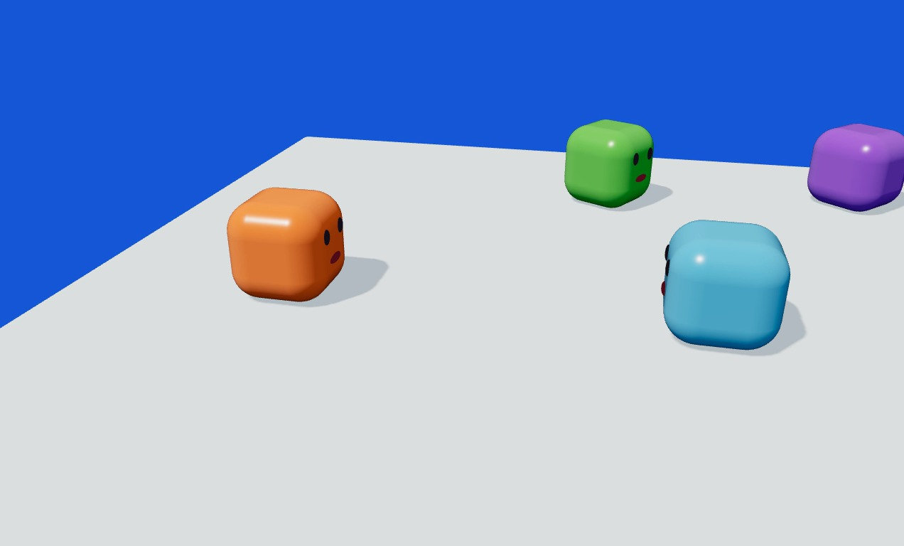
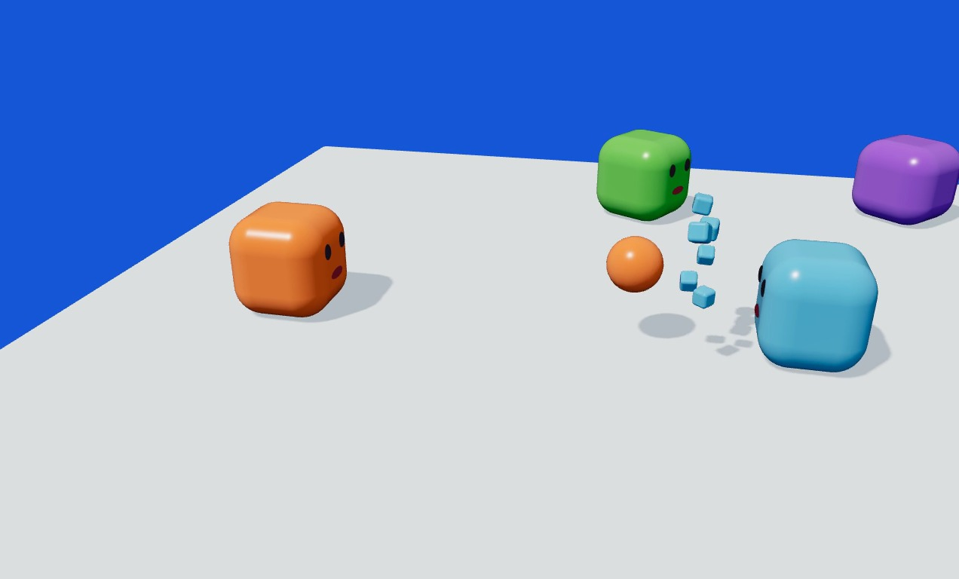
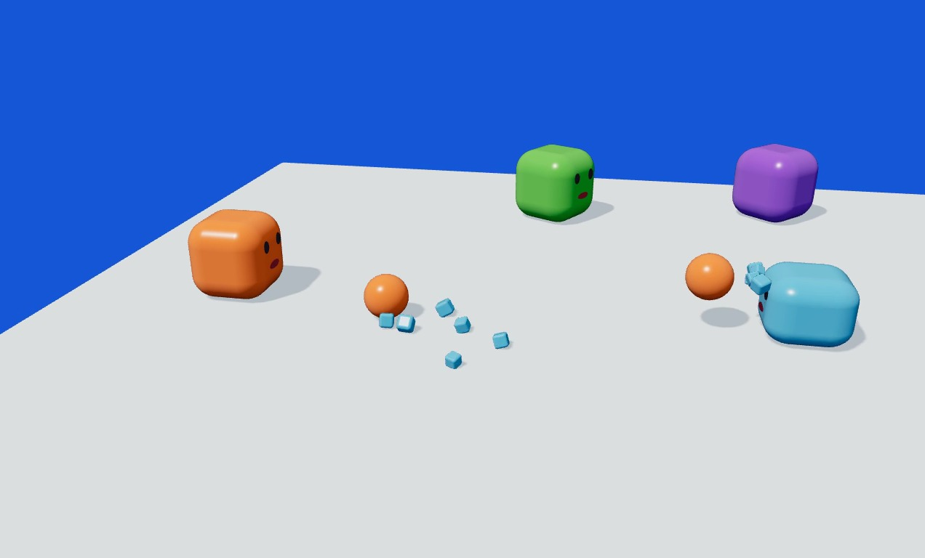
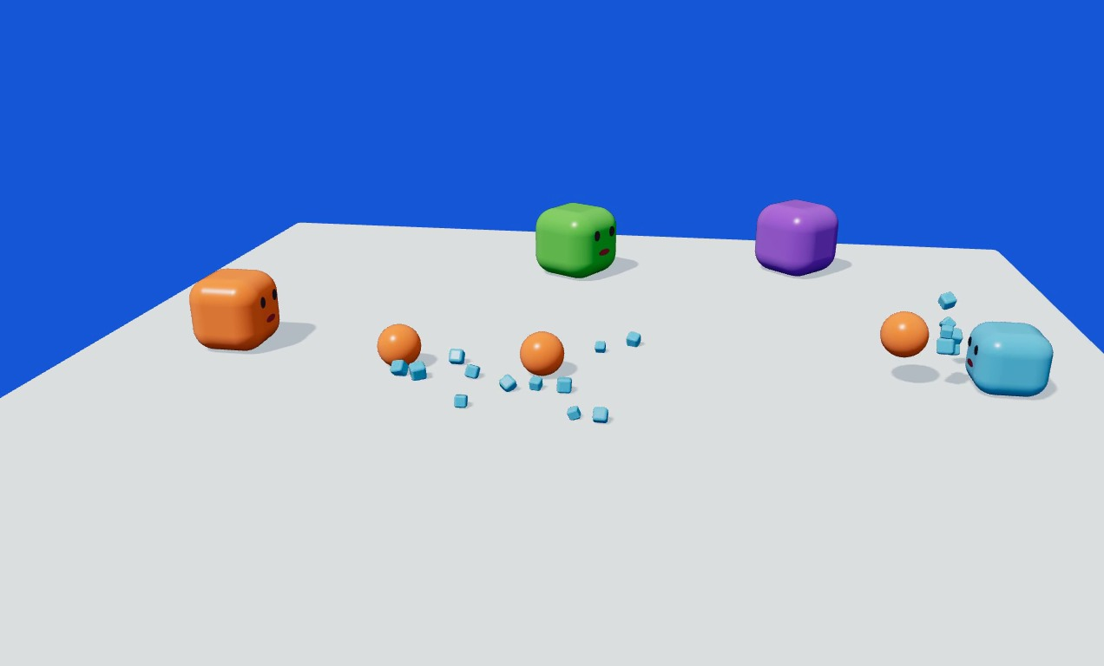
Shooter Party
CMP406 GameTech · Fall 2026
05 · DRAFTS & PROTOTYPES
Physics prototype
Does knockback read on screen?
Before
Shot 1
Shot 2
Shot 3
WHAT WE BUILT AND SAW
WHAT CHANGED SINCE
A deterministic physics test in Three.js. Over three shots the target flies further each time, and the rule is readable without any UI.
This early test showed lost mass as shrinking. Our rule now keeps the size and lowers only the mass, so the Unity test needs another way to show it: a HUD bar, a colour or an effect, to be chosen.
Shooter Party · Game proposal
16 / 25
Notes:
A real prototype: a deterministic physics test in Three.js. Over three shots the target flies further each time, and the rule is readable without any UI. What changed since: this early test showed lost mass as shrinking. Our rule now keeps the size and lowers only the mass, so the Unity test needs another way to show it, a HUD bar, a colour or an effect, still to be chosen.

Slide 17
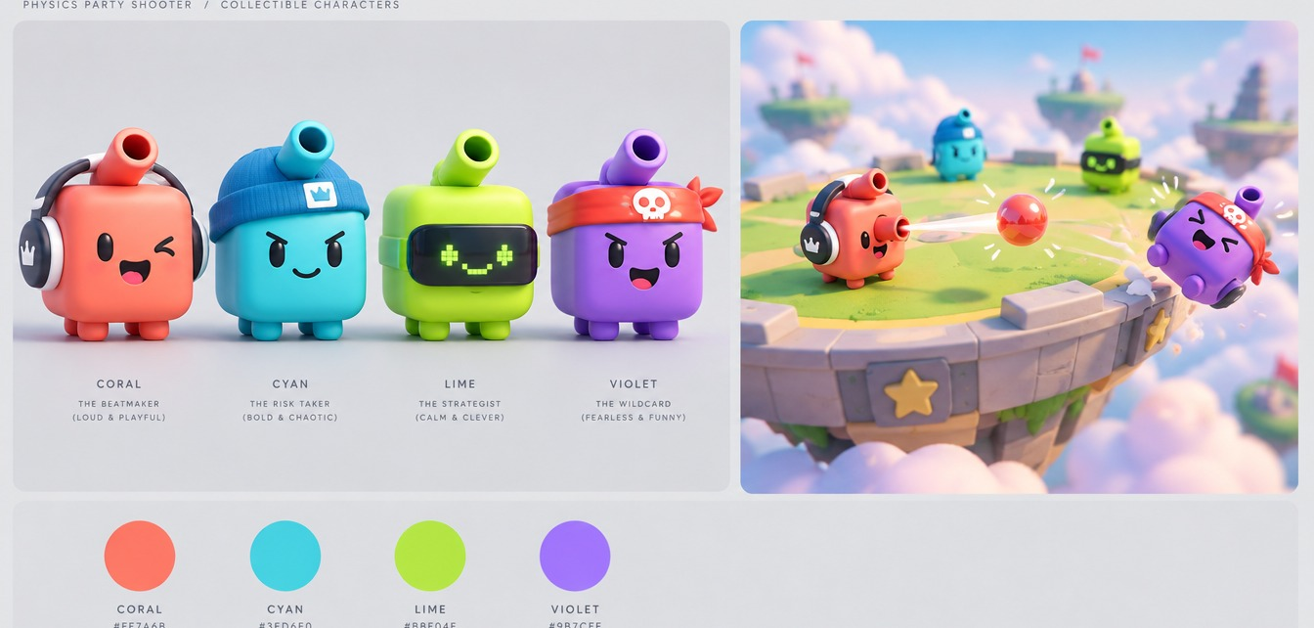
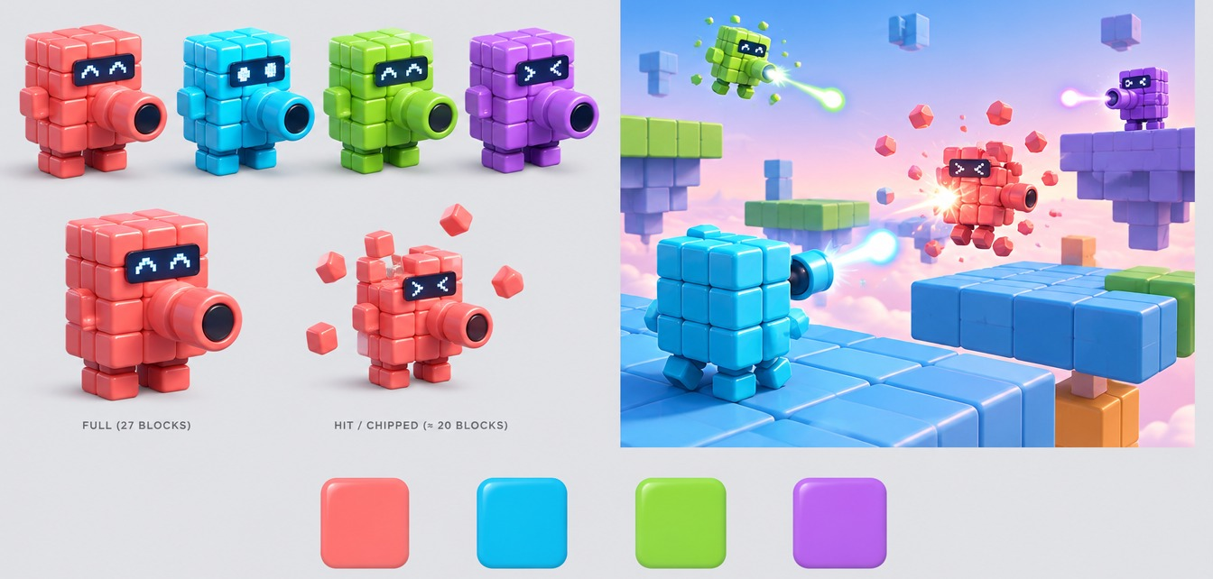
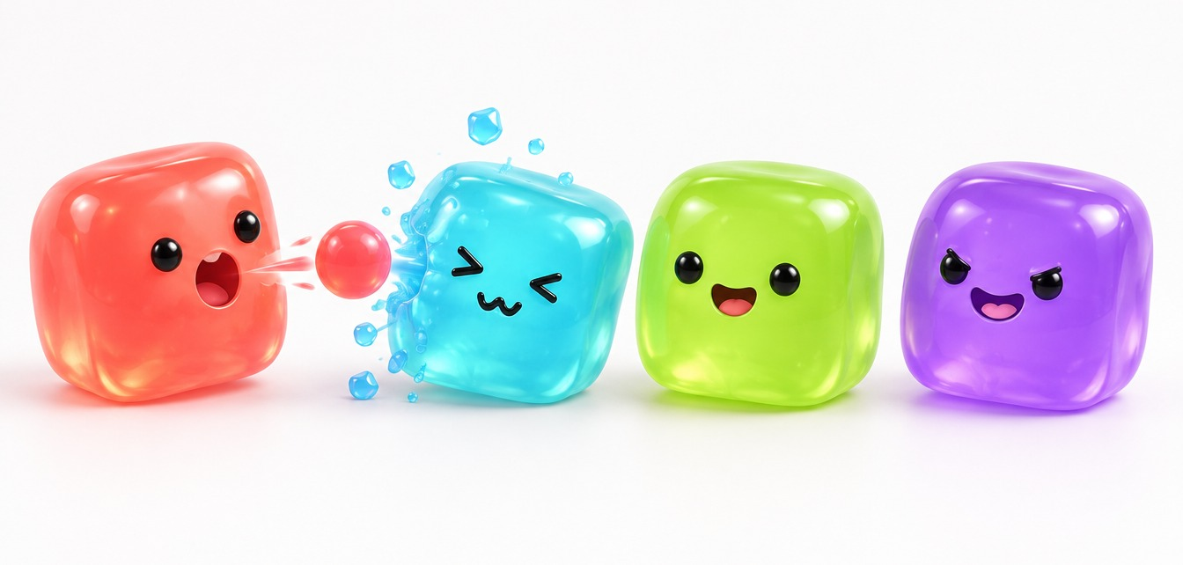
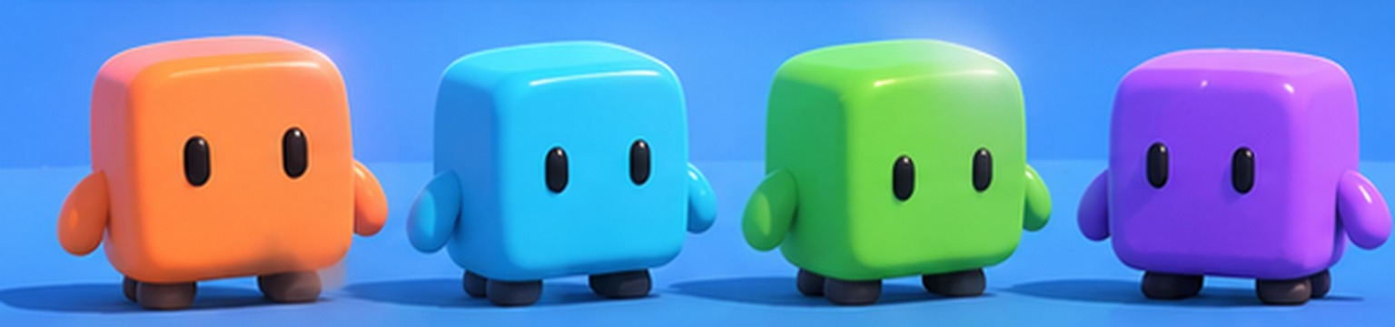
Shooter Party
CMP406 GameTech · Fall 2026
05 · DRAFTS & PROTOTYPES
Art direction: glossy toy
Four looks compared before modelling; the glossy toy was chosen.
CHOSEN
C, glossy toy. Every concept render in this deck uses it.
SETTINGS
Arenas take bright party settings, such as grass, sky and water. Ice is the theme of one mini-game, not the whole game.
A
Vinyl toy
B
Building blocks
PLAYER COLOURS
Orange
Cyan
Lime
Purple
All AI-generated drafts. None is gameplay.
C
Glossy toy · chosen
D
Jelly
Shooter Party · Game proposal
17 / 25
Notes:
Four AI-generated looks for the same character were compared before modelling: vinyl toy, building blocks, glossy toy and jelly. We chose the glossy toy. Arenas take bright party settings like grass, sky and water; ice is only the theme of Ice Loop. The four player colours stay the same whatever the arena.

Slide 18

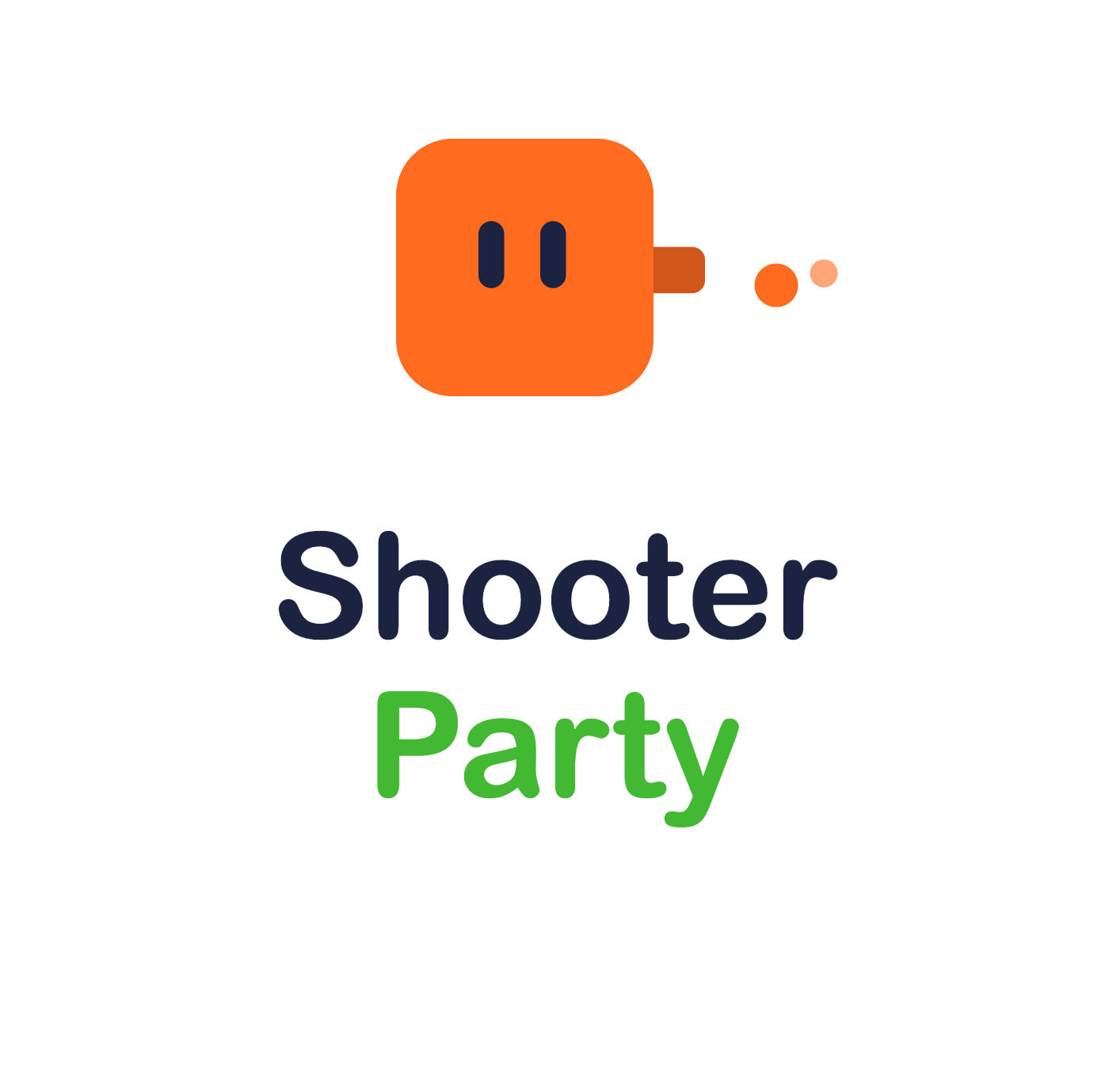

Shooter Party
CMP406 GameTech · Fall 2026
05 · DRAFTS & PROTOTYPES
Logo drafts
Three uses of one mark. The name is a working title.
DRAFT A · WORDMARK
DRAFT B · STACKED
DRAFT C · ICON
Title screen, deck cover, video end card.
Square formats: store capsule, lobby screen.
Taskbar, build icon, favicon.
Shooter Party · Game proposal
18 / 25
Notes:
Three logo drafts for the working title Shooter Party. A is a wordmark for the title screen and the deck. B stacks the name under the shooting cube for square formats like a store capsule. C is a small icon for the taskbar and the build. None is final.

Slide 19
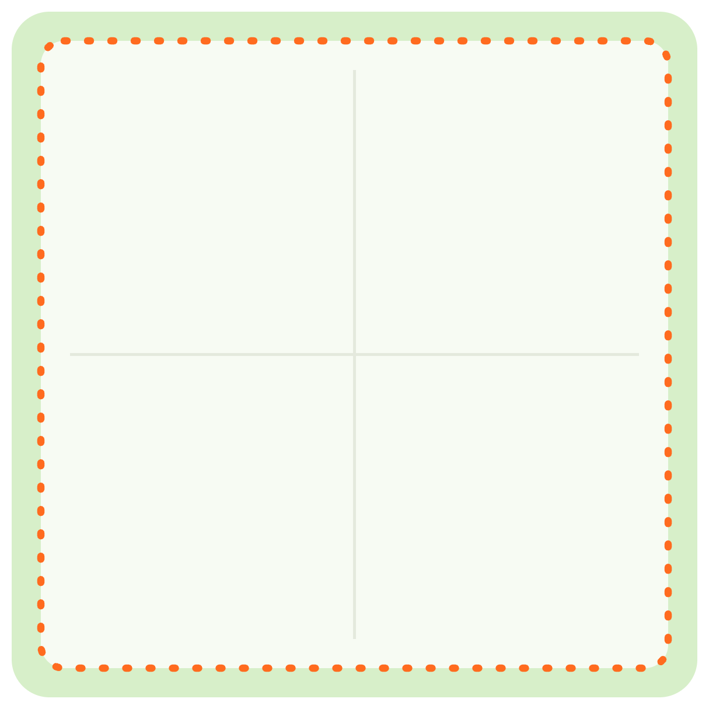
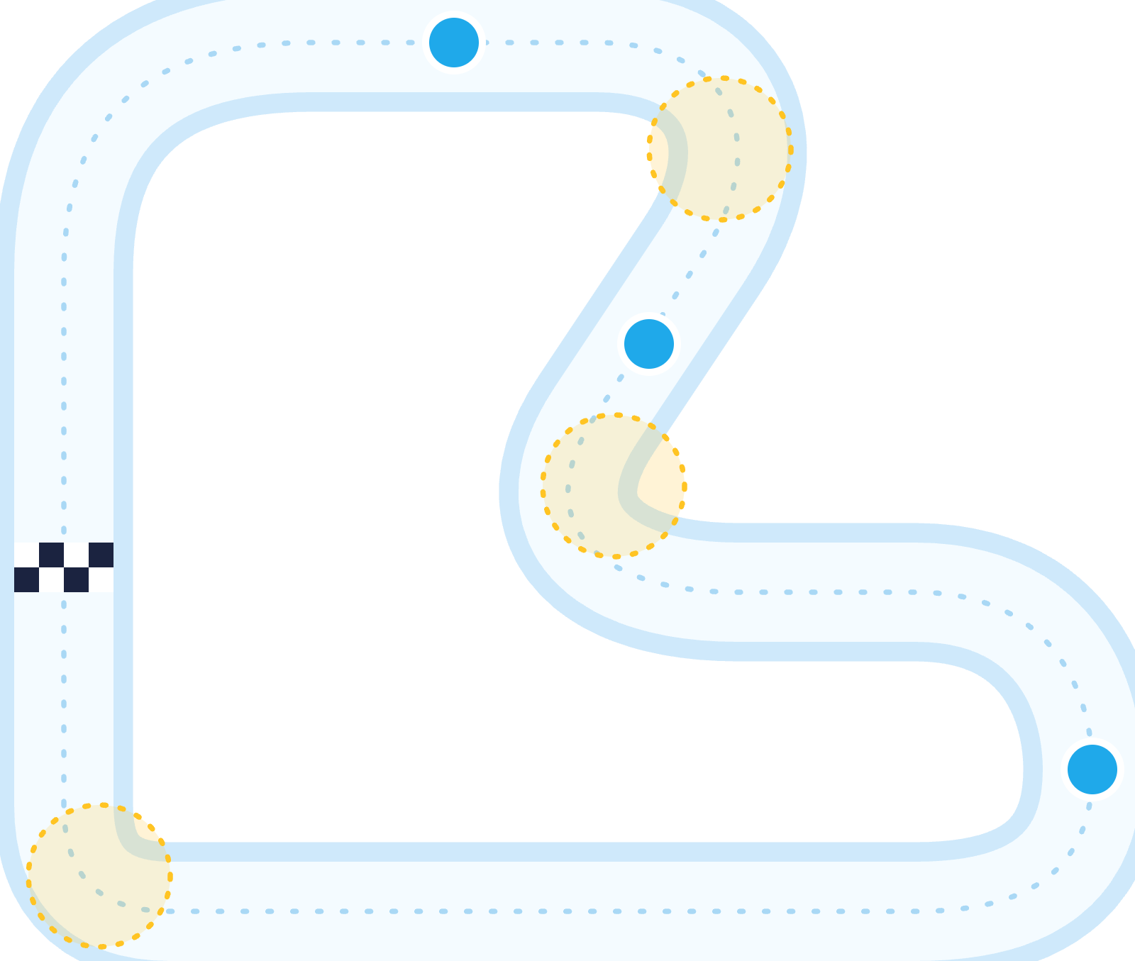




Shooter Party
CMP406 GameTech · Fall 2026
05 · DRAFTS & PROTOTYPES
Level drafts, top-down
Knockback Arena and Ice Loop. Blast Parkour and Hole Grab come next, as blockouts in Unity.
KNOCKBACK ARENA · ARENA DRAFT
ICE LOOP · TRACK DRAFT
CP1
Fall zone. No walls, no cover.
Yellow: slippery corners. Set up early or slide off.
CP2
The track loops; every checkpoint counts +1.
One flat square platform.
START
Spawn near corners.
CP3
OPEN EDGE = KNOCKOUT LINE
Draft layouts. Dimensions, spawn points and checkpoint count are not set.
Shooter Party · Game proposal
19 / 25
Notes:
Two level drafts, seen from above. Knockback Arena: one flat square platform with open edges and no walls; players spawn near the corners and the open edge is the knockout line. Ice Loop: a looping track with checkpoints; every checkpoint counts, lap after lap, and falling into the water puts you back at your last checkpoint. Blast Parkour and Hole Grab layouts come next, as blockouts in Unity.

Slide 20
Shooter Party
CMP406 GameTech · Fall 2026
06 · DEVELOPMENT PLAN
Development plan
12 weeks, four presentations, one playable step each.
Proposed MVP: the shared core plus three mini-games (Knockback Arena, Ice Loop, Hole Grab). Blast Parkour joins in the final phase if time allows; the ideas in progress come after the term. Course checkpoints are on Mondays.
19 Oct
DONE
16 Nov
14 Dec
11 Jan
Proposal
Demo 1
Demo 2
Final
Concept, research, physics prototype and this pitch.
Shared core, LAN host/join and a playable Knockback Arena.
Ice Loop and Hole Grab. A full session with playlist and scoreboard.
Blast Parkour if time allows. Tuning, polish, promo video.
RISK 01
Networked physics
RISK 02
Balance
RISK 03
Scope
Clients disagree on a push or a fall.
Hits too easy, or mass loss snowballing.
More mini-game ideas than one term allows.
Plan: The host simulates; clients only render and interpolate.
Plan: Fire-rate limits; gravity shots if needed.
Plan: The core first; mini-games in priority order; extras only once the MVP is fun.
PROPOSED OWNERS
Ezel
Abdurrahim
Kürşat
Ardıl
Team
Network, build
Shots, mini-game rules
Movement, levels
Art, UI, session
Shared tasks
Shooter Party · Game proposal
20 / 25
Notes:
The plan. The proposed MVP is the shared core plus three mini-games: Knockback Arena, Ice Loop and Hole Grab. Blast Parkour joins in the final phase if time allows. Four Monday checkpoints: the proposal on 19 October; Demo 1 on 16 November with the shared core, LAN host and join and a playable Knockback Arena; Demo 2 on 14 December with Ice Loop, Hole Grab and a full session; the final on 11 January with tuning, polish and the promo video. Three risks: networked physics, handled by host authority; balance, handled by fire-rate limits and gravity shots if needed; and scope, handled by building the core first and adding mini-games in priority order. Scope and owners are a proposal to agree on as a team.

Slide 21

Shooter Party
CMP406 GameTech · Fall 2026
06 · DEVELOPMENT PLAN
Gantt chart: demo 1 · 16 Nov
19–23 Oct
26–30 Oct
2–6 Nov
9–13 Nov
WBS
TASK
OWNER
DURATION
W1
W2
W3
W4
M
T
W
T
F
M
T
W
T
F
M
T
W
T
F
M
T
W
T
F
1
Demo 1 · 16 Nov
1.1
Unity project, scenes, build pipeline
Ezel
1 wk
1.2
Cube controller: WASD, jump
Kürşat
2 wk
1.3
Third-person camera
Kürşat
1 wk
1.4
LAN host / join (Netcode)
Ezel
2 wk
1.5
Host authority & state sync
Ezel
1 wk
1.6
Shot system: projectiles, fire rate
Abdurrahim
2 wk
1.7
Mass loss & knockback rule
Abdurrahim
2 wk
1.8
Knockback Arena level & fall-out
Kürşat
1 wk
1.9
Lobby & join UI
Ardıl
2 wk
1.10
Character model, four colours
Ardıl
1 wk
1.11
Demo 1 build & presentation
Team
1 wk
Shooter Party · Game proposal
21 / 25
Notes:
Weeks 1 to 4. Ezel sets up the project and the LAN layer with host authority. Kürşat builds the cube controller, the third-person camera and the Knockback Arena level. Abdurrahim builds the shot system and the mass and knockback rule. Ardıl builds the lobby UI and the character model in four colours. Week 4 ends with the Demo 1 build.

Slide 22

Shooter Party
CMP406 GameTech · Fall 2026
06 · DEVELOPMENT PLAN
Gantt chart: demo 2 · 14 Dec
16–20 Nov
23–27 Nov
30 Nov–4 Dec
7–11 Dec
WBS
TASK
OWNER
DURATION
W5
W6
W7
W8
M
T
W
T
F
M
T
W
T
F
M
T
W
T
F
M
T
W
T
F
2
Demo 2 · 14 Dec
2.1
Networked projectiles & hits
Ezel
3 wk
2.2
Session: playlist and end rules
Ardıl
2 wk
2.3
Scoreboard & placement points
Ardıl
2 wk
2.4
Ice Loop: ice physics, checkpoints
Kürşat
3 wk
2.5
Hole Grab: holes, rounds, bulldozer
Abdurrahim
3 wk
2.6
First full-session playtest
Team
1 wk
2.7
Demo 2 build & presentation
Team
1 wk
Shooter Party · Game proposal
22 / 25
Notes:
Weeks 5 to 8. Networked projectiles and hits; the session with playlist and end rules; the scoreboard and placement points; Ice Loop with ice physics and checkpoints; Hole Grab with holes, rounds and the bulldozer. Week 8 is the first full-session playtest and the Demo 2 build.

Slide 23

Shooter Party
CMP406 GameTech · Fall 2026
06 · DEVELOPMENT PLAN
Gantt chart: final · 11 Jan
14–18 Dec
21–25 Dec
28 Dec–1 Jan
4–8 Jan
WBS
TASK
OWNER
DURATION
W9
W10
W11
W12
M
T
W
T
F
M
T
W
T
F
M
T
W
T
F
M
T
W
T
F
3
Final · 11 Jan
3.1
Blast Parkour (stretch goal)
Abdurrahim
3 wk
3.2
Network fixes from playtests
Ezel
2 wk
3.3
Balance tuning from playtests
Team
2 wk
3.4
VFX & sound
Kürşat
2 wk
3.5
Art & UI polish, party-theme arenas
Ardıl
3 wk
3.6
LAN stress test & final build
Ezel
1 wk
3.7
Promo video & final deck
Team
1 wk
PROPOSED OWNERS
Ezel
Abdurrahim
Kürşat
Ardıl
Team
Network, build
Shots, mini-game rules
Movement, levels
Art, UI, session
Shared tasks
Shooter Party · Game proposal
23 / 25
Notes:
Weeks 9 to 12. Blast Parkour as the stretch goal, network fixes and balance tuning from playtests, VFX and sound, art and UI polish with party-theme arenas, a LAN stress test and the final build, and in the last week the promo video and final deck. The final date may still move; we would shift the last weeks with it.

Slide 24
FINAL STANDINGS
Shooter Party in short
1st
2–4 players, one LAN, no internet, your own playlist.
2nd
One shooting cube; every mini-game changes what a shot does.
3rd
Every hit lowers your mass, so the next push sends you further.
Questions?
Ezel Bayraktar · Abdurrahim Özağaç · Kürşat Hürkan Aydın · Ardıl Bilal Ülkü
Notes:
In short: two to four players, one LAN, no internet, your own playlist. One shooting cube, and every mini-game changes what a shot does. Every hit lowers your mass, so the next push sends you further. Questions.

Slide 25
Shooter Party
CMP406 GameTech · Fall 2026
APPENDIX
Sources
[1] Newzoo final 2025 figures, via GameDev Reports, 26 Jun 2026. gamedevreports.substack.com/p/newzoo-gaming-market-surpassed-200
[2] Alinea Analytics, games with co-op on Steam, H1 2025 (proprietary estimates). alineaanalytics.substack.com/p/games-with-co-op-generated-over-4
[3] ESA Essential Facts 2026 (survey Feb 2026, n=13,545). theesa.com
[4] Steam store search, tag “Party Game” × LAN PvP / Online PvP / Shared-Split-screen PvP, 17 Oct 2026. Tags are user-applied.
[5] Game Developers, 2025 Steam revenue distribution (Gamalytic estimates), 21 Aug 2026. game-developers.org/2025-steam-game-revenue-distribution
[6] PC Gamer, Valve at GDC 2026: 5,863 games over $100K on Steam in 2025. pcgamer.com
[7] Steam store pages and SteamDB charts, apps 1260320, 285900, 1097150, 880940, 1858400: prices, peaks, reviews, owner estimates. 17 Oct 2026.
[8] GameRevolution / Prima Games: Party Animals requires an internet connection, including split-screen.
[9] Squarena on Steam (app 1858400); codeaclysmgames.com/squarena-details.
[10] Morphies Law official site, morphieslaw.com/game.
Images: concept renders are AI-generated (GPT Image via Higgsfield; MiniMax H3) from our own reference art; illustrations and level drafts were made for this pitch. None show gameplay.
Shooter Party · Game proposal
25 / 25
Notes:
Full research notes with all sources are in research/market-research.md.

