Slide 1
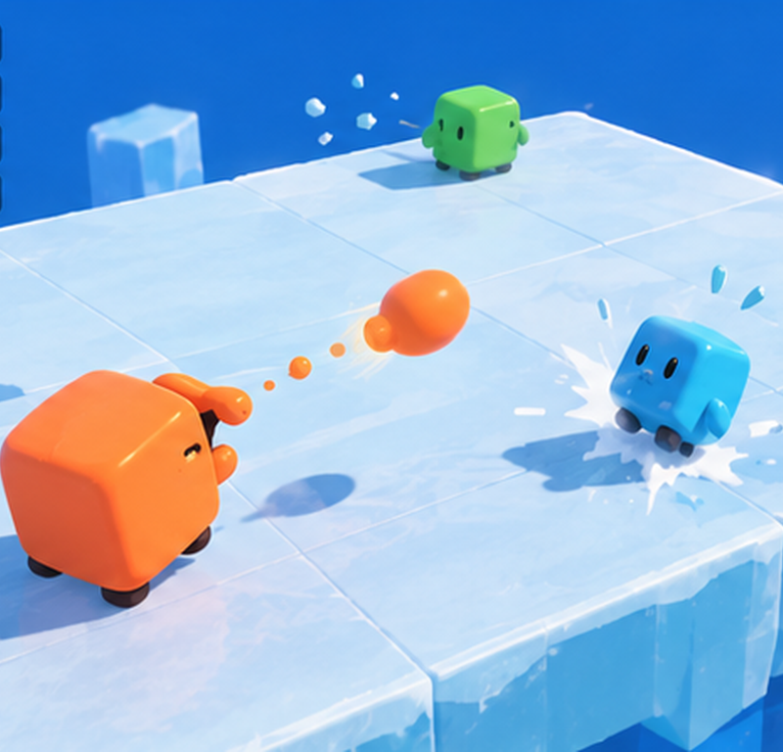
CMP406 · GAMETECH F26 · PROJECT PROPOSAL
Ice
Rumble
WORKING TITLE
A LAN party game where everything you throw is a piece of you.
Ezel Bayraktar
2220356197
Abdurrahim Özağaç
2220356033
Kürşat Hürkan Aydın
2230356008
Ardıl Bilal Ülkü
2230356051
Notes:
[0:30] Intro. We are team of four. Working title Ice Rumble. One line: a LAN party game where everything you throw is a piece of you. All imagery in this deck is AI-generated concept art or simulation — we label it as such. Nothing here is recorded gameplay from a finished build.

Slide 2
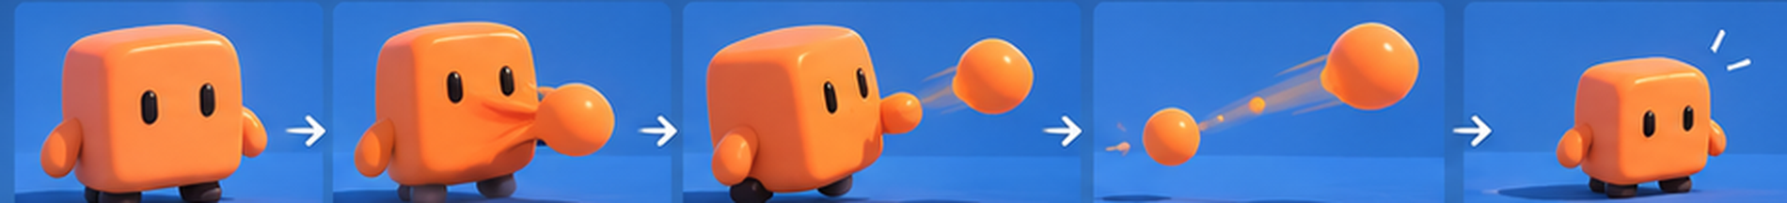
01 / THE PITCH
Everything you throw
is a piece of you.
Two to four friends, one local network, short chaotic mini-games and a running scoreboard. Squishy cubes have no weapons — they win by spitting chunks of their own body at each other. Every shot makes you smaller; every hit makes your rival lighter and easier to launch off the stage.
FULL SIZE
GATHER
SPIT
FLY
LIGHTER
FIG. 1 — Concept sequence (AI-generated illustration, not gameplay capture)
Notes:
[1:00] The hook. In Smash, damage is an abstract percentage. Here it is physical: shooting costs you body mass, getting hit costs you body mass, and lighter bodies fly further. One rule explains the whole game. Read the five frames left to right: full size, gather, spit, fly, lighter.

Slide 3
One night, a few rounds, one champion
02 / HOW A NIGHT PLAYS
01
02
03
04
Lobby
Mini-game
Placement
Standings
One player hosts. Friends join by local IP. Pick a color.
A 60–90 second round with the same controls and different physics.
1st gets 4 points, 2nd 3, 3rd 2, 4th 1 (proposed, to be playtested).
The scoreboard updates and the next round loads immediately.
↻ repeat for ~4 rounds, then the champion is crowned
SAMPLE STANDINGS AFTER ROUND 3
1
ORANGE
10
2
PURPLE
8
3
GREEN
6
4
CYAN
5
Notes:
[1:15] How it plays in plain words. Someone hosts, friends join on the same network, rounds are short, placements become points, standings show after every round. Points are proposed and will be tuned in playtests. Sample standings are illustrative.

Slide 4
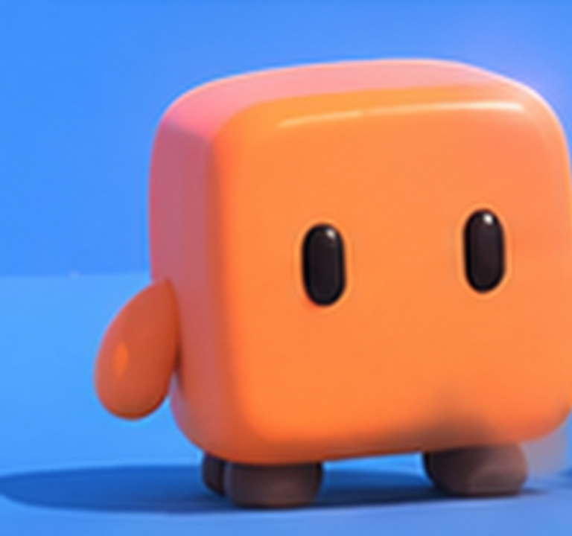
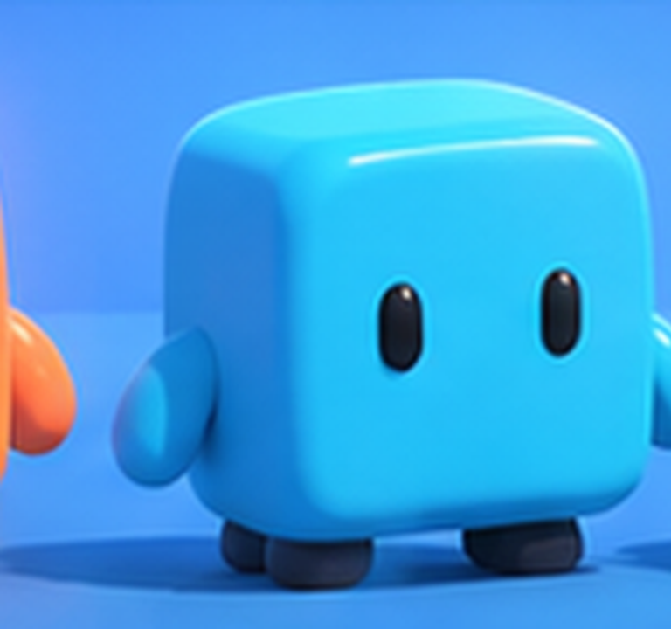
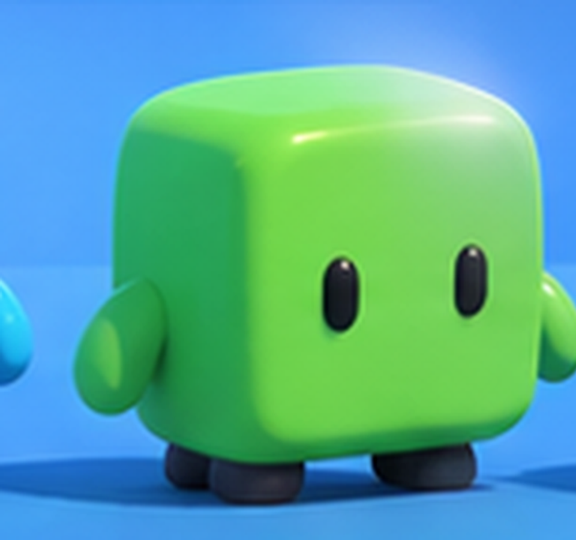
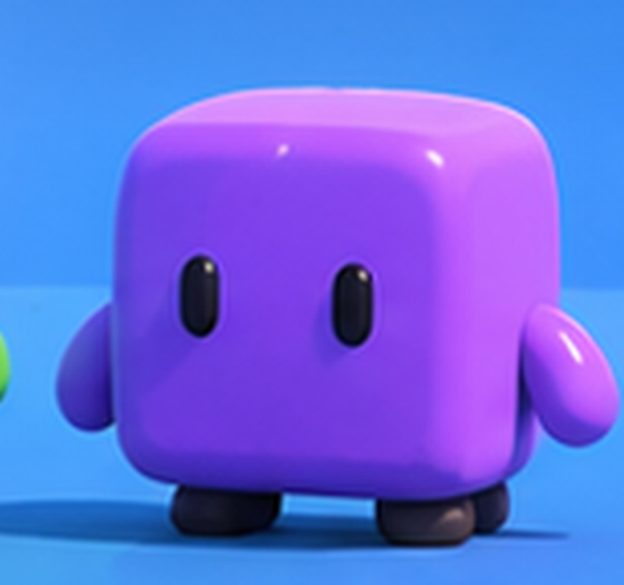
Four cubes, one rule set
03 / THE CAST
ORANGE
CYAN
GREEN
PURPLE
Loud and first to throw.
Slides further than anyone.
Waits, then strikes.
Chaos with a grin.
The same body for everyone — rounded cube, big eyes, tiny arms and feet. Color is identity; skill decides the winner. One shared character prefab keeps the project small and the rules readable at a glance.
Size
full 1.0 → minimum 0.65
FIG. 2 — Character sheet (AI-generated concept art; final models TBD)
Notes:
[0:45] The cast. Four identical bodies in four colors. Identical on purpose: no class balance to tune, skill decides. Size runs from 1.0 down to a floor of 0.65 so nobody disappears.

Slide 5
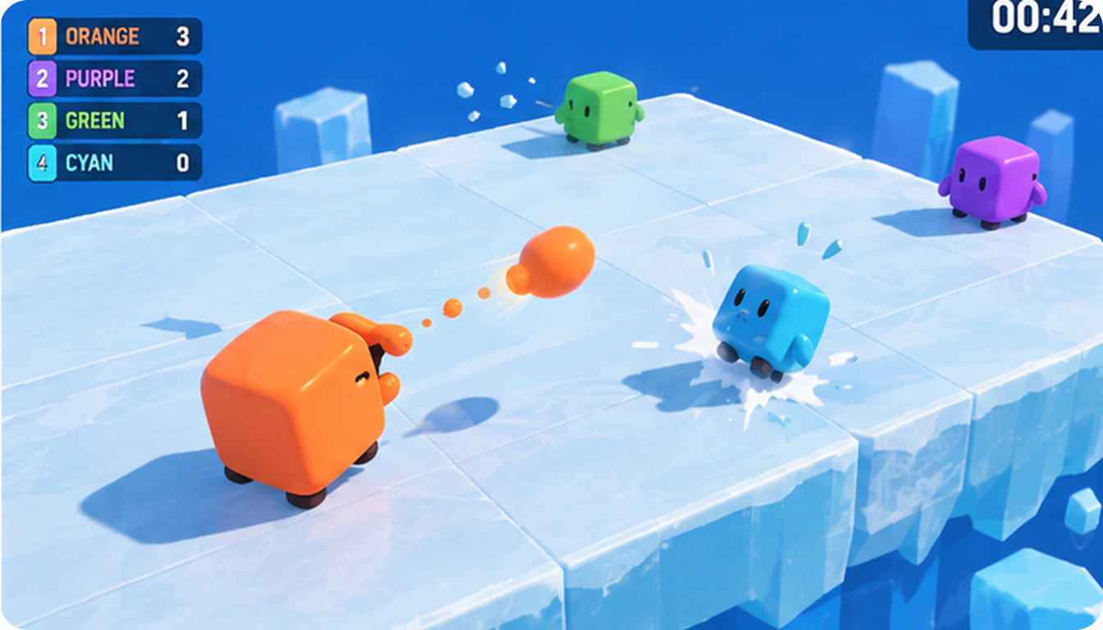
Every shot costs you
04 / THE CORE VERB
−0.08
SIZE PER THROW
A chunk of your own body leaves as the projectile. A miss still costs you.
−0.12
SIZE WHEN HIT
The target squashes, splashes cyan fragments and loses mass.
+70%
KNOCKBACK AT MINIMUM SIZE
Lighter bodies launch further, so each hit makes the next one stronger.
FIG. 3 — Orange has just spat a piece of itself at Cyan (AI concept visual)
Values are illustrative starting points for playtesting, not final tuning.
Notes:
[1:15] The one verb. Throwing costs eight percent of your size; being hit costs twelve; and the lighter you are, the further a hit sends you. All numbers are starting points. Inspirations: Smash for the knockback feel, Osmos and Agar.io for ejecting mass as an action.

Slide 6
Lighter means launched further
05 / THE PHYSICS
×1.7
Design target at the 0.65 floor — felt, not frustrating.
×3.6
What real physics would give. Too punishing for a party game.
Reset
Size resets every round, so one bad exchange cannot decide a night.
Curves are illustrative design targets to be validated in the prototype.
Notes:
[1:15] Visual engineering slide. Orange line: our design target, knockback rises from 1.0 to 1.7 as you shrink to the 0.65 floor. Purple line: pure physics, knockback scaling with one over size cubed, would reach 3.6 — snowballs and feels bad. We tune for fun, not realism, and reset size each round to stop snowballing. These are design targets, not measurements.

Slide 7
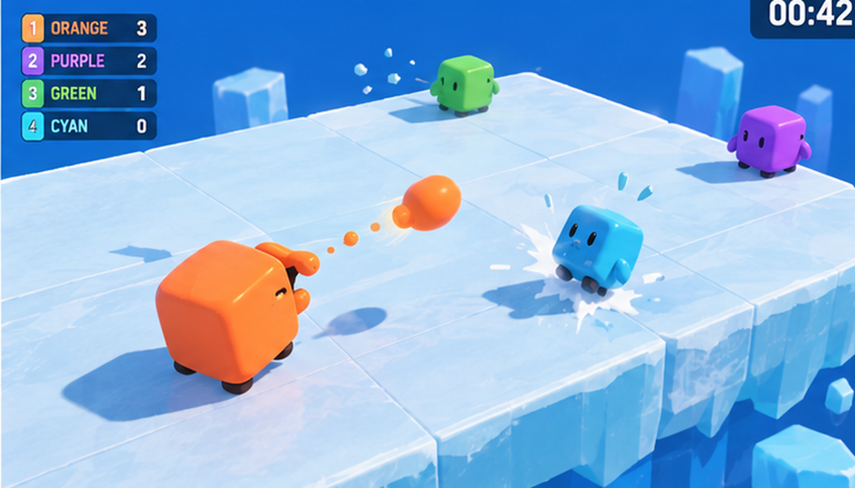
Mass Knockout
06 / MINI-GAME ONE
One flat ice platform, no walls.
Throw chunks of yourself to push rivals off the edge.
Aim and throw
Each throw shrinks you; a hit shrinks them
Smaller cubes get knocked further
Last hitter scores the knockout; victims respawn after 2 s
Round ends on a timer: most knockouts wins
Design risk if throwing shrinks you, waiting becomes optimal. We reward knockouts and keep rounds short.
AI-generated preview of the intended mechanic — not recorded gameplay
Notes:
[1:30] Mini-game one. A single flat platform with no walls. You throw chunks of your own body. Be upfront about the risk: if throwing makes you smaller, standing back and waiting could be optimal, so we reward knockouts, keep rounds short and will playtest. The video is an AI visualization of the intended rule, not a capture from a build.

Slide 8
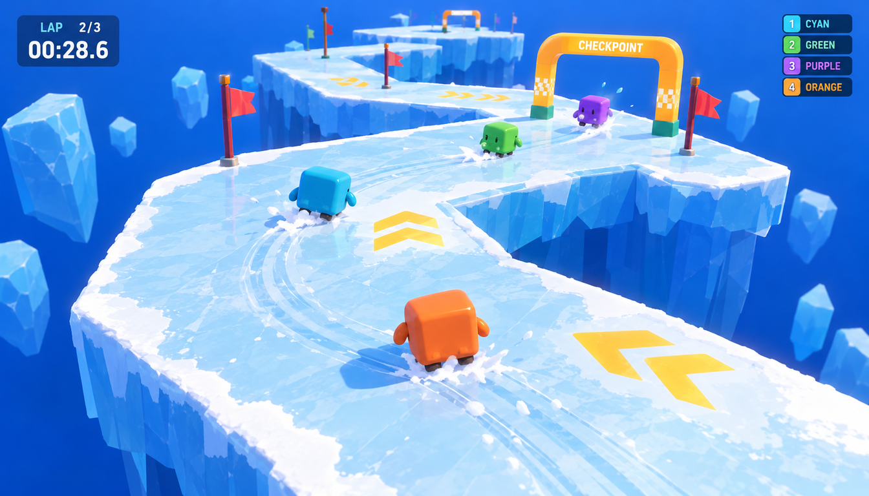
Ice Race
07 / MINI-GAME TWO
Momentum is the opponent.
A ribbon of ice above the void: steer early or slide off.
Input accelerates — it never sets velocity
Low grip: a cube can face the corner and still drift outward
Checkpoints respawn you after a fall
No weapons: same grip and acceleration for all
First across the line wins; unfinished racers rank by progress
Prototype track: 5–8 box segments, 2 turns, 2 checkpoints. No moving platforms.
AI-generated preview of the intended mechanic — not recorded gameplay
Notes:
[1:15] Mini-game two. The challenge is momentum: input accelerates, it does not set velocity, so cubes drift. No weapons here, the same character just feels different. The prototype track is deliberately tiny: a handful of box segments and two turns.

Slide 9
Build once, play many
08 / SHARED SYSTEMS
ICE RACE
low grip · checkpoints · finish order
MASS KNOCKOUT
mass throw · impulse · ring-out
+ NEXT MINI-GAME
reuses everything below
SHARED CORE
Character prefab
Input + camera
Round state machine
Scoreboard + results
Fall detector
LAN host / client layer · host-authoritative physics, projectiles and score · no dedicated server
Each new mini-game is a small module: its own tuning (grip, speed, cooldown) and win rule on top of systems we build once. The MVP ships two modules; a third is a stretch goal.
Notes:
[1:00] Technology. Think of the project as a stack. Bottom: LAN networking. Middle: the shared core, one character, input, camera, round state machine, scoreboard. Top: mini-games as thin modules with their own tuning. That is why two polished mini-games is realistic and a third is a stretch.

Slide 10
A living-room network
09 / NETWORKING
CLIENT 2
sends input
No servers, no accounts
The host owns physics, projectiles and score; clients send input and render snapshots.
Join by LAN address
2–4 players keeps sync cheap
Online play is out of scope
HOST
runs the simulation
and also plays
CLIENT 3
sends input
clients send inputs → ← host sends state
CLIENT 4
sends input
Honest risk networked rigidbody physics will drift; we start with the simplest scene to learn what breaks.
LOCAL NETWORK · ONE ROUTER OR HOTSPOT
Notes:
[0:45] Networking. One player is the host and runs the authoritative simulation; others send inputs and render what the host says. No dedicated server and no online play. Two to four players keeps bandwidth trivial. The real risk is physics drifting across machines, so we prototype that first. We plan to use Unity networking (Netcode for GameObjects is the candidate).

Slide 11
Friends are the market
10 / MARKET AND AUDIENCE
$4.1B
89%
55%
Co-op games grossed on Steam in H1 2025 — an all-time record
of Gen Z have played video games with other people
of all play time happens Friday to Sunday: game night
Alinea Analytics, Aug 2025
ESA Essential Facts 2026
ESA Essential Facts 2026
Friend groups on PC, 16–29
Game-night hosts
Students and early-career players who already buy cheap social games such as R.E.P.O. (19M players in 2025).
Dorms, student societies, LAN clubs and family evenings where one person sets it up for the room.
Indie party games on Steam sit in a $5–20 price band. Full sources in the appendix.
Notes:
[1:15] Market. Co-op and social games set a record on Steam: 4.1 billion dollars in the first half of 2025. 89 percent of Gen Z have played with others, and over half of play time is Friday to Sunday: this is a game-night game. Core audience: friend groups on PC and the people who host game nights. Caveat to say out loud: Steam is winner-take-all, the median 2026 game earned about 1.7 thousand dollars, so our goal for the course is a complete polished experience, not a commercial forecast.

Slide 12
Almost nobody plays the room
11 / THE LAN GAP
≈8%
of Steam party games list LAN multiplayer. Fall Guys is online-only, and Party Animals needs internet even for split-screen.
Be honest: only 13% of US adult players call offline multiplayer a top buying factor. LAN is our differentiator, not the whole pitch.
Source: Steam store search, 17 Oct 2026 (tags are user-applied; counts include unreleased titles). ESA 2026.
Notes:
[0:45] Of about 3,490 Steam games tagged party game, only around 292 list LAN PvP — 8 percent. Most are online-first. That is a gap for classroom, dorm and club use, where everyone is in one room and nobody wants accounts or lag. We are honest that most buyers do not rank offline play first, so LAN is a differentiator, not the entire story.

Slide 13
Four games we're measured against
12 / THE COMPETITION
Game | Look and theme | Core mechanic | Plays | The numbers | What it leaves open
Fall Guys | Pastel jellybeans, game-show set | Obstacle-course survival and shoving | Online only | 11M PC copies (2020); 50M players by 2022; free-to-play since 2022 | No LAN, no shooting; most players are out early and just watch
Party Animals | Plush animals, slapstick | Ragdoll brawling, grab and throw | Online; split-screen needs internet | ≈2.6M copies est. at $19.99; 104k Steam peak | No offline or LAN play; melee only
Gang Beasts | Wobbly gel-blob people | Clumsy ring-out brawling | Local and online | ≈2.5M copies est. at $19.99 (estimates vary) | Melee only; no scoring across varied mini-games
Smash Ultimate | Polished Nintendo crossover | Damage % raises knockback, ring-out KO | Local wireless up to 8, online | 38.1M units on Switch at $59.99 (Nintendo, 2026) | Switch only, steep skill curve, not a party scoreboard
Ice Rumble | Soft rounded cubes on an ice-blue void | Throw your own mass; lighter means launched further | LAN, 2–4, one host | Concept stage; indie price band $5–20 | 3D physics throwing + mass knockback + scoreboard + LAN
Sources: Mediatonic via Vandal (2020); Shacknews (2022); SteamDB, Raijin estimates, Steam pages (17 Oct 2026); Nintendo IR (30 Jun 2026). "est." = third-party estimate, not an official figure.
Notes:
[1:30] Four comparables on look, mechanic, how you play, and the money. Fall Guys: huge but online only and elimination leaves most people watching. Party Animals: cute and brutal but needs internet. Gang Beasts: wobble comedy, melee only. Smash: the knockback reference, but Switch-only and not a party scoreboard. Be clear that sales figures marked est. are third-party estimates. We also examined Pummel Party, Ultimate Chicken Horse, Stick Fight and Mario Party Jamboree — details in the appendix and research file.

Slide 14
What nobody else puts together
13 / WHAT IS NEW
01
02
03
Your ammo is your body
One verb, many games
A party night on LAN
Smash turns damage into a percentage counter. Literal mass loss only appears in obscure titles and mods. Here it is physical, visible and shared by every player.
Splatoon proves a single shooting verb can carry many modes, but on Switch. PC party games change controls every round. We keep one and remix its physics.
Only ≈8% of Steam party games list LAN. Fall Guys and Party Animals need internet. One host, one room, zero accounts.
The combination is the claim: 3D physics throwing + mass knockback + a mini-game scoreboard + LAN hosting on PC. None of the eight games we examined does all four.
Ancestors we borrow from: Smash (knockback), Osmos and Agar.io (ejecting mass as an action).
Notes:
[1:30] The innovation slide. We do not claim any single idea is brand new. Smash has damage-as-knockback, Splatoon has one verb across modes, Duck Game has LAN. The defensible claim is the combination — and the specific twist that your ammunition is your own body, so attack and vulnerability are the same resource. Be precise and honest; it makes the claim stronger.

Slide 15
Where it can go next
14 / WHERE IT CAN GO
MVP
MVP
STRETCH
Mass Knockout
Ice Race
Spot Grab
Throw your own mass, last hitter scores.
Momentum racing with no weapons.
Fewer safe spots than players; size decides who fits.
EXPLORE
EXPLORE
EXPLORE
Mass pickups
Ghost cannons
Light and fast
Regrow by touching glowing chunks, a built-in comeback.
Knocked-out players keep playing from the rim (Bomberman precedent).
Small cubes move faster but fall easier: a risk-reward trade.
MVP is two polished mini-games. Everything else is a candidate we will playtest before building.
Notes:
[0:45] Scope discipline. MVP is Mass Knockout and Ice Race. Spot Grab came from our first brainstorm and is a stretch. The explore ideas are ways to fix the snowball risk or deepen the mechanic; we will only keep what playtests justify.

Slide 16
Plan, risks and what is still open
15 / PLAN AND RISKS
M1
Foundation
Risk | Our answer
Snowball: hit, lighter, hit more | Reset size each round; pickups or speed bonus if needed
Waiting becomes optimal | Reward knockouts; short rounds; playtest early
Physics drifting on LAN | Host-authoritative, 2–4 players, simplest scene first
AI art is not gameplay | Label it; build a graybox before any claims
dates TBD
Character, camera, LAN lobby, fall detector
M2
Ice Race
dates TBD
Momentum, track, checkpoints, finish order
M3
Mass Knockout
dates TBD
Mass throw, impulse, ring-out, respawn
M4
Round system + polish
dates TBD
Scoreboard, results, hit feedback, UI
Still TBD Gantt chart, milestone dates and task owners will be added once the course schedule is fixed.
Notes:
[1:15] Plan and risks. Four milestones, in the order that retires risk first: foundation and LAN, then the simpler game, then the harder game, then rounds and polish. Dates, owners and the Gantt chart are TBD until the course schedule is fixed. Name the four risks and our answer to each; the first one is the design risk we most want feedback on.

Slide 17
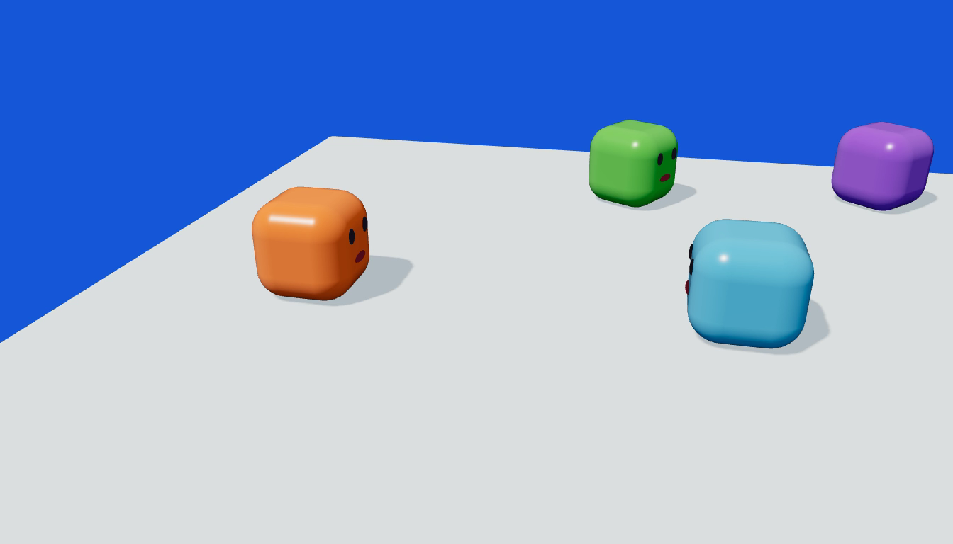
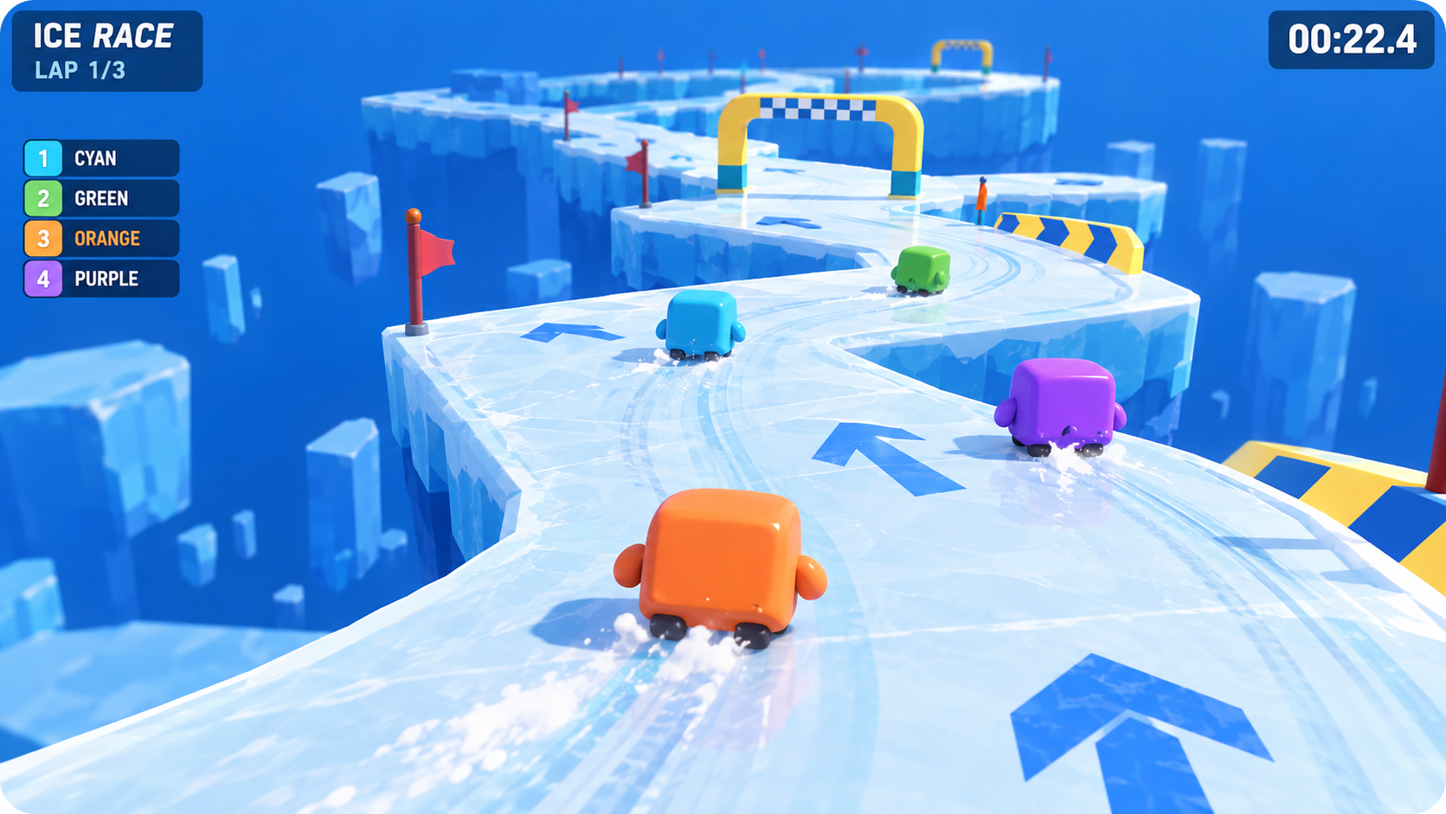
Drafts, concepts and a physics blockout
16 / WHAT ALREADY EXISTS
Rules verified in simulation
A fixed-step graybox proves the rule chain works before any art or networking.
Concept art and UI mockups
Four characters, two arenas and HUD drafts (AI-generated, labelled as such).
Gameplay-feel playbook
Hit-stop, squash and follow-through rules distilled from six VFX tutorials.
Physics blockout: a deterministic simulation of spit, recoil, hit, shrink, knockback and ring-out
Concept visuals are AI-generated and not recorded gameplay. The blockout is a real simulation, not a game build.
Notes:
[1:15] What exists. We built a deterministic physics blockout so the rule chain — spit, recoil, hit, shrink, knockback, ring-out — is checked before any art. We also have concept art for the characters and both arenas, and a playbook of game-feel rules from six VFX tutorials. State plainly: concept visuals are AI-generated and are not gameplay; the blockout is a simulation, not our Unity build.

Slide 18
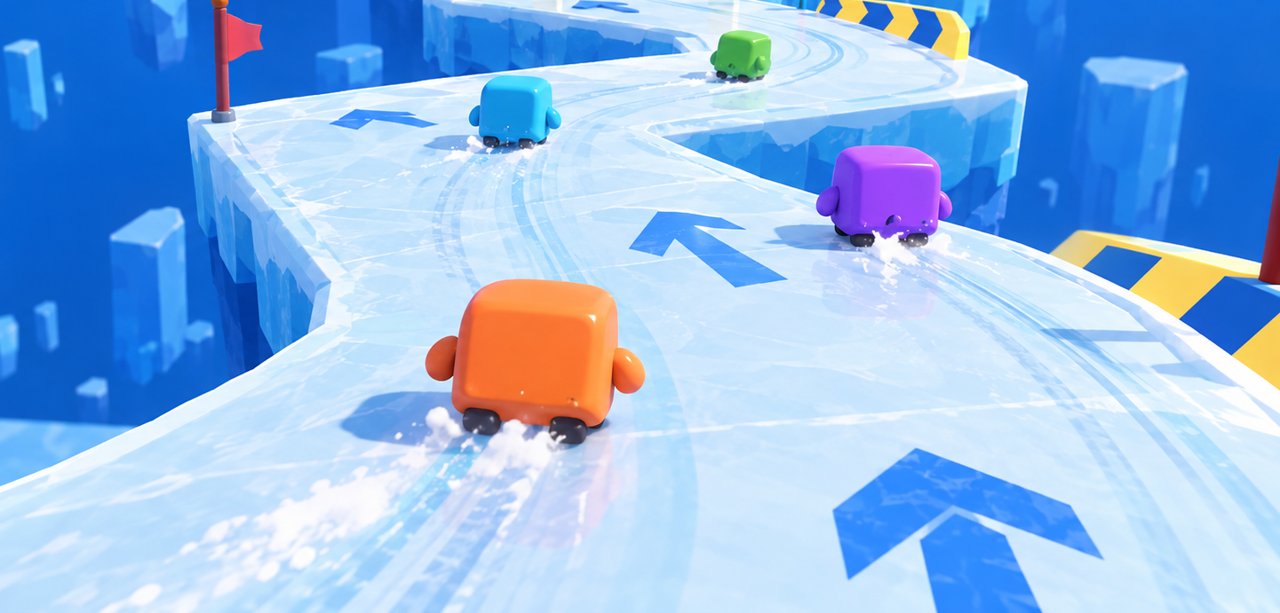
Throw a little. Lose a little.
Win it all.
Thank you — questions?
Ezel Bayraktar · Abdurrahim Özağaç · Kürşat Hürkan Aydın · Ardıl Bilal Ülkü
Notes:
[0:30] Close. Recap: one rule, your ammo is your body, that makes a whole party game. Two polished mini-games on a LAN. Invite questions; the open items we would like feedback on are the snowball risk and whether two mini-games is the right MVP.

Slide 19
Sources and caveats
APPENDIX / SOURCES AND CAVEATS
Newzoo 2025 market report, via GameDev Reports (26 Jun 2026)
Alinea Analytics: co-op H1 2025 and 2025 year in review (Aug and Dec 2025)
ESA Essential Facts 2026 (survey Feb 2026, n = 13,545)
Steam store search, SteamDB, SteamCharts, Raijin (all pulled 17 Oct 2026)
Nintendo IR top-selling titles (as of 30 Jun 2026)
Fall Guys: Mediatonic via Vandal (Dec 2020), Shacknews (Jul 2022)
Splatoon 3 and Party Animals pages, Prima Games, Push Square (Bomberman precedent)
CAVEATS
Raijin sales numbers are model estimates and change between snapshots.
Steam tags are user-applied; counts include unreleased titles.
All imagery is AI-generated concept art or simulation, not gameplay from a build.
Tuning values are starting points for playtesting.
The full research file with every source link is in the project folder.
Notes:
Not presented. Backup for questions on numbers. Full source URLs are in projects/proposal/research/market-research.md.

