Slide 1
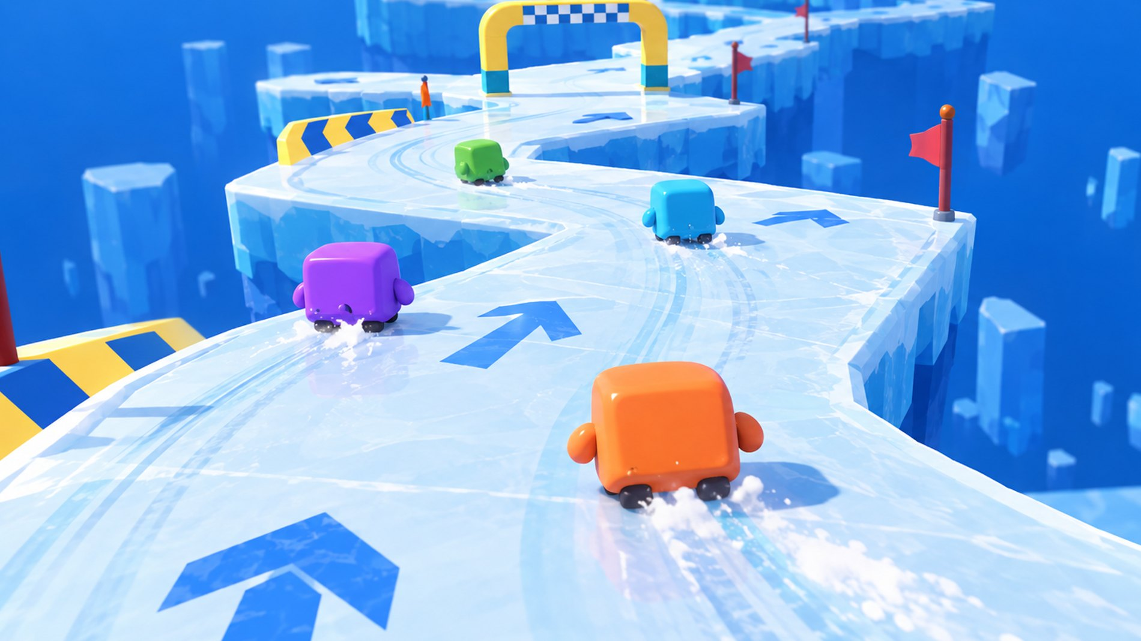

CMP406 GAMETECH · FALL 2026 · GAME PROPOSAL
Ice Rumble
WORKING TITLE
A LAN party game for 2–4 players: short physics mini-games, one shared scoreboard.
MASS KNOCKOUT
ICE RACE
Ezel Bayraktar
2220356197
Abdurrahim Özağaç
2220356033
Kürşat Hürkan Aydın
2230356008
Ardıl Bilal Ülkü
2230356051
Concept render, AI-generated. Not gameplay.
Notes:
Ice Rumble is a working title. It is a party game for two to four players on one local network: short physics mini-games, with points carried on one scoreboard. All game images in this deck are AI concept renders made from our own reference art; none of them is gameplay.

Slide 2

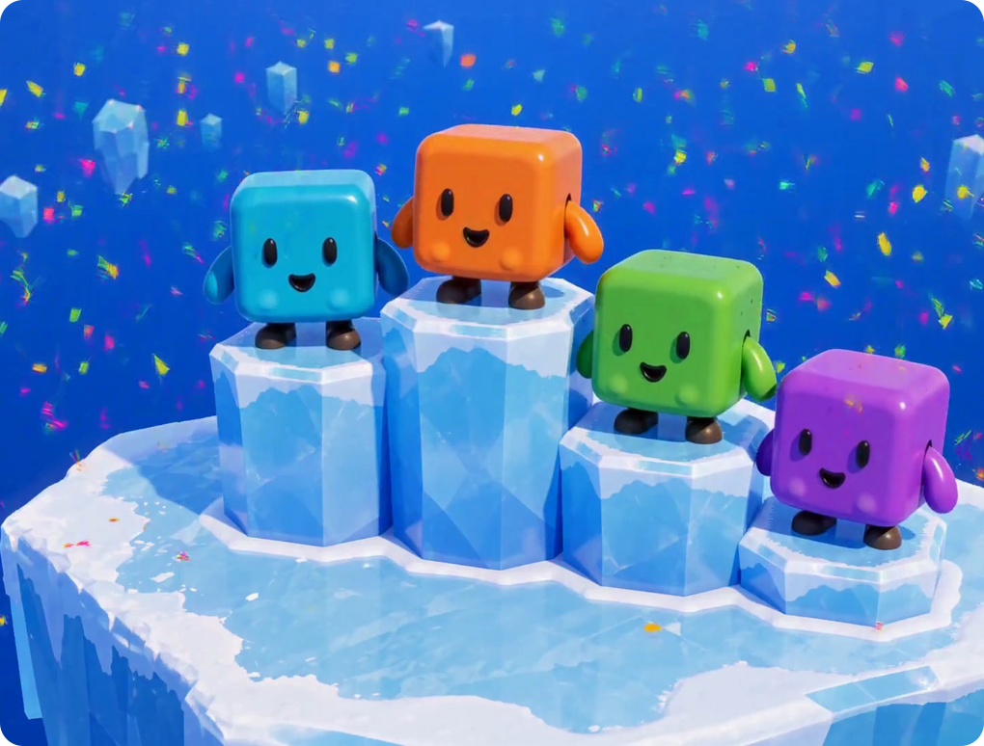




A LAN party game made of short physics mini-games
■ 01 THE GAME
PLAYERS
2–4 people in one room, each on their own PC. One PC hosts; the others join over the local network. No internet, no accounts.
SESSION
A playlist of short mini-games. Placement in each round earns points; one scoreboard runs across the whole session.
CHARACTERS
Everyone plays the same cube character, in one of four colours, with the same controls in every mini-game.
MVP SCOPE
Two mini-games, Mass Knockout and Ice Race, on one shared Unity core.
End of a round: placement decides points. Concept render, AI-generated. Not gameplay.
Notes:
Plain-language summary. Who: two to four friends, each on a PC, in the same room, one PC hosts. What: a session is a run of short mini-games; your place in each round gives points; the scoreboard decides the night. Scope: two mini-games for the course, both built on the same shared core.

Slide 3





How a session runs: lobby, rounds, standings
■ 02 SESSION FLOW
LOBBY
ROUND
PLAY
PLACE
STANDINGS
Host starts a session. Others join with the host’s local IP.
Host picks the next mini-game. Everyone loads the same arena.
Host runs the physics. Clients send input and render the result.
Round ends. Placement becomes points (4 / 3 / 2 / 1, proposed).
Scoreboard updates. After the last round: overall winner.
NEXT MINI-GAME
BETWEEN ROUNDS
Points
The only thing that accumulates across the session.
Catch-up scoring
The last round’s winner earns slightly fewer points in the next one; last place earns slightly more. Nobody drops out of the race before the final.
Nothing physical
Mass and position reset every round, so one bad round does not snowball.
Notes:
The session loop. The host owns the lobby and the round order. Only points carry over between rounds; mass and position reset, so a bad round never makes the next one harder. We also plan catch-up scoring: whoever won the last round earns slightly fewer points in the next one, and whoever came last earns slightly more, so trailing players stay in contention until the final. Placement points 4, 3, 2, 1 and the size of the adjustment are proposals we will tune in playtests.

Slide 4

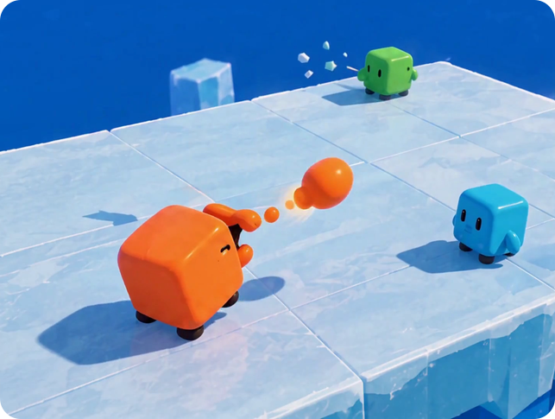
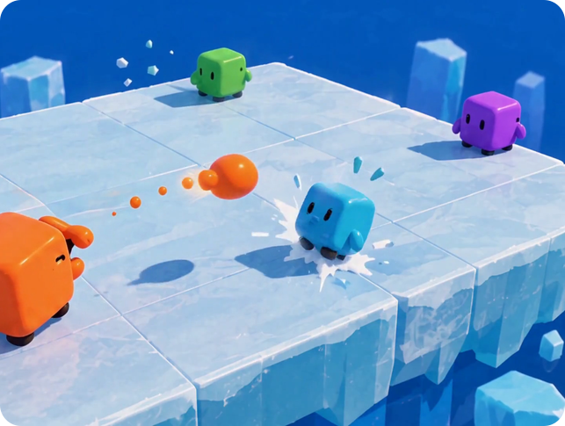
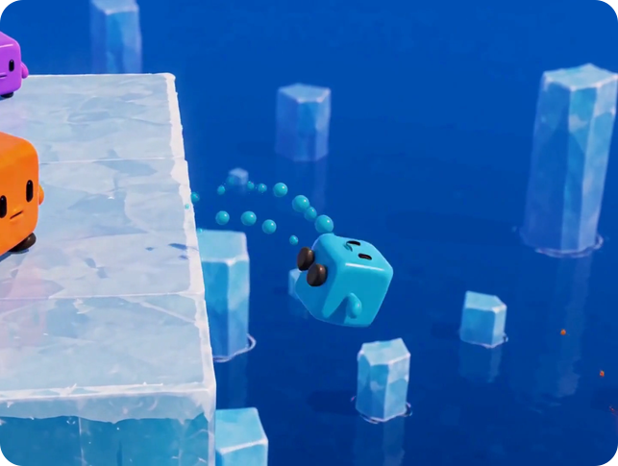
Mass is your health, your ammo and your weight
■ 03 CORE MECHANIC
1
2
3
→
→
SHOOT
HIT
FALL
A cube spits out a piece of its own body. Every shot makes it smaller, hit or miss.
The target loses mass on impact and is pushed back along the line of the shot.
Less mass means the same hit pushes further. Off the edge is a knockout.
Three moments of one exchange in Mass Knockout. Concept render, AI-generated. Not gameplay.
Notes:
One resource does three jobs. Shooting spends it, getting hit loses it, and the less you have, the further you fly. We present the rule, not the numbers: the exact costs are tuning values we will set in playtests.

Slide 5
Why both the shooter and the target lose mass
■ 04 DESIGN REASONING
IF ONLY THE SHOOTER PAID
IF ONLY THE TARGET PAID
BOTH PAY: OUR RULE
Shooting is pure loss. The best play is to never shoot and wait for the others to weaken each other.
Shooting is free. The best play is to shoot nonstop in every direction.
Every shot is a trade. A hit should take more from the target than the shot cost you, and a miss costs only you.
✗ Rewards hiding
✗ Rewards spam
✓ Rewards aim and timing
Spending mass only pays off when the shot lands, so accuracy becomes the skill.
Exact costs are tuning values. We fix them in playtests, not on paper.
Notes:
Why the rule charges both sides. If only the shooter paid, hiding would win. If only the target paid, spamming would win. Charging both makes each shot a trade that only pays off when it lands, so aim and timing become the skill.

Slide 6
Can a player win by never shooting?
■ 04 DESIGN REASONING
THE RISK
SAME HIT, LESS MASS, MORE KNOCKBACK
A cube that never shoots keeps its mass, so it stays heavy and hard to push. If the last cube standing won, waiting could be the best strategy.
OUR ANSWER: SCORE KNOCKOUTS, NOT SURVIVAL
1
Points come from knockouts. A cube that never shoots scores nothing, however heavy it is.
2
Respawn at full mass. A knocked-out cube returns after a short delay, so falling behind does not snowball.
3
Short round timer. Waiting out the clock earns no points.
Fallback if playtests still show stalling: a shrinking arena, or letting cubes re-absorb spent globs.
Shape only; values come from tuning. Mass decreases left to right.
Notes:
The obvious objection: shooting costs mass, so why not just wait? A waiting cube does stay heavy and hard to push. But points come from knockouts, not survival, so waiting scores nothing. Respawning at full mass stops snowballing, and a short timer removes the stall. If playtests still show stalling, we have two fallbacks: shrink the arena, or let cubes re-absorb spent globs.

Slide 7

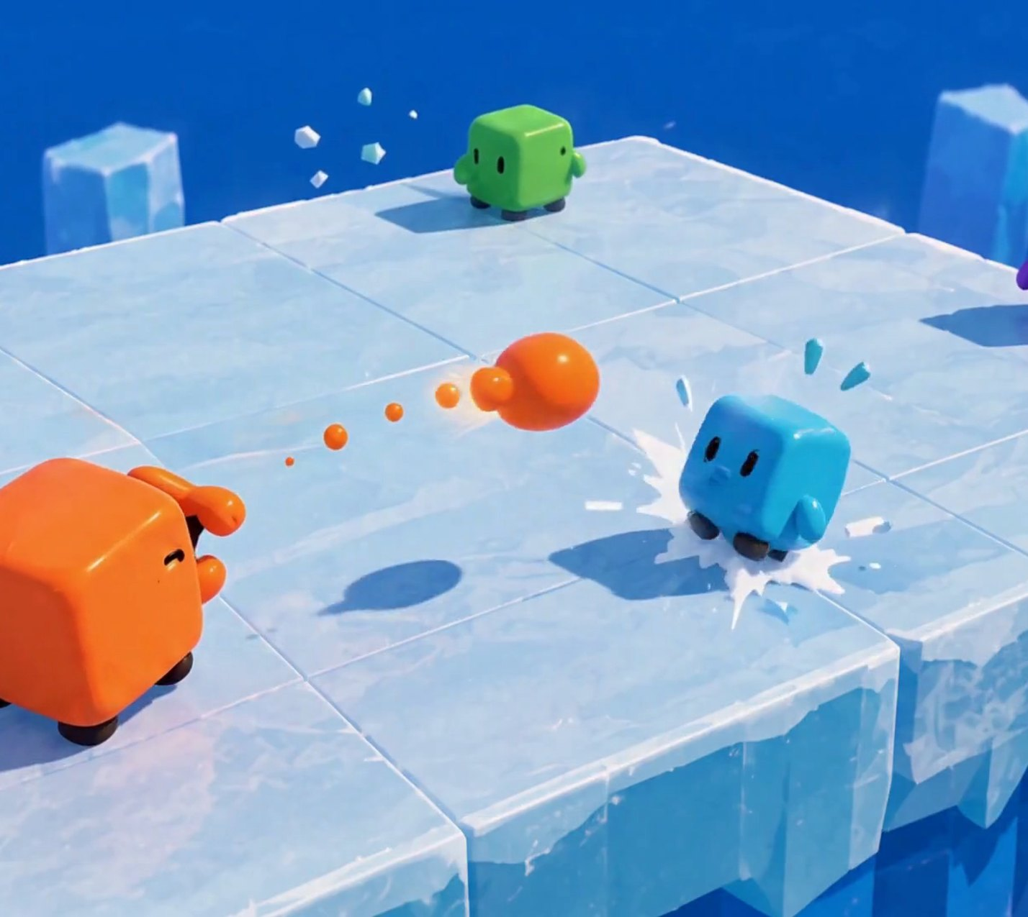


Mass Knockout
■ 05 MINI-GAME 1
GOAL
Knock other cubes off the floating platform.
CONTROLS
Move, aim, spit. A short cooldown between shots.
SCORING
The knockout goes to the last cube that hit the one that fell. Most knockouts at the timer wins.
RESPAWN
After a short delay, at full mass.
ARENA
One flat square platform. Open edges, no walls.
Orange spits a piece of itself; Cyan is hit near the edge. Concept render, AI-generated. Not gameplay.
Notes:
Mass Knockout. One flat platform with open edges. Spitting costs you mass; hits cost the target mass and push it; lighter cubes fly further. The last cube to hit someone gets the knockout. Rounds are timed and ranked by knockouts. Respawns are at full mass.

Slide 8
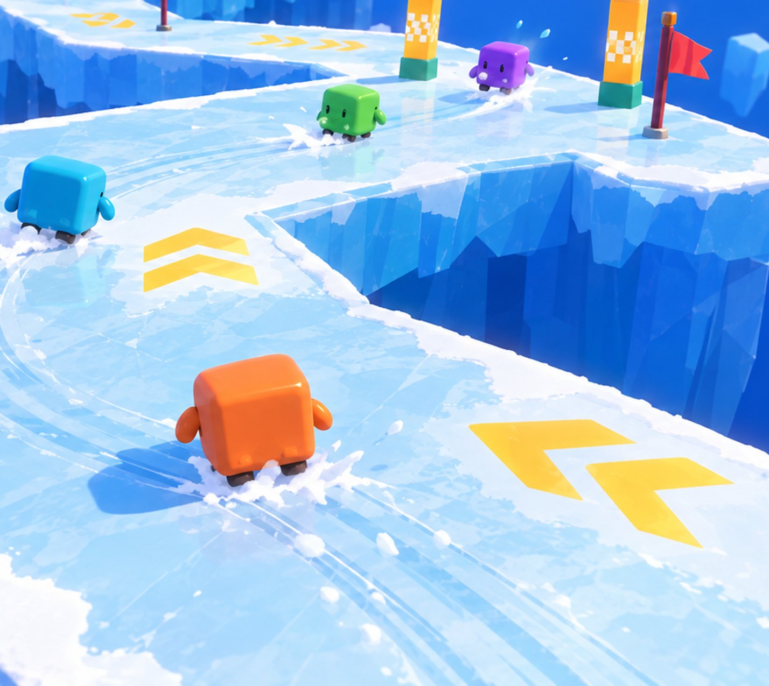
Ice Race
■ 06 MINI-GAME 2
GOAL
Finish the laps first on a floating ice track.
CONTROLS
Steering changes acceleration, not velocity. Braking restores grip.
SKILL
Low sideways grip: carry speed through corners without sliding off.
FALLS
Respawn at the last checkpoint. You lose time, not the race.
PLACEMENT
Finish order. Unfinished players are ranked by track progress.
Racing a floating ice track. Concept render, AI-generated. Not gameplay.
Notes:
Ice Race. No shooting here; the skill is momentum. Input sets acceleration, sideways grip is low, so you have to set up corners early. Falling sends you back to the last checkpoint. Finish order gives placement, and anyone unfinished at the timeout is ranked by progress.

Slide 9



One shared core; each mini-game plugs into it
■ 07 TECHNICAL IMPLEMENTATION
MINI-GAMES
Mass Knockout
mass state · spit projectile · knockback
Ice Race
ice movement profile · track · checkpoints
Reuse
A new mini-game is new rules plus one arena. Character, camera, network and scores already exist.
MINI-GAME CONTRACT
Setup(players) → Run() → Results(): placement
Per-game physics
Each mini-game sets its own profile: low grip on ice, firm grip in Knockout.
SHARED GAMEPLAY
Character
Camera
Round state
Scoreboard
Lobby & UI
NETWORK
Host-authoritative LAN · Unity Netcode for GameObjects (candidate)
One truth
Everything that decides a result runs on the host, so every screen agrees.
ENGINE
Unity · built-in rigidbody physics
Notes:
Architecture. The mini-games sit on top of a shared core. Each one implements the same small contract: set up with the players, run, report placement. Below that sit the character, camera, round state machine, scoreboard and lobby, then the LAN layer, where the host is authoritative. Unity Netcode for GameObjects is our candidate library, not a final choice.

Slide 10
One throw over the LAN, step by step
■ 07 TECHNICAL IMPLEMENTATION
CLIENT A
shooter
HOST
authority: runs the physics
CLIENT B
target
1
Fire input + aim direction
2
Check cooldown; shrink A; spawn the glob
3
Physics step: glob reaches B
4
B loses mass; push scaled by B’s new mass
5
Same snapshot to every client
5
Snapshot: positions, sizes, scores
6 Clients interpolate between snapshots and draw.
Your own movement is predicted locally so it feels instant. Hits, mass changes and knockouts are decided only on the host. Main risk: smooth physics on clients; LAN latency is low, and we tune the snapshot rate.
Notes:
One throw end to end. The client only sends intent. The host checks the cooldown, takes mass from the shooter, simulates the glob, applies the hit and knockback, and sends one snapshot to everyone. Clients interpolate. Own movement is predicted locally for feel; anything that decides a result lives on the host.

Slide 11

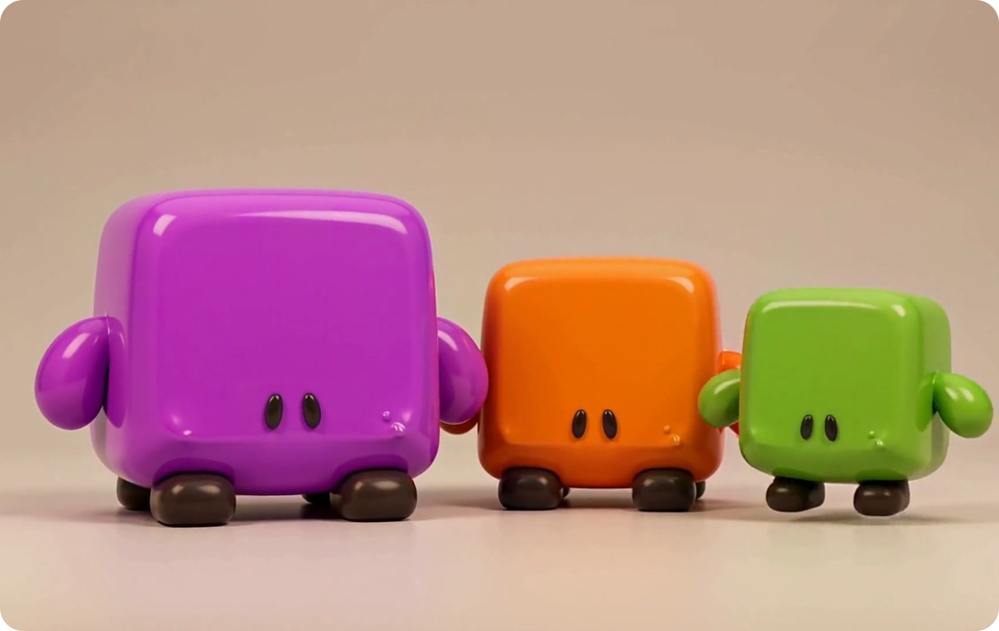
Same rules, different builds
■ 08 INNOVATION
Each character could start from a different build. Because mass is also ammunition, a build changes how you play, not only how you look.
More starting mass: more shots to spend, harder to push. Moves slower.
HEAVY
The reference build every other one is tuned against.
BALANCED
Less starting mass: fewer shots, flies further when hit. Moves faster.
LIGHT
Heavy, balanced and light builds of the same character. Concept render, AI-generated. Not gameplay.
Weight classes are standard in the genre (e.g. Mario Kart). The twist is that weight is also your ammunition. Stats are not designed yet; this is a framework for after the MVP.
Notes:
A framework, not a finished design. Characters can differ in starting mass and speed. Weight classes are common in the genre; what is different here is that mass is also ammunition, so a heavy build has more shots and a light build fewer. We would tune this after the two MVP mini-games work.

Slide 12
No game we found ties knockback to lost mass
■ 08 INNOVATION
01 SPEND
Shooting spits out part of your own body.
LINK | CLOSEST PRIOR ART | STATUS
01 Spend your body | Osmos ejects its own matter to move, not to attack. Agar.io ejects mass. | DIFFERENT USE
02 Hits shrink you | Squarena (2D): lower health, smaller body. Morphies Law: hits move mass between robots. | PRECEDENT
03 Attack costs health | Crisol: Theater of Idols: your blood is your ammunition. Not physical mass. | PRECEDENT
04 Lighter, launched further | Not found. Smash Bros. raises knockback with a damage % counter; in Squarena, smaller bodies feel more of their own recoil. | NOT FOUND
01–04 in one 3D party game | Not found. | NOT FOUND
02 DRAIN
Every hit you take removes body mass.
03 ONE VALUE
That mass is your size, ammunition and health.
04 LAUNCH
Less mass: the same incoming hit sends you further.
THE MASS KNOCKOUT LOOP. STEP 04 IS THE LINK WE DID NOT FIND IN ANY GAME.
Prior-art search of shipped games, Oct 2026 [9–12]. “Not found” = not found after searching.
Notes:
Our core rule is that losing mass makes the next incoming hit launch you further. We searched for this and did not find it in any shipped game. The other links have relatives, and we name them: Osmos and Agar.io spend body mass, but to move; Squarena shrinks you as you lose health, in 2D; Morphies Law moves mass between robots; Crisol spends your blood as ammunition. Smash Bros. raises knockback with a percentage counter, not with mass. Mass Knockout puts all four links on one physical value that the player can see.

Slide 13





Social PC play is growing; LAN party games are rare
■ 09 MARKET
$43.6B
$4.1B
STEAM “PARTY GAME” TITLES BY MULTIPLAYER TAG
PC games revenue in 2025, up 12% year on year.
Steam revenue of games with co-op in H1 2025, an all-time high (estimate).
Newzoo [1]
Alinea [2]
70%
≈8%
of US players aged 8+ play with other people.
of ~3,490 Steam “Party Game” titles list LAN PvP.
ESA 2026 [3]
Steam, Oct 2026 [4]
Risk, stated plainly: an estimated 65.9% of 2025 Steam releases earned under $1,000 [5], while 5,863 games passed $100K in 2025 (Valve) [6]. LAN is our differentiator, not a demand driver.
Notes:
Market potential. PC is a 43.6 billion dollar market that grew 12 percent in 2025; games with co-op made an estimated 4.1 billion on Steam in the first half of 2025; most players play with others. Only about 8 percent of Steam party games list LAN. Revenue is very uneven: most releases earn little, but thousands pass 100 thousand dollars. LAN is how we stand out, not why people buy.

Slide 14
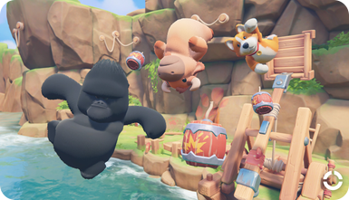
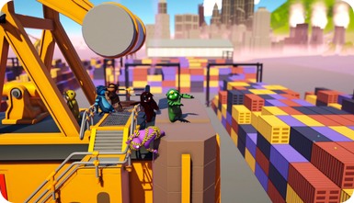
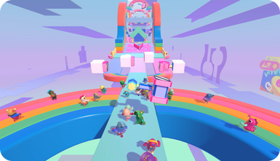
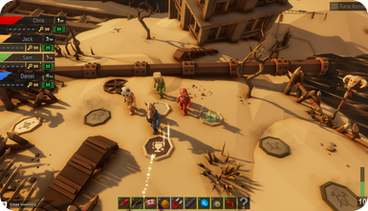
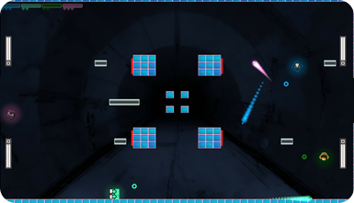
Five games we are measured against
■ 09 MARKET
AUDIENCE
PHYSICS
FORMAT
FORMAT
MECHANIC
Party Animals
Gang Beasts
Fall Guys
Pummel Party
Squarena
Recreate Games · 2023
store.steampowered.com/app/1260320
Boneloaf · 2017
store.steampowered.com/app/285900
Mediatonic / Epic · 2020
store.steampowered.com/app/1097150
Rebuilt Games · 2018
store.steampowered.com/app/880940
Codeaclysm · 2022
store.steampowered.com/app/1858400
VISUAL
VISUAL
VISUAL
VISUAL
VISUAL
Plush 3D animals, toy-like arenas.
Soft, gelatinous 3D people.
Candy-coloured beans, obstacle courses.
Colourful low-poly 3D, slapstick items.
Minimal flat 2D squares.
MECHANIC
MECHANIC
MECHANIC
MECHANIC
MECHANIC
Physics brawling: grab, punch, throw rivals out.
Ragdoll brawling into stage hazards.
Short race and survival rounds in a playlist.
Board game with short competitive mini-games.
Arena shooter: low health shrinks you; small bodies feel more recoil.
MULTIPLAYER
MULTIPLAYER
MULTIPLAYER
MULTIPLAYER
MULTIPLAYER
Online and same-screen. No LAN listed.
Same-screen and online. No LAN listed.
Online, cross-platform only.
4–8 online and local. No LAN listed.
Up to 6 local. No LAN listed.
FINANCIALS
FINANCIALS
FINANCIALS
FINANCIALS
FINANCIALS
Launch peak 104,174 players. Owner est. 2.5M–6.0M.
85% positive. Owner est. 4.6M–5.8M.
Free-to-play. Legacy Steam peak 172,213. Metacritic 80.
$14.99. Peak 20,957. Owner est. 1.5M–7.6M.
$4.99. Sales not disclosed.
Screenshots: official Steam media, © publishers. “Owner est.” = third-party estimates via SteamDB, not sales. 2026-10-17 [7].
Notes:
Five comparables, each chosen for one reason. Party Animals and Gang Beasts share our audience and physics comedy. Fall Guys and Pummel Party share our session format of short rounds. Squarena is the closest mechanic: it shrinks you as you lose health, in 2D. Owner numbers are third-party estimates and we label them that way.

Slide 15
Where we sit among them
■ 09 MARKET
 | PARTY ANIMALS | GANG BEASTS | FALL GUYS | PUMMEL PARTY | SQUARENA | ICE RUMBLE
3D characters | ● Yes | ● Yes | ● Yes | ● Yes | — | ● Yes
Ranged attacks | ◐ Partly | — | — | ◐ Partly | ● Yes | ● Yes
Damage changes your body size | — | — | — | — | ● Yes | ● Yes
Less mass, further knockback | — | — | — | — | — | ● Yes
Several mini-games, one result | — | — | ◐ Partly | ● Yes | — | ● Yes
Official LAN play | — | — | — | — | — | ● Yes
Plays with no internet | — | ● Yes | — | ● Yes | ● Yes | ● Yes
“Official LAN” = advertised in the game’s Steam features. “Partly”: Party Animals and Pummel Party have some weapons or items; Fall Guys’ playlist eliminates rather than scores. Party Animals needs internet even on one screen [8]. Ice Rumble column = planned design.
Notes:
Positioning. Each competitor covers part of this table. Squarena is the only one where damage changes your size, and none ties knockback to lost mass. None advertises official LAN. The Ice Rumble column is our plan, not shipped software.

Slide 16
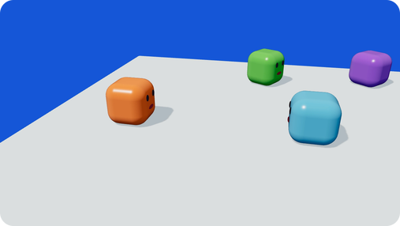
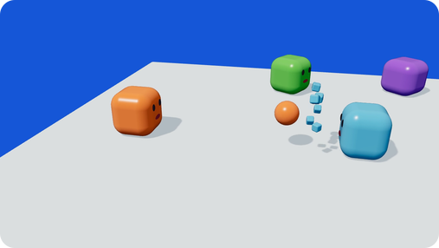
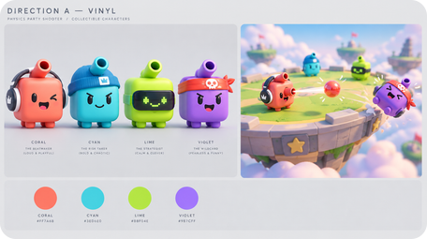
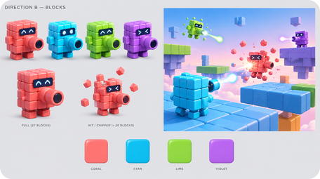
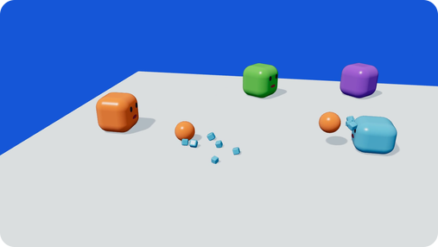
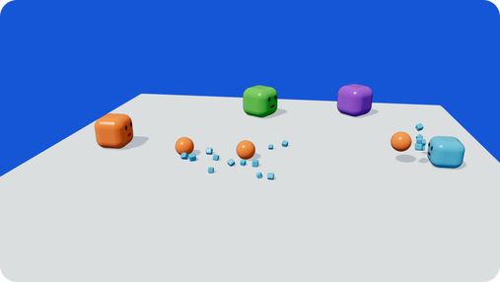
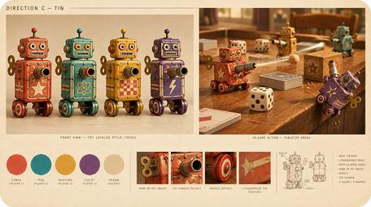
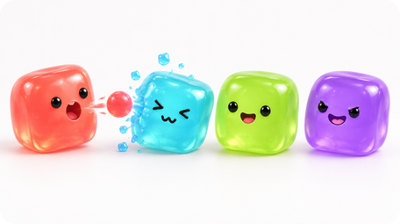
What we have built and drawn so far
■ 10 DRAFTS & PROTOTYPES
PHYSICS PROTOTYPE
ART-DIRECTION DRAFTS
A VINYL TOY
B BUILDING BLOCKS
C TIN TOY
D JELLY
Three.js, deterministic, rendered frame by frame. Three shots: the target shrinks and is pushed further each time. We used it to check that the rule reads before writing Unity code.
Four looks for the same cube, generated to choose a direction. This deck uses the glossy-toy direction. All AI-generated; none is gameplay.
Notes:
Drafts and prototypes. Left: a real prototype, a deterministic physics simulation of the Mass Knockout rule, which showed the escalating knockback reads clearly. Right: four art-direction drafts for the same character. The concept renders in this deck follow the glossy-toy direction.

Slide 17



Build order: shared core first, then each mini-game
■ 11 DEVELOPMENT PLAN
M1 · DATE TBD
M2 · DATE TBD
M3 · DATE TBD
M4 · DATE TBD
Core Character, camera, movement, fall detection
LAN Host / join, host authority, sync of transforms and score
Ice Race Ice movement profile, track, checkpoints, finish
Mass Knockout Mass state, spit projectile, hits, knockback, respawn
Session Lobby, rotation, scoreboard, catch-up scoring, results
Tune & polish Playtests; trails, hit flash, UI
OWNERS: TBD · ORDER IS FIXED, DATES ARE NOT
RISK: NETWORKED PHYSICS
Clients disagree on a knockback. Host-authoritative simulation; clients only render.
RISK: BALANCE
Stalling or snowballing. Score knockouts; respawn at full mass; catch-up scoring.
RISK: SCOPE
Too many mini-games. Two for the MVP; more only once both are fun.
Notes:
Build order. The shared core comes first, then the LAN layer, then the two mini-games, with Mass Knockout as the riskier one, then the session loop and tuning. Milestone dates and owners are still to be decided. Three main risks, each with its mitigation.

Slide 18
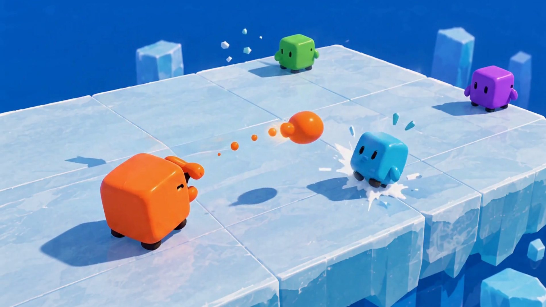

SUMMARY
Ice Rumble
2–4 players, one LAN, no internet.
Two mini-games on one shared Unity core.
In Mass Knockout, every shot costs the shooter mass, so aim matters more than volume.
Questions?
Ezel Bayraktar · Abdurrahim Özağaç · Kürşat Hürkan Aydın · Ardıl Bilal Ülkü
Concept render, AI-generated. Not gameplay.
Notes:
Summary: a LAN party game, two mini-games on one shared core, and one rule that makes every shot a trade. Questions.

Slide 19

Sources
■ APPENDIX
[1] Newzoo final 2025 figures, via GameDev Reports, 2026-06-26. gamedevreports.substack.com/p/newzoo-gaming-market-surpassed-200
[2] Alinea Analytics, games with co-op on Steam, H1 2025 (proprietary estimates). alineaanalytics.substack.com/p/games-with-co-op-generated-over-4
[3] ESA Essential Facts 2026 (survey Feb 2026, n=13,545). theesa.com
[4] Steam store search, tag “Party Game” × LAN PvP / Online PvP / Shared-Split-screen PvP, 2026-10-17. Tags are user-applied.
[5] Game Developers, 2025 Steam revenue distribution (Gamalytic estimates), 2026-08-21. game-developers.org/2025-steam-game-revenue-distribution
[6] PC Gamer, Valve at GDC 2026: 5,863 games over $100K on Steam in 2025. pcgamer.com
[7] Steam store pages and SteamDB charts, apps 1260320, 285900, 1097150, 880940, 1858400: prices, peaks, reviews, owner estimates. 2026-10-17.
[8] GameRevolution / Prima Games: Party Animals requires an internet connection, including split-screen.
[9] Osmos official site, osmos-game.com. [10] Squarena on Steam (app 1858400); codeaclysmgames.com/squarena-details.
[11] Morphies Law official site, morphieslaw.com/game. [12] Crisol: Theater of Idols, Blumhouse Games and Steam (app 1790930).
Images: all game visuals are AI concept renders (GPT Image via Higgsfield; MiniMax H3) from our own reference art, except competitor screenshots (official Steam media).
Notes:
Full research notes with all sources are in the research folder.

