Slide 1


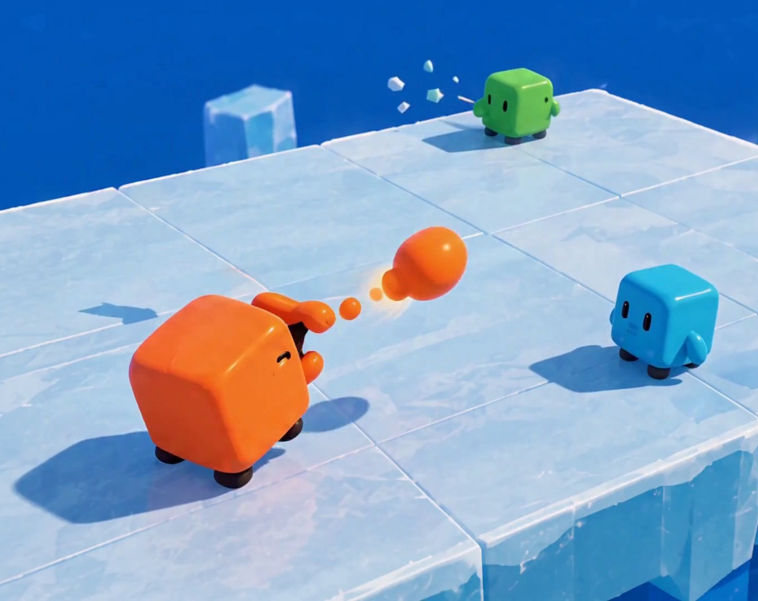




CMP406 GAMETECH · FALL 2026 · GAME PROPOSAL
Ice
Rumble
WORKING TITLE
A LAN party game for 2–4 players: short physics mini-games, one shared scoreboard.
Ezel Bayraktar
Abdurrahim Özağaç
Kürşat Hürkan Aydın
Ardıl Bilal Ülkü
2220356197
2220356033
2230356008
2230356051
Concept render, AI-generated. Not gameplay.
Notes:
Ice Rumble is a working title. It is a party game for two to four players on one local network: short physics mini-games, with points carried on one scoreboard. The four of us are the four players at the bottom. All game images in this deck are AI concept renders made from our own reference art; none of them is gameplay.

Slide 2



01 · The game
02 / 24
How it plays: one room, short rounds, one scoreboard
2–4 friends in one room, each at their own PC. One PC hosts; the others join over the local network. Everyone plays the same cube, in one of four colours.
1
Lobby
2
Round
3
Play
4
Place
5
Standings
Host starts a session. Others join with the host’s local IP.
Host picks the next mini-game. Everyone loads the same arena.
Host runs the physics. Clients send input and draw the result.
Round ends. Placement becomes points.
Scoreboard updates. After the last round: overall winner.
NEXT MINI-GAME
PLACEMENT POINTS · PROPOSED
BETWEEN ROUNDS
1st
4 PTS
CARRIES OVER
Points. Nothing else accumulates.
2nd
3 PTS
CATCH-UP
The last round's winner earns slightly fewer points next round; last place earns slightly more.
3rd
2 PTS
4th
1 PTS
RESETS
Mass and position, so one bad round does not snowball.
Notes:
Plain-language summary first: two to four friends, each on a PC, in the same room; one PC hosts. Everyone plays the same cube in one of four colours. The session loop. The host owns the lobby and the round order. Only points carry over between rounds; mass and position reset, so a bad round never makes the next one harder. We also plan catch-up scoring: whoever won the last round earns slightly fewer points in the next one, and whoever came last earns slightly more, so trailing players stay in contention until the final. Placement points 4, 3, 2, 1 and the size of the adjustment are proposals we will tune in playtests.

Slide 3

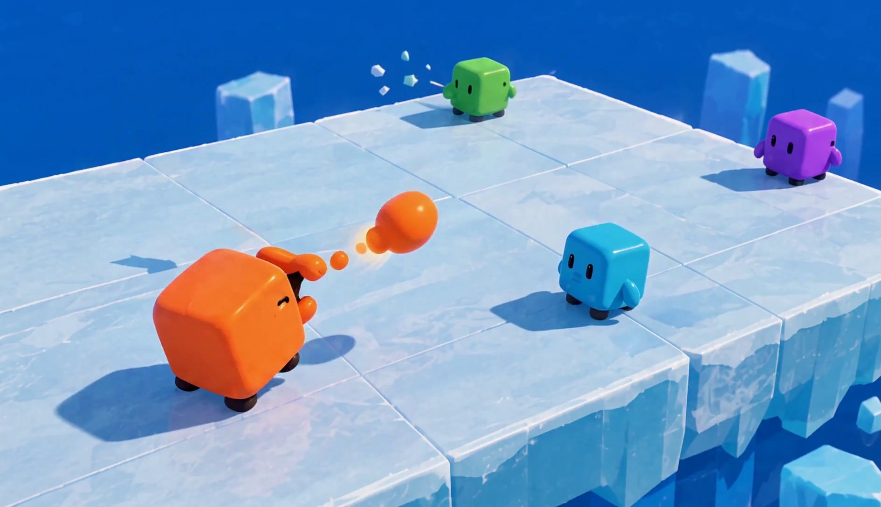
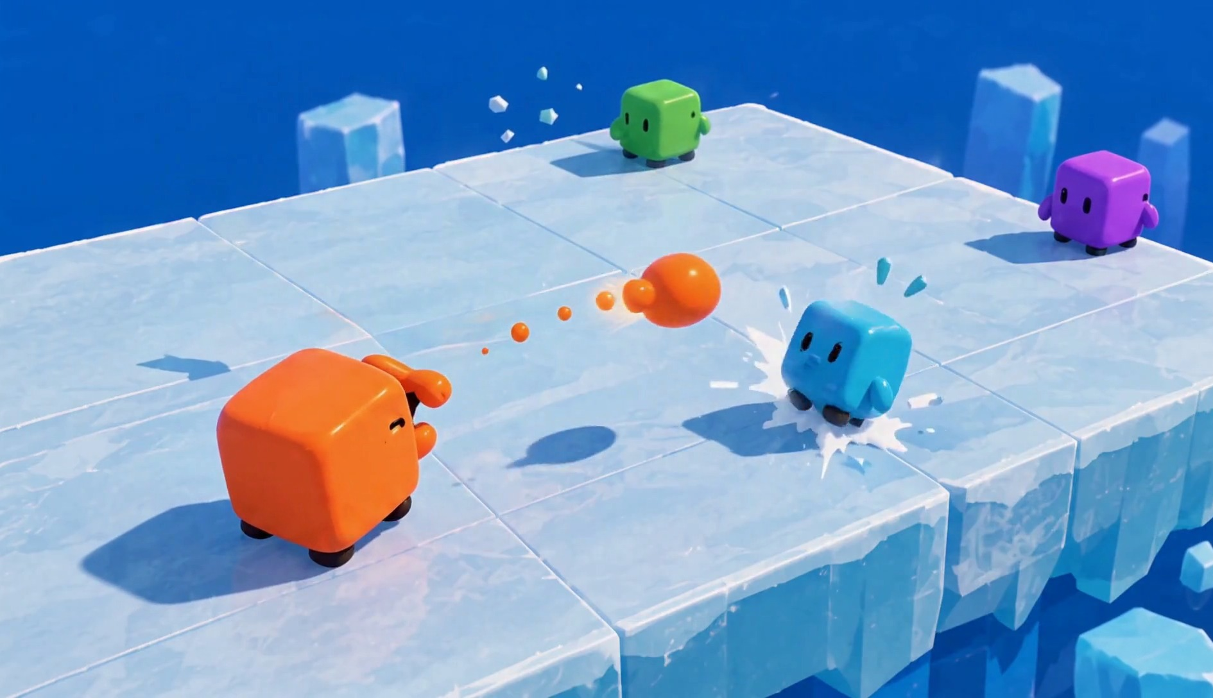
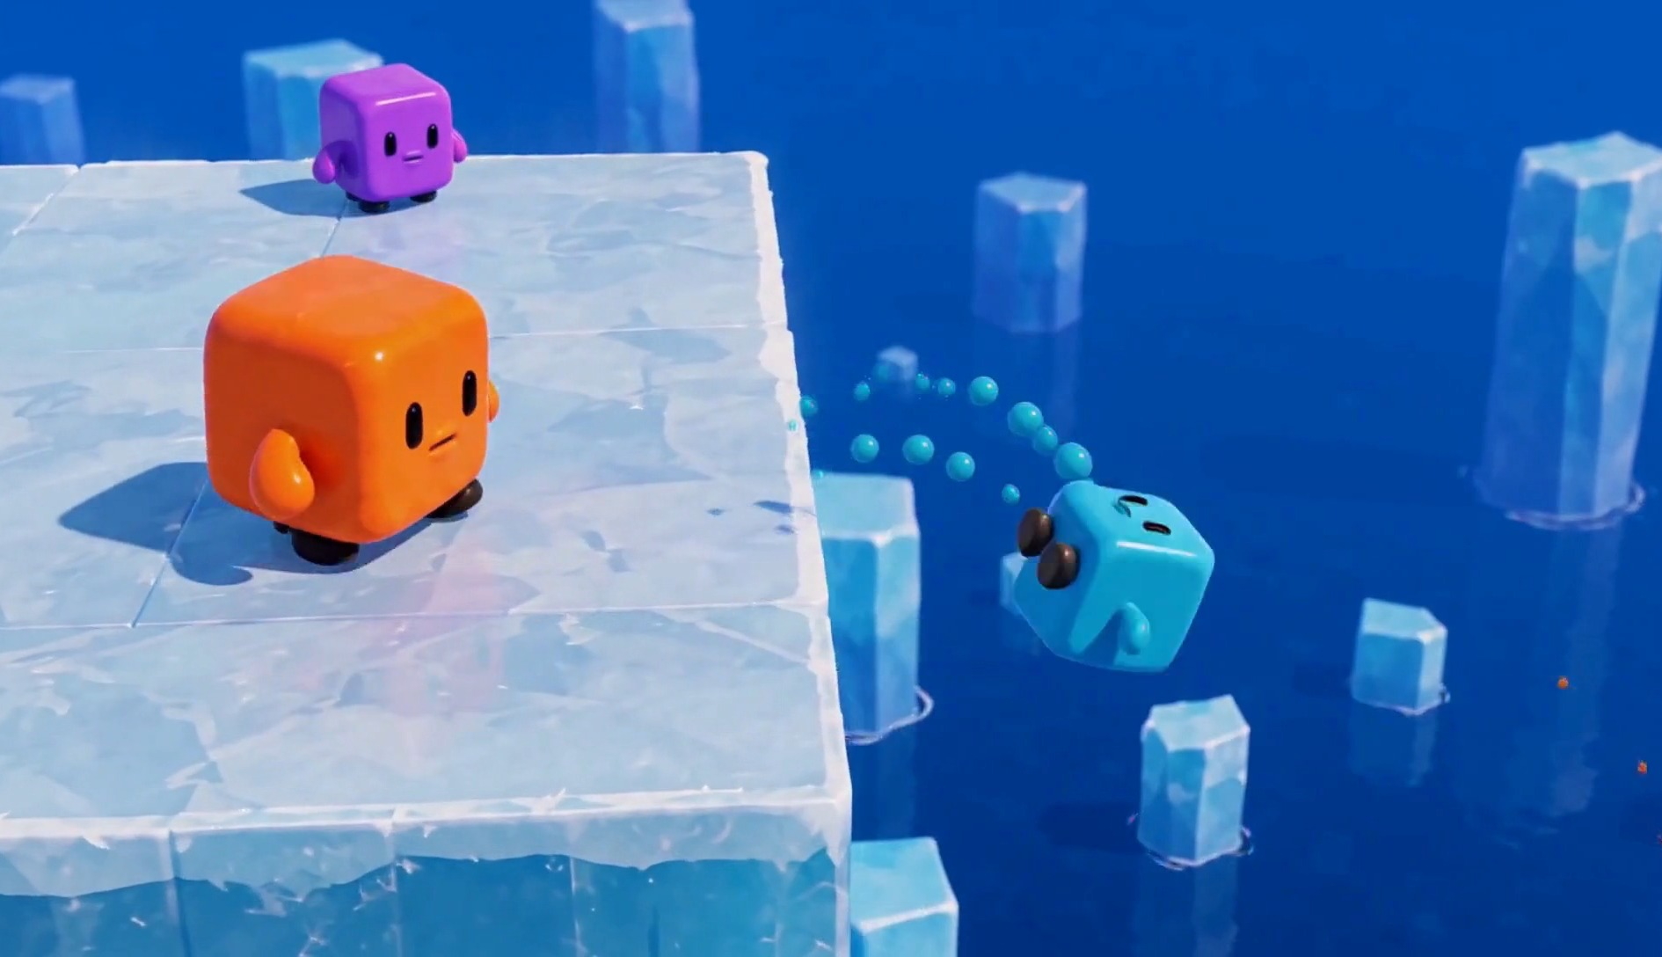
02 · Gameplay & tech
03 / 24
One value is your health, your ammunition and your weight
1 · Shoot
2 · Hit
3 · Fall
A cube spits out a piece of its own body. Every shot makes it smaller, hit or miss.
The target loses mass on impact and is pushed back along the line of the shot.
Less mass means the same hit pushes further. Off the edge is a knockout.
SHOOTER MASS
TARGET MASS
KNOCKBACK, SAME HIT
Faded part: lost in this exchange
Faded part: lost in this exchange
Grows as mass drops
Shooting, getting hit and getting launched all read from one number the player can see: the cube's size.
Bars show direction only. Costs and knockback values are set in playtests.
Notes:
One resource does three jobs. Shooting spends it: the cube spits out a piece of its own body, hit or miss. Getting hit loses it and pushes you back. And the less you have, the further the same hit sends you; off the edge is a knockout. We present the rule, not the numbers: the exact costs are tuning values we will set in playtests.

Slide 4





02 · Gameplay & tech
04 / 24
Why both the shooter and the target lose mass
VARIANT A
VARIANT B
VARIANT C
Only the shooter pays
Only the target pays
Both pay: our rule
− MASS
FREE
FREE
− MASS
− MASS
− MASS
BEST PLAY
BEST PLAY
BEST PLAY
Shooting is pure loss. The best play is to never shoot and wait for the others to weaken each other.
Shooting is free. The best play is to shoot nonstop in every direction.
Every shot is a trade. A hit should take more from the target than the shot cost you, and a miss costs only you.
✕ REWARDS HIDING
✕ REWARDS SPAM
✓ REWARDS AIM AND TIMING
A shot only pays off when it lands, so accuracy becomes the skill. And never shooting scores nothing: points come from knockouts, not survival.
Exact costs are tuning values. We fix them in playtests, not on paper.
Notes:
Why the rule charges both sides. If only the shooter paid, shooting would be pure loss and hiding would win. If only the target paid, shooting would be free and spamming would win. Charging both makes each shot a trade: a hit should take more from the target than the shot cost you, and a miss costs only you. So aim and timing become the skill. The obvious objection, why not just wait and stay heavy, is answered by scoring: points come from knockouts, not survival, so a cube that never shoots scores nothing. Respawn at full mass and a round timer handle the rest.

Slide 5

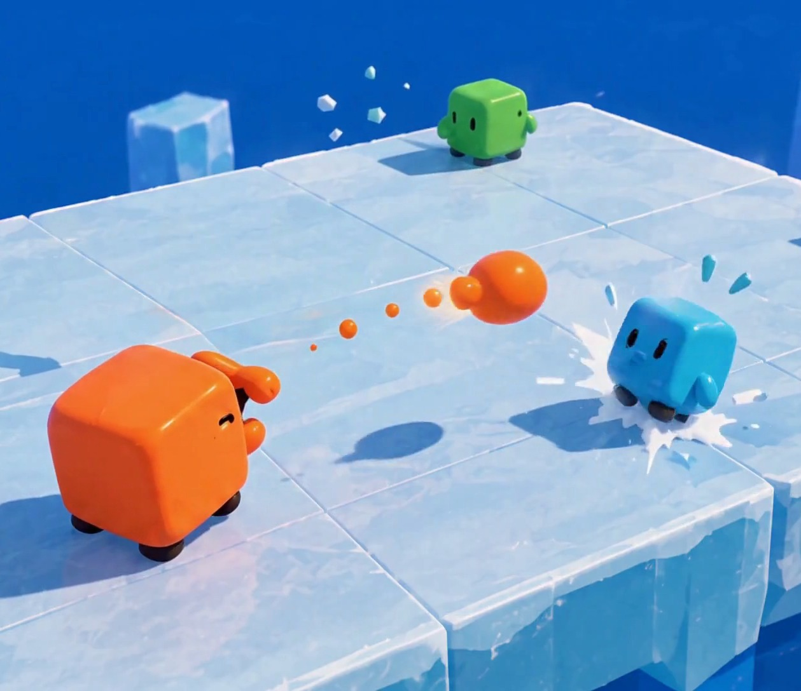

02 · Gameplay & tech
05 / 24
MINI-GAME 01
Mass
Knockout
GOAL
Knock other cubes off the floating platform.
CONTROLS
Move, aim, spit. A short cooldown between shots.
SCORING
A knockout goes to the last cube that hit the one that fell. Most knockouts at the timer wins.
RESPAWN
After a short delay, at full mass.
ARENA
One flat square platform. Open edges, no walls.
FIG 2 · Orange spits a piece of itself; Cyan is hit near the edge. Concept render, AI-generated.
Notes:
Mass Knockout. One flat platform with open edges. Spitting costs you mass; hits cost the target mass and push it; lighter cubes fly further. The last cube to hit someone gets the knockout. Rounds are timed and ranked by knockouts. Respawns are at full mass.

Slide 6


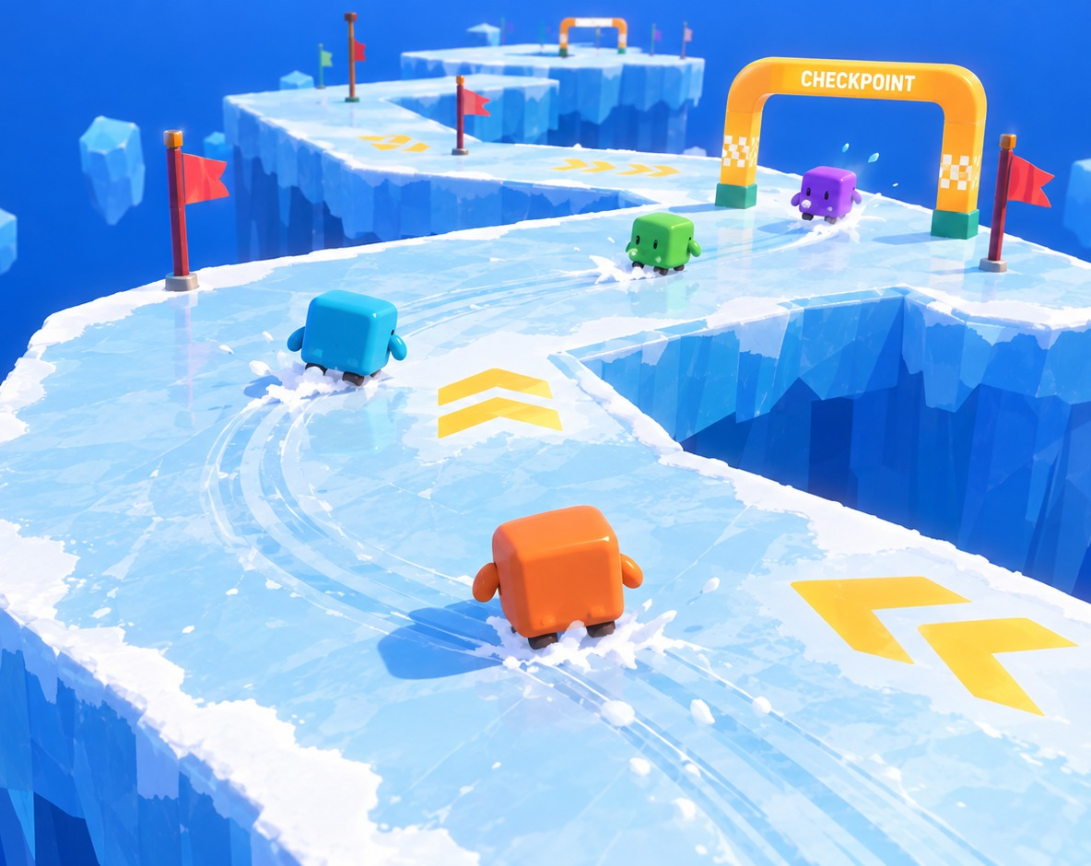
02 · Gameplay & tech
06 / 24
MINI-GAME 02
Ice
Race
GOAL
Finish the laps first on a floating ice track.
CONTROLS
Steering changes acceleration, not velocity. Braking restores grip.
SKILL
Low sideways grip: carry speed through corners without sliding off.
FALLS
Respawn at the last checkpoint. You lose time, not the race.
PLACEMENT
Finish order. Unfinished players ranked by track progress.
FIG 3 · Racing a floating ice track; the HUD is part of the render. Concept render, AI-generated.
Notes:
Ice Race. No shooting here; the skill is momentum. Input sets acceleration, not velocity, and sideways grip is low, so you have to set up corners early. Braking restores grip. Falling sends you back to the last checkpoint: you lose time, not the race. Finish order gives placement, and anyone unfinished at the timeout is ranked by track progress.

Slide 7

02 · Gameplay & tech
07 / 24
One shared core; each mini-game plugs into it
MINI-GAMES
Mass Knockout
Ice Race
Next mini-game
WHY THIS SPLIT
mass state · spit · knockback
ice profile · track · checkpoints
new rules + one arena
Reuse
A new mini-game is new rules plus one arena. Character, camera, network and scores already exist.
MINI-GAME CONTRACT
Setup(players) → Run() → Results() : placement
SHARED GAMEPLAY
Per-game physics
Character
Camera
Round state machine
Scoreboard
Lobby & UI
Each mini-game sets its own profile: low grip on ice, firm grip in Knockout.
NETWORK
Host-authoritative LAN · Unity Netcode for GameObjects (candidate)
One truth
Everything that decides a result runs on the host, so every screen agrees.
ENGINE
Unity · built-in rigidbody physics
Notes:
Architecture. The mini-games sit on top of a shared core. Each one implements the same small contract: set up with the players, run, report placement. Below that sit the character, camera, round state machine, scoreboard and lobby, then the LAN layer, where the host is authoritative. Unity Netcode for GameObjects is our candidate library, not a final choice.

Slide 8



02 · Gameplay & tech
08 / 24
One shot over the LAN, step by step
Client A
Host
Client B
shooter
authority: runs the physics
target
1
Fire input + aim direction
2
Check cooldown; shrink A; spawn the glob
3
Physics step: the glob reaches B
4
B loses mass; push scaled by B’s new mass
Snapshot: positions, sizes, scores
5
5
Same snapshot to every client
6
Clients interpolate between snapshots and draw.
6
Your own movement is predicted locally, so it feels instant. Hits, mass changes and knockouts are decided only on the host. Main risk: keeping physics smooth on clients. LAN latency is low, and we tune the snapshot rate.
Notes:
One shot end to end. The client only sends intent. The host checks the cooldown, takes mass from the shooter, simulates the glob, applies the hit and knockback, and sends one snapshot to everyone. Clients interpolate. Own movement is predicted locally for feel; anything that decides a result lives on the host.

Slide 9

03 · Market
09 / 24
Social PC play is growing; LAN party games are rare
$43.6B
$4.1B
STEAM “PARTY GAME” TITLES BY MULTIPLAYER TAG
PC games revenue in 2025, up 12% year on year.
Steam revenue of games with co-op in H1 2025, an all-time high (estimate).
ONLINE PVP
1,870
Newzoo [1]
Alinea [2]
SHARED / SPLIT-SCREEN PVP
1,017
70%
≈8%
LAN PVP
292
of US players aged 8+ play with other people.
of ~3,490 Steam “Party Game” titles list LAN PvP.
ESA 2026 [3]
Steam, Oct 2026 [4]
Steam store search, Oct 2026 [4]. Tags are user-applied.
RISK, STATED PLAINLY
An estimated 65.9% of 2025 Steam releases earned under $1,000 [5], while 5,863 games passed $100K in 2025 (Valve) [6]. LAN is our differentiator, not a demand driver.
Notes:
Market potential. PC is a 43.6 billion dollar market that grew 12 percent in 2025; games with co-op made an estimated 4.1 billion on Steam in the first half of 2025; most players play with others. Only about 8 percent of Steam party games list LAN. Revenue is very uneven: most releases earn little, but thousands pass 100 thousand dollars. LAN is how we stand out, not why people buy.

Slide 10

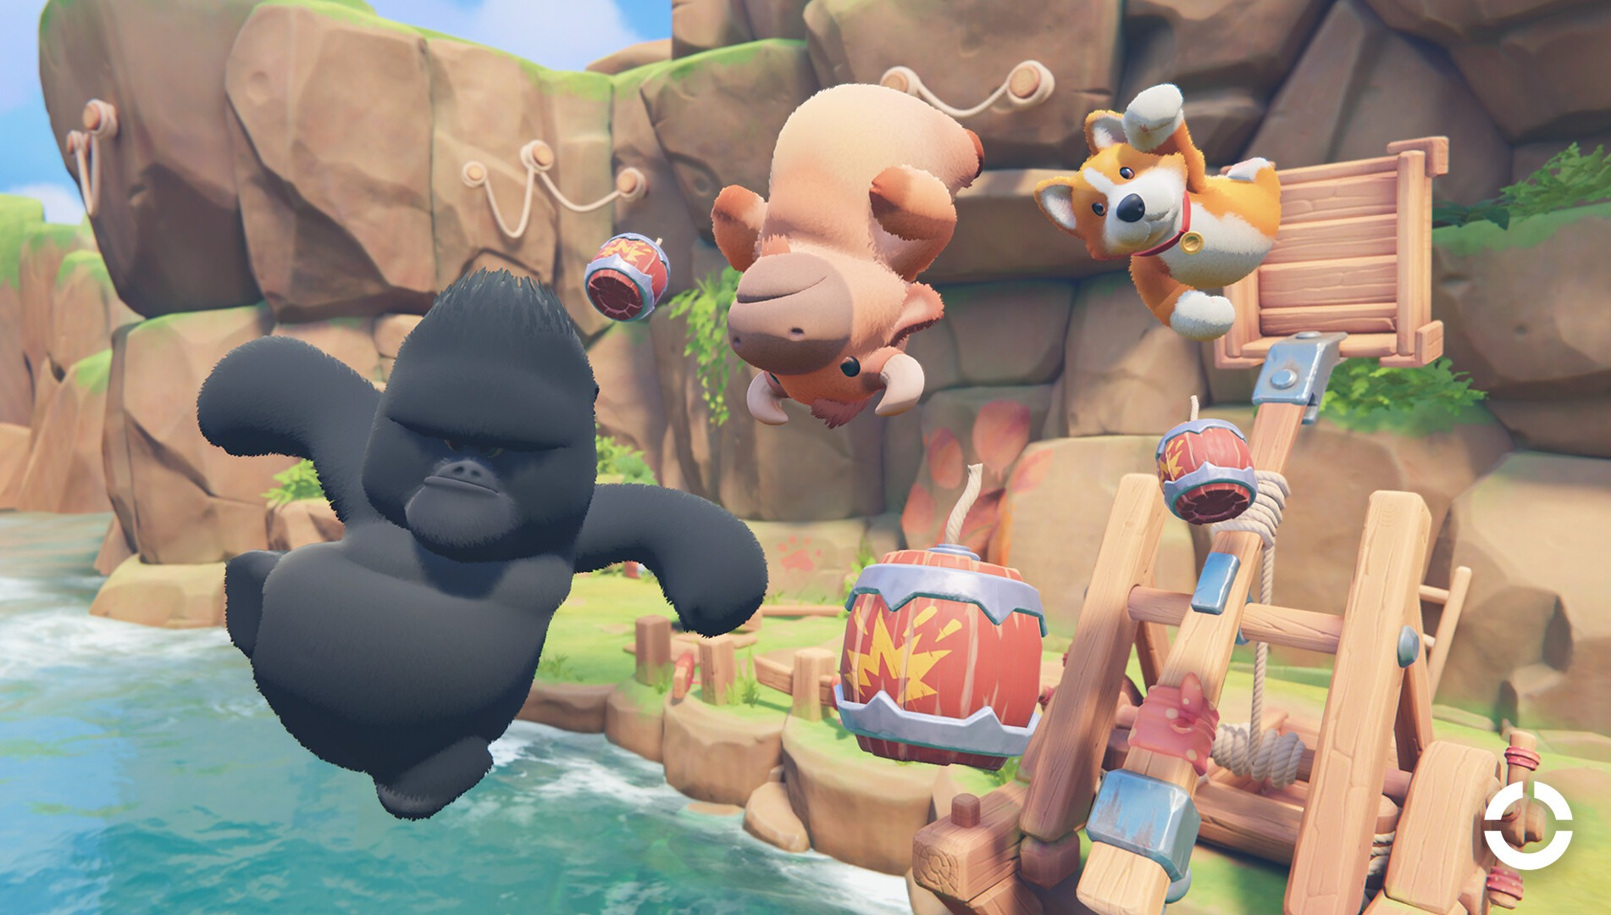
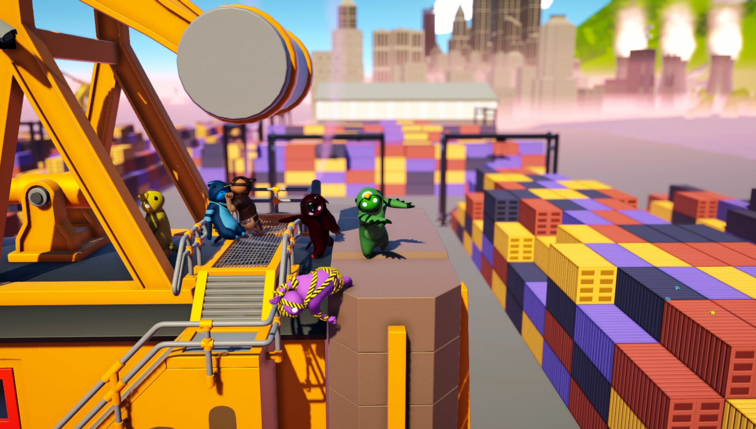
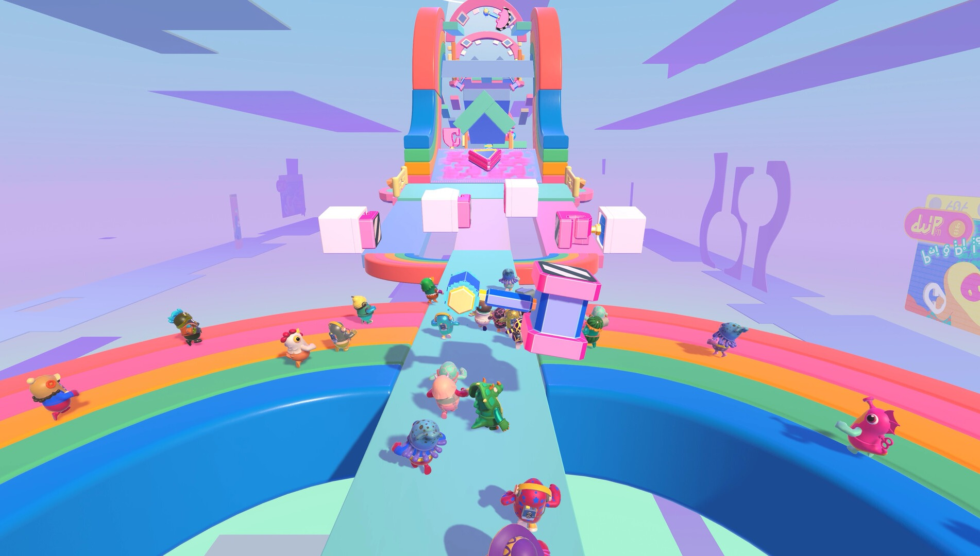
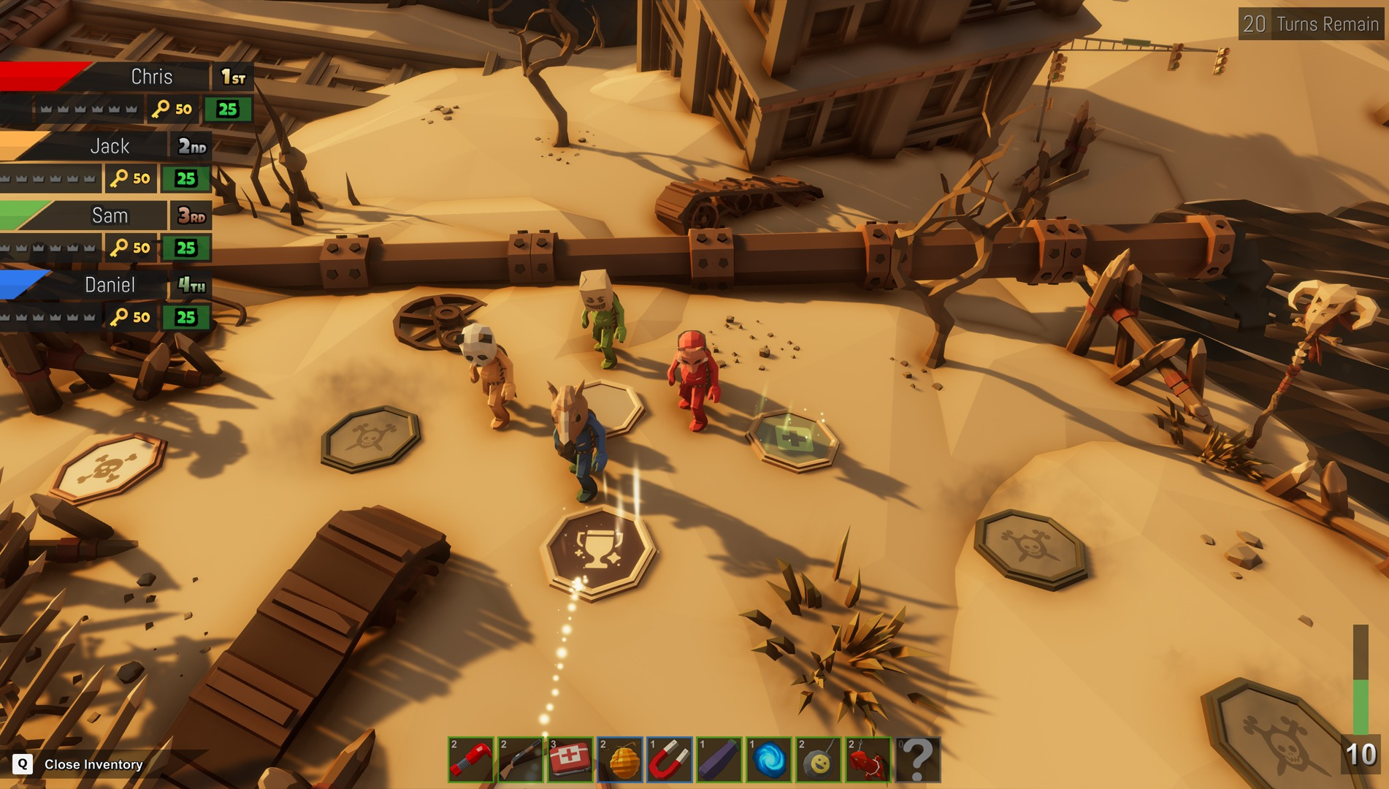
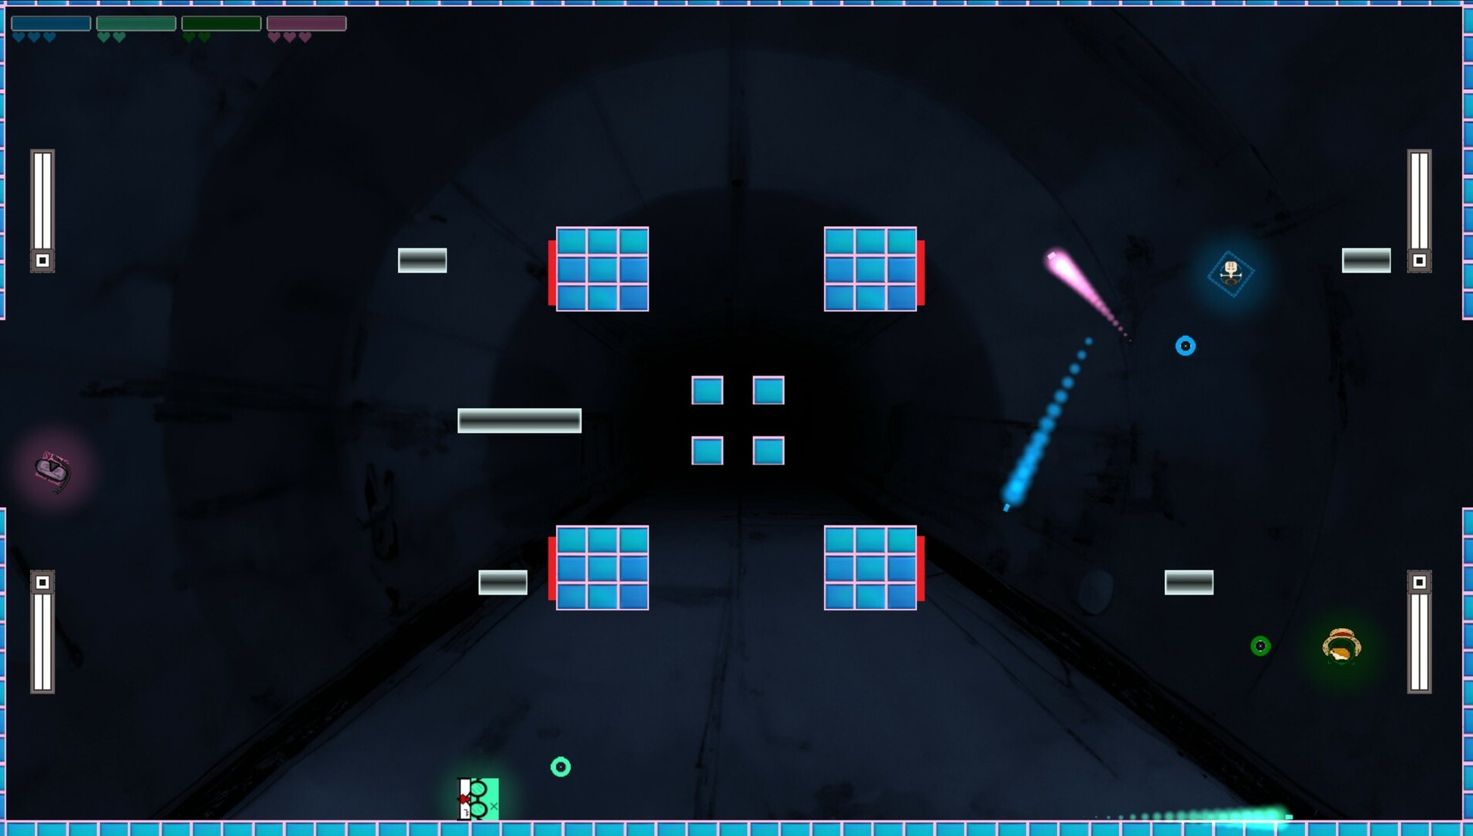
03 · Market
10 / 24
Five games we are measured against
AUDIENCE
PHYSICS
FORMAT
FORMAT
MECHANIC
Party Animals
Gang Beasts
Fall Guys
Pummel Party
Squarena
Recreate Games · 2023
Boneloaf · 2017
Mediatonic / Epic · 2020
Rebuilt Games · 2018
Codeaclysm · 2022
VISUAL
VISUAL
VISUAL
VISUAL
VISUAL
Plush 3D animals, toy-like arenas.
Soft, gelatinous 3D people.
Candy-coloured beans, obstacle courses.
Colourful low-poly 3D, slapstick items.
Minimal flat 2D squares.
MECHANIC
MECHANIC
MECHANIC
MECHANIC
MECHANIC
Physics brawling: grab, punch, throw rivals out.
Ragdoll brawling into stage hazards.
Short race and survival rounds in a playlist.
Board game with short competitive mini-games.
Arena shooter: low health shrinks you; small bodies feel more recoil.
MULTIPLAYER
MULTIPLAYER
MULTIPLAYER
MULTIPLAYER
MULTIPLAYER
Online and same-screen. No LAN listed.
Same-screen and online. No LAN listed.
Online, cross-platform only.
4–8 online and local. No LAN listed.
Up to 6 local. No LAN listed.
FINANCIALS
FINANCIALS
FINANCIALS
FINANCIALS
FINANCIALS
Launch peak 104,174 players. Owner est. 2.5M–6.0M.
85% positive. Owner est. 4.6M–5.8M.
Free-to-play. Legacy Steam peak 172,213. Metacritic 80.
$14.99. Peak 20,957. Owner est. 1.5M–7.6M.
$4.99. Sales not disclosed.
Screenshots: official Steam media, © publishers. “Owner est.” = third-party estimates via SteamDB, not sales. 2026-10-17 [7].
Notes:
Five comparables, each chosen for one reason. Party Animals and Gang Beasts share our audience and physics comedy. Fall Guys and Pummel Party share our session format of short rounds. Squarena is the closest mechanic: it shrinks you as you lose health, in 2D. Owner numbers are third-party estimates and we label them that way.

Slide 11


























03 · Market
11 / 24
Where we sit among them
PARTY ANIMALS
GANG BEASTS
FALL GUYS
PUMMEL PARTY
SQUARENA
ICE RUMBLE
3D characters
Ranged attacks
Damage changes your body size
Less mass, further knockback
Several mini-games, one result
Official LAN play
Plays with no internet
Yes
Partly
No
Planned (Ice Rumble)
“Official LAN: No” = not advertised in the game's Steam features. “Partly”: Party Animals and Pummel Party have some weapons or items; Fall Guys' playlist eliminates rather than scores. Party Animals needs internet even on one screen [8]. Ice Rumble column = planned design.
Notes:
Positioning. Each competitor covers part of this table. Squarena is the only one where damage changes your size, and none ties knockback to lost mass. None advertises official LAN. The Ice Rumble column is our plan, not shipped software.

Slide 12



04 · Innovation
12 / 24
THE NEW LINK
No shipped game we found ties knockback to the mass you have lost.
01 Spend
Shooting spits out part of your own body.
Mass Knockout puts four links on one physical value the player can see. Links 01 to 03 have relatives in other games. Link 04 we did not find.
04 Launch
02 Drain
Less mass: the same incoming hit sends you further.
Every hit you take removes body mass.
Mass
ONE VALUE
NOT FOUND ELSEWHERE
03 One value
That mass is your size, ammunition and health.
Prior-art search of shipped games, Oct 2026 [9–12]. Evidence on the next slide.
Notes:
Our core rule is that losing mass makes the next incoming hit launch you further. Spend your body to shoot, lose body when hit, that body is your size, ammunition and health, and less of it means you fly further. We searched for the last link and did not find it in any shipped game. The next slide shows the closest prior art for each link.

Slide 13

04 · Innovation
13 / 24
Closest prior art for each link, and what we did not find
LINK
CLOSEST PRIOR ART
STATUS
01
Spend your body
Osmos ejects its own matter to move, not to attack. Agar.io ejects mass.
DIFFERENT USE
02
Hits shrink you
Squarena (2D): lower health, smaller body. Morphies Law: hits move mass between robots.
PRECEDENT
03
Attack costs health
Crisol: Theater of Idols: your blood is your ammunition. Not physical mass.
PRECEDENT
04
Lighter, launched further
Smash Bros. raises knockback with a damage % counter, not mass. In Squarena, smaller bodies feel more of their own recoil.
NOT FOUND
01–04
All four in one 3D party game
No shipped game found.
NOT FOUND
Prior-art search of shipped games, Oct 2026 [9–12]. “Not found” means not found after searching.
Notes:
The other links have relatives, and we name them: Osmos and Agar.io spend body mass, but to move; Squarena shrinks you as you lose health, in 2D; Morphies Law moves mass between robots; Crisol spends your blood as ammunition. Smash Bros. raises knockback with a percentage counter, not with mass. Lighter-means-launched-further, and all four links in one 3D party game, we did not find.

Slide 14

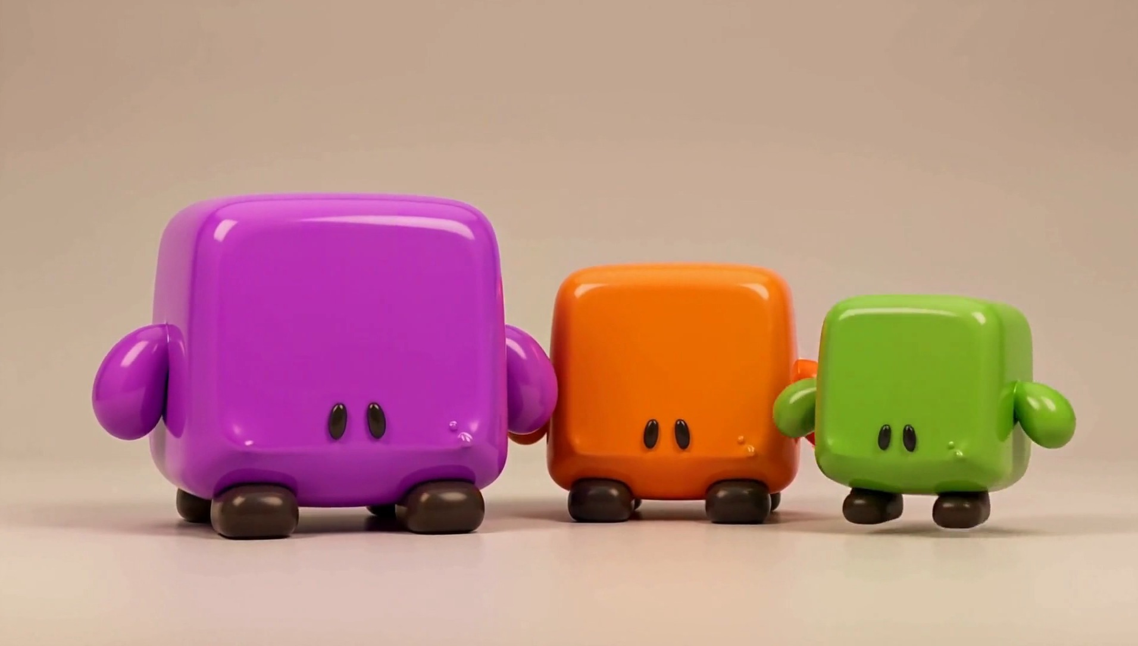



04 · Innovation
14 / 24
Same rules, different builds: weight is also ammunition
Heavy
MASS · AMMO
More starting mass: more shots to spend, harder to push. Moves slower.
SPEED
Balanced
MASS · AMMO
The reference build every other one is tuned against.
SPEED
Light
MASS · AMMO
FIG 4 · Heavy, balanced and light builds of the same character. Concept render, AI-generated.
Less starting mass: fewer shots, flies further when hit. Moves faster.
SPEED
Weight classes are standard in the genre (e.g. Mario Kart). The twist: here weight is also your ammunition, so a build changes how you play, not only how you look.
Framework for after the MVP. Pips are relative; stats are not designed yet.
Notes:
A framework, not a finished design. Characters can differ in starting mass and speed. Weight classes are common in the genre; what is different here is that mass is also ammunition, so a heavy build has more shots and a light build fewer. We would tune this after the two MVP mini-games work.

Slide 15

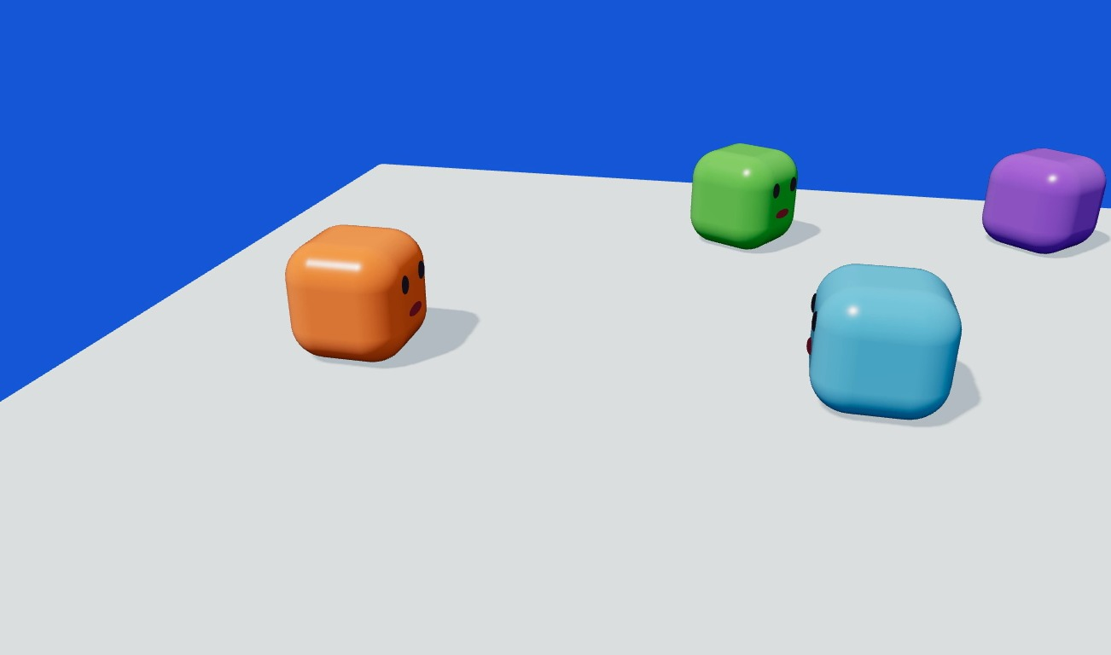
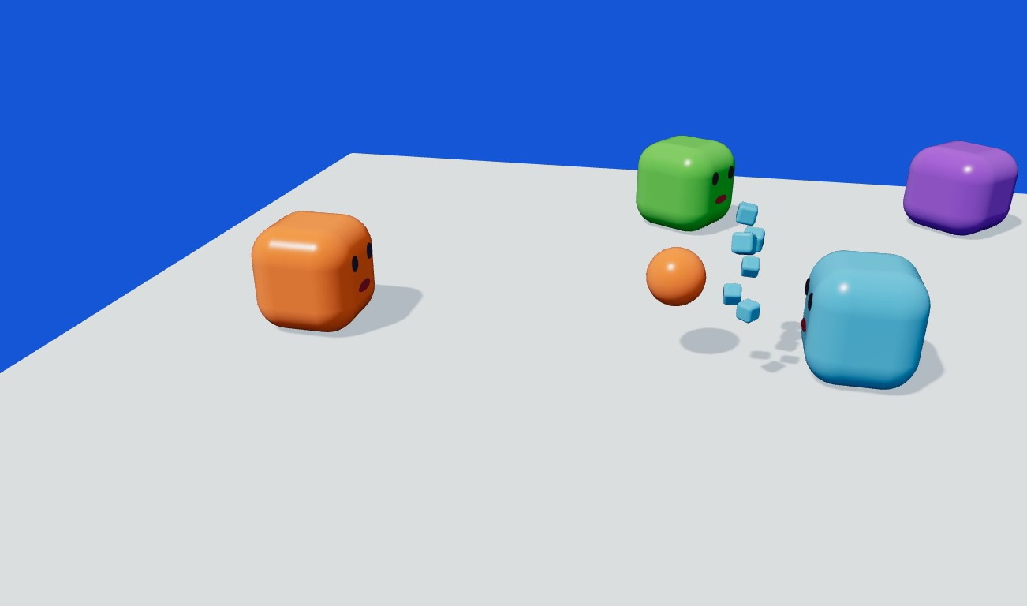
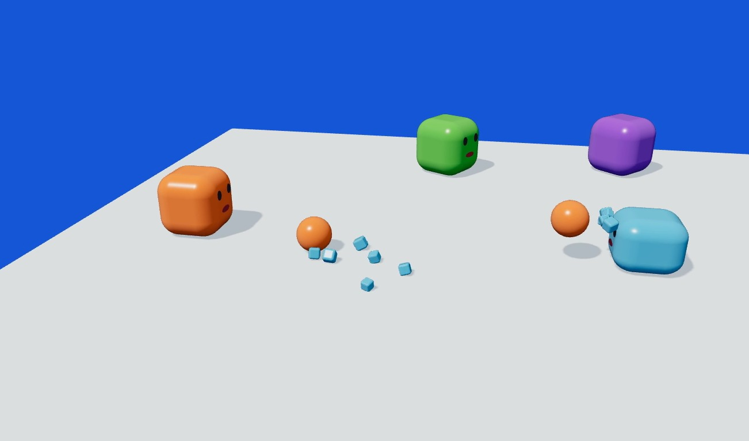
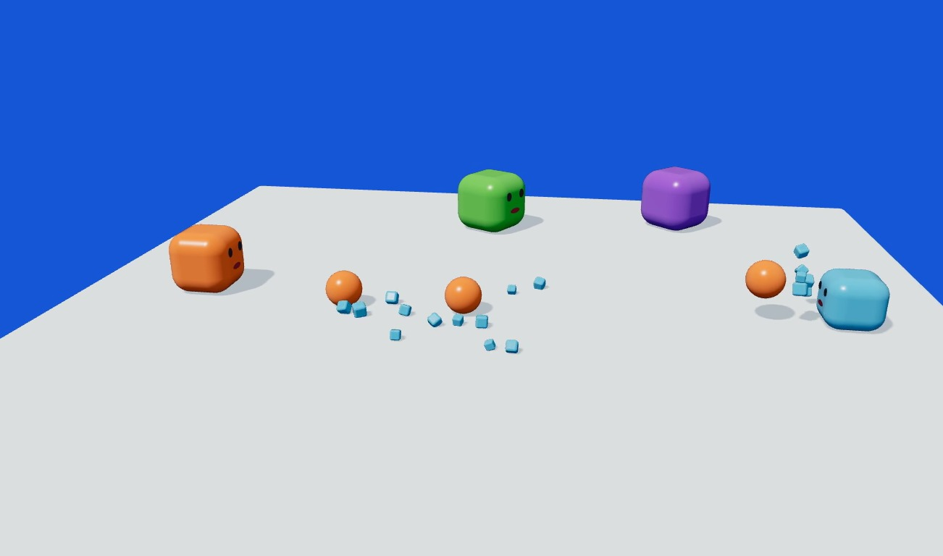
05 · Drafts & prototypes
15 / 24
Prototype: we checked that the mass rule reads on screen
Before
Shot 1
Shot 2
Shot 3
WHAT WE BUILT
WHAT WE SAW
HOW WE USE IT
A deterministic physics simulation of the Mass Knockout rule in Three.js, rendered frame by frame.
Over three shots the target shrinks and flies further each time. You can follow the rule without any UI.
It is the reference for our first Unity test of Mass Knockout in Demo 1: same scene, same rule.
Notes:
Drafts and prototypes. This is a real prototype: a deterministic physics simulation of the Mass Knockout rule, written in Three.js and rendered frame by frame. Over three shots the target shrinks and flies further each time, and you can follow that without any UI. It is the reference for our first Unity test of Mass Knockout in Demo 1.

Slide 16

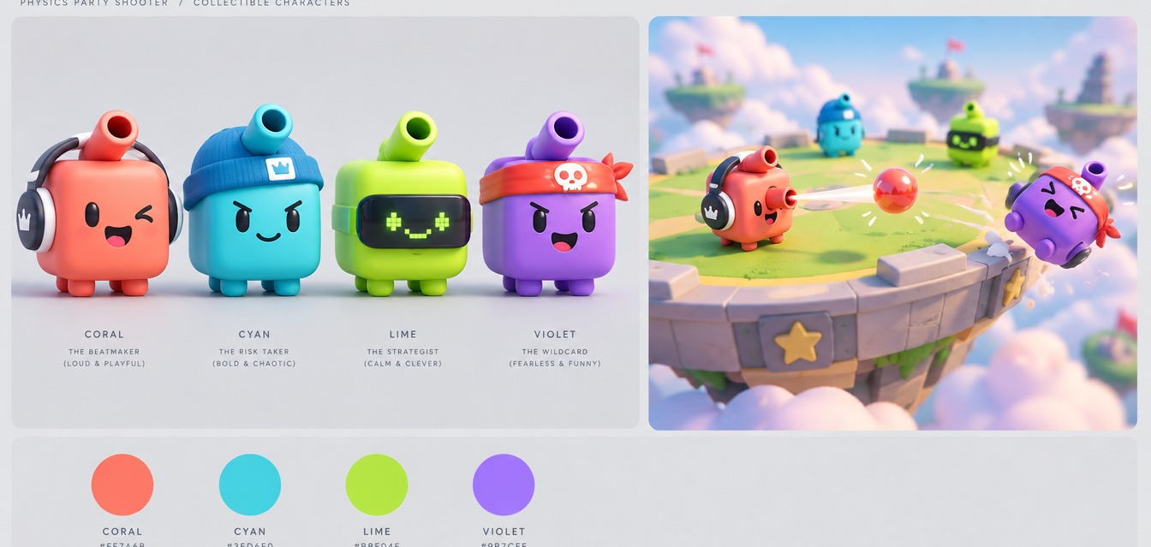
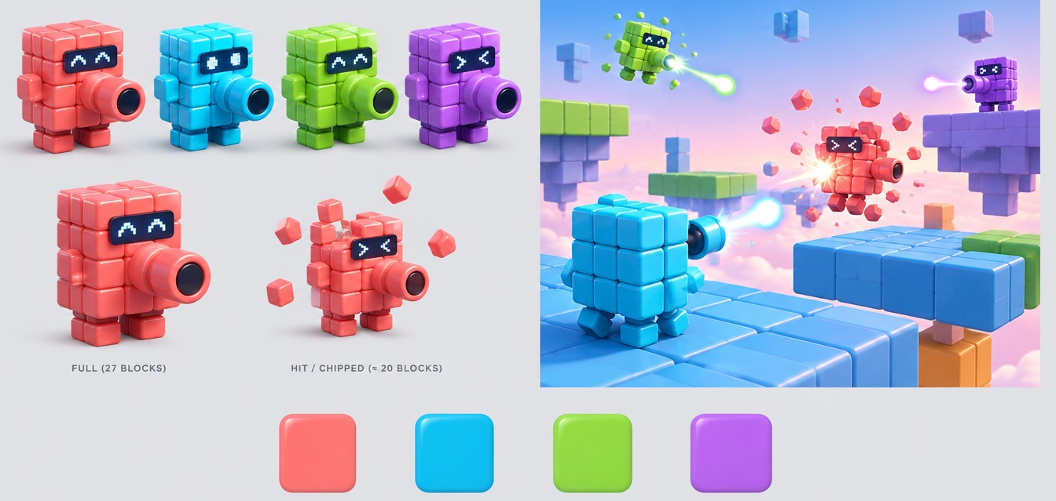
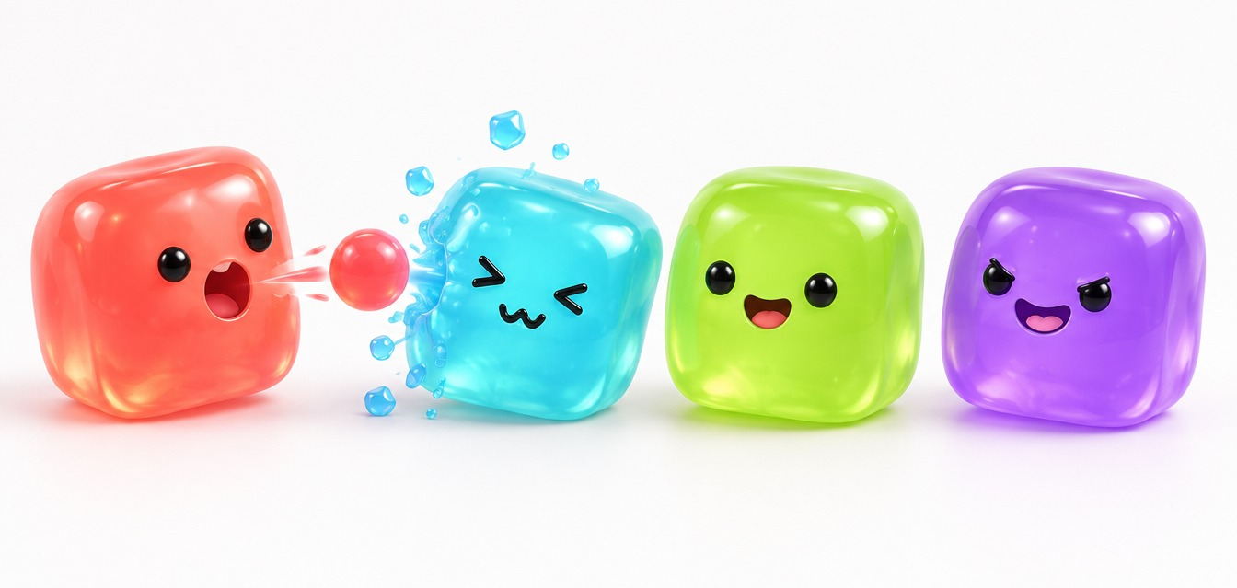
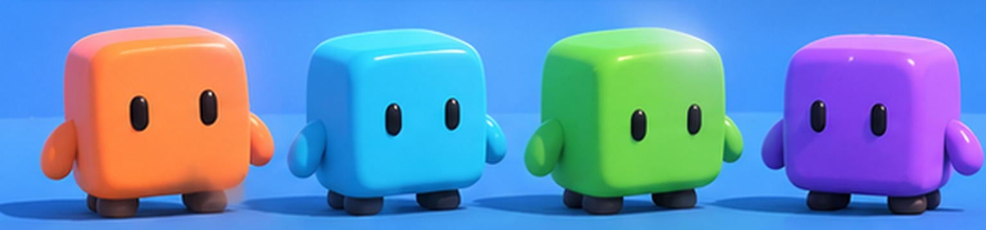
05 · Drafts & prototypes
16 / 24
Four art directions for the same cube
PURPOSE
Four looks for the same character, generated to choose a direction before modelling.
USED IN THIS DECK
C, glossy toy. Every concept render in this deck uses it.
A
Vinyl toy
B
Building blocks
PLAYER COLOURS
Orange
Cyan
Lime
Purple
All AI-generated drafts. None is gameplay.
C
Glossy toy · chosen
D
Jelly
Notes:
Four art-direction drafts for the same character: vinyl toy, building blocks, glossy toy and jelly. We generated them to choose a direction before anyone models anything. We chose C, the glossy toy; every concept render in this deck uses it. The four player colours stay the same whatever look we pick.

Slide 17




05 · Drafts & prototypes
17 / 24
Logo drafts
DRAFT A · WORDMARK
DRAFT B · STACKED
DRAFT C · ICON
Title screen, deck cover, video end card.
Square formats: store capsule, lobby screen.
Taskbar, build icon, favicon.
Drafts made for this proposal. The name is a working title; the logo is not final.
Notes:
Three logo drafts for the working title. A is a wordmark for the title screen and this deck. B stacks the name under the cube for square formats like a store capsule. C is a small icon for the taskbar and the build. None is final.

Slide 18

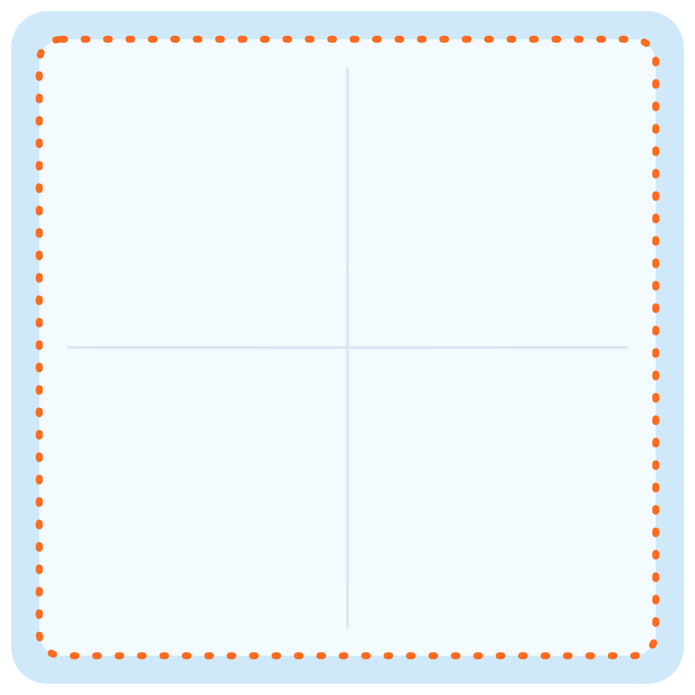
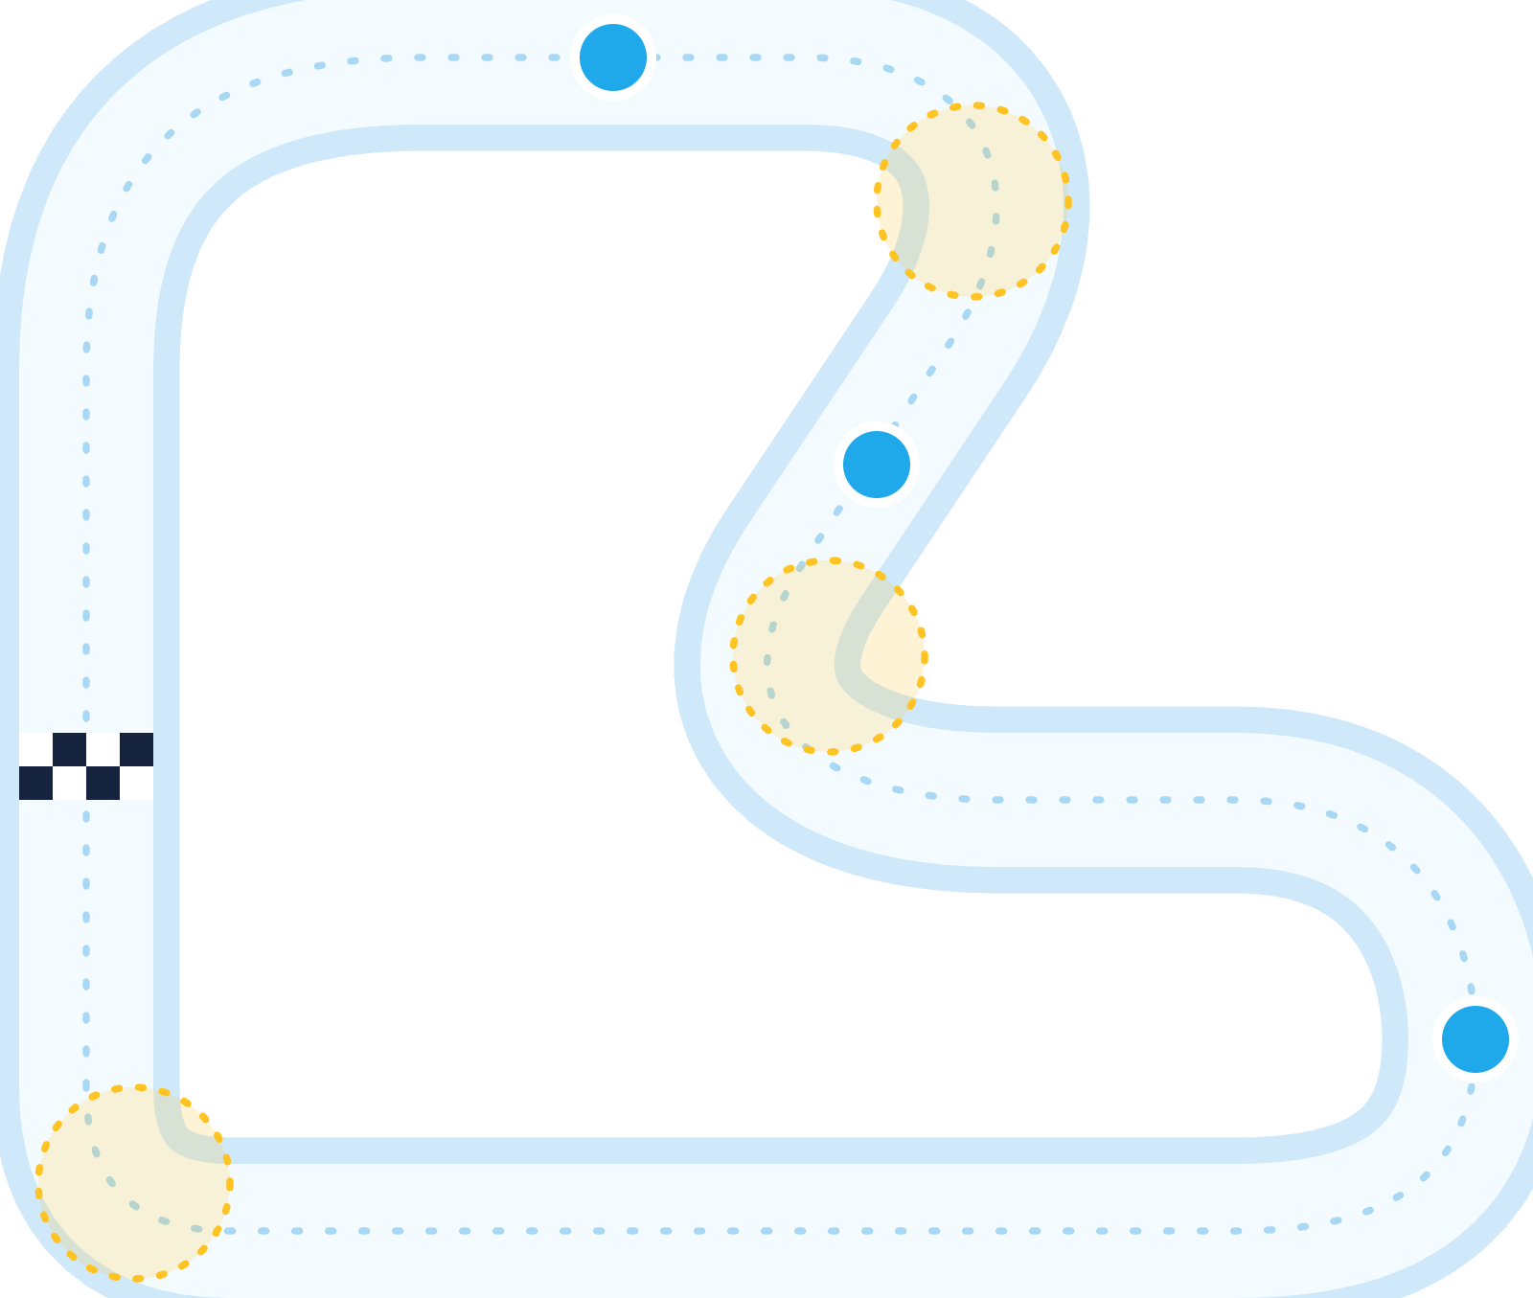




05 · Drafts & prototypes
18 / 24
Level drafts, top-down: arena and track
MASS KNOCKOUT · ARENA DRAFT
ICE RACE · TRACK DRAFT
CP1
Fall zone. No walls, no cover.
Yellow: low-grip corners. Set up early or slide off.
CP2
Open edges. A fall respawns you at the last checkpoint.
One flat square platform.
START / FINISH
Spawn near corners (draft).
CP3
OPEN EDGE = KNOCKOUT LINE
Draft layouts for scope and blockout. Dimensions, spawn points and checkpoint count are not set.
Notes:
Two level drafts, seen from above. Mass Knockout: one flat square platform with open edges and no walls, so every edge is a knockout line; players spawn near the corners. Ice Race: a closed loop with a start-finish line and checkpoints; corners are where low grip matters, and a fall puts you back at the last checkpoint. These are drafts for the blockout, not final levels.

Slide 19

06 · Development plan
19 / 24
Roadmap: four presentations, one playable step each
COURSE CHECKPOINTS · ALL MONDAYS
19 Oct
DONE
16 Nov
14 Dec
11 Jan
Proposal
Demo 1
Demo 2
Final
Concept, research, prototype and drafts. This deck.
Shared core and LAN host/join. Ice Race playable as a blockout.
Mass Knockout over LAN. A full session with rounds and the scoreboard.
Tuned, polished build. Promo video. Date subject to change.
RISK 01
RISK 02
RISK 03
Networked physics
Balance
Scope
Clients disagree on a knockback.
Stalling, or a leader snowballing.
Too many mini-games for one term.
Host simulates; clients only render and interpolate.
Score knockouts; full-mass respawn; timer; catch-up scoring.
Exactly two in the MVP. More only once both are fun.
Notes:
The course gives us four checkpoints: the proposal on 19 October, progress presentations on 16 November and 14 December, and the final on 11 January, which may still move. Each one has a playable goal. Demo 1: the shared core, LAN and a blockout of Ice Race. Demo 2: Mass Knockout over LAN and a full session with the scoreboard. Final: a tuned, polished build and the promo video. Below, the three main risks and how the design contains them.

Slide 20


06 · Development plan
20 / 24
Gantt chart: demo 1, the shared core and Ice Race
19–23 Oct
26–30 Oct
2–6 Nov
9–13 Nov
WBS
TASK
OWNER
DURATION
WEEK 3
WEEK 4
WEEK 5
WEEK 6
M
T
W
T
F
M
T
W
T
F
M
T
W
T
F
M
T
W
T
F
2
Demo 1 · 16 Nov
2.1
Unity project, scenes, build pipeline
Ezel
1 wk
2.2
Character controller & camera
Kürşat
2 wk
2.3
LAN host / join (Netcode)
Ezel
2 wk
2.4
Host authority & state sync
Ezel
1 wk
2.5
Ice movement profile
Kürşat
1 wk
2.6
Ice Race track blockout & checkpoints
Kürşat
1 wk
2.7
Mass state & spit projectile
Abdurrahim
3 wk
2.8
Lobby & join UI
Ardıl
2 wk
2.9
Character model, four colours
Ardıl
1 wk
2.10
Demo 1 build & presentation
Team
1 wk
Notes:
Work breakdown up to the first progress presentation on 16 November. We build the shared core first: project setup, character and camera, then LAN host and join and host authority. Ice Race comes first because it reuses most of the core; Mass Knockout's mass state and spit start in parallel. Owners are a proposed split by area.

Slide 21


06 · Development plan
21 / 24
Gantt chart: demo 2, Mass Knockout and the full session
16–20 Nov
23–27 Nov
30 Nov–4 Dec
7–11 Dec
WBS
TASK
OWNER
DURATION
WEEK 7
WEEK 8
WEEK 9
WEEK 10
M
T
W
T
F
M
T
W
T
F
M
T
W
T
F
M
T
W
T
F
3
Demo 2 · 14 Dec
3.1
Hit detection & mass loss
Abdurrahim
1 wk
3.2
Knockback scaled by mass
Abdurrahim
1 wk
3.3
Knockout credit & full-mass respawn
Abdurrahim
1 wk
3.4
Networked projectiles & hits
Ezel
3 wk
3.5
Mass Knockout arena
Ardıl
2 wk
3.6
Ice Race finish & placement
Kürşat
2 wk
3.7
Round state machine & rotation
Kürşat
2 wk
3.8
Scoreboard & catch-up scoring
Ardıl
2 wk
3.9
First full-session playtest
Team
1 wk
3.10
Demo 2 build & presentation
Team
1 wk
Notes:
Demo 2, on 14 December, completes Mass Knockout: hits, knockback scaled by mass, knockout credit and respawn, all synchronised over the LAN, plus the round state machine and scoreboard. It ends with our first full-session playtest.

Slide 22


06 · Development plan
22 / 24
Gantt chart: final, tuning, polish and the promo video
14–18 Dec
21–25 Dec
28 Dec–1 Jan
4–8 Jan
WBS
TASK
OWNER
DURATION
WEEK 11
WEEK 12
WEEK 13
WEEK 14
M
T
W
T
F
M
T
W
T
F
M
T
W
T
F
M
T
W
T
F
4
Final · 11 Jan
4.1
Balance tuning from playtests
Team
2 wk
4.2
VFX: trails, hit flash, splashes
Abdurrahim
2 wk
4.3
Sound effects & music
Kürşat
2 wk
4.4
Art & UI polish
Ardıl
3 wk
4.5
LAN stress test & final build
Ezel
1 wk
4.6
Promo video & final deck
Team
1 wk
PROPOSED OWNERS
Ezel
Abdurrahim
Kürşat
Ardıl
Team
Network, build
Mass Knockout
Movement, Ice Race
Art, UI, session
Shared tasks
Notes:
The final phase, up to 11 January, is tuning from playtests, effects, sound, art and UI polish, a LAN stress test and the promo video. The final date may still change; we will shift the last weeks with it.

Slide 23

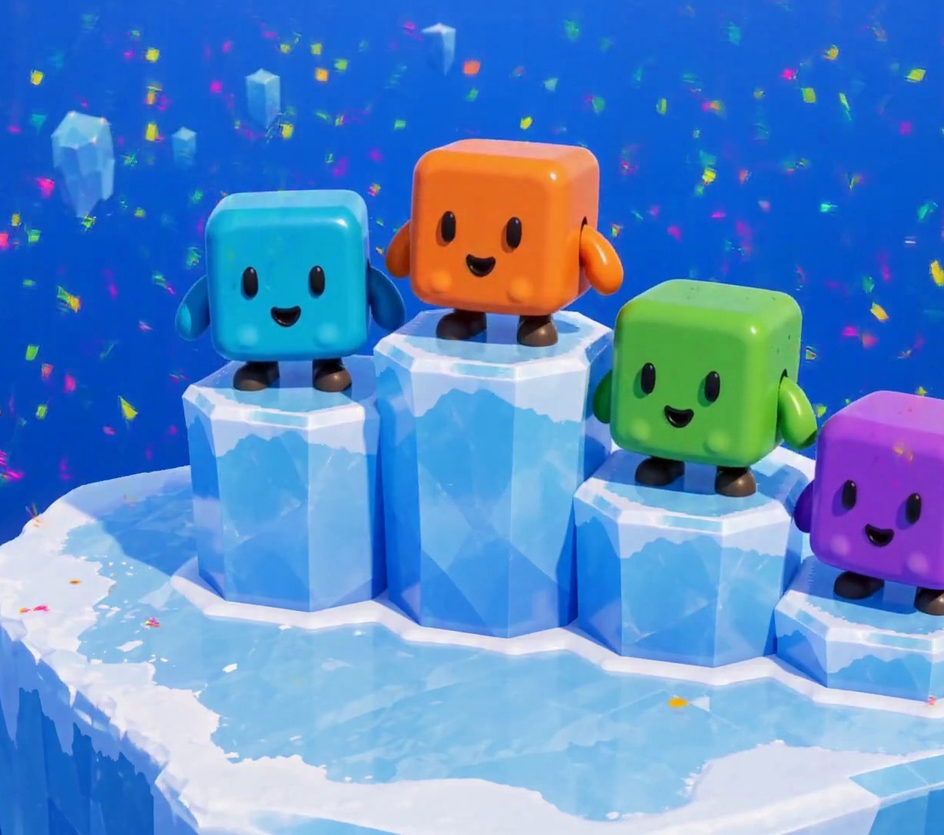
FINAL STANDINGS
Ice Rumble
1st
2–4 players, one LAN, no internet.
2nd
Two mini-games on one shared Unity core.
3rd
Every shot costs the shooter mass, so aim matters more than volume.
Questions?
Ezel Bayraktar · Abdurrahim Özağaç · Kürşat Hürkan Aydın · Ardıl Bilal Ülkü
Concept render, AI-generated. Not gameplay.
Notes:
Summary: a LAN party game, two mini-games on one shared core, and one rule that makes every shot a trade. Questions.

Slide 24

Appendix
24 / 24
Sources
[1] Newzoo final 2025 figures, via GameDev Reports, 2026-06-26. gamedevreports.substack.com/p/newzoo-gaming-market-surpassed-200
[2] Alinea Analytics, games with co-op on Steam, H1 2025 (proprietary estimates). alineaanalytics.substack.com/p/games-with-co-op-generated-over-4
[3] ESA Essential Facts 2026 (survey Feb 2026, n=13,545). theesa.com
[4] Steam store search, tag “Party Game” × LAN PvP / Online PvP / Shared-Split-screen PvP, 2026-10-17. Tags are user-applied.
[5] Game Developers, 2025 Steam revenue distribution (Gamalytic estimates), 2026-08-21. game-developers.org/2025-steam-game-revenue-distribution
[6] PC Gamer, Valve at GDC 2026: 5,863 games over $100K on Steam in 2025. pcgamer.com
[7] Steam store pages and SteamDB charts, apps 1260320, 285900, 1097150, 880940, 1858400: prices, peaks, reviews, owner estimates. 2026-10-17.
[8] GameRevolution / Prima Games: Party Animals requires an internet connection, including split-screen.
[9] Osmos official site, osmos-game.com. [10] Squarena on Steam (app 1858400); codeaclysmgames.com/squarena-details.
[11] Morphies Law official site, morphieslaw.com/game. [12] Crisol: Theater of Idols, Blumhouse Games and Steam (app 1790930).
Images: all game visuals are AI concept renders (GPT Image via Higgsfield; MiniMax H3) from our own reference art, except competitor screenshots (official Steam media). Logo and level drafts made for this proposal.
Notes:
Full research notes with all sources are in research/market-research.md.

