Slide 1


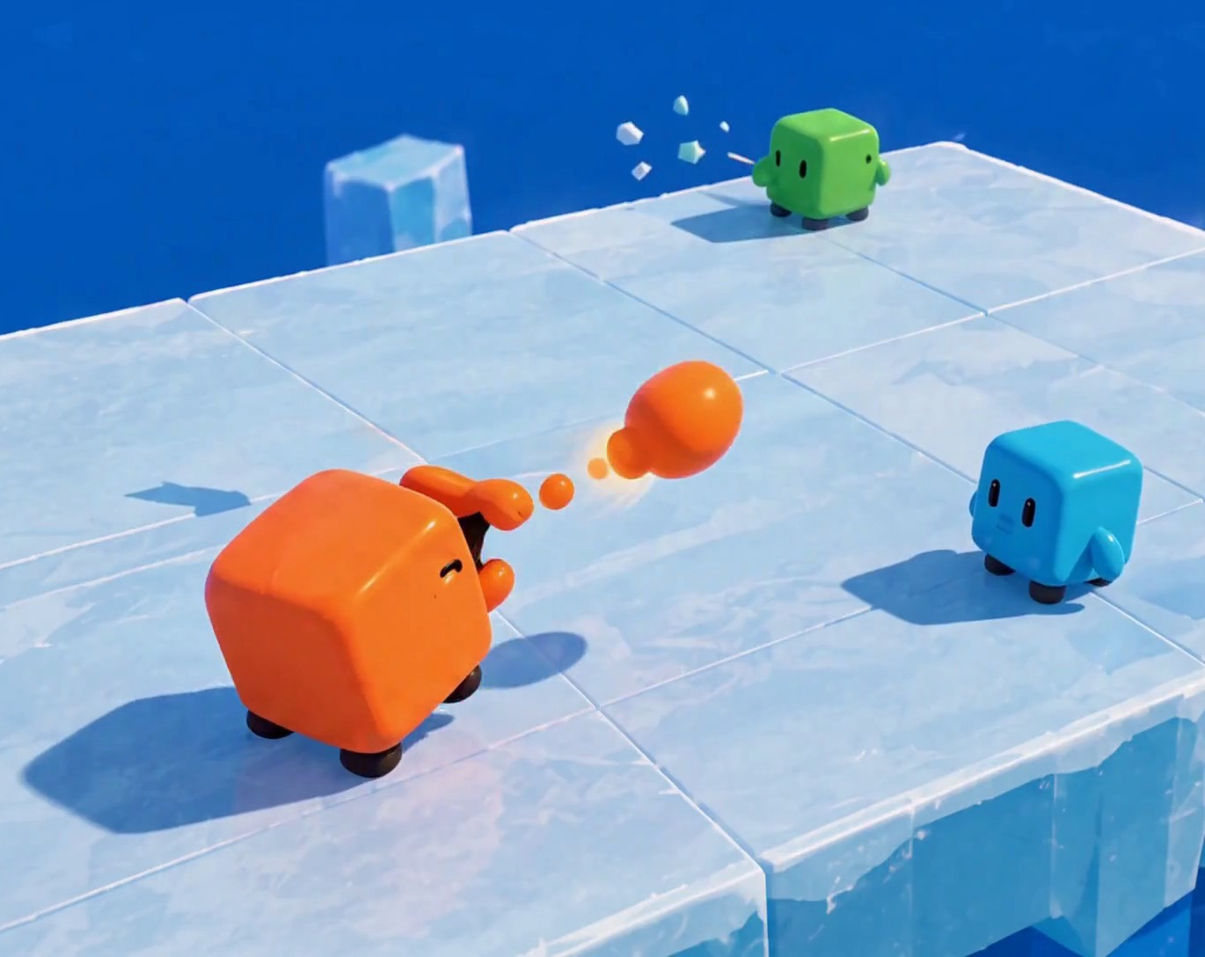




CMP406 GAMETECH · FALL 2026 · GAME PROPOSAL
Ice
Rumble
WORKING TITLE
A LAN party game for 2–4 players: short physics mini-games, one shared scoreboard.
Ezel Bayraktar
Abdurrahim Özağaç
Kürşat Hürkan Aydın
Ardıl Bilal Ülkü
2220356197
2220356033
2230356008
2230356051
Concept render, AI-generated. Not gameplay.
Notes:
Ice Rumble is a working title. It is a party game for two to four players on one local network: short physics mini-games, with points carried on one scoreboard. The four of us are the four players at the bottom. All game images in this deck are AI concept renders made from our own reference art; none of them is gameplay.

Slide 2



01 · The game
02 / 25
How it plays: one room, short rounds, one scoreboard
2–4 friends in one room, each at their own PC. One PC hosts; the others join over the local network. Everyone plays the same cube, in one of four colours.
1
Lobby
2
Round
3
Play
4
Place
5
Standings
Host starts a session and sets the playlist. Others join by local IP.
The next mini-game loads. Some have rounds of their own.
Host runs the physics. Clients send input and draw the result.
Round ends. Placement becomes points.
Ends after a set number of mini-games or at a target score.
NEXT MINI-GAME
PLACEMENT POINTS · PROPOSED
BETWEEN ROUNDS
1st
4 PTS
CARRIES OVER
Points. Nothing else accumulates.
2nd
3 PTS
PLAYLIST
Random or custom. Unwanted games can be left out; a game can be played more than once.
3rd
2 PTS
4th
1 PTS
RESETS
Mass and position, so one bad round does not snowball.
Notes:
Plain-language summary first: two to four friends, each on a PC, in the same room; one PC hosts. Everyone plays the same cube in one of four colours. The session loop. The host starts the session and sets the playlist: random or custom, with unwanted games left out and repeats allowed. Some mini-games have rounds of their own. Placement in each mini-game gives points, and the session ends after a set number of mini-games or when someone reaches a target score. Only points carry over; mass and position reset. Placement points 4, 3, 2, 1 are a proposal we will tune in playtests.

Slide 3

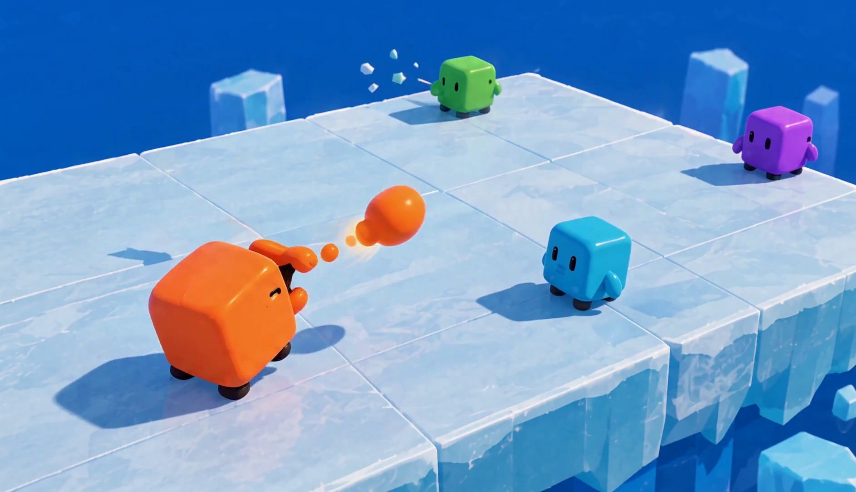
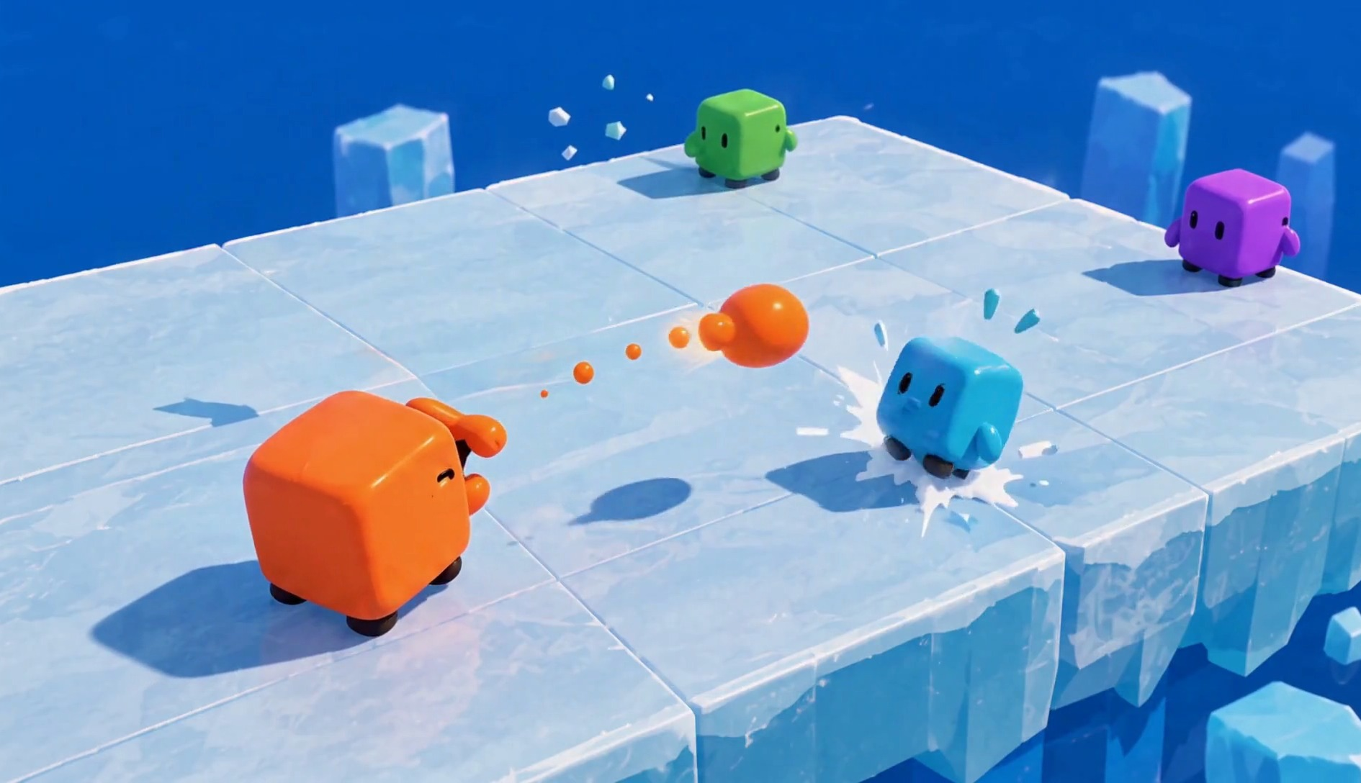
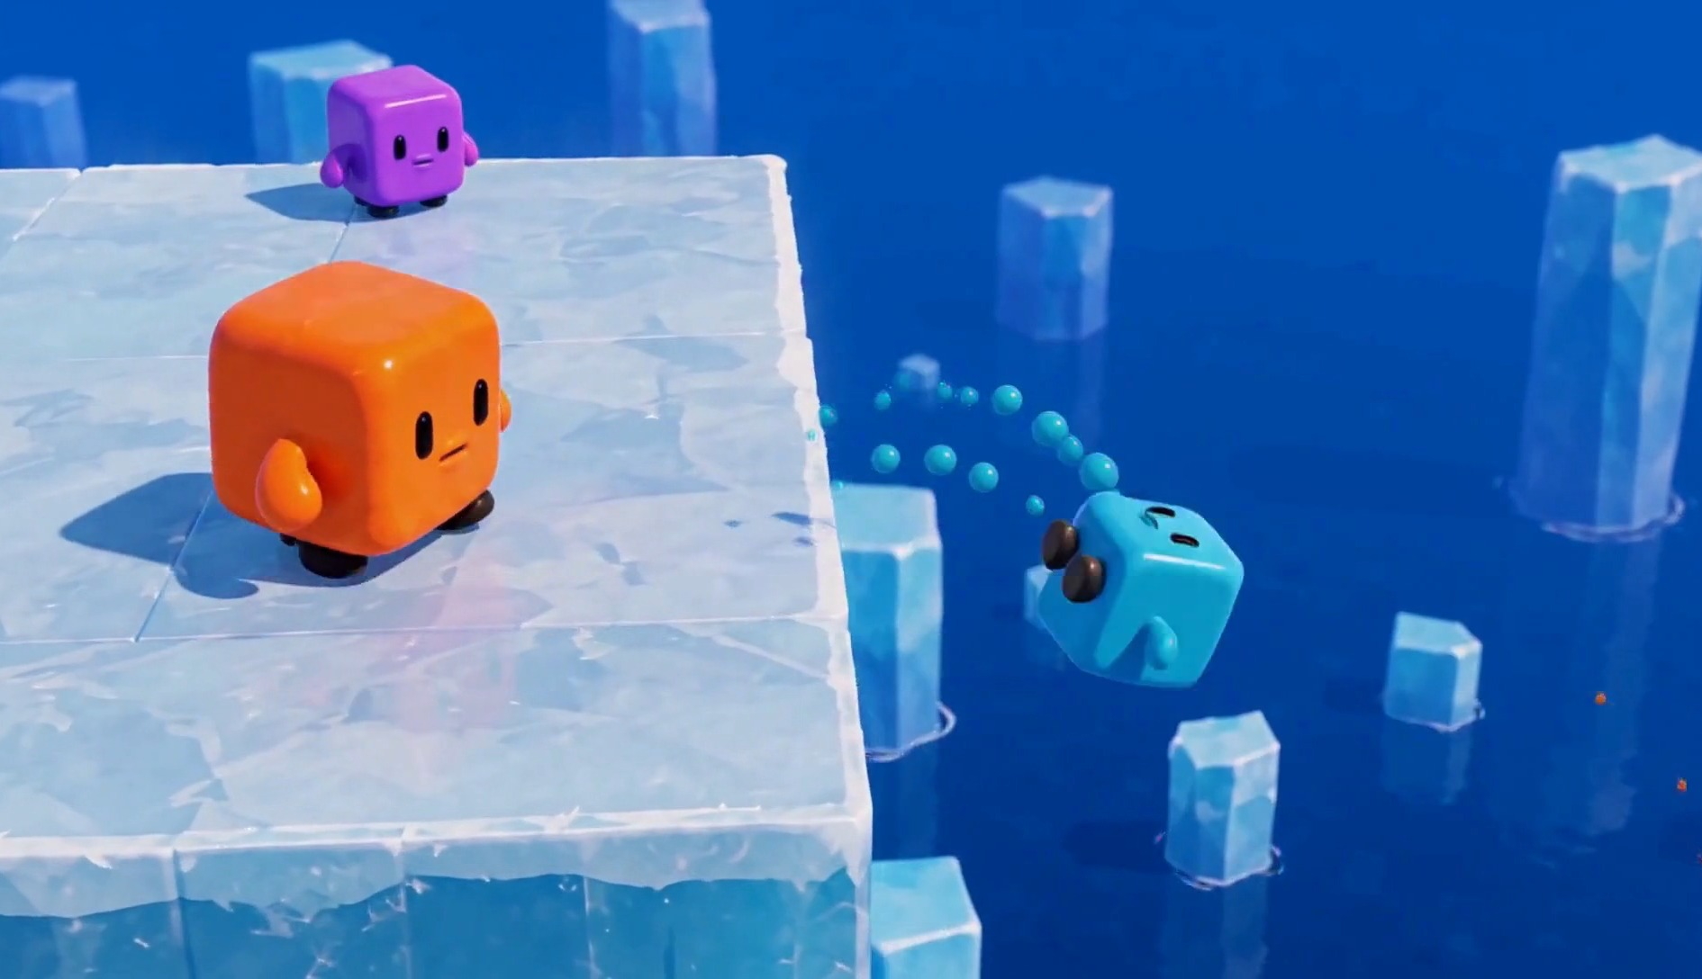
02 · Gameplay & tech
03 / 25
Every hit makes you lighter, so the next one sends you further
1 · Shoot
2 · Hit
3 · Fall
Shots are real physical projectiles. Shooting is free; only a fire-rate limit sets the pace.
The target is pushed back from the direction of the shot and loses mass. Its size stays the same.
Less mass means the same shot pushes further. A cube that falls off is out.
SHOOTER MASS
TARGET MASS
KNOCKBACK, SAME SHOT
Unchanged: shooting costs nothing
Faded part: lost to this hit
Grows as mass drops
The force of a shot never changes. The target's mass does, so every hit makes the next one more dangerous.
Bars show direction only. Fire rate, mass loss and force are set in playtests.
Notes:
The core rule of Mass Knockout. Shooting is free; only a fire-rate limit sets the pace, and the shots are real physical projectiles. The shooter is not affected. The target is pushed back from the direction of the shot and loses mass, not size. Because the force of a shot stays the same, a lighter cube is pushed further by the same shot, and a cube that falls off is out. Exact values come from playtests.

Slide 4





02 · Gameplay & tech
04 / 25
One shot, a different effect in each mini-game
MOVE
CAMERA
SHOOT
JUMP
WASD
Third-person
Real projectiles, fire-rate limit
Only where the mini-game allows it
MVP
MECHANIC IDEA
BACKLOG
BACKLOG
Knockback
Steer
Launch
Damage
Mass Knockout
Ice Race
Parkour Blast
Versus
The target is pushed back from the shot’s direction and loses mass.
Shoot forward while sliding and use the shot’s momentum to change direction.
The shot explodes and lifts you. Shoot the ground to jump.
A hit lowers the target’s health.
The shot is shared code. Each mini-game decides what a hit does.
From our design doc. Steering by shot momentum is a mechanic idea; values come from playtests.
Notes:
The controls stay the same everywhere: WASD to move, a third-person camera, aim and shoot. Jumping is on in some mini-games and off in others. What changes is what a shot does. In Mass Knockout a hit pushes the target back and lowers its mass. On the ice, one mechanic idea is to shoot forward while sliding and use the shot's momentum to steer. In the parkour idea a shot explodes and lifts you, so you can shoot the ground to jump. In other mini-games a hit simply lowers the target's health.

Slide 5

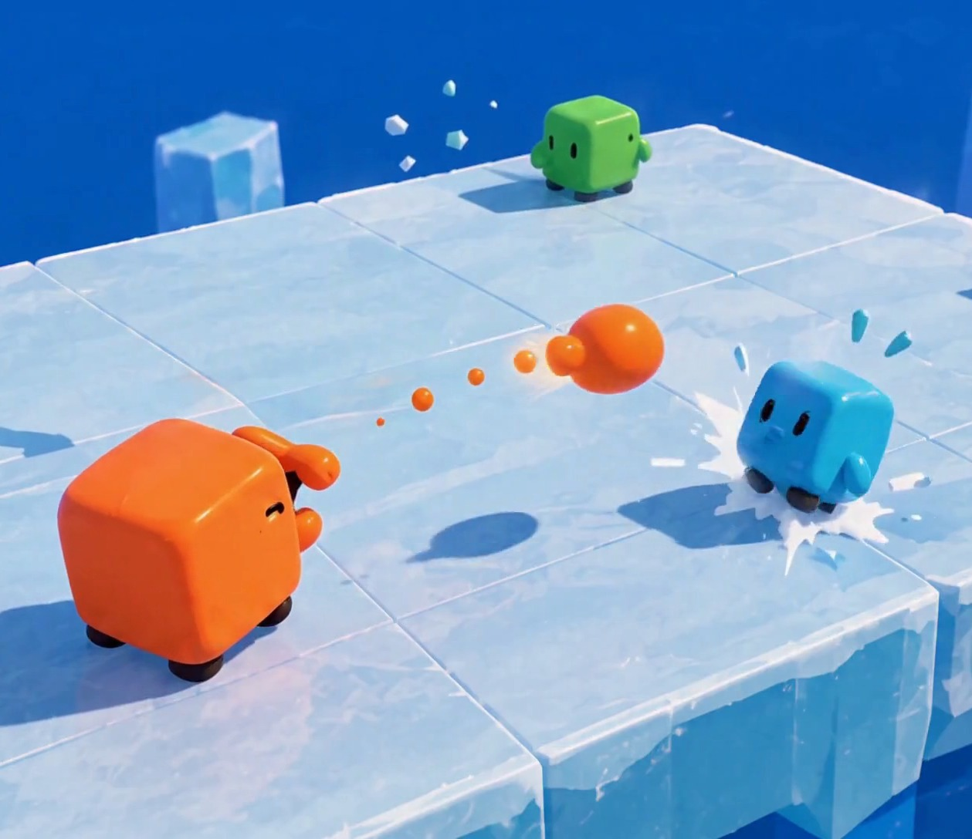

02 · Gameplay & tech
05 / 25
MINI-GAME 01
Mass
Knockout
GOAL
Knock the other cubes off the flat platform.
SHOOTING
Free, with a fire-rate limit. Shots are real projectiles; the shooter is not affected.
HIT
The target is pushed back from the shot’s direction and loses mass, not size.
FALLING
A cube that falls off dies.
ARENA
One flat platform. Open edges, no walls.
FIG 2 · Orange fires; Cyan is hit near the edge. Concept render, AI-generated.
Notes:
Mass Knockout. We shoot each other on one flat platform with open edges. Shooting is free but has a fire-rate limit, and the shots are real projectiles that do nothing to the shooter. A hit pushes the target back from the direction of the shot and lowers its mass, not its size. The lighter it gets, the further the same shot pushes it. A cube that falls off dies.

Slide 6


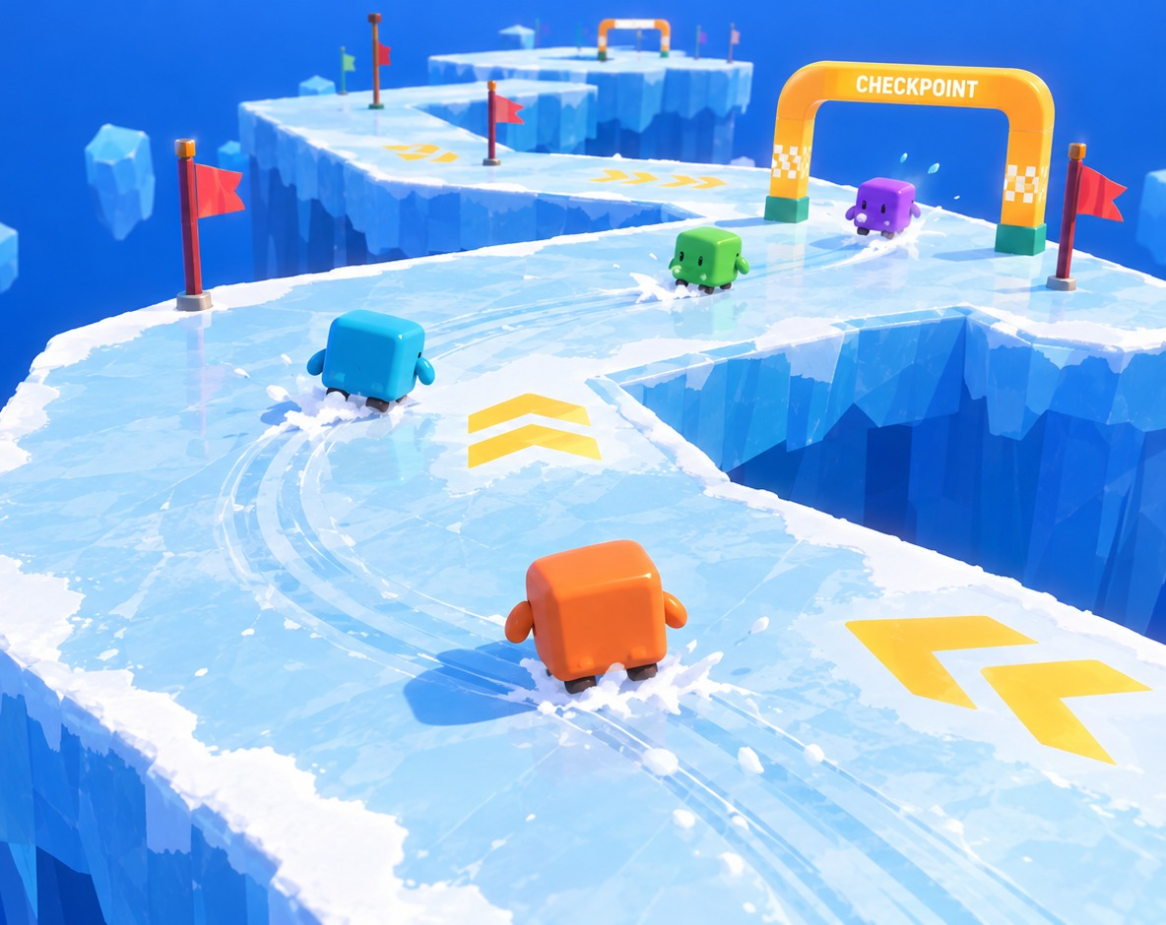
02 · Gameplay & tech
06 / 25
MINI-GAME 02
Ice
Race
GOAL
Pass the most checkpoints before the time runs out.
LOOP
The track loops. Every checkpoint you pass counts +1, lap after lap.
ICE
Slippery floor: carry speed through corners without sliding off.
RIVALS
Push others off the ice to gain an advantage.
FALLS
Fall into the water and restart at your last checkpoint.
FIG 3 · Racing a floating ice track; the HUD is part of the render. Concept render, AI-generated.
Notes:
Ice Race. A slippery ice track with checkpoints. The goal is to pass the most checkpoints within the time limit. The track loops, so after the last checkpoint you go round again and every checkpoint still counts plus one. Players can push each other off the ice to gain an advantage; whoever falls into the water restarts at their last checkpoint.

Slide 7


02 · Gameplay & tech
07 / 25
Mini-game backlog: three more ideas from our design doc
IDEA 01
IDEA 02
IDEA 03
Parkour Blast
Musical Chairs
Versus
SHOT: LAUNCH
SHOT: PUSH
SHOT: DAMAGE
Cross a course by shooting and blasting off.
Player-shaped holes open in the floor, each at a set angle. One fewer every round.
A straight head-to-head battle.
Hold to charge a strong blast. You can’t move while firing, so you are exposed.
Whoever is left out is crushed by a giant bulldozer.
Hits lower health.
No hiding spots. Falling off is out.
Shots push rivals, but a cube in a hole can’t be pushed out.
Still being designed.
If hitting is too easy, shots can arc under gravity.
Ideas, not in the MVP. Each one reuses the shared shot and plugs into the same mini-game contract.
Notes:
Our design doc has more mini-game ideas than the two in the MVP. Parkour Blast: cross a course by shooting and blasting; holding the button charges a strong blast, but you can't move while firing, so you are exposed. There is nowhere to hide, and falling is out. If hitting turns out too easy, shots can arc under gravity. Musical Chairs: player-shaped holes open in the floor, each at a set angle, with one fewer hole every round; whoever is left out is crushed by a giant bulldozer. Shots push players, but a cube already in a hole can't be pushed out. Versus is a straight battle that we are still designing. All of them come after the MVP.

Slide 8

02 · Gameplay & tech
08 / 25
One shared core; each mini-game plugs into it
MINI-GAMES
Mass Knockout
Ice Race
Next mini-game
WHY THIS SPLIT
mass · knockback · fall-out
ice grip · loop track · checkpoints
new rules + one arena
Reuse
A new mini-game is new rules plus one arena. Character, camera, network and scores already exist.
MINI-GAME CONTRACT
Setup(players) → Run() → Results() : placement
SHARED GAMEPLAY
Per-game rules
Character
TPS camera
Shot
Rounds & playlist
Scoreboard
Lobby & UI
Each mini-game sets what a shot does, how much grip the floor has, and whether jumping is on.
NETWORK
Host-authoritative LAN · Unity Netcode for GameObjects (candidate)
One truth
Everything that decides a result runs on the host, so every screen agrees.
ENGINE
Unity · built-in rigidbody physics
Notes:
Architecture. The mini-games sit on top of a shared core. Each one implements the same small contract: set up with the players, run, report placement. Below that sit the character, the third-person camera, the shared shot, rounds and the playlist, the scoreboard and the lobby, then the LAN layer, where the host is authoritative. Unity Netcode for GameObjects is our candidate library, not a final choice.

Slide 9



02 · Gameplay & tech
09 / 25
One shot over the LAN, step by step
Client A
Host
Client B
shooter
authority: runs the physics
target
1
Fire input + aim direction
2
Check fire rate; spawn the shot
3
Physics step: the shot reaches B
4
B loses mass; push scaled by B’s new mass
Snapshot: positions, sizes, scores
5
5
Same snapshot to every client
6
Clients interpolate between snapshots and draw.
6
Your own movement is predicted locally, so it feels instant. Hits, mass changes and knockouts are decided only on the host. Main risk: keeping physics smooth on clients. LAN latency is low, and we tune the snapshot rate.
Notes:
One shot end to end. The client only sends intent. The host checks the fire-rate limit, spawns and simulates the shot, applies the hit and knockback, and sends one snapshot to everyone. Clients interpolate. Own movement is predicted locally for feel; anything that decides a result lives on the host.

Slide 10

03 · Market
10 / 25
Social PC play is growing; LAN party games are rare
$43.6B
$4.1B
STEAM “PARTY GAME” TITLES BY MULTIPLAYER TAG
PC games revenue in 2025, up 12% year on year.
Steam revenue of games with co-op in H1 2025, an all-time high (estimate).
ONLINE PVP
1,870
Newzoo [1]
Alinea [2]
SHARED / SPLIT-SCREEN PVP
1,017
70%
≈8%
LAN PVP
292
of US players aged 8+ play with other people.
of ~3,490 Steam “Party Game” titles list LAN PvP.
ESA 2026 [3]
Steam, Oct 2026 [4]
Steam store search, Oct 2026 [4]. Tags are user-applied.
RISK, STATED PLAINLY
An estimated 65.9% of 2025 Steam releases earned under $1,000 [5], while 5,863 games passed $100K in 2025 (Valve) [6]. LAN is our differentiator, not a demand driver.
Notes:
Market potential. PC is a 43.6 billion dollar market that grew 12 percent in 2025; games with co-op made an estimated 4.1 billion on Steam in the first half of 2025; most players play with others. Only about 8 percent of Steam party games list LAN. Revenue is very uneven: most releases earn little, but thousands pass 100 thousand dollars. LAN is how we stand out, not why people buy.

Slide 11

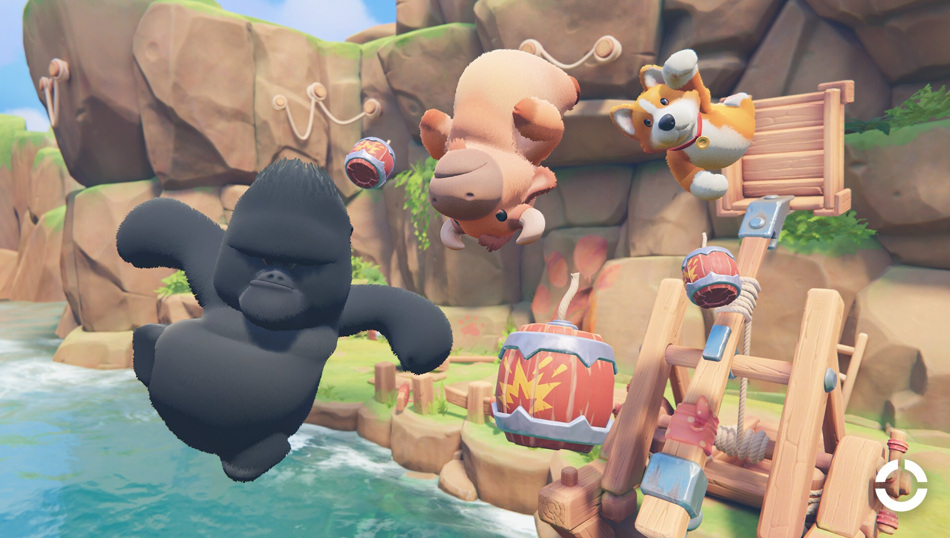
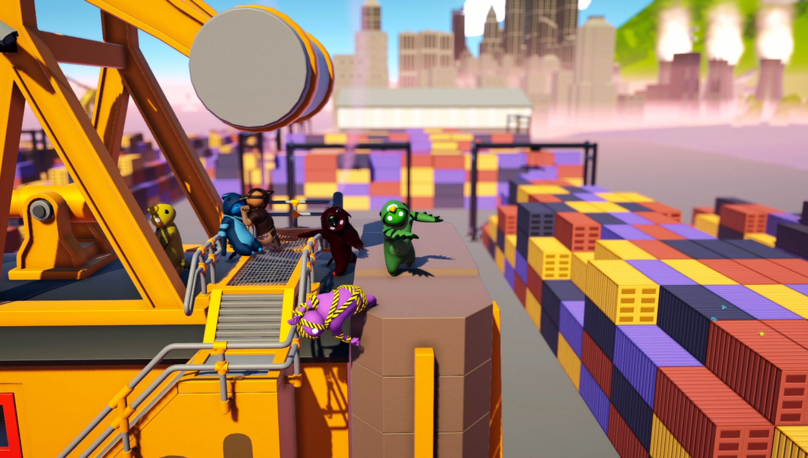
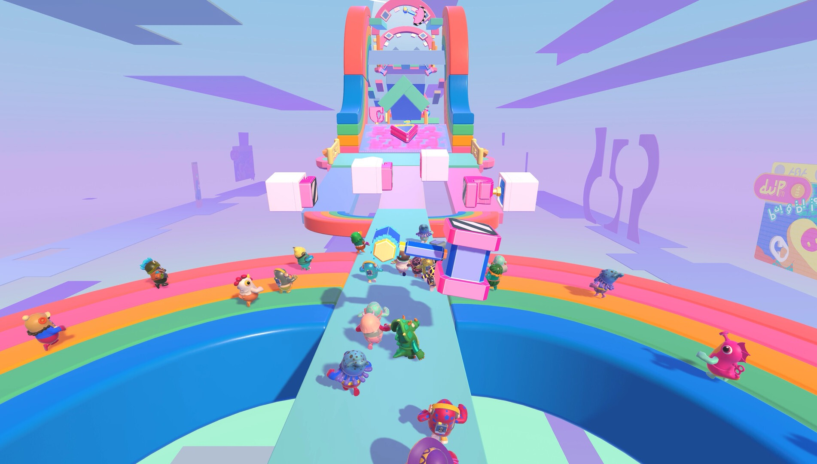
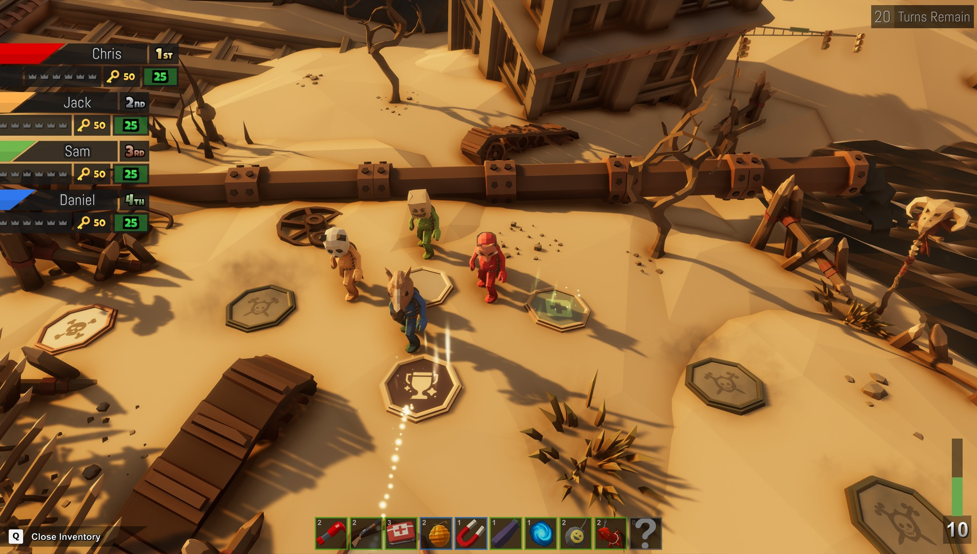
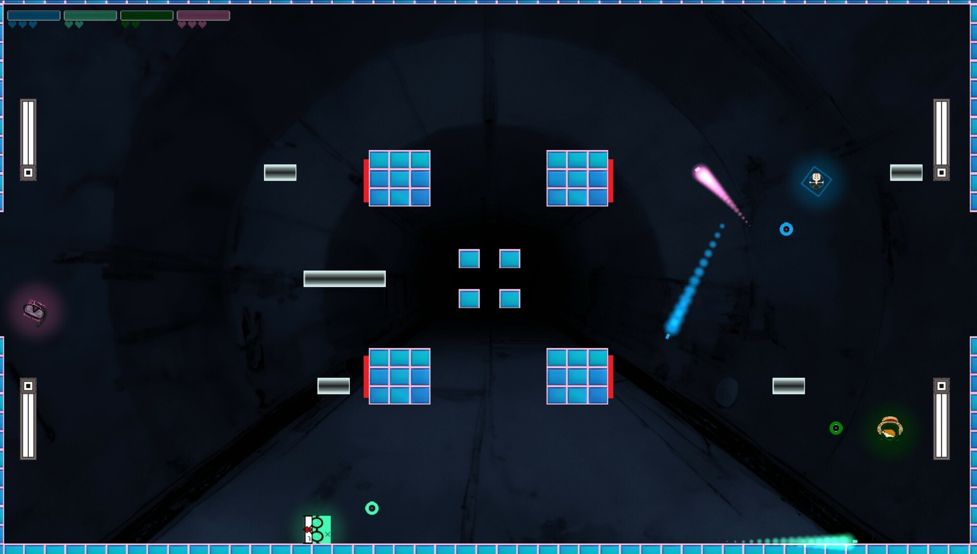
03 · Market
11 / 25
Five games we are measured against
AUDIENCE
PHYSICS
FORMAT
FORMAT
MECHANIC
Party Animals
Gang Beasts
Fall Guys
Pummel Party
Squarena
Recreate Games · 2023
Boneloaf · 2017
Mediatonic / Epic · 2020
Rebuilt Games · 2018
Codeaclysm · 2022
VISUAL
VISUAL
VISUAL
VISUAL
VISUAL
Plush 3D animals, toy-like arenas.
Soft, gelatinous 3D people.
Candy-coloured beans, obstacle courses.
Colourful low-poly 3D, slapstick items.
Minimal flat 2D squares.
MECHANIC
MECHANIC
MECHANIC
MECHANIC
MECHANIC
Physics brawling: grab, punch, throw rivals out.
Ragdoll brawling into stage hazards.
Short race and survival rounds in a playlist.
Board game with short competitive mini-games.
Arena shooter: low health shrinks you; small bodies feel more recoil.
MULTIPLAYER
MULTIPLAYER
MULTIPLAYER
MULTIPLAYER
MULTIPLAYER
Online and same-screen. No LAN listed.
Same-screen and online. No LAN listed.
Online, cross-platform only.
4–8 online and local. No LAN listed.
Up to 6 local. No LAN listed.
FINANCIALS
FINANCIALS
FINANCIALS
FINANCIALS
FINANCIALS
Launch peak 104,174 players. Owner est. 2.5M–6.0M.
85% positive. Owner est. 4.6M–5.8M.
Free-to-play. Legacy Steam peak 172,213. Metacritic 80.
$14.99. Peak 20,957. Owner est. 1.5M–7.6M.
$4.99. Sales not disclosed.
Screenshots: official Steam media, © publishers. “Owner est.” = third-party estimates via SteamDB, not sales. 2026-10-17 [7].
Notes:
Five comparables, each chosen for one reason. Party Animals and Gang Beasts share our audience and physics comedy. Fall Guys and Pummel Party share our session format of short rounds. Squarena is the closest mechanic: it shrinks you as you lose health, in 2D. Owner numbers are third-party estimates and we label them that way.

Slide 12


























03 · Market
12 / 25
Where we sit among them
PARTY ANIMALS
GANG BEASTS
FALL GUYS
PUMMEL PARTY
SQUARENA
ICE RUMBLE
3D characters
Ranged attacks
Hits lower mass, so knockback grows
Several mini-games, one result
Official LAN play
Plays with no internet
Yes
Partly
No
Planned (Ice Rumble)
“Official LAN: No” = not advertised in the game's Steam features. “Partly”: Party Animals and Pummel Party have some weapons or items; Fall Guys' playlist eliminates rather than scores. Party Animals needs internet even on one screen [8]. Ice Rumble column = planned design.
Notes:
Positioning. Each competitor covers part of this table. None of them ties knockback to the mass a player has lost. None advertises official LAN. The Ice Rumble column is our plan, not shipped software.

Slide 13



04 · Innovation
13 / 25
THE NEW LINK
No shipped game we found ties knockback to the mass lost from hits.
01 Shoot
A real projectile. Free; only the fire rate limits it.
Mass Knockout builds every hit on one physical value: mass. Links 01 to 03 have relatives in other games. Link 04 we did not find.
04 Launch
02 Push
Less mass: the same shot now sends it further.
A hit pushes the target back from the shot’s direction.
Mass
ONE VALUE
NOT FOUND ELSEWHERE
03 Drain
The hit lowers its mass. Its size stays the same.
Prior-art search of shipped games, Oct 2026 [9–10]. Evidence on the next slide.
Notes:
Our core rule is that every hit lowers the target's mass, so the same shot launches it further next time. Shoot, push, drain, launch. We searched for the last link and did not find it in any shipped game. The next slide shows the closest prior art for each link.

Slide 14

04 · Innovation
14 / 25
Closest prior art for each link, and what we did not find
LINK
CLOSEST PRIOR ART
STATUS
01–02
Shots that push
Knockback from attacks is standard in the genre, e.g. Smash Bros.
STANDARD
03
Hits change your body
Squarena (2D): lower health, smaller body. Morphies Law: hits move mass between robots.
PRECEDENT
04
Lighter, launched further
Smash Bros. raises knockback with a damage % counter, not mass. In Squarena, smaller bodies feel more of their own recoil.
NOT FOUND
01–04
All four in one 3D party game
No shipped game found.
NOT FOUND
Prior-art search of shipped games, Oct 2026 [9–10]. “Not found” means not found after searching.
Notes:
The other links have relatives, and we name them. Knockback from attacks is standard, for example in Smash Bros. Squarena changes your body as you lose health, in 2D, and Morphies Law moves mass between robots. Smash Bros. raises knockback with a percentage counter, not with physical mass. Lost mass launching you further, and all of it in one 3D party game, we did not find.

Slide 15

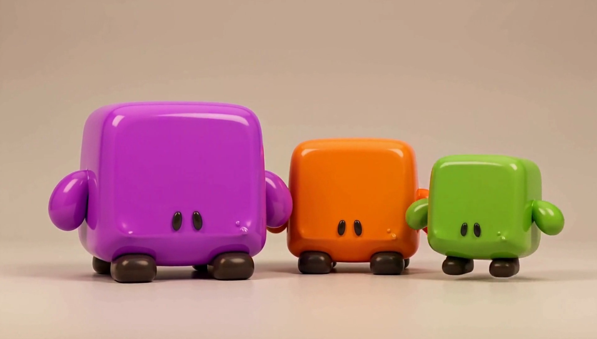



04 · Innovation
15 / 25
Same rules, different builds: starting mass sets how far you fly
Heavy
STARTING MASS
More starting mass: harder to push off the edge.
KNOCKBACK TAKEN
Balanced
STARTING MASS
The reference build the others are tuned against.
KNOCKBACK TAKEN
Light
STARTING MASS
FIG 4 · Heavy, balanced and light builds of the same character. Concept render, AI-generated.
Less starting mass: flies further when hit, jumps higher where jumping is on.
KNOCKBACK TAKEN
Weight classes are standard in the genre (e.g. Mario Kart). Here starting mass feeds the knockback rule directly, so a build changes how you play, not only how you look.
Idea from our design doc: selectable character types. Not in the MVP; pips are relative.
Notes:
An idea from our design doc, not a finished design: characters with different properties that players pick. With our rule the natural property is starting mass: a heavy build is harder to push off, a light one flies further and jumps higher. We would design this after the two MVP mini-games work.

Slide 16

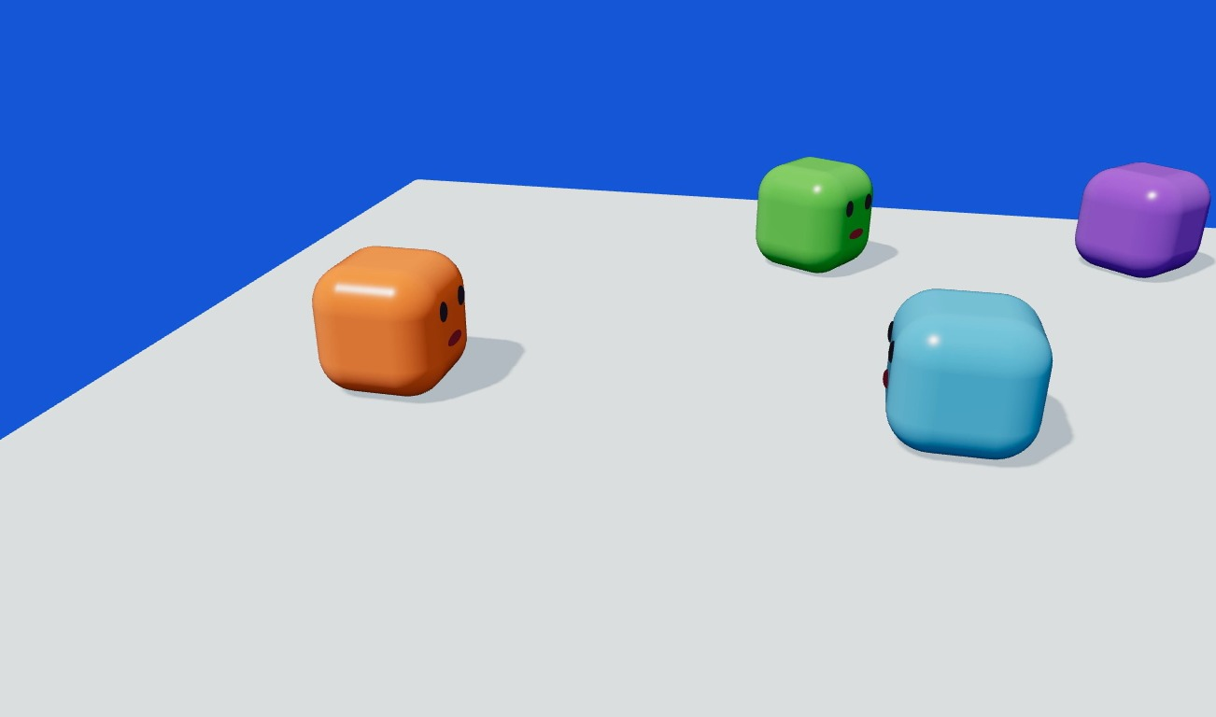
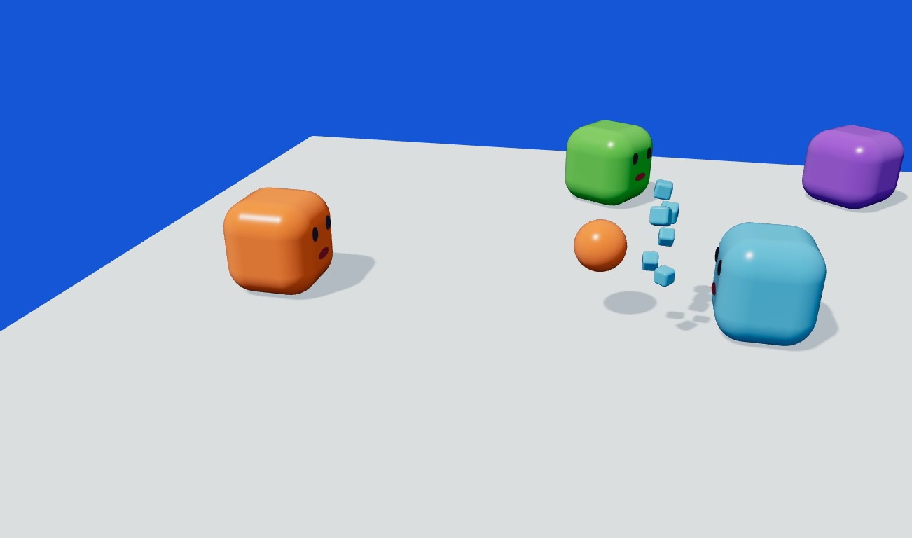
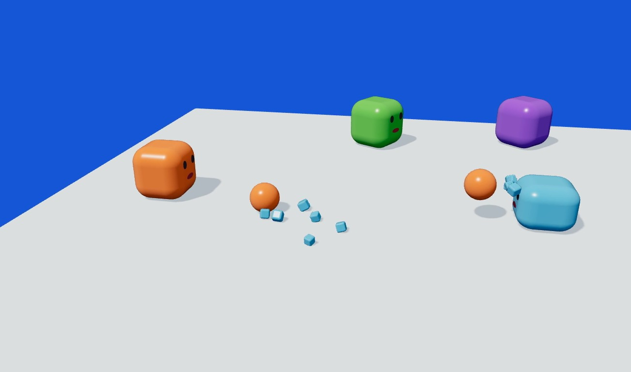
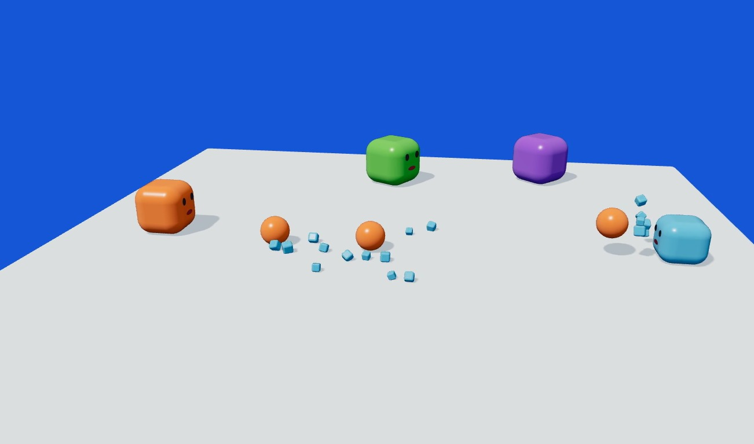
05 · Drafts & prototypes
16 / 25
Prototype: we checked that the mass rule reads on screen
Before
Shot 1
Shot 2
Shot 3
WHAT WE BUILT
WHAT WE SAW
HOW WE USE IT
A deterministic physics simulation of the Mass Knockout rule in Three.js, rendered frame by frame.
Over three shots the target flies further each time. It also shrinks here to make the rule visible; in the game only mass drops.
It is the reference for our first Unity test of Mass Knockout in Demo 1: same scene, same rule.
Notes:
Drafts and prototypes. This is a real prototype: a deterministic physics simulation of the Mass Knockout rule, written in Three.js and rendered frame by frame. Over three shots the target flies further each time. In the prototype it also shrinks so the rule is easy to see; in the game its size stays the same and only its mass drops. It is the reference for our first Unity test of Mass Knockout in Demo 1.

Slide 17

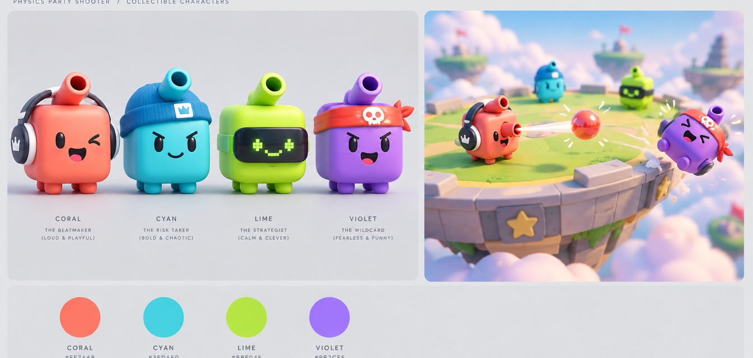
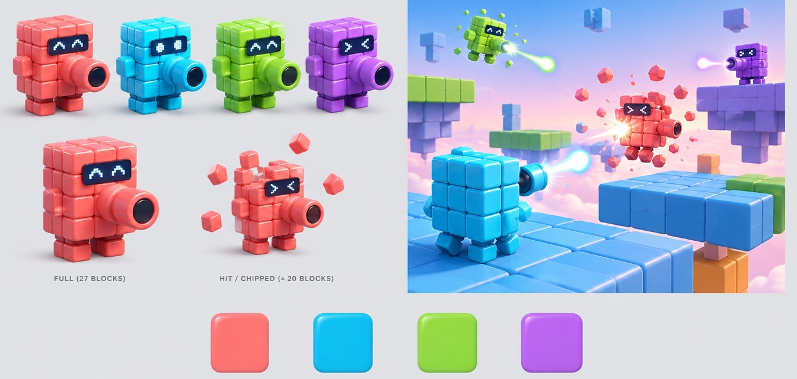
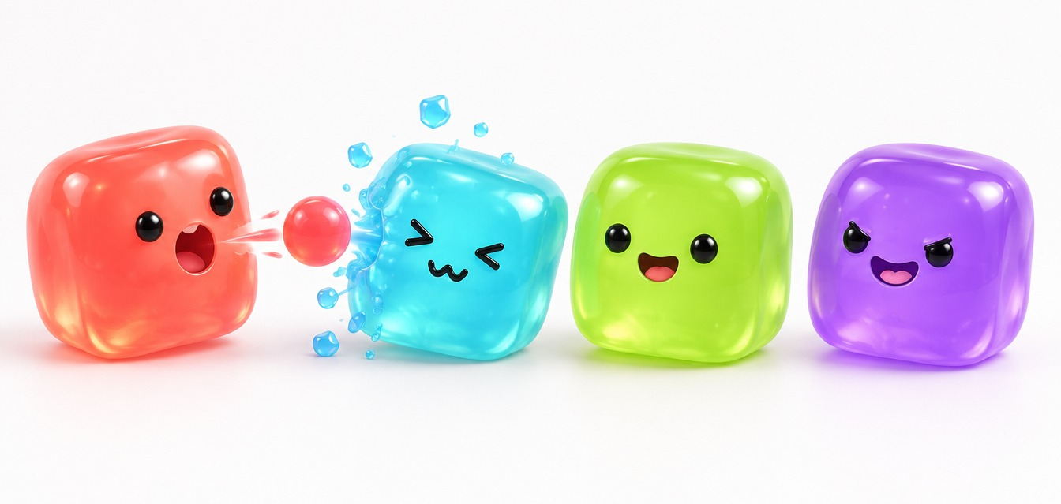
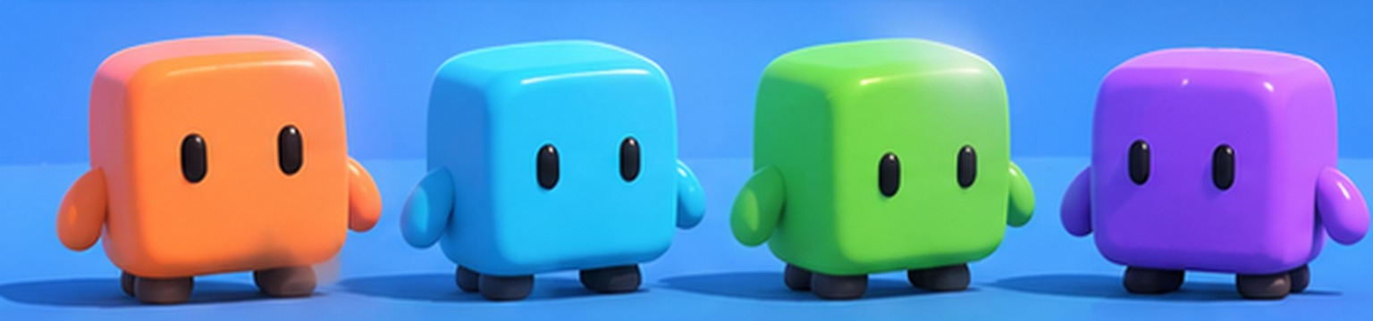
05 · Drafts & prototypes
17 / 25
Four art directions for the same cube
PURPOSE
Four looks for the same character, generated to choose a direction before modelling.
USED IN THIS DECK
C, glossy toy. Every concept render in this deck uses it.
A
Vinyl toy
B
Building blocks
PLAYER COLOURS
Orange
Cyan
Lime
Purple
All AI-generated drafts. None is gameplay.
C
Glossy toy · chosen
D
Jelly
Notes:
Four art-direction drafts for the same character: vinyl toy, building blocks, glossy toy and jelly. We generated them to choose a direction before anyone models anything. We chose C, the glossy toy; every concept render in this deck uses it. The four player colours stay the same whatever look we pick.

Slide 18




05 · Drafts & prototypes
18 / 25
Logo drafts
DRAFT A · WORDMARK
DRAFT B · STACKED
DRAFT C · ICON
Title screen, deck cover, video end card.
Square formats: store capsule, lobby screen.
Taskbar, build icon, favicon.
Drafts made for this proposal. The name is a working title; the logo is not final.
Notes:
Three logo drafts for the working title. A is a wordmark for the title screen and this deck. B stacks the name under the cube for square formats like a store capsule. C is a small icon for the taskbar and the build. None is final.

Slide 19


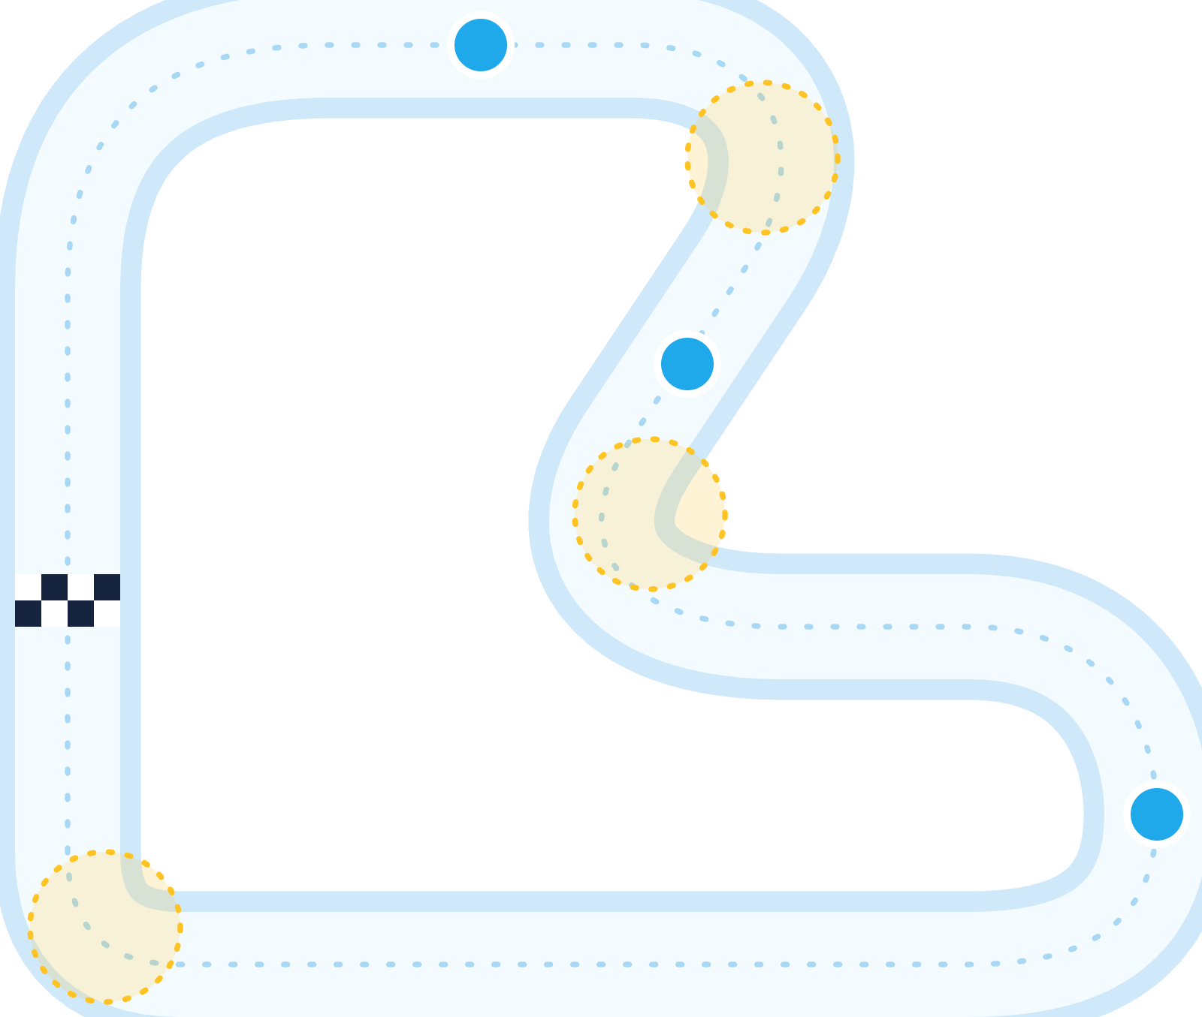




05 · Drafts & prototypes
19 / 25
Level drafts, top-down: arena and track
MASS KNOCKOUT · ARENA DRAFT
ICE RACE · TRACK DRAFT
CP1
Fall zone. No walls, no cover.
Yellow: low-grip corners. Set up early or slide off.
CP2
Pushed into the water? Restart at your last checkpoint.
One flat square platform.
START
Spawn near corners (draft).
CP3
OPEN EDGE: FALL OFF AND YOU ARE OUT
Draft layouts for blockout. The track loops: after CP3 you pass CP1 again, and every checkpoint counts +1. Sizes and checkpoint count are not set.
Notes:
Two level drafts, seen from above. Mass Knockout: one flat square platform with open edges and no walls, so falling off any edge is out; players spawn near the corners. Ice Race: a closed loop with checkpoints; every checkpoint you pass counts, lap after lap. Corners are where the slippery floor matters, and falling into the water puts you back at your last checkpoint. These are drafts for the blockout, not final levels.

Slide 20

06 · Development plan
20 / 25
Roadmap: 12 weeks, four presentations, one playable step each
COURSE CHECKPOINTS · ALL MONDAYS
19 Oct
DONE
16 Nov
14 Dec
11 Jan
Proposal
Demo 1
Demo 2
Final
Concept, research, prototype and drafts. This deck.
Shared core and LAN host/join. Ice Race playable as a blockout.
Mass Knockout over LAN. A full session: playlist, rounds and the scoreboard.
Tuned, polished build. Promo video. Date subject to change.
RISK 01
RISK 02
RISK 03
Networked physics
Balance
Scope
Clients disagree on a knockback.
Hits are too easy to land.
Too many mini-games for one term.
Host simulates; clients only render and interpolate.
If playtests show it, shots arc under gravity, so aiming takes skill.
Exactly two in the MVP. More only once both are fun.
Notes:
The course gives us four checkpoints: the proposal on 19 October, progress presentations on 16 November and 14 December, and the final on 11 January, which may still move. Each one has a playable goal. Demo 1: the shared core, LAN and a blockout of Ice Race. Demo 2: Mass Knockout over LAN and a full session with the scoreboard. Final: a tuned, polished build and the promo video. Below, the three main risks: networked physics, handled by host authority; hits that are too easy to land, handled by gravity-affected shots if playtests show it; and scope, handled by keeping the MVP to two mini-games.

Slide 21


06 · Development plan
21 / 25
Gantt chart: demo 1, the shared core and Ice Race
19–23 Oct
26–30 Oct
2–6 Nov
9–13 Nov
WBS
TASK
OWNER
DURATION
WEEK 3
WEEK 4
WEEK 5
WEEK 6
M
T
W
T
F
M
T
W
T
F
M
T
W
T
F
M
T
W
T
F
2
Demo 1 · 16 Nov
2.1
Unity project, scenes, build pipeline
Ezel
1 wk
2.2
Character controller & camera
Kürşat
2 wk
2.3
LAN host / join (Netcode)
Ezel
2 wk
2.4
Host authority & state sync
Ezel
1 wk
2.5
Ice movement profile
Kürşat
1 wk
2.6
Ice Race track blockout & checkpoints
Kürşat
1 wk
2.7
Shot projectile & fire-rate limit
Abdurrahim
3 wk
2.8
Lobby & join UI
Ardıl
2 wk
2.9
Character model, four colours
Ardıl
1 wk
2.10
Demo 1 build & presentation
Team
1 wk
Notes:
Our 12-week plan starts here. Work breakdown up to the first progress presentation on 16 November. We build the shared core first: project setup, character and camera, then LAN host and join and host authority. Ice Race comes first because it reuses most of the core; the shared shot starts in parallel for Mass Knockout. Owners are a proposed split by area.

Slide 22

06 · Development plan
22 / 25
Gantt chart: demo 2, Mass Knockout and the full session
16–20 Nov
23–27 Nov
30 Nov–4 Dec
7–11 Dec
WBS
TASK
OWNER
DURATION
WEEK 7
WEEK 8
WEEK 9
WEEK 10
M
T
W
T
F
M
T
W
T
F
M
T
W
T
F
M
T
W
T
F
3
Demo 2 · 14 Dec
3.1
Hit detection & mass loss
Abdurrahim
1 wk
3.2
Knockback scaled by mass
Abdurrahim
1 wk
3.3
Fall-out & placement order
Abdurrahim
1 wk
3.4
Networked projectiles & hits
Ezel
3 wk
3.5
Mass Knockout arena
Ardıl
2 wk
3.6
Ice Race loop & checkpoint scoring
Kürşat
2 wk
3.7
Playlist, rounds & end condition
Kürşat
2 wk
3.8
Scoreboard & results
Ardıl
2 wk
3.9
First full-session playtest
Team
1 wk
3.10
Demo 2 build & presentation
Team
1 wk
Notes:
Demo 2, on 14 December, completes Mass Knockout: hits, mass loss, knockback scaled by mass and falling out, all synchronised over the LAN, plus the Ice Race checkpoint loop, the playlist with rounds and the end condition, and the scoreboard. It ends with our first full-session playtest.

Slide 23


06 · Development plan
23 / 25
Gantt chart: final, tuning, polish and the promo video
14–18 Dec
21–25 Dec
28 Dec–1 Jan
4–8 Jan
WBS
TASK
OWNER
DURATION
WEEK 11
WEEK 12
WEEK 13
WEEK 14
M
T
W
T
F
M
T
W
T
F
M
T
W
T
F
M
T
W
T
F
4
Final · 11 Jan
4.1
Balance tuning from playtests
Team
2 wk
4.2
VFX: trails, hit flash, splashes
Abdurrahim
2 wk
4.3
Sound effects & music
Kürşat
2 wk
4.4
Art & UI polish
Ardıl
3 wk
4.5
LAN stress test & final build
Ezel
1 wk
4.6
Promo video & final deck
Team
1 wk
PROPOSED OWNERS
Ezel
Abdurrahim
Kürşat
Ardıl
Team
Network, build
Mass Knockout
Movement, Ice Race
Art, UI, session
Shared tasks
Notes:
The final phase, up to 11 January, is tuning from playtests, effects, sound, art and UI polish, a LAN stress test and the promo video. The final date may still change; we will shift the last weeks with it.

Slide 24

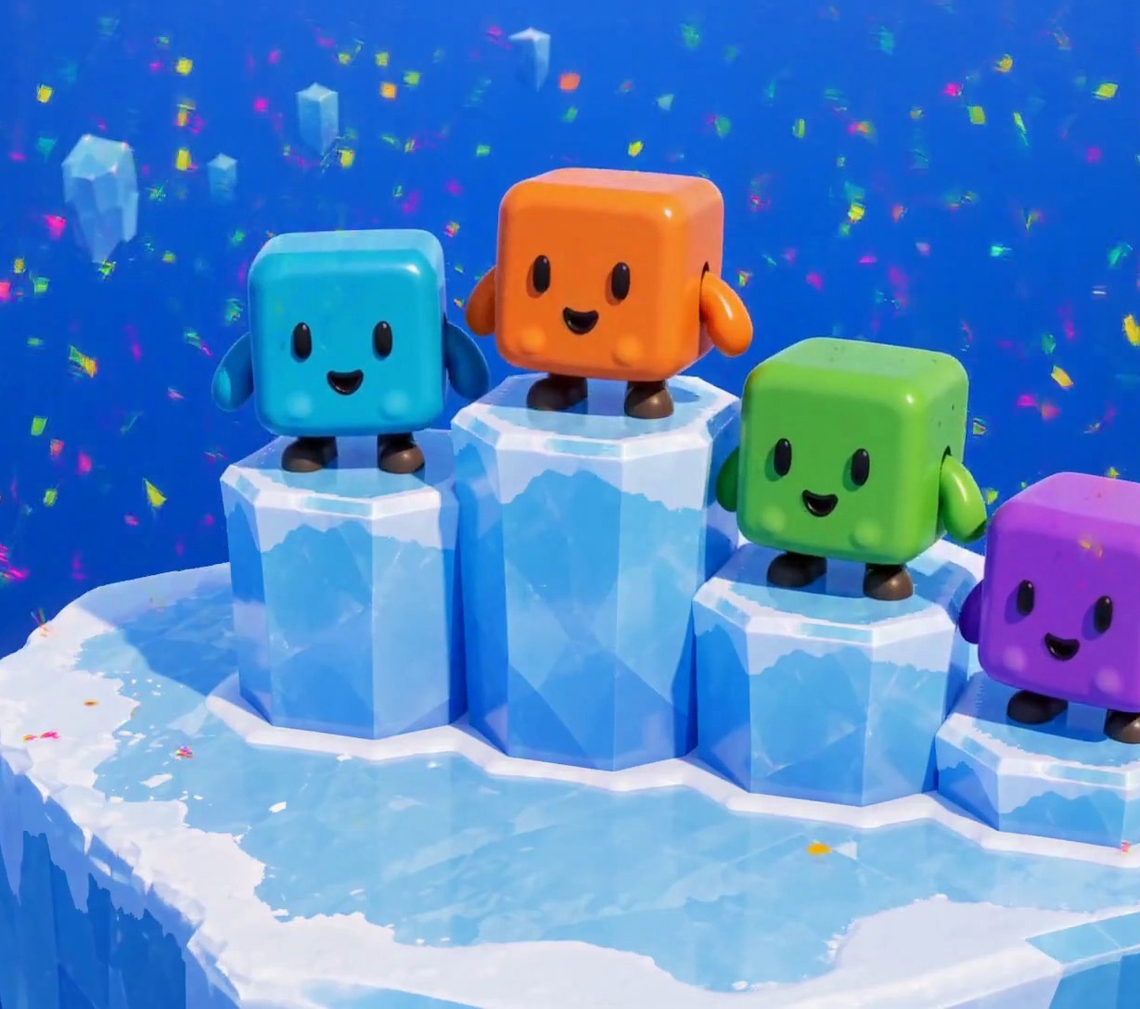
FINAL STANDINGS
Ice Rumble
1st
2–4 players, one LAN, no internet.
2nd
Two mini-games on one shared Unity core.
3rd
Every hit makes the target lighter, so the next one sends it further.
Questions?
Ezel Bayraktar · Abdurrahim Özağaç · Kürşat Hürkan Aydın · Ardıl Bilal Ülkü
Concept render, AI-generated. Not gameplay.
Notes:
Summary: a LAN party game, two mini-games on one shared core, and one rule that makes every hit more dangerous than the last. Questions.

Slide 25

Appendix
25 / 25
Sources
[1] Newzoo final 2025 figures, via GameDev Reports, 2026-06-26. gamedevreports.substack.com/p/newzoo-gaming-market-surpassed-200
[2] Alinea Analytics, games with co-op on Steam, H1 2025 (proprietary estimates). alineaanalytics.substack.com/p/games-with-co-op-generated-over-4
[3] ESA Essential Facts 2026 (survey Feb 2026, n=13,545). theesa.com
[4] Steam store search, tag “Party Game” × LAN PvP / Online PvP / Shared-Split-screen PvP, 2026-10-17. Tags are user-applied.
[5] Game Developers, 2025 Steam revenue distribution (Gamalytic estimates), 2026-08-21. game-developers.org/2025-steam-game-revenue-distribution
[6] PC Gamer, Valve at GDC 2026: 5,863 games over $100K on Steam in 2025. pcgamer.com
[7] Steam store pages and SteamDB charts, apps 1260320, 285900, 1097150, 880940, 1858400: prices, peaks, reviews, owner estimates. 2026-10-17.
[8] GameRevolution / Prima Games: Party Animals requires an internet connection, including split-screen.
[9] Squarena on Steam (app 1858400); codeaclysmgames.com/squarena-details.
[10] Morphies Law official site, morphieslaw.com/game.
Images: all game visuals are AI concept renders (GPT Image via Higgsfield; MiniMax H3) from our own reference art, except competitor screenshots (official Steam media). Logo and level drafts made for this proposal.
Notes:
Full research notes with all sources are in research/market-research.md.

