Slide 1

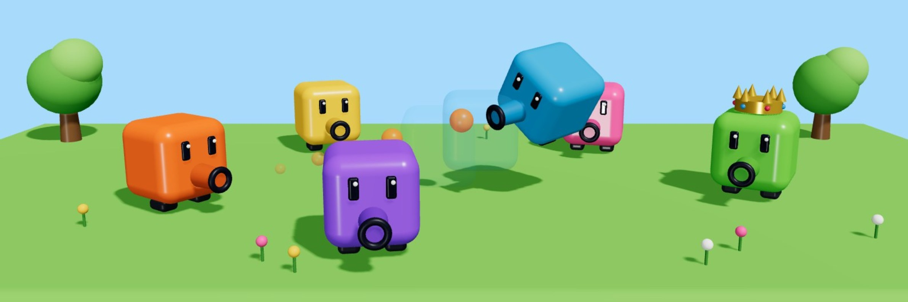
CMP406 GAMETECH · FALL 2026
WRITTEN PITCH · GAME PROPOSAL
Shooter Party
Ezel Bayraktar
Abdurrahim Özağaç
2220356197
2220356033
Online system, sound
Core prototype, scoreboard
WORKING TITLE
October 2026
Kürşat Hürkan Aydın
Ardıl Bilal Ülkü
A multiplayer party game: one shooting cube, many mini-games, and a shot that does something new in each one.
2230356008
2230356051
UI design, sound & music
Menus, promo video
Everyone also designs one mini-game.
Notes:
Shooter Party, our working title. A multiplayer party game: one shooting cube, many mini-games, and a shot that does something new in each one. The four of us are at the bottom right with our shared systems; everyone also designs one mini-game. All character and scene images are 3D concept renders made for this pitch; none show final gameplay.

Slide 2



Shooter Party
CMP406 GameTech · Fall 2026
01 · THE GAME
Game description
Every round is a new mini-game, and placement turns into points.
Shooter Party is a multiplayer party game. Each player plays on their own device: one hosts the session and the others join over the network. Everyone controls a small shooting cube in their own colour. The mini-games change what a shot does: one pushes, one damages, one lifts you with a blast. When the session ends, the player with the most points wins.
HOW A SESSION RUNS
1
Lobby
2
Pick
3
Play
4
Place
5
Standings
Host sets the session rules. Others join over the network.
The playlist picks the next mini-game. Everyone loads the same arena.
Some mini-games have their own rounds inside.
Final placement becomes points.
Scoreboard updates; the leader wears the crown.
SESSION SETTINGS
End condition
Playlist
Inner rounds
After a set number of mini-games, or when a player reaches a target score.
Random or custom. Unwanted mini-games can be excluded, and one mini-game can be played many times.
A mini-game can run its own rounds, like Hole Grab losing one hole each round.
Shooter Party · Game proposal
02 / 28
Notes:
Each player is on their own device; one hosts and the others join over the network. Everyone is a small shooting cube in their own colour, and every mini-game changes what the shot does. A session runs lobby, pick, play, place, standings, and repeats. The host sets the rules: the session ends after a set number of mini-games or at a target score; the playlist is random or custom, with exclusions and repeats; and a mini-game can run rounds of its own.

Slide 3

Shooter Party
CMP406 GameTech · Fall 2026
01 · THE GAME
Placement points & comeback rules
Placement turns into points, and whoever is behind gets an edge.
COMEBACK RULES: AN EDGE FOR WHOEVER IS BEHIND
PLACEMENT POINTS · PROPOSED
+1
+1 comeback point
1st
4 PTS
The player in last place overall earns one bonus point after each mini-game.
2nd
3 PTS
=
Ties go to the underdog
3rd
2 PTS
On equal points, the player who was further behind ranks higher.
4th
1 PT
A crown on the leader
Everyone can see who to catch, so the leader becomes the target.
Shown for four players; the scale grows with the player count.
Shooter Party · Game proposal
03 / 28
Notes:
Placement in each mini-game becomes points: 4, 3, 2, 1 for four players, as a proposal; the scale grows with the player count. Three comeback rules keep the session open. The player in last place overall earns one bonus point after each mini-game. On equal points, the player who was further behind ranks higher. And the leader wears a crown, so everyone can see who to catch.

Slide 4
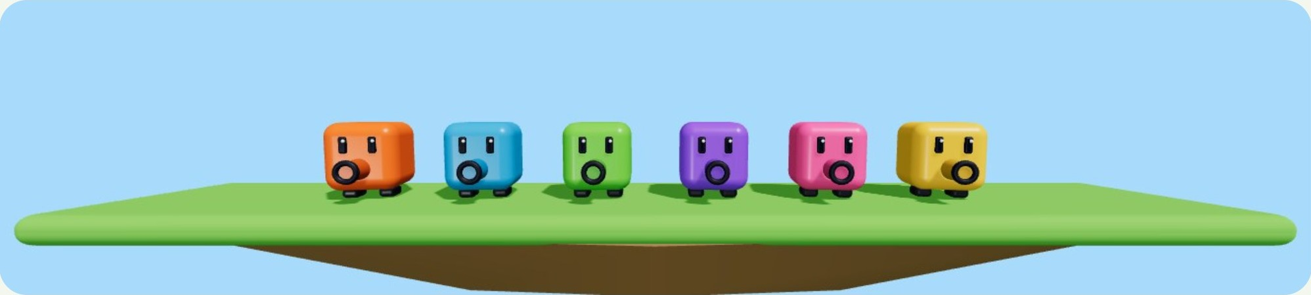
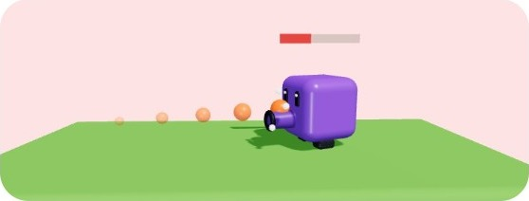
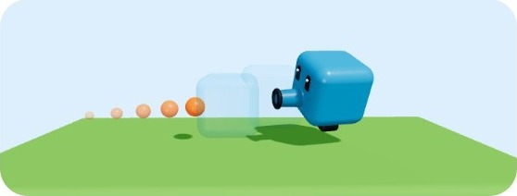

Shooter Party
CMP406 GameTech · Fall 2026
02 · GAMEPLAY MECHANICS
Core mechanics
One shooting cube. Every mini-game changes what a shot does.
THE PLAYER
A small character whose barrel fires real projectiles: physics objects, not instant hits. It does not have to be a cube, but its proportions stay close to 1:1:1. Every player gets a different colour.
ONE TRIGGER, THREE EFFECTS
Damage
Knockback
Blast
The shot lowers the target’s health.
The target is pushed away from where the shot came from.
The shot explodes. Fired at the ground, it lifts you up.
Shooter Party · Game proposal
04 / 28
Notes:
One shooting cube everywhere: a small character whose barrel fires real physics projectiles, not instant hits. Its proportions stay close to 1:1:1, and every player has their own colour. One trigger, three effects. Damage lowers the target's health. Knockback pushes the target away from where the shot came from. Blast explodes, and fired at the ground it lifts you up.

Slide 5
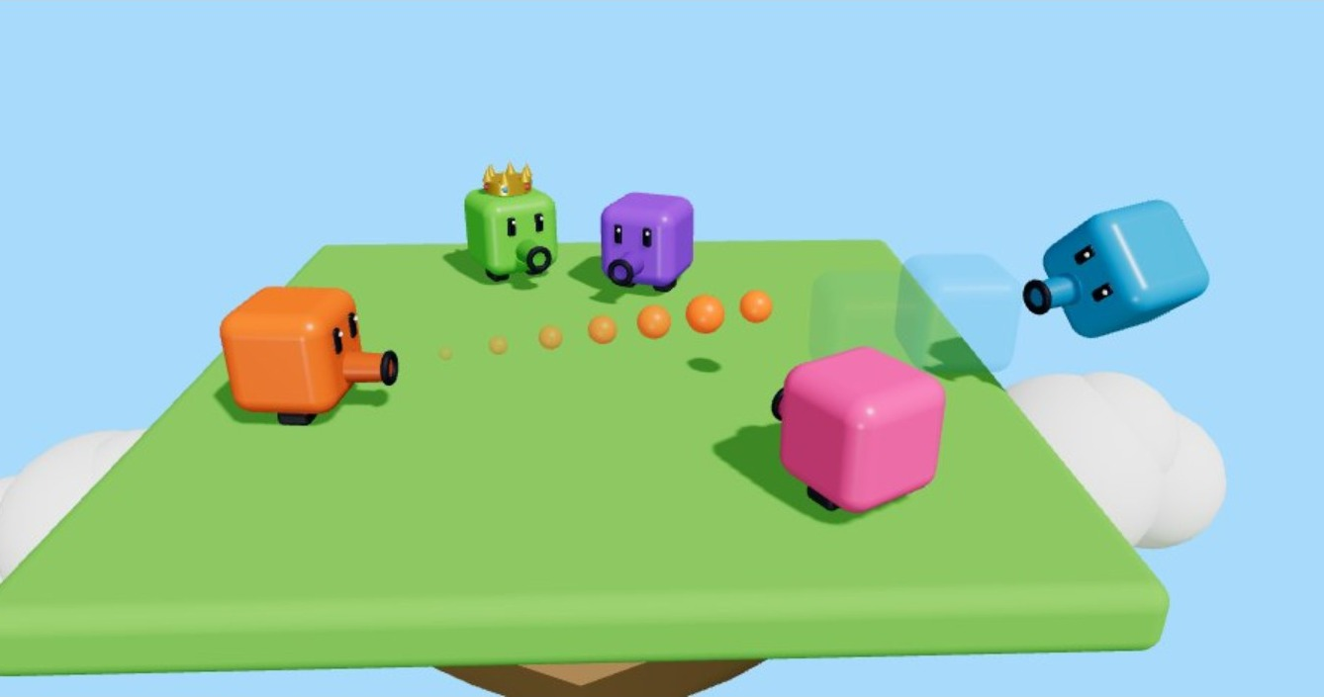
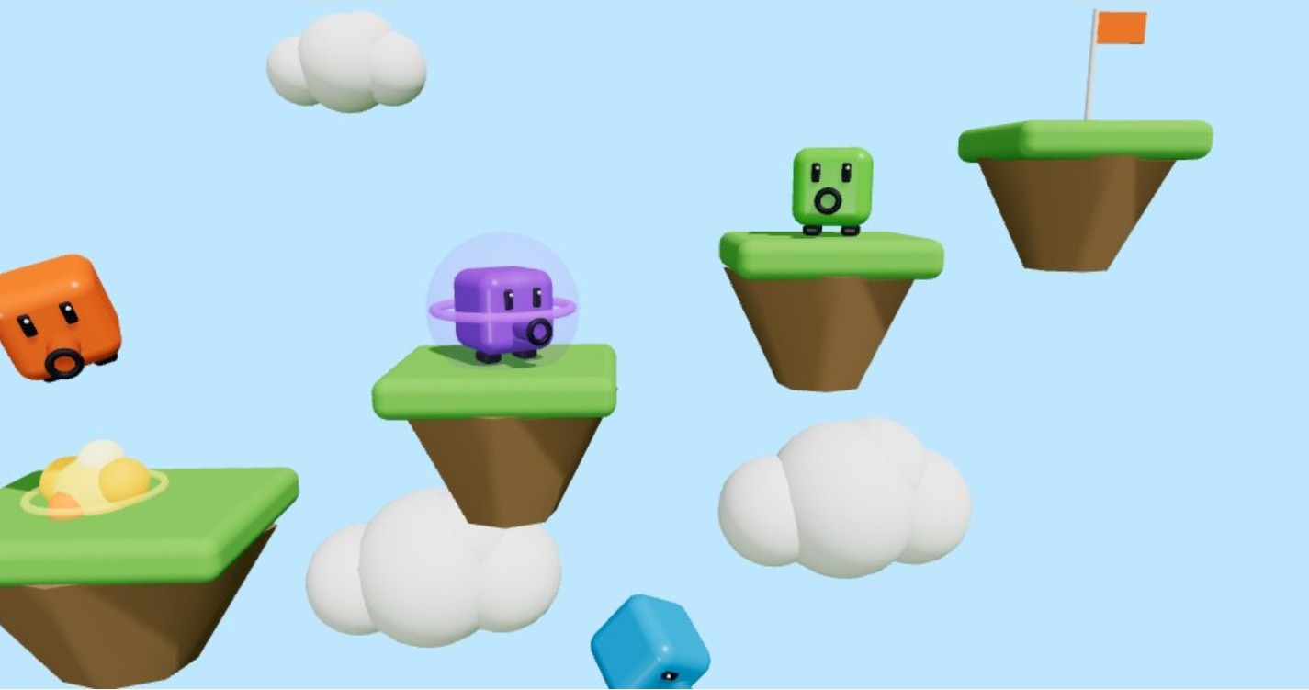
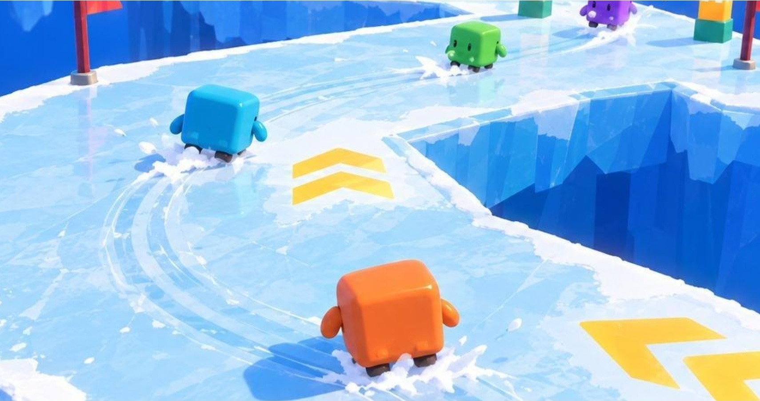
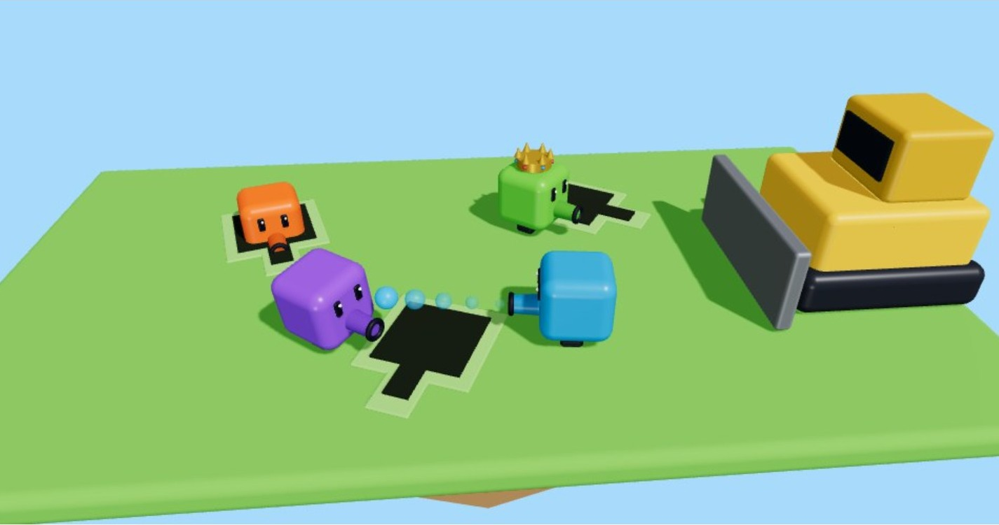
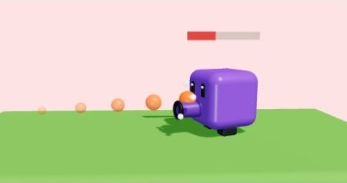
Shooter Party
CMP406 GameTech · Fall 2026
02 · GAMEPLAY MECHANICS
What the shot does in each mini-game
One input everywhere; each mini-game sets the effect.
MINI-GAME
EFFECT
WHAT THE SHOT DOES
Knockback Arena
KNOCKBACK + MASS
Knockback, and every hit lowers the target’s mass.
Blast Parkour
BLAST
Blast: lifts you, pushes rivals off ledges; hold for a strong one.
Ice Loop
KNOCKBACK + MOMENTUM
Knockback and momentum: push rivals, steer yourself with recoil.
Hole Grab
KNOCKBACK
Knockback: push rivals away from the holes.
Battle
DAMAGE
Damage: shots lower health, last cube standing wins.
MOVEMENT
CAMERA
WASD to move. Jumping only where a mini-game allows it. Shift to dash, on a cooldown or as charges from a power-up.
A third-person shooter camera in a 3D world, since aiming is the heart of the game. A mini-game can adjust it where it needs to.
Shooter Party · Game proposal
05 / 28
Notes:
The same shot, five meanings. In Knockback Arena it pushes, and every hit lowers the target's mass. In Blast Parkour it is a blast that lifts you and pushes rivals off ledges; hold it for a strong one. In Ice Loop it is knockback and momentum: push rivals and steer yourself with recoil. In Hole Grab it pushes rivals away from the holes. In Battle it does damage. Movement is WASD; jumping only where a mini-game allows it; Shift to dash on a cooldown or as charges from a power-up. The camera is a third-person shooter camera in a 3D world, and a mini-game can adjust it.

Slide 6
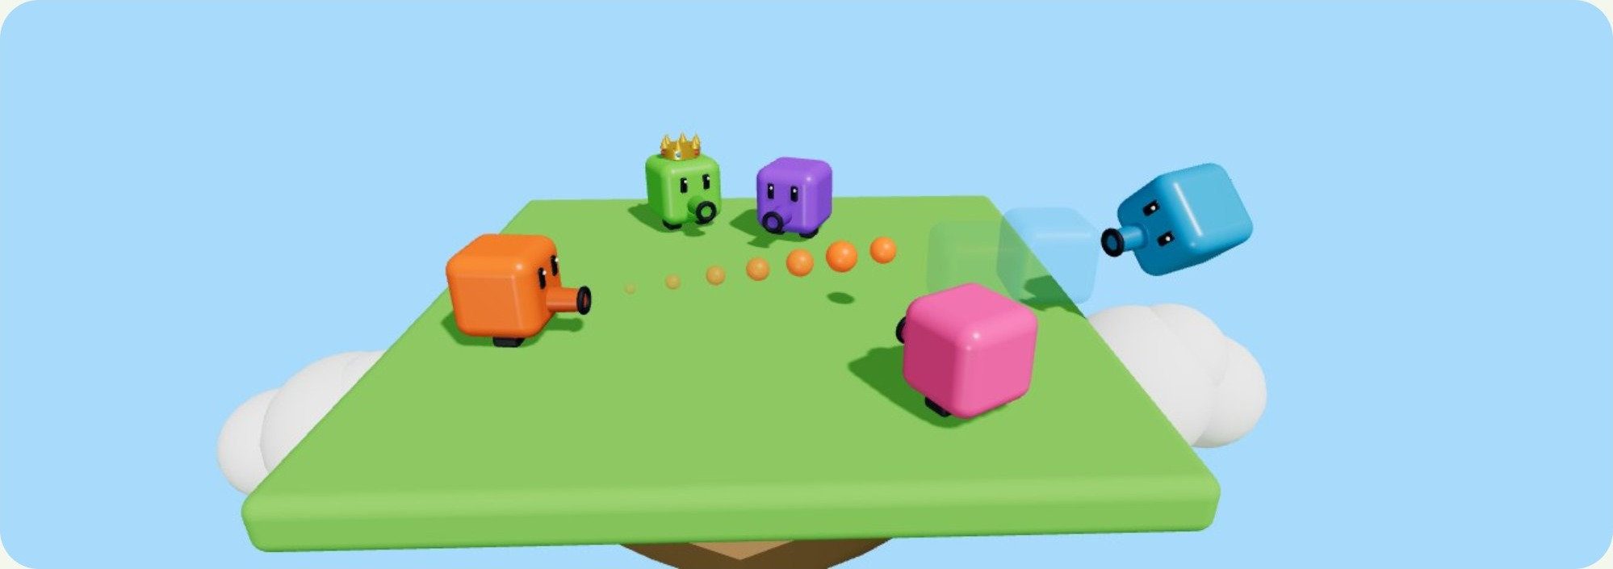



Shooter Party
CMP406 GameTech · Fall 2026
MINI-GAME 01 · WORKING NAME
Knockback Arena
Shoot the others off a flat floor. Every hit makes them lighter.
SHOOTING
Free, with a fire-rate limit. Shots are real thrown objects and have no effect on the shooter.
GETTING HIT
A force from the shot’s direction, and a drop in mass. The size stays the same.
3D concept render, not gameplay. Arena theme and size are not set.
POWER-UPS
Jump: strong, so it is a pickup; a lighter cube jumps higher. Dash: Shift, e.g. 3 charges.
MASS, NOT SIZE: THE SAME SHOT, A LONGER FLIGHT
OUT AND PLACEMENT
Full mass. A hit pushes a little.
After a few hits. Same size, less mass, a longer push.
Many hits. One more shot sends it off the edge.
Falling off means you are out. Placement by order of elimination; the last cube standing wins.
Shooter Party · Game proposal
06 / 28
Notes:
Knockback Arena. Shoot the others off a flat floor. Shooting is free with a fire-rate limit; shots are real thrown objects and do nothing to the shooter. A hit is a force from the shot's direction and a drop in mass; the size stays the same. So the same shot sends a weakened player further: at full mass a hit pushes a little, after a few hits it is a longer push, after many one more shot sends it off the edge. Jump is a pickup because it is strong, and a lighter cube jumps higher; dash is on Shift, for example three charges. Falling off means you are out; placement by order of elimination.

Slide 7
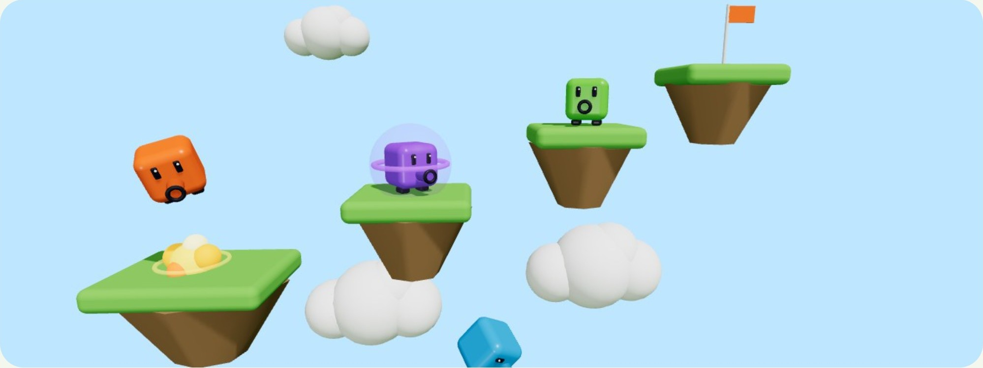
Shooter Party
CMP406 GameTech · Fall 2026
MINI-GAME 02 · WORKING NAME
Blast Parkour
An obstacle course in the sky: spit, blast and climb while knocking the others into the void.
NOWHERE TO HIDE
Open islands with no walls or cover. Everyone is always in someone’s line of fire.
CHARGED BLAST
Hold to fire a strong explosion. While charging you cannot move, so you are open to attack.
BLAST TO CLIMB
3D concept render, not gameplay. Orange blasts the ground to jump; purple charges a strong shot; cyan has been knocked into the void.
A shot at the ground lifts you up. The same blast can push a nearby rival off a ledge.
IF HITTING IS TOO EASY
FALL = OUT
We make shots fall with gravity, so players have to read the arc to land a hit. We decide this in playtests.
Whoever drops below the course is out. First to the top flag wins; the rest are ranked by height reached.
Shooter Party · Game proposal
07 / 28
Notes:
Blast Parkour, an obstacle course in the sky. Open islands with no walls or cover, so everyone is always in someone's line of fire. Hold to fire a strong explosion, but while charging you cannot move. A shot at the ground lifts you up, and the same blast can push a nearby rival off a ledge. Whoever drops below the course is out; first to the top flag wins and the rest are ranked by height. If hitting is too easy, shots fall with gravity; we decide that in playtests.

Slide 8
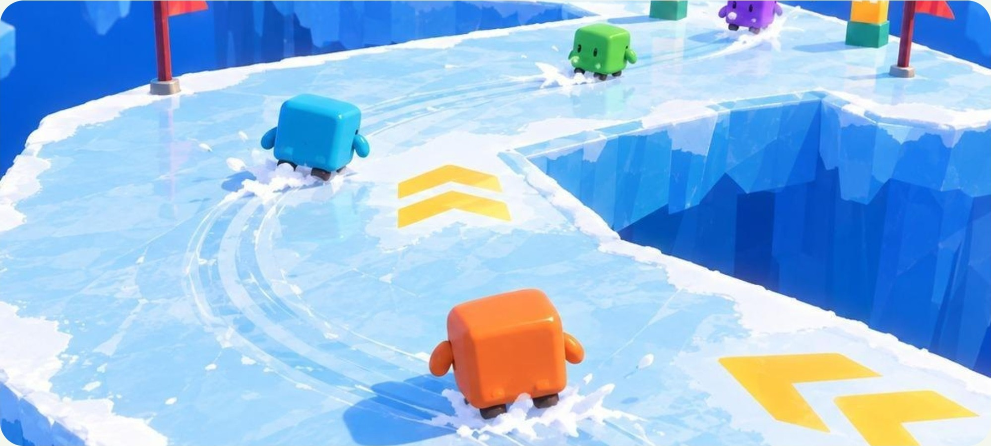
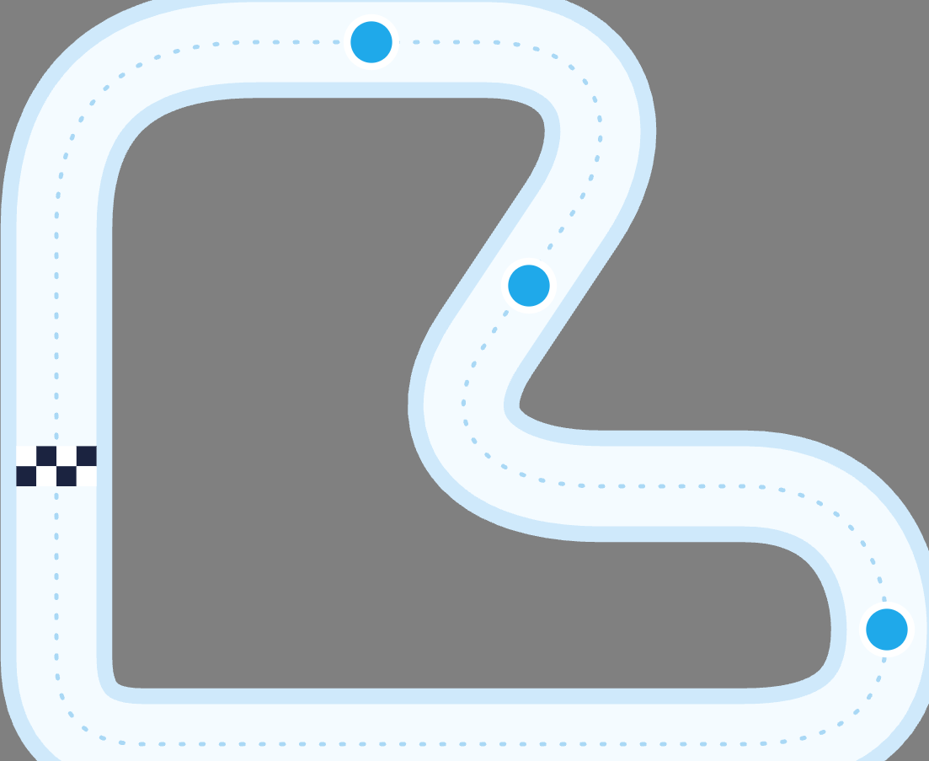
Shooter Party
CMP406 GameTech · Fall 2026
MINI-GAME 03 · WORKING NAME
Ice Loop
Most checkpoints before the timer runs out wins. The ice does not help.
TRACK DRAFT, TOP-DOWN
CP1
CP2
START
CP3
Concept render, not gameplay. Ice is the theme of this one mini-game only.
Checkpoint count and length are not set.
LOOPED TRACK
PUSH TO WIN
STEER WITH RECOIL
When the track ends it starts again, and every checkpoint you pass counts +1. The count, not the lap, decides the placement.
The ice is slippery. Push rivals off it into the water and they restart from their last checkpoint.
Firing forward while sliding pushes you back, so a shot can also correct your line.
Shooter Party · Game proposal
08 / 28
Notes:
Ice Loop. Most checkpoints before the timer runs out wins. When the track ends it starts again, and every checkpoint you pass counts plus one; the count, not the lap, decides the placement. The ice is slippery: push rivals off it into the water and they restart from their last checkpoint. Firing forward while sliding pushes you back, so a shot can also correct your line. Ice is the theme of this mini-game only.

Slide 9
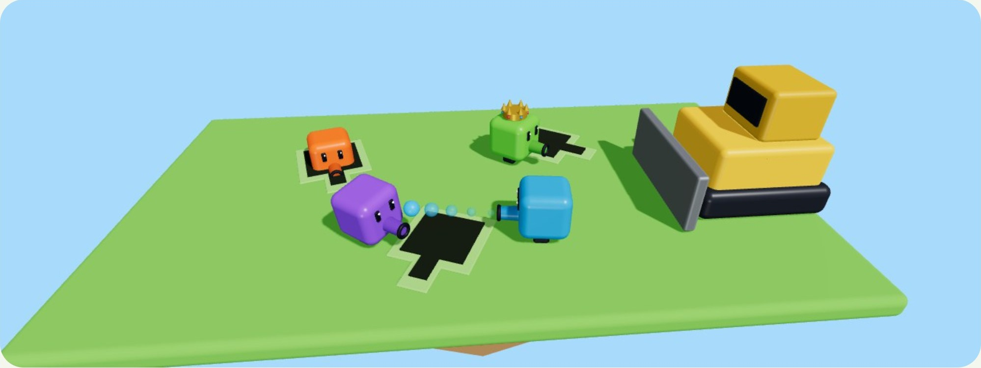
Shooter Party
CMP406 GameTech · Fall 2026
MINI-GAME 04 · WORKING NAME
Hole Grab
Musical chairs with holes. No hole, and the bulldozer gets you.
PLAYER-SHAPED HOLES
Holes open in the ground in the player’s shape, with the barrel’s angle marked. You have to line up to drop in.
SHOOT TO PUSH
3D concept render, not gameplay. Each hole has the player’s shape and a fixed barrel slot. Orange is already in a hole; the bulldozer moves in from the right.
Shots push other players away from the holes. A player already inside a hole cannot be pushed out.
ROUNDS INSIDE THE MINI-GAME (EXAMPLE WITH 4 PLAYERS)
Round 1
Round 2
Round 3
4 players, 3 holes. One is crushed.
3 players, 2 holes. One is crushed.
2 players, 1 hole. The one inside wins.
With more players there are more holes; each round always has one hole fewer than players.
Shooter Party · Game proposal
09 / 28
Notes:
Hole Grab: musical chairs with holes. Holes open in the ground in the player's shape, with the barrel's angle marked, so you have to line up to drop in. Each round has one hole fewer than players: with four players, three holes, then two, then one. Whoever is left without a hole is crushed by the bulldozer. Shots push other players away from the holes, but a player already inside a hole cannot be pushed out.

Slide 10





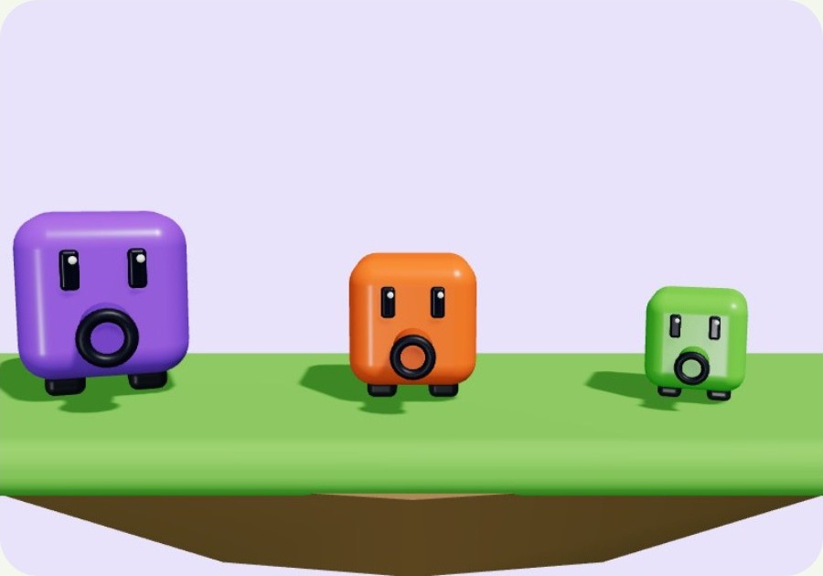
Shooter Party
CMP406 GameTech · Fall 2026
02 · GAMEPLAY
More mini-games & concept ideas
Same cube, same shot, new maps and rules. The playlist is built to grow.
MORE MINI-GAMES
CONCEPT IDEAS WE MAY ADD
Not part of the plan yet; candidates once the core game is fun.
DAMAGE
Character types
Players pick a type with its own strengths. Since knockback depends on mass, weight is the natural first difference.
Battle
The Monster
A straight shoot-out between all players. Here the shot does damage: hits lower health and the last cube standing wins. A harder setting can raise the damage or remove power-ups.
One player becomes the monster for a round and everyone else plays against them. The role moves on each round, so everyone gets a turn.
Heavy
MASS
SPEED
Balanced
MASS
SPEED
Light
MASS
SPEED
Rage meter
A meter that builds up across mini-games. Once it fills over a few rounds, the player can spend it in a later mini-game.
Battle is next in line once the four are fun: it is the stretch goal of the final phase.
Shooter Party · Game proposal
10 / 28
Notes:
The playlist is built to grow: same cube, same shot, new maps and rules. Battle is a straight shoot-out where the shot does damage; a harder setting can raise the damage or remove power-ups. In The Monster, one player becomes the monster for a round and everyone else plays against them; the role moves on each round. Battle is next in line once the four are fun. Two concept ideas, not in the plan yet: character types, where weight is the natural first difference because knockback depends on mass, and a rage meter that builds up across mini-games and can be spent later.

Slide 11
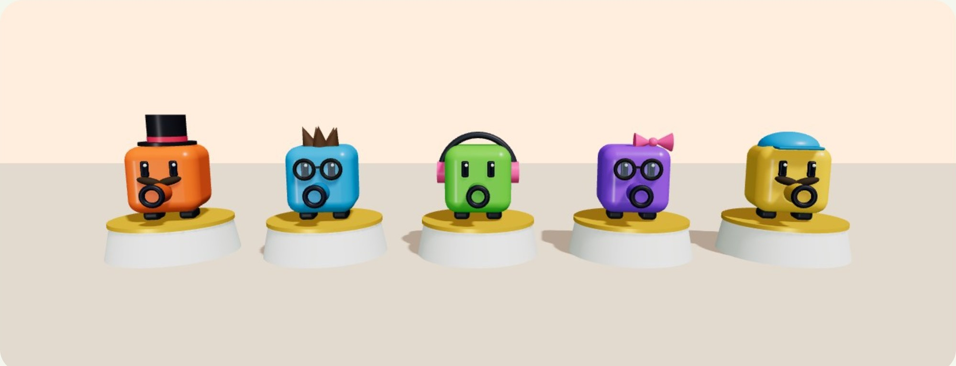
Shooter Party
CMP406 GameTech · Fall 2026
02 · GAMEPLAY · COSMETICS
Character customisation
Make the cube yours. Cosmetics change the look, never the game.
THE SHOP
An in-game shop where players browse cosmetics, try them on in the lobby and dress their cube before a session.
PURELY COSMETIC
Nothing in the shop changes mass, speed or the shot. Every player stays on equal terms.
ALWAYS READABLE
3D concept render of the shop: top hat and moustache, glasses and hair, headphones, bow, cap.
Cosmetics never cover the barrel or the eyes, so where a player is aiming stays clear in every fight.
COSMETIC SLOTS
Head
Face
Ears
Extras
THE CROWN STAYS SPECIAL
Hats, caps, hair styles
Glasses, moustaches
Headphones, earrings
Bows, badges, trails
The crown is not for sale: only the current session leader wears it, so everyone knows who to catch.
Shooter Party · Game proposal
11 / 28
Notes:
Players can make the cube their own, but cosmetics change the look, never the game. Four slots: head, face, ears and extras. An in-game shop lets players browse cosmetics, try them on in the lobby and dress their cube before a session. Nothing in the shop changes mass, speed or the shot. Cosmetics never cover the barrel or the eyes, so aiming stays readable. And the crown is not for sale: only the current session leader wears it.

Slide 12
Shooter Party
CMP406 GameTech · Fall 2026
02 · GAMEPLAY & TECH
Technical design
One shared core; every mini-game plugs into it.
MINI-GAMES
Knockback Arena
Blast Parkour
Ice Loop
Hole Grab
Battle, more
CONTRACT
Setup(players, settings) → Run() → Results() : placement
SHARED GAMEPLAY
Cube controller
TPS camera
Shot system
WASD, jump, dash
per-game tweaks
effect set per game
Session & playlist
Scoreboard
Menus, UI, shop
end rules, exclusions
points, comeback, crown
join, settings, cosmetics
NETWORK
One player hosts, the others join as clients · Unity Netcode (candidate) · online servers later
ENGINE
Unity · 3D · built-in rigidbody physics
Shooter Party · Game proposal
12 / 28
Notes:
Every mini-game implements the same small contract: set up with the players and the session settings, run, and report placement. Below it is shared gameplay: the cube controller with WASD, jump and dash; the third-person camera with per-game tweaks; the shot system whose effect each mini-game sets; the session and playlist; the scoreboard with points, comeback rules and the crown; and menus, UI and the shop. Under that, one player hosts and the others join as clients; Unity Netcode is our candidate, and online servers come later. The engine is Unity in 3D with built-in rigidbody physics.

Slide 13

Shooter Party
CMP406 GameTech · Fall 2026
02 · GAMEPLAY & TECH
One shot in Knockback Arena, over the network
The host decides; every screen agrees.
Client A
Host
Client B
shooter
runs the physics
target
1
Fire input and aim direction
2
Check the fire-rate limit and spawn the projectile. The shooter is not affected.
3
Physics step: the projectile reaches B.
4
Apply this mini-game’s effect: B loses mass and is pushed from the shot’s direction.
Snapshot: positions, mass, scores
5
5
The same snapshot to all clients
6
Clients interpolate between snapshots and draw.
6
Your own movement is predicted locally, so it feels instant. Everything that decides a result runs on the host, so every screen agrees. Main risk: keeping physics smooth on every client; we tune the snapshot rate and test with real players early.
Shooter Party · Game proposal
13 / 28
Notes:
One shot end to end. Client A sends fire input and aim direction. The host checks the fire-rate limit and spawns the projectile; the shooter is not affected. The physics step carries it to B, and the host applies this mini-game's effect: B loses mass and is pushed from the shot's direction. The host sends the same snapshot of positions, mass and scores to every client, and clients interpolate between snapshots. Your own movement is predicted locally so it feels instant. The main risk is smooth physics on every client; we tune the snapshot rate and test with real players early.

Slide 14
Shooter Party
CMP406 GameTech · Fall 2026
03 · MARKET
Market potential & target audience
People play to play together, and party games keep selling for years.
Our audience is groups of friends who want short, chaotic rounds together, online or in the same room, and the streamers and viewers who enjoy watching party-game chaos.
$197B
$43.6B
70%
$4.1B
Global games market in 2025, up 7.5% year on year.
PC games revenue in 2025, up 12% year on year.
of US players aged 8+ play games with other people.
Steam revenue of co-op games in H1 2025, a record (estimate).
Newzoo [1]
Newzoo [2]
ESA 2026 [3]
Alinea [4]
RISK, STATED PLAINLY
Steam is crowded: an estimated 65.9% of 2025 releases earned under $1,000 [10]. A party game needs a hook people can explain in one sentence. Ours: one shot that means something new in every mini-game.
Shooter Party · Game proposal
14 / 28
Notes:
Our audience is groups of friends who want short, chaotic rounds together, online or in the same room, plus streamers and viewers who enjoy party-game chaos. The global games market was 197 billion dollars in 2025; PC alone was 43.6 billion, up 12 percent. 70 percent of US players aged 8 and up play with other people, and co-op games made an estimated 4.1 billion dollars on Steam in the first half of 2025. The risk: Steam is crowded, and most releases earn very little. Our one-sentence hook is one shot that means something new in every mini-game.

Slide 15
Shooter Party
CMP406 GameTech · Fall 2026
03 · MARKET
Party games keep selling
A mass-market genre that is still growing, and open to small studios.
PARTY GAME
FIGURE
WHAT IT SHOWS
Super Mario Party
21M+ sold
Mini-game party games are a mass-market genre. [5]
Super Mario Party Jamboree
5.6M+ in 11 wks
The genre is still growing: the series’ fastest seller. [5]
Stick Fight: The Game
≈4.75M
A small studio’s physics shooter can reach millions (Steam estimate). [6]
Pummel Party
2–5M owners
Mini-games and friends, sold for years after launch (estimate). [7]
Party Animals
135,834 peak
Players in its free playtest; 113,000+ Twitch viewers watched. [8]
Feather Party
87% positive
Of 551 Steam reviews; 22 mini-games for up to 8 players. [9]
Shooter Party · Game proposal
15 / 28
Notes:
Six data points. Super Mario Party sold over 21 million: mini-game party games are a mass-market genre. Jamboree sold 5.6 million in 11 weeks, the series' fastest seller, so the genre is still growing. Stick Fight, a small studio's physics shooter, reached an estimated 4.75 million. Pummel Party still sells years after launch. Party Animals had 135,834 players in its free playtest and over 113,000 Twitch viewers. Feather Party, 22 mini-games for up to 8 players, is at 87 percent positive.

Slide 16
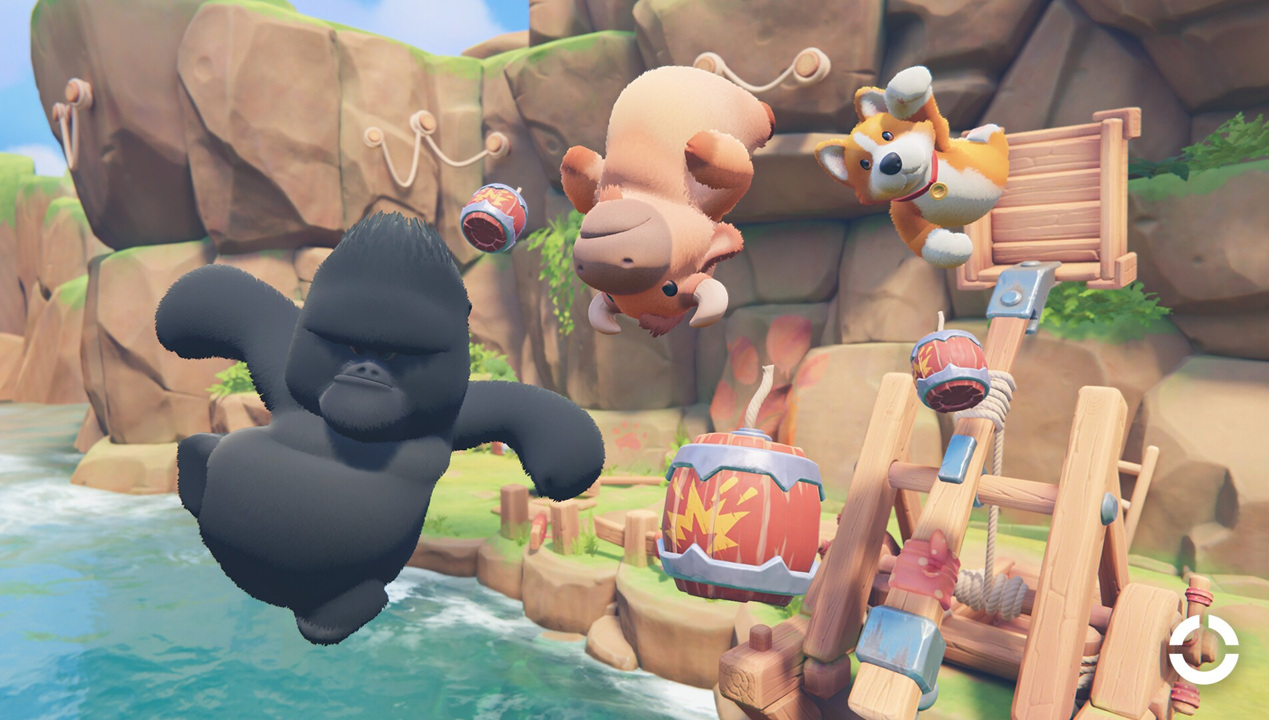
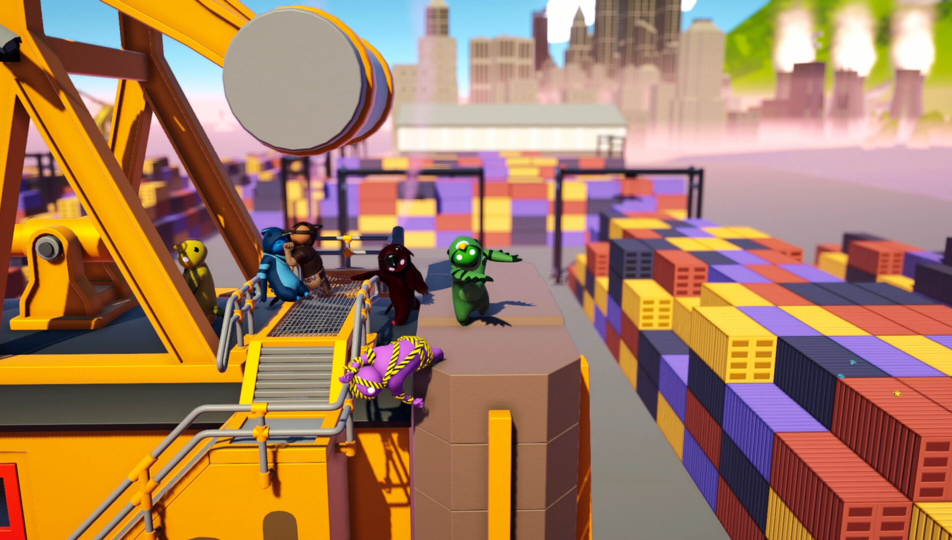
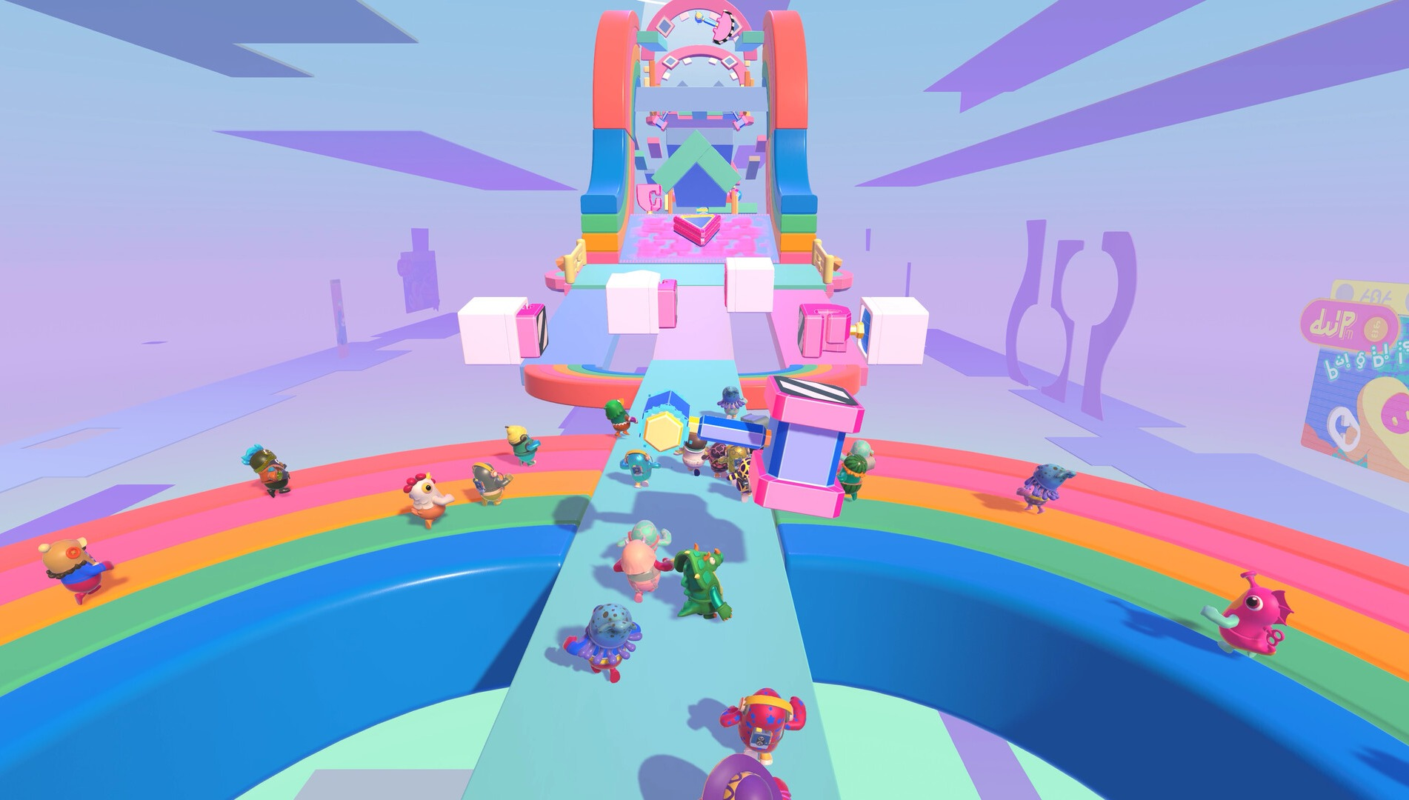
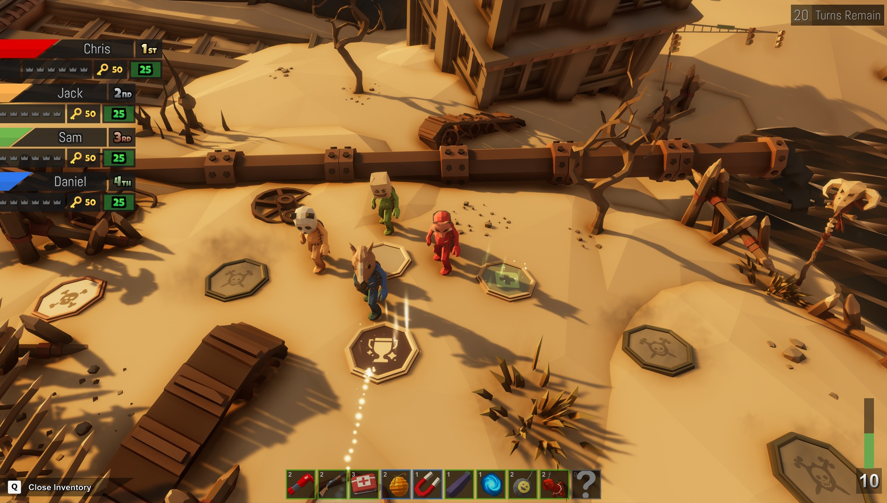
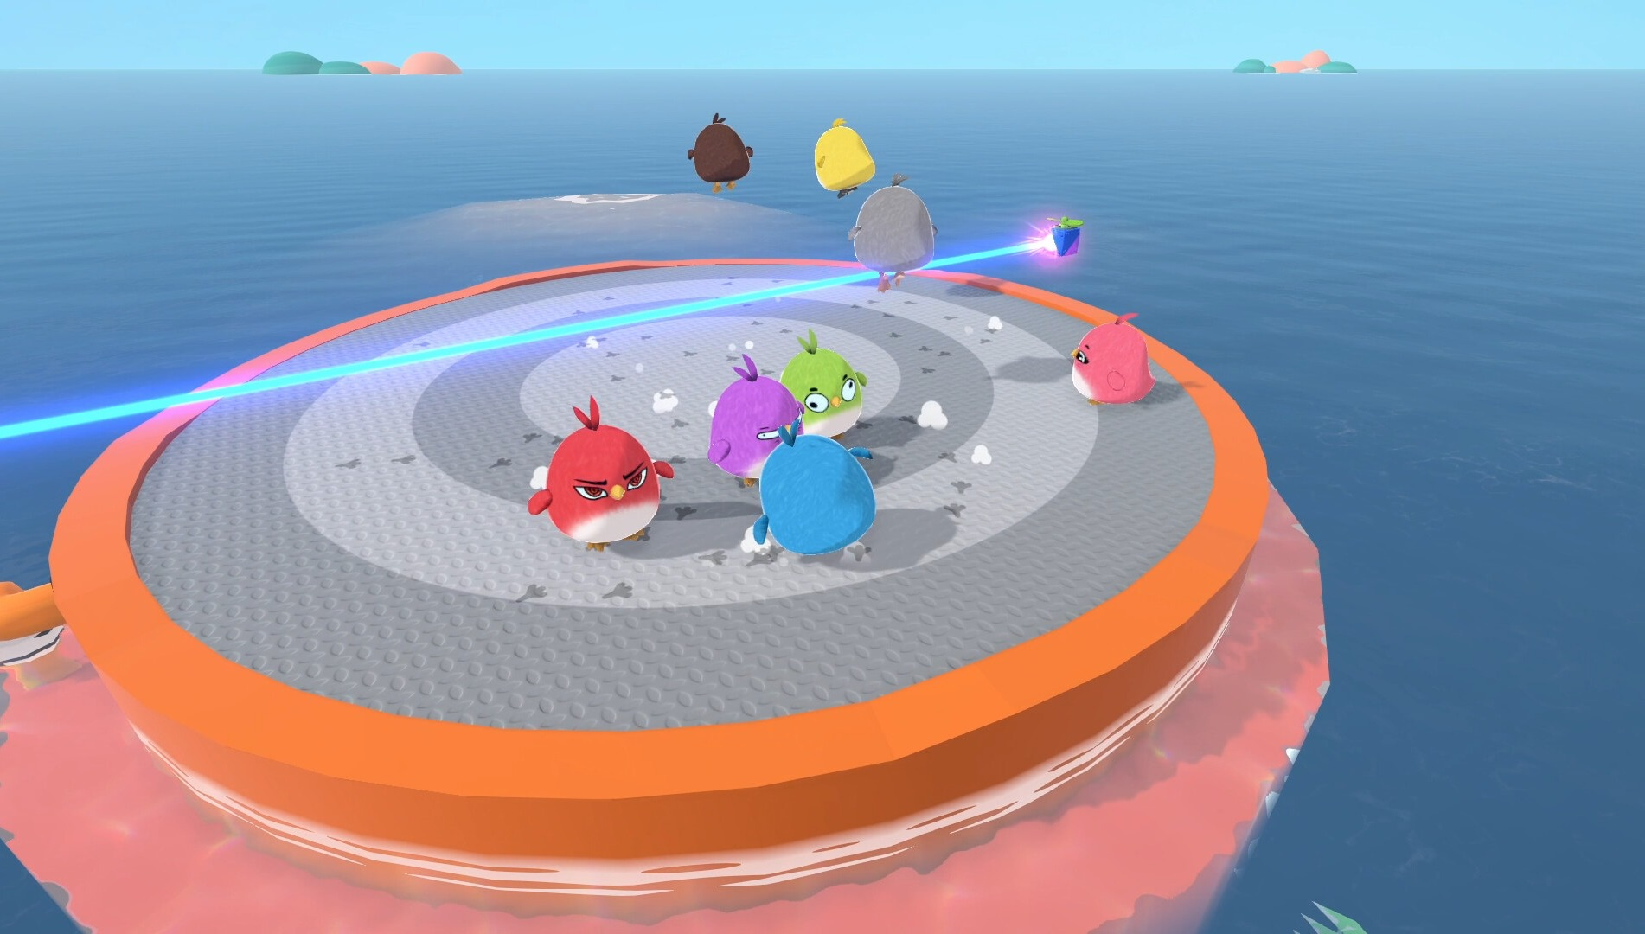
Shooter Party
CMP406 GameTech · Fall 2026
03 · MARKET
Competitors
Five games we are measured against.
Party Animals
Gang Beasts
Fall Guys
Pummel Party
Feather Party
Recreate Games · 2023
Boneloaf · 2017
Mediatonic / Epic · 2020
Rebuilt Games · 2018
threeW · 2026
MECHANIC
MECHANIC
MECHANIC
MECHANIC
MECHANIC
Physics brawling: grab, punch, throw rivals out.
Ragdoll brawling into stage hazards.
Short race and survival rounds in a playlist.
Board game with short competitive mini-games.
Board mode plus 22 mini-games; ice, fire and electric effects change the physics.
MULTIPLAYER
MULTIPLAYER
MULTIPLAYER
MULTIPLAYER
MULTIPLAYER
Online and same-screen.
Same-screen and online.
Online, cross-platform.
4–8 players, online and local.
Up to 8 players, online.
FINANCIALS
FINANCIALS
FINANCIALS
FINANCIALS
FINANCIALS
Launch peak 104,174 players. Owner est. 2.5M–6.0M.
85% positive. Owner est. 4.6M–5.8M.
Free-to-play. Legacy Steam peak 172,213. Metacritic 80.
$14.99. Peak 20,957. Owner est. 1.5M–7.6M.
$8.99. 87% positive of 551 reviews.
Screenshots: official Steam media, © publishers. Owner estimates are third-party (SteamDB), not sales [11]; Feather Party from its Steam page [9].
Shooter Party · Game proposal
16 / 28
Notes:
Five games we are measured against. Party Animals and Gang Beasts are physics brawlers. Fall Guys runs short rounds in a playlist. Pummel Party is a board game with competitive mini-games. Feather Party has a board mode and 22 mini-games where ice, fire and electric effects change the physics. Owner numbers are third-party estimates, and we label them that way.

Slide 17

















Shooter Party
CMP406 GameTech · Fall 2026
03 · MARKET
Where we sit among them
Everyone has 3D characters and cosmetics. No one keeps one shot with a new effect per mini-game.
PARTY ANIMALS
GANG BEASTS
FALL GUYS
PUMMEL PARTY
FEATHER PARTY
SHOOTER PARTY
3D characters
Several mini-games, one result
Cosmetic customisation
One shot, new effect per mini-game
Yes
Partly
No
Planned (Shooter Party)
“Partly”: Fall Guys’ playlist eliminates players rather than scoring each round. Feather Party changes physics with elemental effects; it has no shared shot. The Shooter Party column is our plan, not shipped software.
Shooter Party · Game proposal
17 / 28
Notes:
All five competitors have 3D characters and cosmetic customisation. Pummel Party and Feather Party combine several mini-games into one result; Fall Guys partly, since its playlist eliminates players instead of scoring each round. None keeps one shot whose effect changes per mini-game; Feather Party changes physics with elemental effects but has no shared shot. Our column is the plan.

Slide 18






Shooter Party
CMP406 GameTech · Fall 2026
04 · INNOVATION
Innovation & creativity
A party game built on one shot that changes its meaning in every mini-game.
01
02
03
One trigger, many effects
Shooting at the heart
Variety on one mechanic
The same shot pushes, damages, lifts or steers, depending on the mini-game. Controls are learned once; every mini-game still feels new.
Most party games are about brawling, racing or luck. Here aiming and timing a shot is the core skill in every round.
Different maps, themes and rules, from grass islands to an ice track, all built on the same cube and the same shot.
04
05
06
A comeback built in
Your session, your rules
Mass, not size
Last place earns +1 point, ties go to the underdog, and the leader wears a crown everyone aims at.
Random or custom playlists, excluded or repeated mini-games, and an end by game count or target score.
In Knockback Arena, hits lower a player’s mass while the size stays, so the same shot sends them further each time.
Shooter Party · Game proposal
18 / 28
Notes:
Six things together. One trigger, many effects: the same shot pushes, damages, lifts or steers, so controls are learned once. Shooting at the heart: aiming and timing a shot is the core skill in every round, where most party games are about brawling, racing or luck. Variety on one mechanic: different maps, themes and rules on the same cube and shot. A comeback built in: plus one for last place, ties to the underdog and a crown on the leader. Your session, your rules. And mass, not size: hits lower mass while the size stays.

Slide 19
Shooter Party
CMP406 GameTech · Fall 2026
04 · INNOVATION
How this differs from the closest games
One shared shot
Pummel Party and Feather Party give each mini-game its own controls and goal; Feather Party varies physics with elemental effects. Neither keeps one shot as the common verb.
Comeback rules
Racing and party games often help the trailing player with random items, a luck-based catch-up. Ours is a fixed, visible rule: +1 point and the tie-break.
Knockback from lost mass
Smash Bros. raises knockback with a damage % counter. We use the physical mass a hit removes.
Custom sessions
Many party games let players pick mini-games. We add an end by score or by count, and favourites that can repeat.
Most party games are a playlist of unrelated mini-games. Shooter Party keeps one character and one shot across the whole session and lets each mini-game bend what that shot means, so players carry their skill from round to round.
Shooter Party · Game proposal
19 / 28
Notes:
How we differ. Pummel Party and Feather Party give each mini-game its own controls and goal; neither keeps one shot as the common verb. Racing and party games often help the trailing player with random items; our comeback is a fixed, visible rule. Smash Bros. raises knockback with a damage percentage; we use the physical mass a hit removes. Many party games let players pick mini-games; we add an end by score or count, and favourites that can repeat.

Slide 20
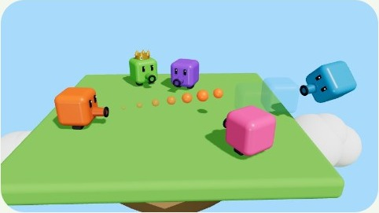
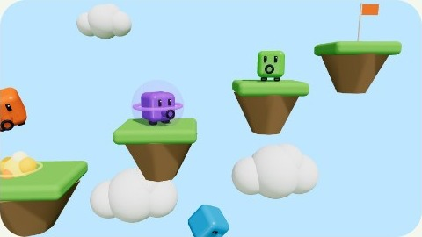
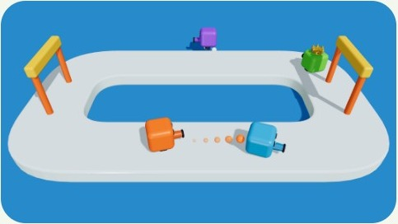
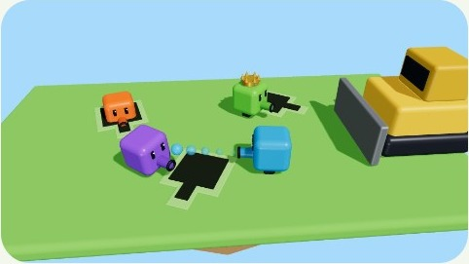
Shooter Party
CMP406 GameTech · Fall 2026
05 · DRAFTS
Drafts: art direction & 3D blockouts
Art direction: glossy toy.
Rounded cubes in bright colours, a barrel on every character, and bright party settings such as grass, sky and water. Ice appears in Ice Loop only.
3D BLOCKOUT SCENES
Knockback Arena
Blast Parkour
Ice Loop
Hole Grab
Each mini-game was blocked out in 3D to check camera angle, scale and how readable the shots are before building it in Unity.
Shooter Party · Game proposal
20 / 28
Notes:
The art direction is a glossy toy: rounded cubes in bright colours, a barrel on every character, and bright party settings such as grass, sky and water. Ice appears in Ice Loop only. Each mini-game was blocked out in 3D to check the camera angle, the scale and how readable the shots are before we build it in Unity.

Slide 21
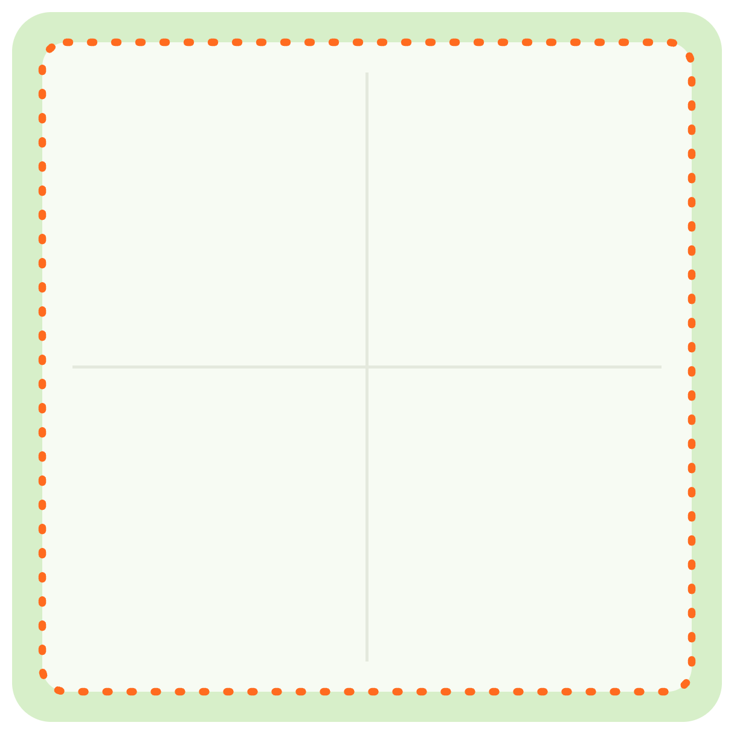
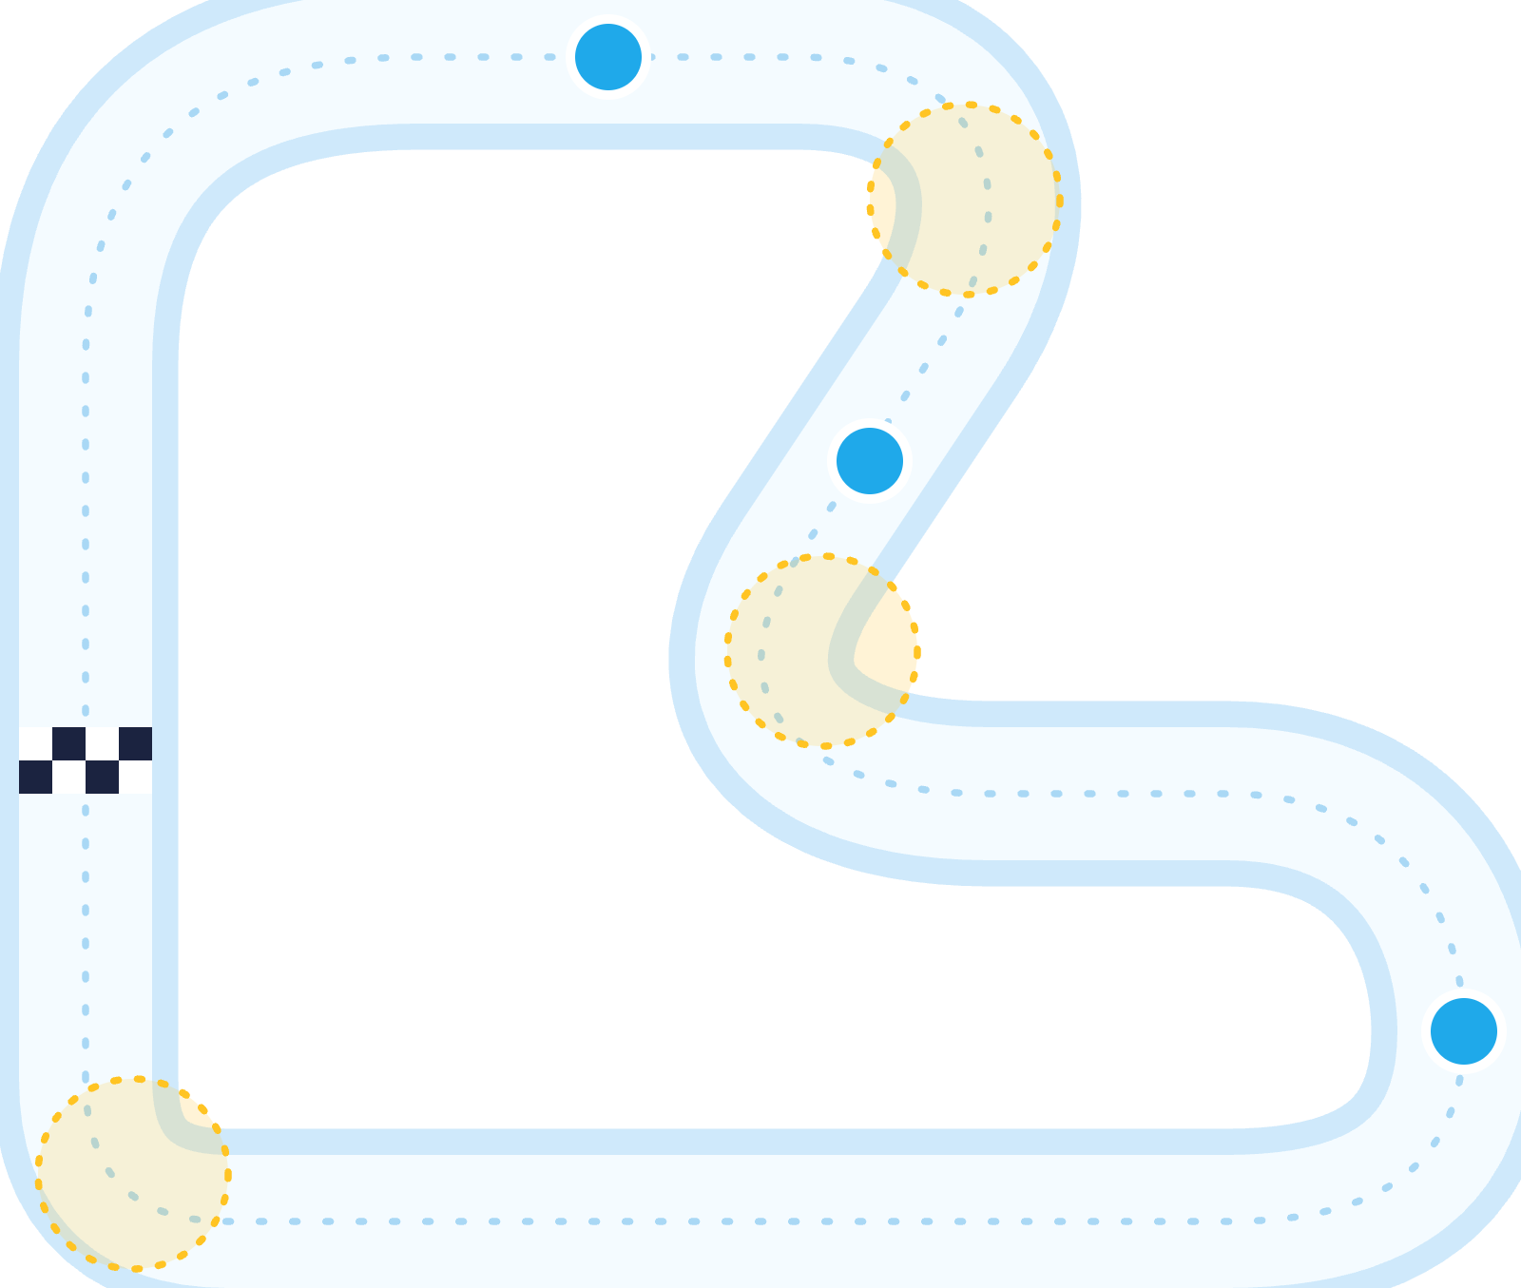




Shooter Party
CMP406 GameTech · Fall 2026
05 · DRAFTS
Level drafts, top-down
Draft layouts for scope and blockout.
KNOCKBACK ARENA · ARENA DRAFT
ICE LOOP · TRACK DRAFT
CP1
Fall zone. No walls, no cover.
Yellow: slippery corners. Set up early or slide off.
CP2
Open edges: a fall respawns you at the last checkpoint.
One flat square platform.
START / FINISH
Spawn near corners.
CP3
OPEN EDGE = KNOCKOUT LINE
Dimensions, spawn points and checkpoint count are not set.
Shooter Party · Game proposal
21 / 28
Notes:
Two level drafts seen from above, for scope and blockout. Knockback Arena: one flat square platform with open edges and no walls; players spawn near the corners and the open edge is the knockout line. Ice Loop: a looping track with checkpoints; a fall into the water respawns you at your last checkpoint. Dimensions, spawn points and checkpoint count are not set.

Slide 22
Shooter Party
CMP406 GameTech · Fall 2026
06 · DEVELOPMENT PLAN
Development plan
12 weeks, four presentations, one playable step each.
19 Oct
16 Nov
14 Dec
11 Jan
Proposal
Demo 1
Demo 2
Final
Concept, research, 3D drafts and this pitch.
Core prototype, host and join, first mini-games playable.
All four mini-games and a full session with scoreboard and menus.
UI, sound, cosmetics, polish and the promo video.
RISKS AND HOW WE HANDLE THEM
RISK 01
RISK 02
RISK 03
Networked physics
Balance
Scope
Players disagree on a push or a fall.
Hits too easy, jumping too strong, a runaway leader.
Four mini-games by four people.
Plan: The host simulates; clients only render and interpolate.
Plan: Fire-rate limits, jump as a power-up, comeback rules.
Plan: One shared core first, small mini-games, extras only after the MVP.
Shooter Party · Game proposal
22 / 28
Notes:
Four Monday checkpoints. The proposal on 19 October: concept, research, 3D drafts and this pitch. Demo 1 on 16 November: the core prototype, host and join, and the first mini-games playable. Demo 2 on 14 December: all four mini-games and a full session with scoreboard and menus. The final on 11 January: UI, sound, cosmetics, polish and the promo video. Three risks: networked physics, handled by host simulation; balance, handled by fire-rate limits, jump as a power-up and comeback rules; and scope, handled by building one shared core first and keeping mini-games small.

Slide 23
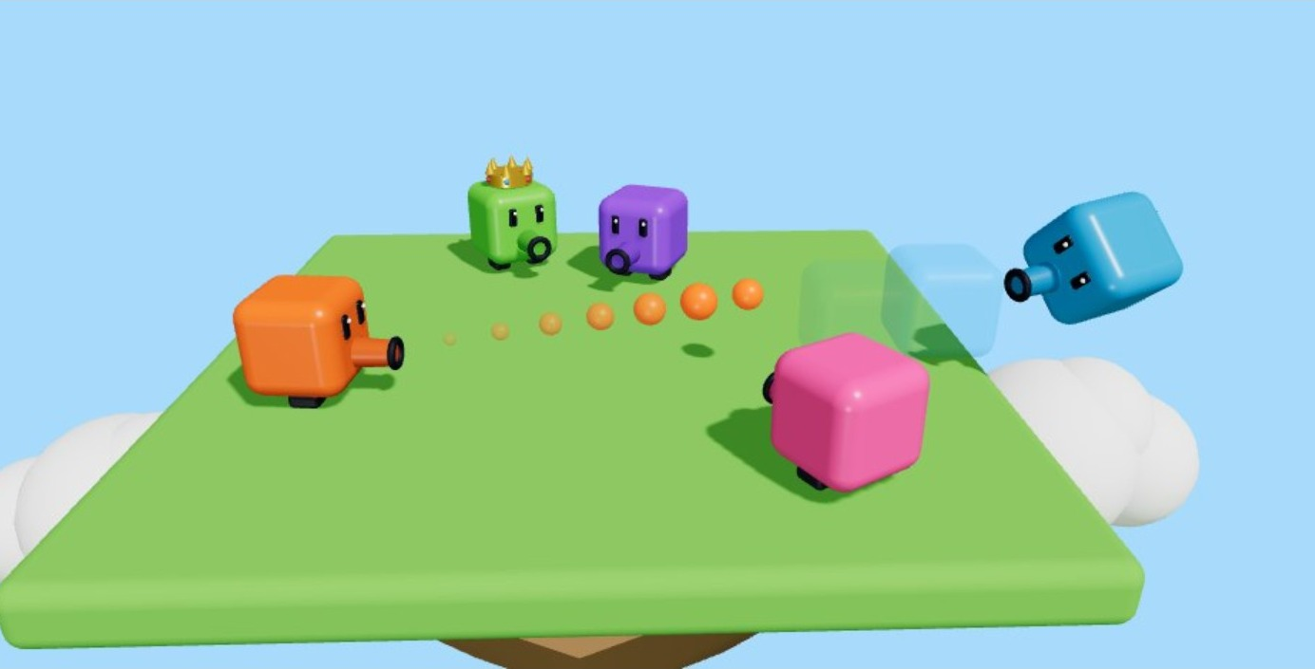
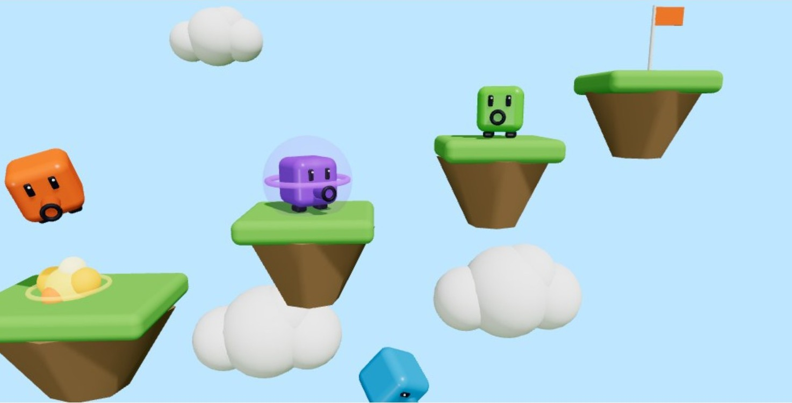
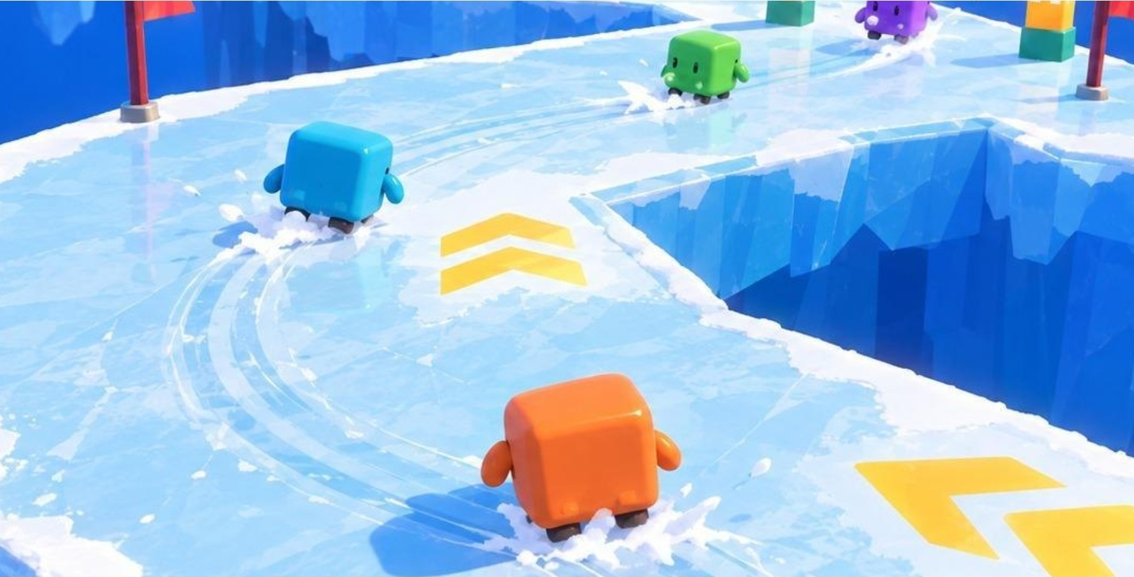
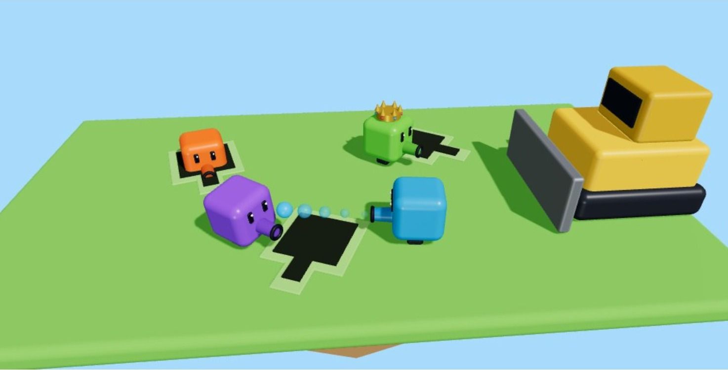
Shooter Party
CMP406 GameTech · Fall 2026
06 · DEVELOPMENT PLAN
Everyone designs a mini-game
One mini-game and its shot each, plus one shared system.
Each member designs and builds at least one mini-game, including what the shot does in it (a hit, a jump or momentum), and finds its assets. Each also owns one shared system.
MEMBER
MINI-GAME AND ITS SHOT
SHARED SYSTEM
Abdurrahim
Knockback Arena: knockback and mass loss
Core mechanics prototype; scoreboard system
Ardıl
Blast Parkour: blast jump and charged shot
Menus; promo video
Kürşat
Ice Loop: push and recoil momentum
UI design; sound and music
Ezel
Hole Grab: push rivals away from holes
Online system (research and build); sound and music
Mini-game assignments are a proposal; Battle is next in line once the four are fun.
Shooter Party · Game proposal
23 / 28
Notes:
Everyone designs and builds at least one mini-game, including what the shot does in it, and finds its assets; each of us also owns a shared system. Abdurrahim: Knockback Arena, plus the core mechanics prototype and the scoreboard. Ardıl: Blast Parkour, plus menus and the promo video. Kürşat: Ice Loop, plus UI design, sound and music. Ezel: Hole Grab, plus the online system, sound and music. The assignments are a proposal.

Slide 24

Shooter Party
CMP406 GameTech · Fall 2026
06 · DEVELOPMENT PLAN
Gantt chart: demo 1 · 16 Nov
Everyone designs one mini-game and develops its shot (hit, jump or momentum). Those rows are in bold.
19–23 Oct
26–30 Oct
2–6 Nov
9–13 Nov
WBS
TASK
OWNER
DURATION
W1
W2
W3
W4
M
T
W
T
F
M
T
W
T
F
M
T
W
T
F
M
T
W
T
F
1
Demo 1 · 16 Nov
1.1
Core mechanics prototype: move, shoot, mass
Abdurrahim
3 wk
1.2
Online system research, host and join
Ezel
3 wk
1.3
Design own mini-game and its shot
Everyone
1 wk
1.4
Main menu and lobby flow
Ardıl
2 wk
1.5
UI style and HUD drafts
Kürşat
2 wk
1.6
Knockback Arena blockout
Abdurrahim
2 wk
1.7
Blast Parkour blockout
Ardıl
2 wk
1.8
Ice Loop blockout
Kürşat
2 wk
1.9
Hole Grab blockout
Ezel
1 wk
1.10
Demo 1 build and presentation
Team
1 wk
Shooter Party · Game proposal
24 / 28
Notes:
Weeks 1 to 4. Abdurrahim builds the core mechanics prototype: move, shoot and mass. Ezel researches the online system and builds host and join. Everyone designs their own mini-game and its shot in week 1. Ardıl does the main menu and lobby flow, Kürşat the UI style and HUD drafts. In weeks 3 and 4 each of us blocks out our mini-game, and week 4 ends with the Demo 1 build.

Slide 25

Shooter Party
CMP406 GameTech · Fall 2026
06 · DEVELOPMENT PLAN
Gantt chart: demo 2 · 14 Dec
Everyone designs one mini-game and develops its shot (hit, jump or momentum). Those rows are in bold.
16–20 Nov
23–27 Nov
30 Nov–4 Dec
7–11 Dec
WBS
TASK
OWNER
DURATION
W5
W6
W7
W8
M
T
W
T
F
M
T
W
T
F
M
T
W
T
F
M
T
W
T
F
2
Demo 2 · 14 Dec
2.1
Scoreboard, points and comeback rules
Abdurrahim
2 wk
2.2
Networked shots and state sync
Ezel
3 wk
2.3
Finish own mini-game and its shot
Everyone
4 wk
2.4
Assets for own mini-game
Everyone
3 wk
2.5
Session menu: playlist and end rules
Ardıl
2 wk
2.6
In-game UI: HUD and scoreboard screens
Kürşat
2 wk
2.7
First full-session playtest
Team
1 wk
2.8
Demo 2 build and presentation
Team
1 wk
Shooter Party · Game proposal
25 / 28
Notes:
Weeks 5 to 8. Scoreboard, points and comeback rules; networked shots and state sync; everyone finishes their own mini-game and its shot and makes its assets; the session menu with playlist and end rules; the in-game HUD and scoreboard screens. Week 8 is the first full-session playtest and the Demo 2 build.

Slide 26
Shooter Party
CMP406 GameTech · Fall 2026
06 · DEVELOPMENT PLAN
Gantt chart: final · 11 Jan
Everyone designs one mini-game and develops its shot (hit, jump or momentum). Those rows are in bold.
14–18 Dec
21–25 Dec
28 Dec–1 Jan
4–8 Jan
WBS
TASK
OWNER
DURATION
W9
W10
W11
W12
M
T
W
T
F
M
T
W
T
F
M
T
W
T
F
M
T
W
T
F
3
Final · 11 Jan
3.1
Cosmetics shop and customisation
Kürşat
2 wk
3.2
Sound effects and music
Kürşat, Ezel
2 wk
3.3
Balance tuning from playtests
Team
2 wk
3.4
Polish own mini-game
Everyone
2 wk
3.5
Battle mini-game (stretch goal)
Abdurrahim
3 wk
3.6
Online tests and final build
Ezel
2 wk
3.7
Promo video
Ardıl
2 wk
3.8
Final deck and hand-in
Team
1 wk
BAR COLOUR = OWNER
Ezel
Abdurrahim
Kürşat
Ardıl
Everyone / Team
Shooter Party · Game proposal
26 / 28
Notes:
Weeks 9 to 12. The cosmetics shop, sound effects and music, balance tuning from playtests, polishing our own mini-games, and the Battle mini-game as the stretch goal. In the last two weeks: online tests and the final build, the promo video, and the final deck and hand-in. The final date may still move.

Slide 27
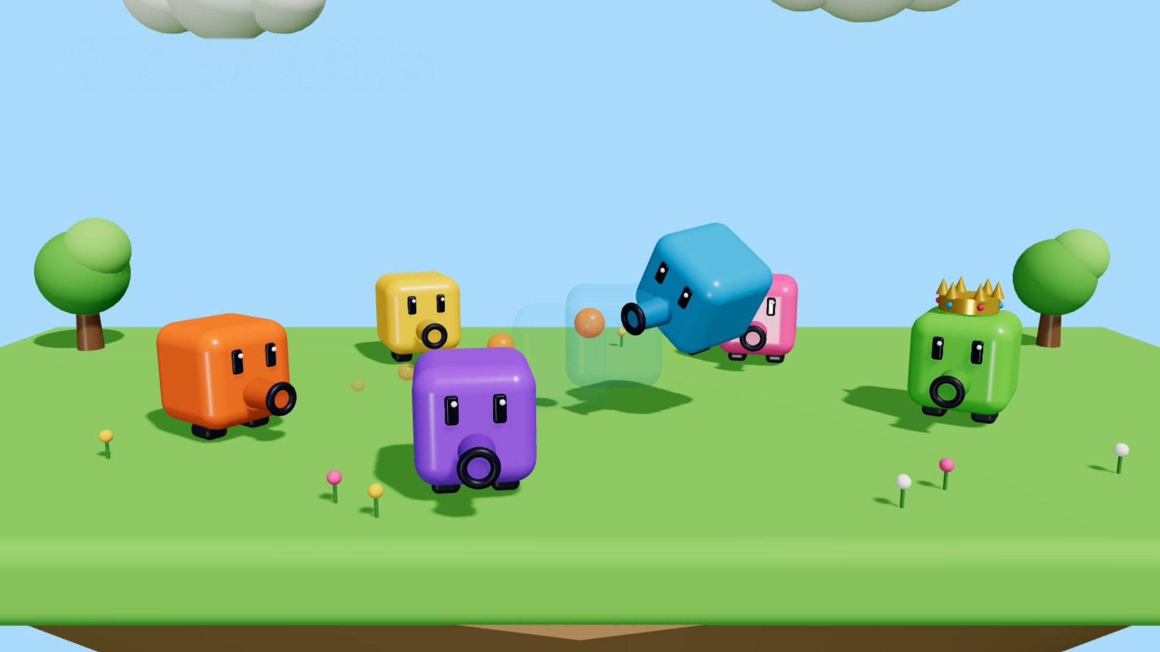
FINAL STANDINGS
Shooter Party in short
1st
One shooting cube; every mini-game changes what a shot does.
2nd
A comeback built in: +1 for last place, ties to the underdog, a crown on the leader.
3rd
Multiplayer sessions you shape: your playlist, your end rule, your look.
Questions?
Ezel Bayraktar · Abdurrahim Özağaç · Kürşat Hürkan Aydın · Ardıl Bilal Ülkü
Notes:
In short. One shooting cube; every mini-game changes what a shot does. A comeback built in: plus one for last place, ties to the underdog, a crown on the leader. And multiplayer sessions you shape: your playlist, your end rule, your look. Questions.

Slide 28
Shooter Party
CMP406 GameTech · Fall 2026
APPENDIX
Sources
[1] Newzoo, State of Gaming 2025, via PocketGamer.biz, 18 Dec 2025. pocketgamer.biz
[2] Newzoo final 2025 figures, via GameDev Reports, 26 Jun 2026. gamedevreports.substack.com
[3] ESA Essential Facts 2026 (survey Feb 2026, n=13,545). theesa.com
[4] Alinea Analytics, games with co-op on Steam, H1 2025 (estimates). alineaanalytics.substack.com
[5] Gameranx: Super Mario Party Jamboree is the fastest-selling entry (Nintendo figures, Feb 2025). gameranx.com
[6] Raijin: Stick Fight: The Game, Steam estimates. raijin.gg
[7] SteamSpy: Pummel Party owner estimate. steamspy.com
[8] Wikipedia: Party Animals (playtest peak, Twitch viewers). wikipedia.org
[9] Feather Party on Steam (app 2300230). store.steampowered.com
[10] Game Developers, 2025 Steam revenue distribution (Gamalytic estimates), 21 Aug 2026. game-developers.org
[11] Steam store pages and SteamDB charts for Party Animals, Gang Beasts, Fall Guys and Pummel Party: prices, peaks, reviews, owner estimates. 17 Oct 2026.
Images. All character and scene images are 3D concept renders made for this pitch; none show final gameplay. Level drafts were made for this pitch. Competitor screenshots: official Steam media, © publishers.
Shooter Party · Game proposal
28 / 28
Notes:
All sources, with dates. Owner counts are third-party estimates.

