Slide 1
Training for iDRAC, vSphere &
vCenter
Briefer:
Fall 2021 Jackson Billings &
Abdurrahmaan Baghdadi
1

Slide 2
Overview
This powerpoint will be a helpful guide to learn the basics of Dell iDRAC, and the VMWARE products vSphere & vCenter.
What is Dell iDRAC? It is a powerful remote server management tool that is used monitor, update or delopy Dell EMC Poweredge servers. In the next slides I will be going more in depth on how the actual iDRAC interface works and show you examples of how we can use it in a real life setting.
Before we talk about vCenter & vSphere we need to first introduce VMware ESXi. ESXi is a type 1 hypervisor which means it is a standalone operating system you can install on your server. You are then able to create virtual machines within ESXi.
What is vCenter? vCenter is a server management platform that is deployed onto ESXi hosts. Using vCenter we can manage multiple ESXi hosts at ease and control the whole infrastructure of the hosts.
Vsphere controls all the vsphere hosts
What is vSphere? Now that we understand the purpose of vCenter we can look more into vSphere. vSphere is a client used to view all the ESXi hosts that are built into vCenter. From there we can manage the virtual machines, clusters and monitor them as well.
Runs on top of the hardware
IDRAC, vSphere & vCenter Training

Slide 3
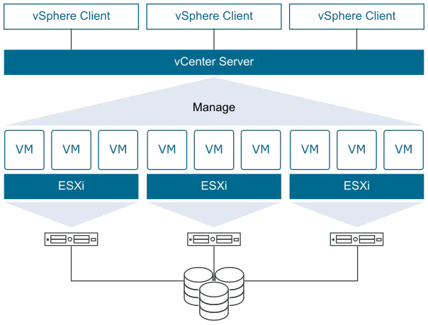
Overview
Here is a diagram showing the flow of how the programs are used together
https://docs.vmware.com/en/VMware-vSphere/index.html
IDRAC, vSphere & vCenter Training

Slide 4
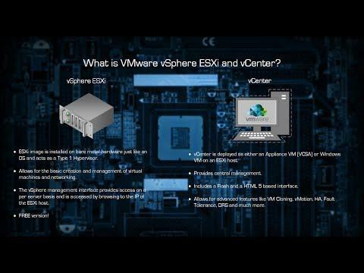
Overview
The difference between vSphere and vCenter might seem confusing so here is a video to help understand them better
IDRAC, vSphere & vCenter Training

Slide 5
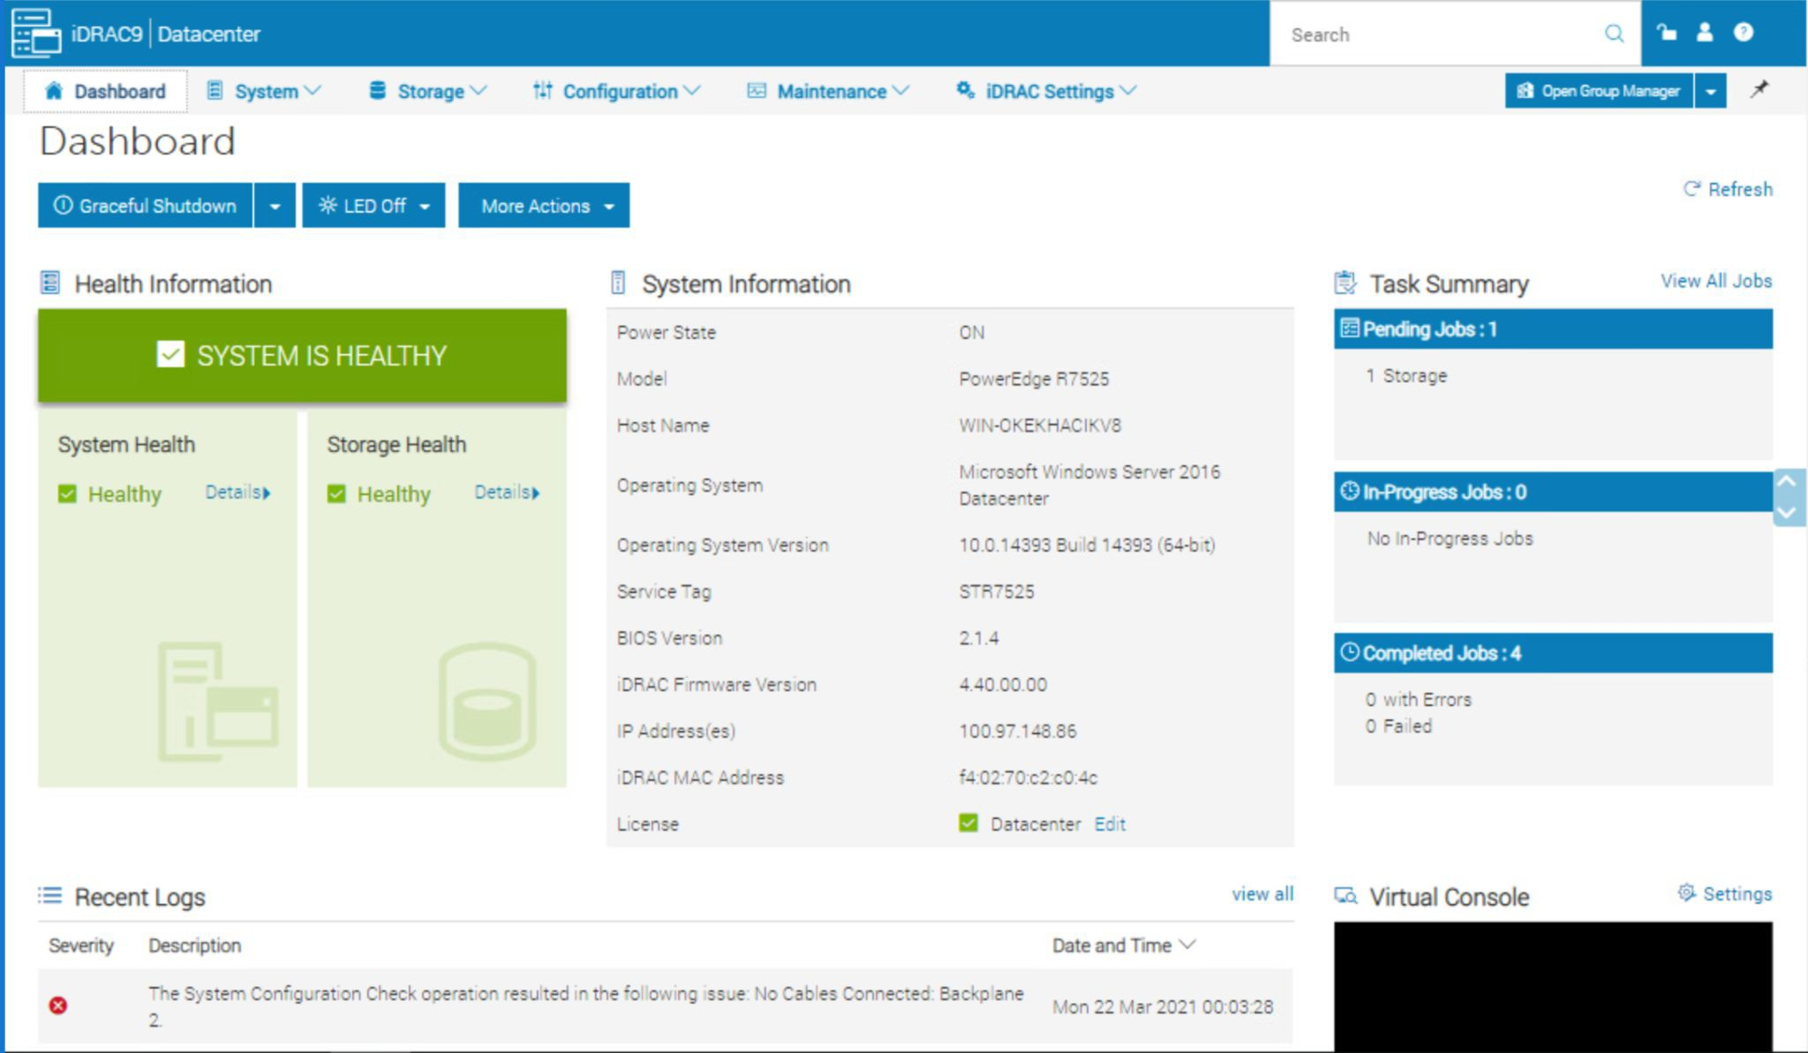
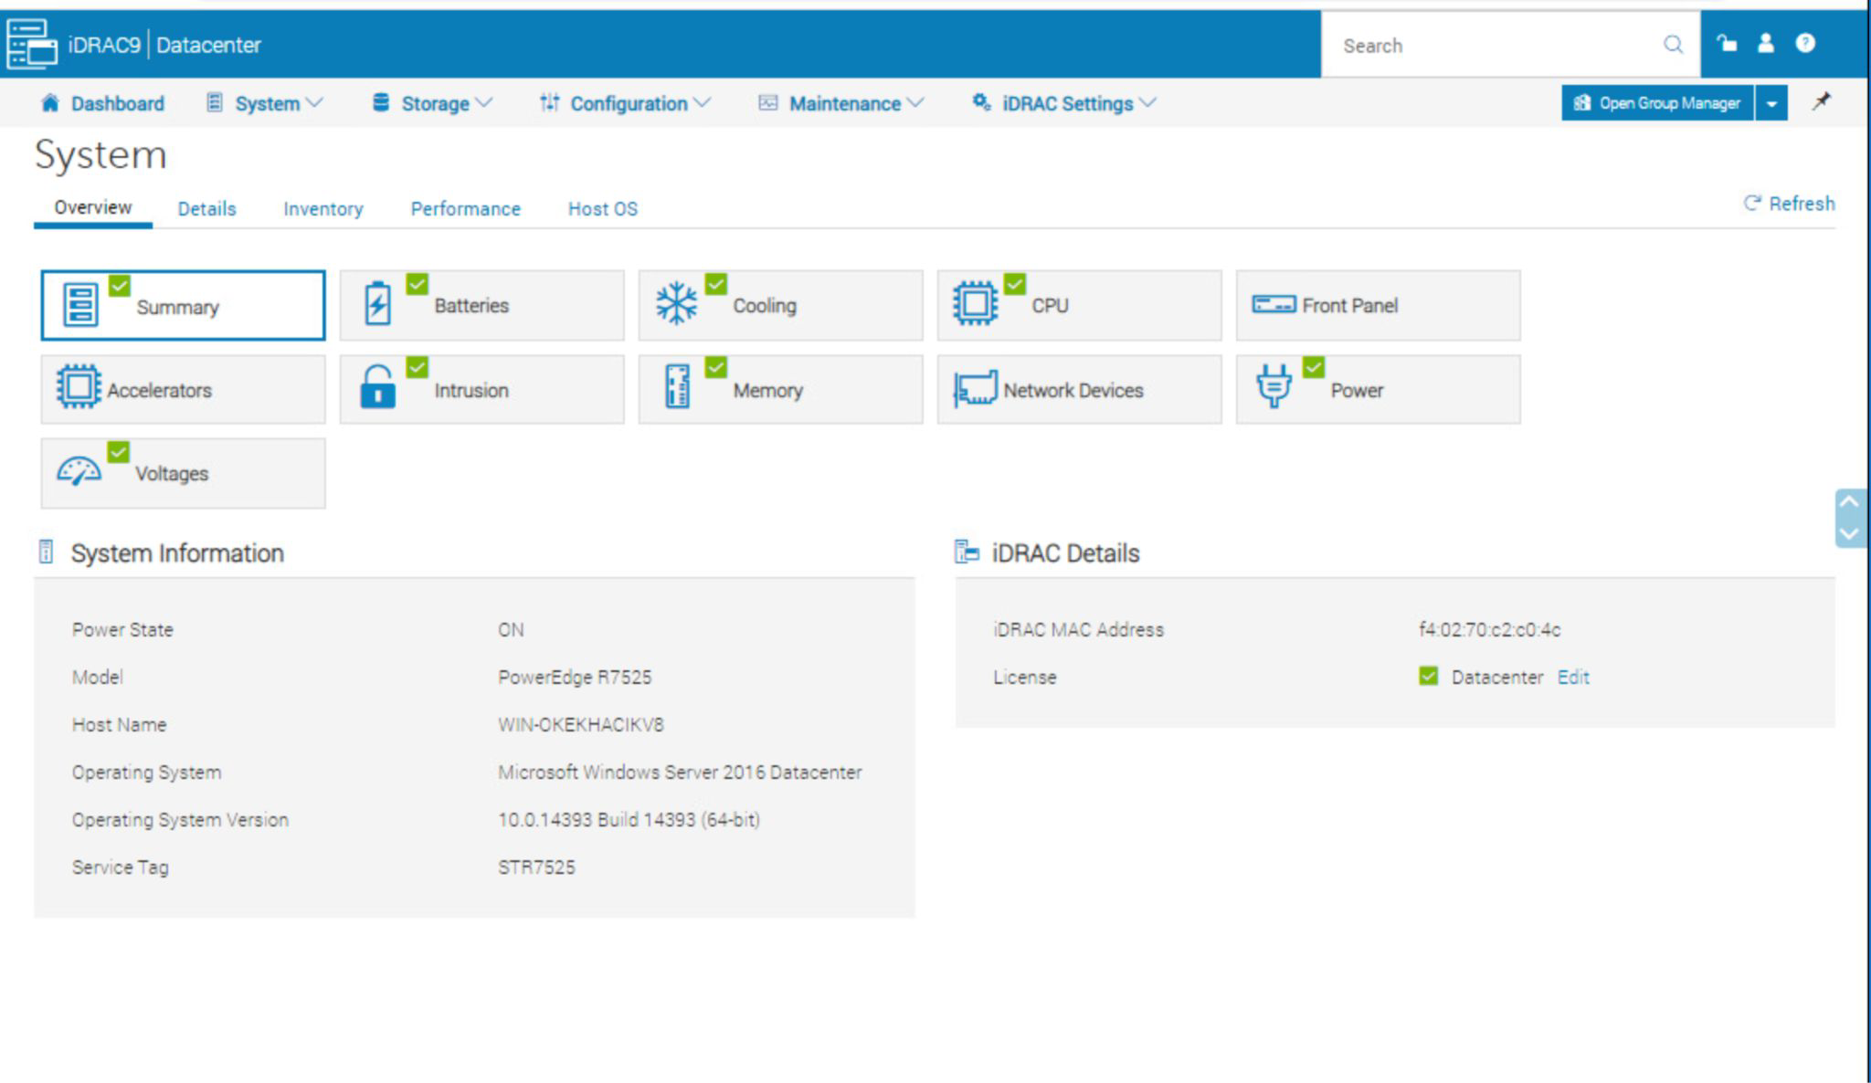
iDRAC
We already know what iDRAC is used for, but it's good to dive deep into the actual program to see the main features and how it can be used. The main dashboard is where you can access most of the information such as task summaries, and system health. If there is ever issues to your system you’d be able to view the status in “health information”. You can also view detailed information by selecting details and you will be show with many more options.

Slide 6
iDRAC
Important Capabilities:
Maintenance
Through the maintenance tab you are able to manage troubleshooting and
filter diagnostics. This allows you to send and receive reports on the system.
Storage
Through the storage tab you are able to manage controllers, physical disk, enclosures, and virtual disk. By creating virtual disk you will be able to
configure organized task oriented storage.
BIOS settings
Through the BIOS settings you are able to change information without restarting the server. You can edit processor settings in preparations for
reboots.
Alerts
Through Alerts you are able to configure notifications for system information.
Redfish Events and SNMP alerts are examples of filters for alters.
Profile configuration
Allows for custom defaults to be set for a system.

Slide 7
iDRAC
Important Capabilities (Cont.):
Virtual Console
Connectivity management menu allows for changing the “Plug-in Type.” Example
changing Java to eHTML5.
Lockdown mode
In Dashboard, more actions allows you to turn on system lockdown mode. With lockdown mode you will be unable to edit the bios settings. By clicking the lock you
will be able to disable lockdown mode.
Security Settings
Utilizing the iDRAC settings page you will see overview of the information on the system. In Connectivity and Network settings that can be used to see local users and password settings. RSA SecurID Configuration can be used to make a system
more secure.
Telemetry Streaming
By viewing the telemetry data stream tab you are able to manage the telemetry
subscriptions and gather metric definition reports.
Thermal Management
Configuration-> system settings -> hardware settings -> cooling configuration. By clicking on the question marks you are able to see more information about the cooling limitations of the system.

Slide 8
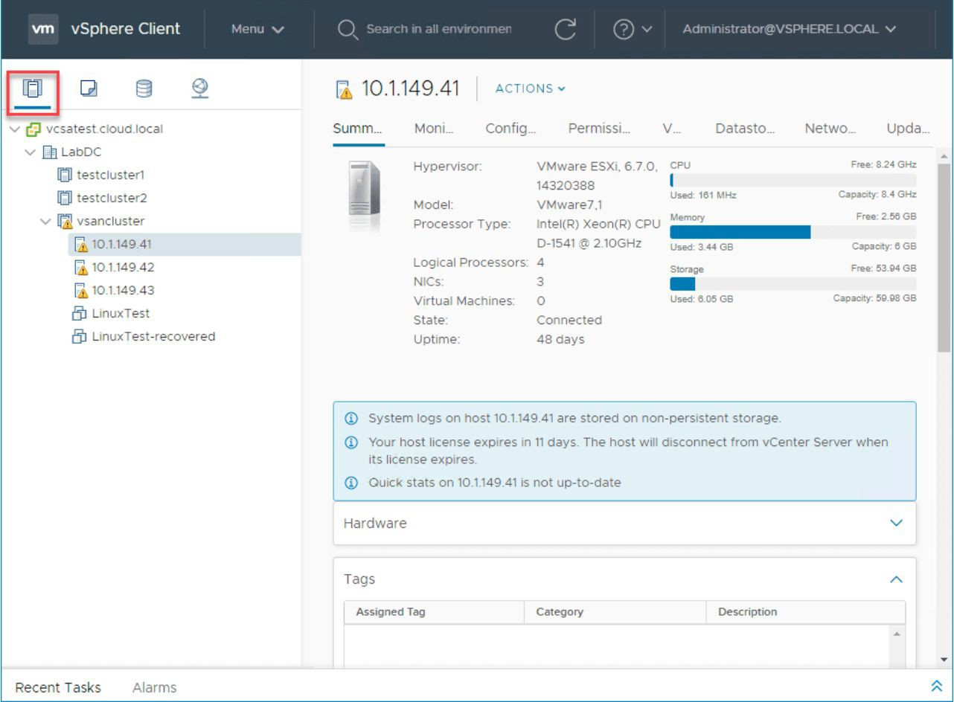
vSphere
As we mentioned in the overview, vSphere is the interface used to control any ESXi hosts that have vCenter running on them. There are many features the vSphere client has and in order to fully understand how the interface works its good to see pictures of the interface. Below is an example of how you are able to view different hosts in a cluster. As you can see you can choose from multiple ESXi hosts in each cluster.

Slide 9
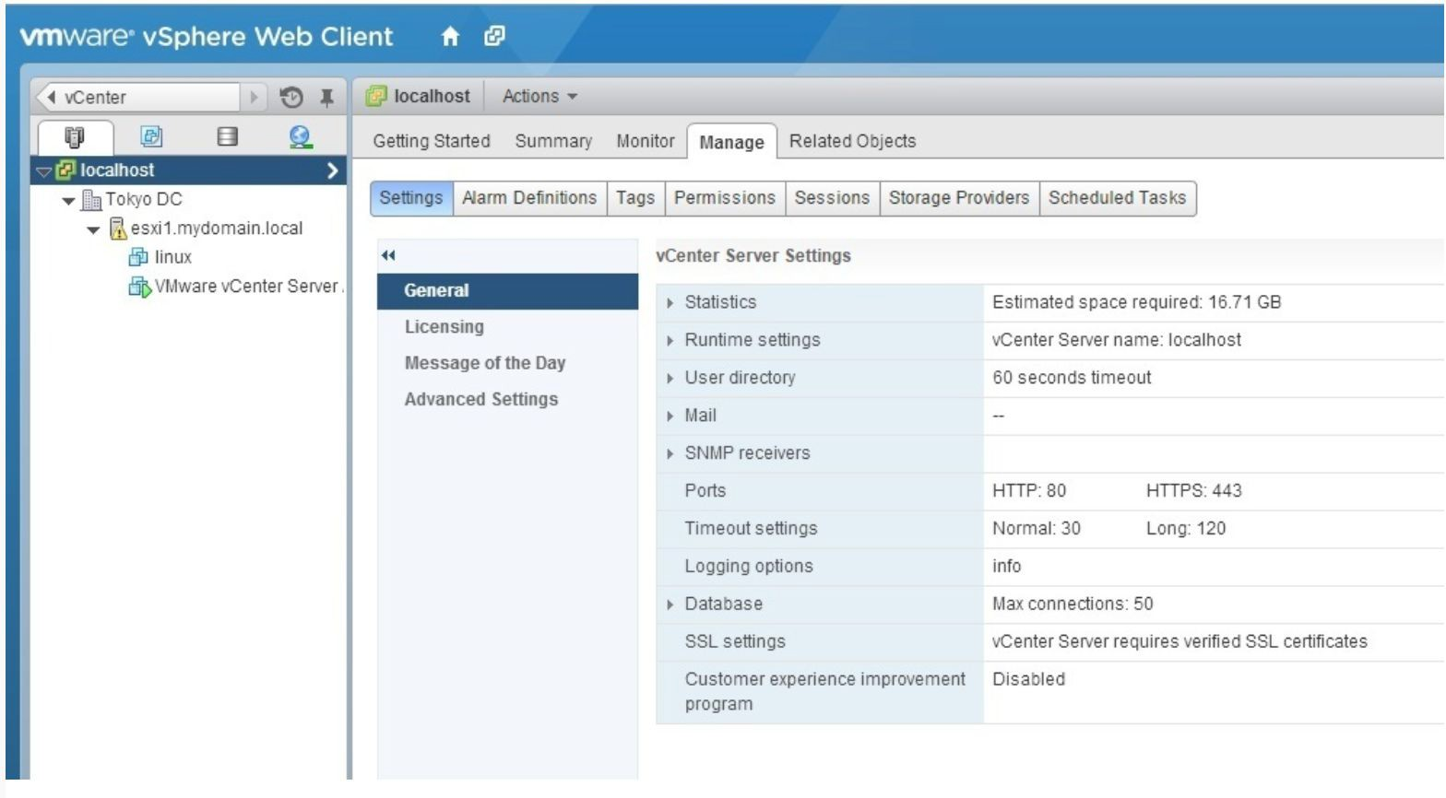
vSphere
There are two ways you can use vSphere, either through the web or an actual client. Here below is an example of the web client and how it can control the ESXi host as well as vCenter installed on the host.

