Slide 1
Evaluating Sales Strategies for New Office Stationery Line
Analysis of Sales Methods and Recommendations
Presenter: Abdurrahman Morsi
Date: 2024-08-24

Slide 2
Objective:
Evaluate the effectiveness of three sales strategies (Email, Call, Email + Call) for a new product line.
To determine the most effective sales strategy for our new office stationery line.
Business Goals:
Maximize revenue from the new product line.
Identify the most efficient sales methods.
Optimize sales team resources and efforts.

Slide 3
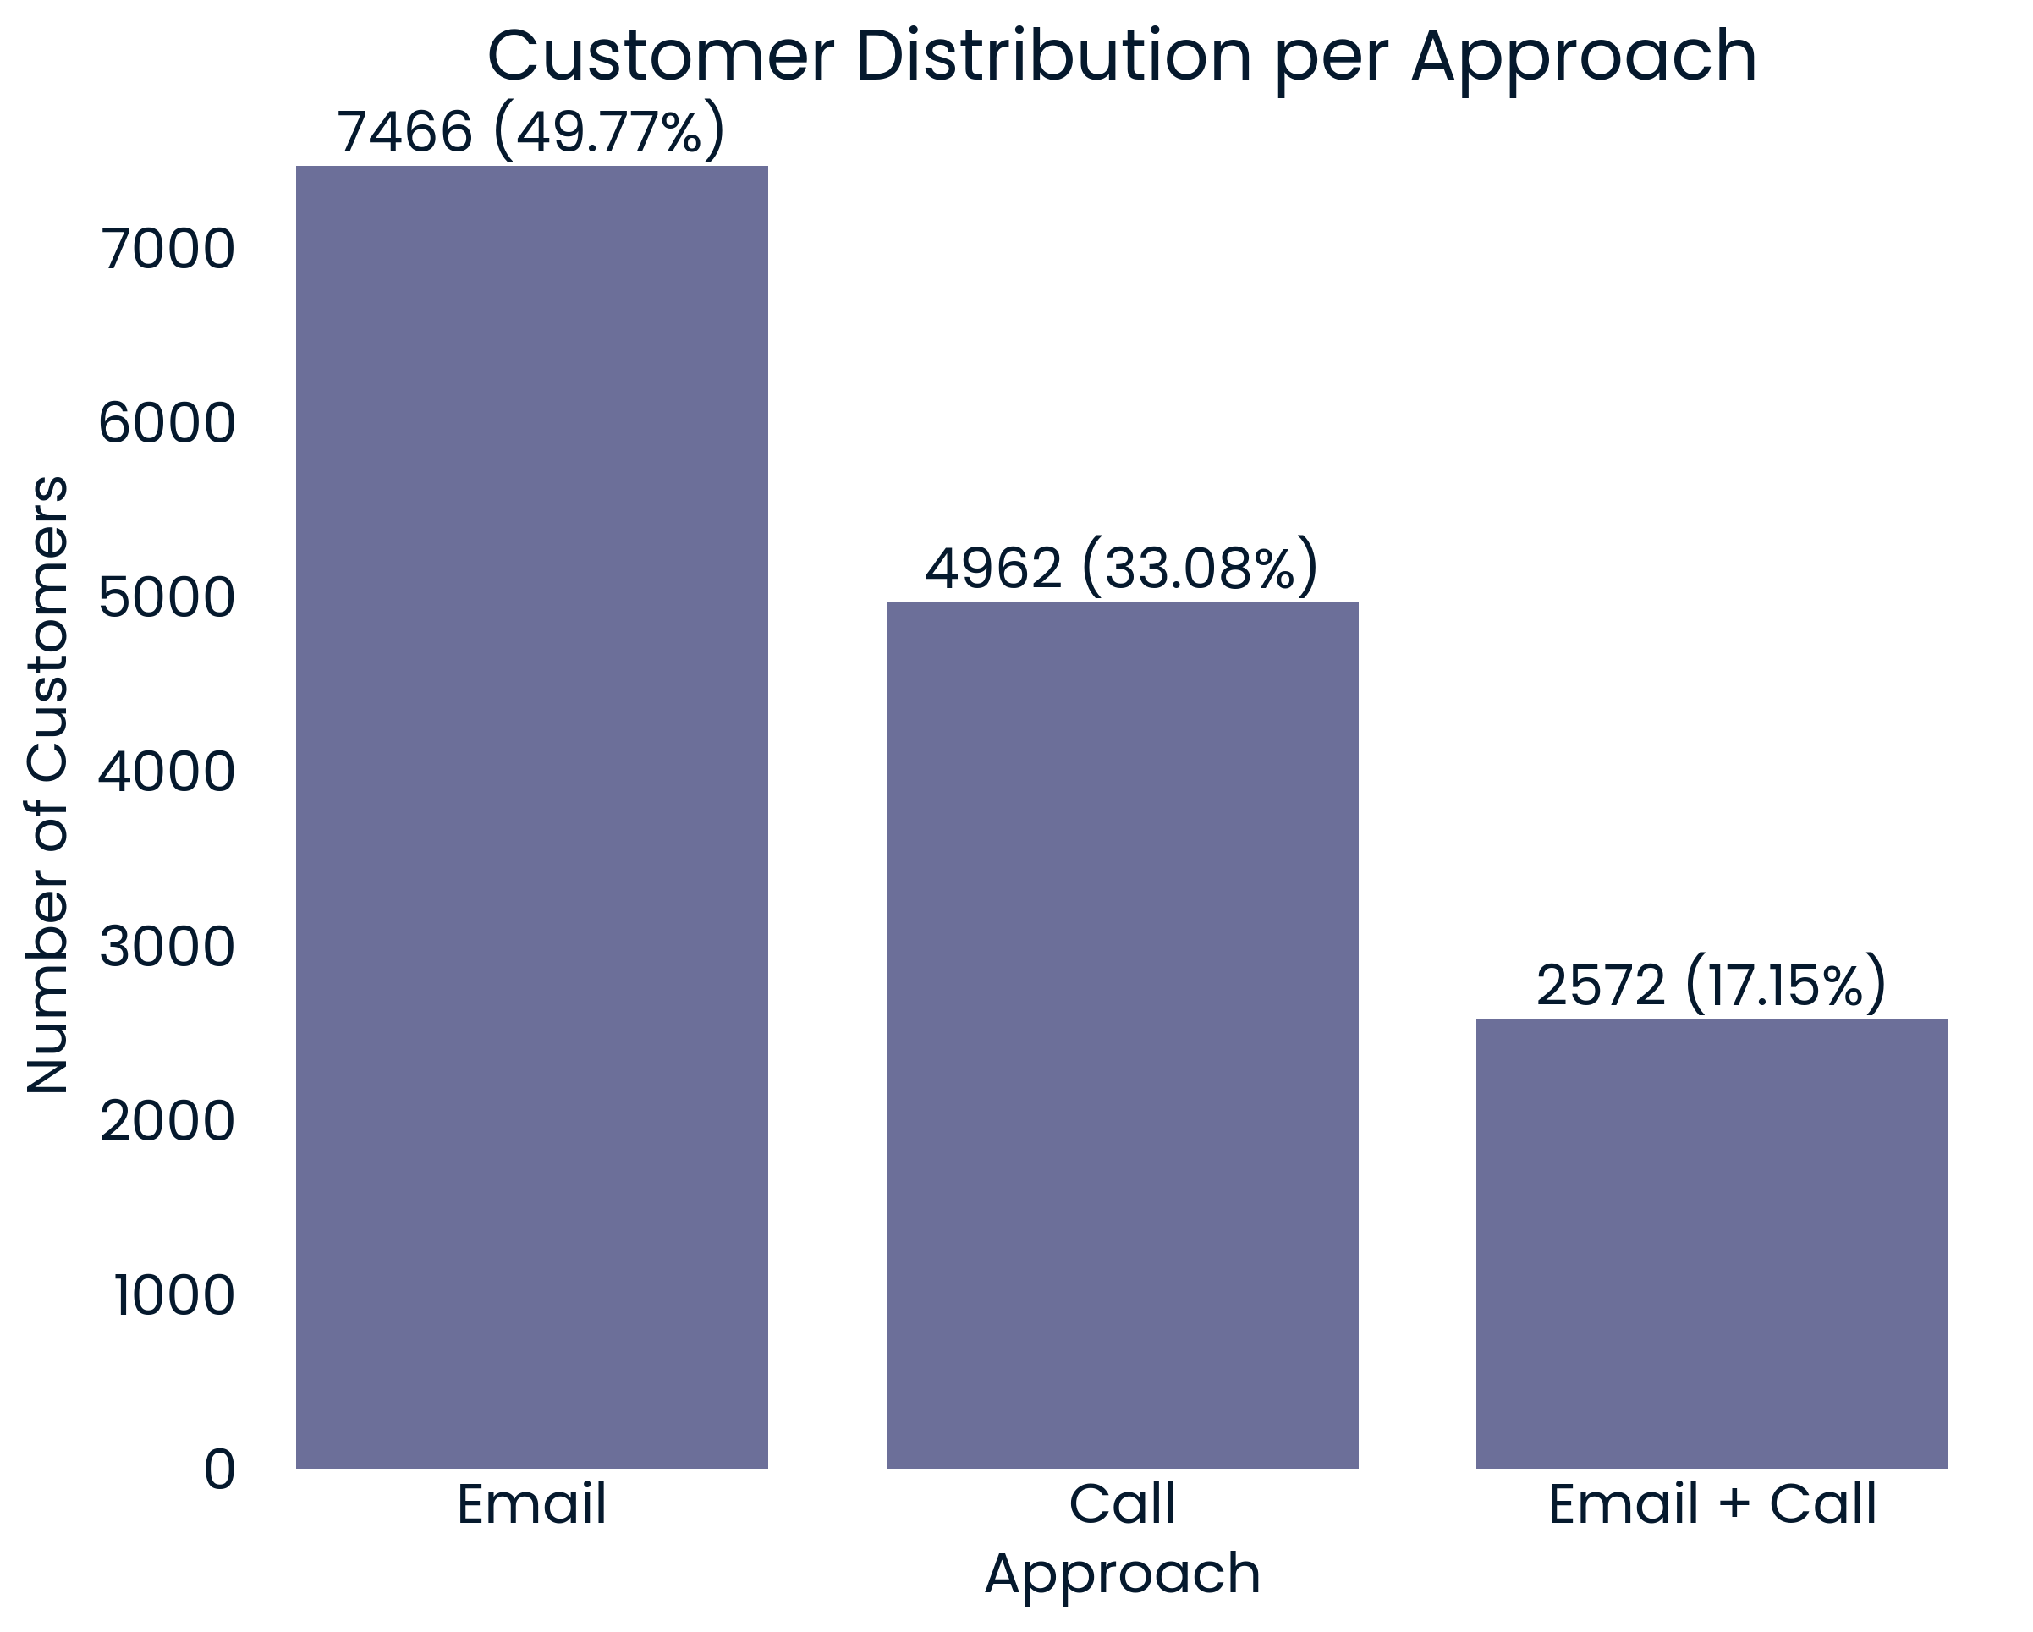
Number of Customers by Sales Method
Email Only: 7,466 (50%)
Initial email followed by a reminder email.
Call Only: 4,962 (33%)
Direct phone calls to customers.
Email + Call: 2,572 (17%)
Initial email followed by a call.

Slide 4
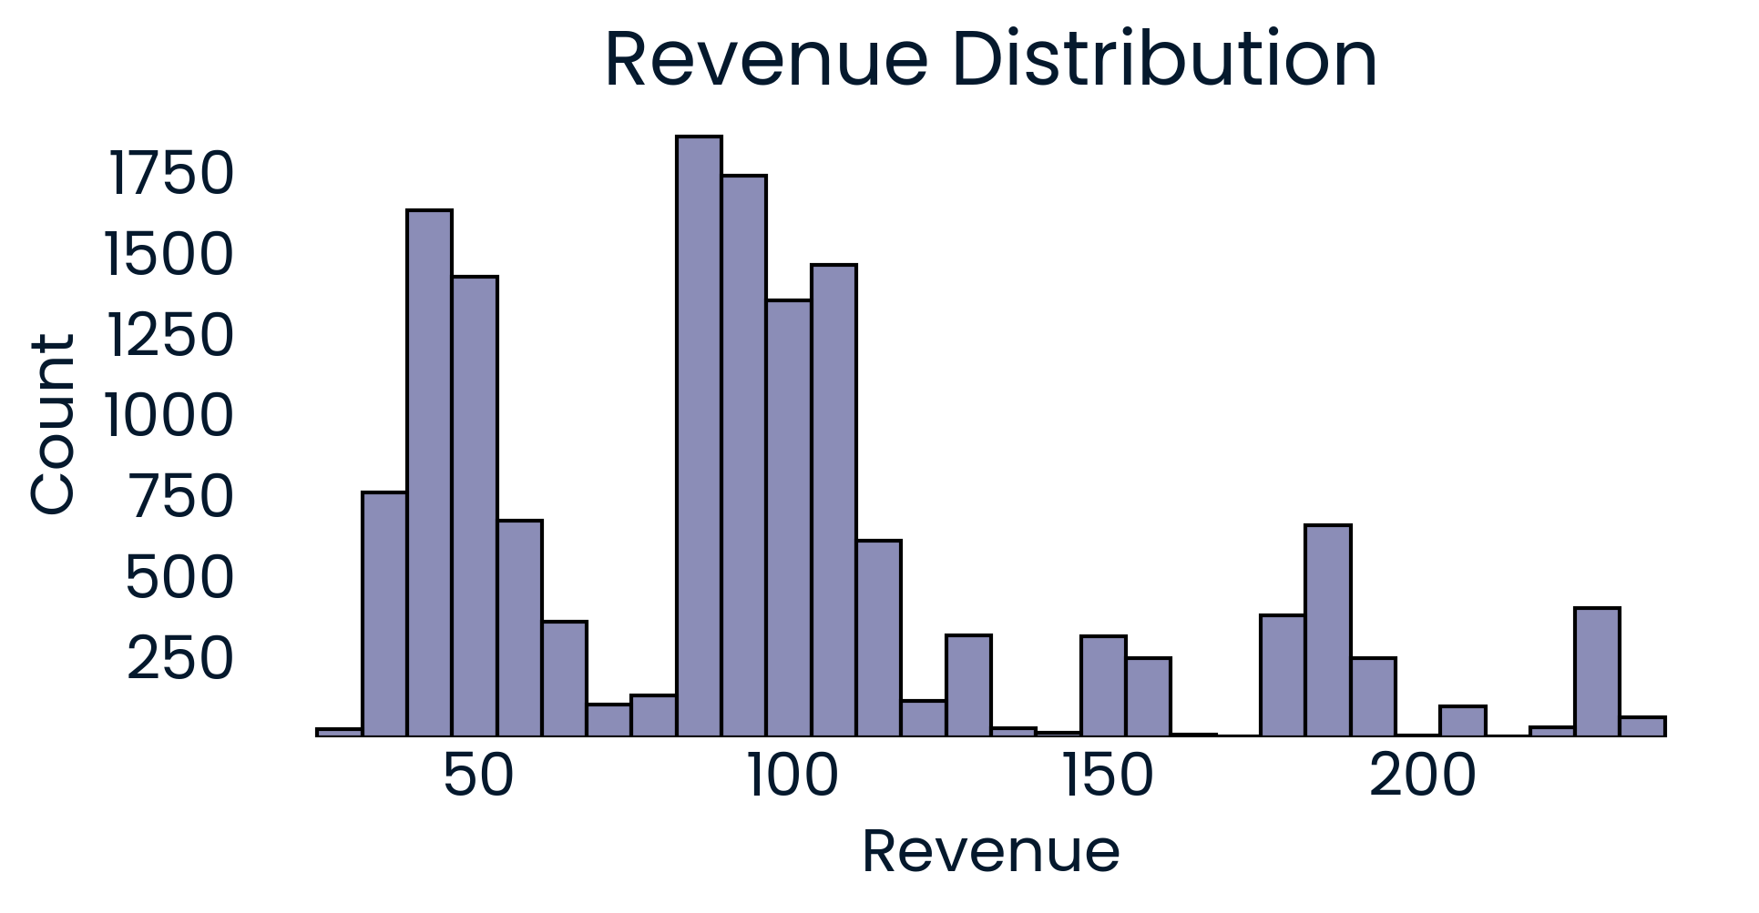
Overall Revenue Distribution
The distribution is multimodal, with significant revenue peaks around $40-55, $80-95, and $180-190.
50% of revenue in the range of $53-108.

Slide 5
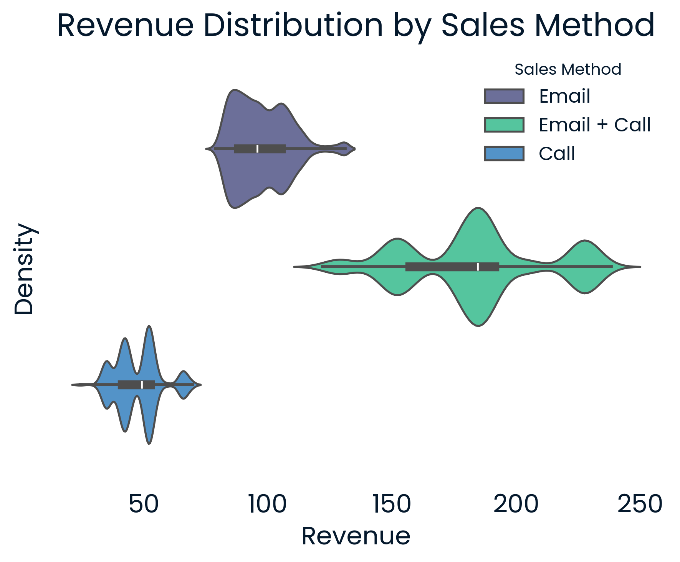
Revenue Distribution by Sales Method
50% of revenue is between $88-105, $41-53, and $157-191 for email, call, and email + call respectively.
The Email + Call method has the widest range and the most balanced distribution.

Slide 6
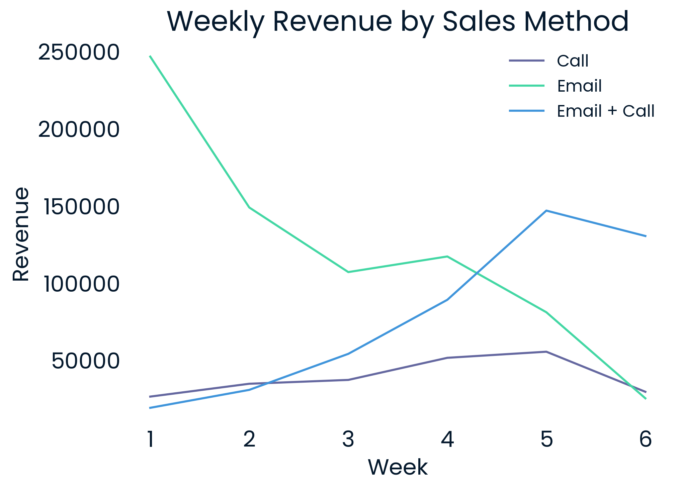
Revenue Over Time by Sales Method
Email Only: Rapid initial growth, then decline.
Call Only: Steady performance with relatively more growth in week 4.
Email + Call: Consistent growth until week 5, then decline.
Week 6 Decline observed across all methods. This suggests potential external factors.

Slide 7
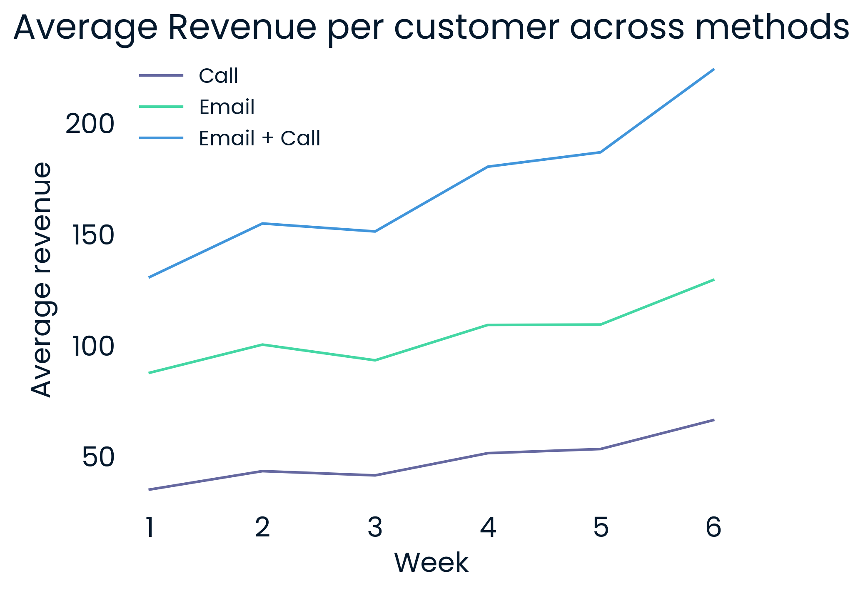
Revenue Over Time by Sales Method
Email + Call: Highest average revenue growth.
Email Only: Good growth with fluctuation.
Call Only: Steady but lower average revenue growth.
Insight: Email + Call shows the best overall average revenue growth.

Slide 8
Recommendation
Primary Recommendation:
Continue using “Email + Call” Method: Highest average revenue and growth. Optimize for efficiency to manage team resources better.
Secondary Option:
Switch to Email Only (If team time is a constraint): Lower revenue’s average but requires minimum resources.
Further Investigation Needed:
Analyze decline in week 6 to understand external impacts.

Slide 9
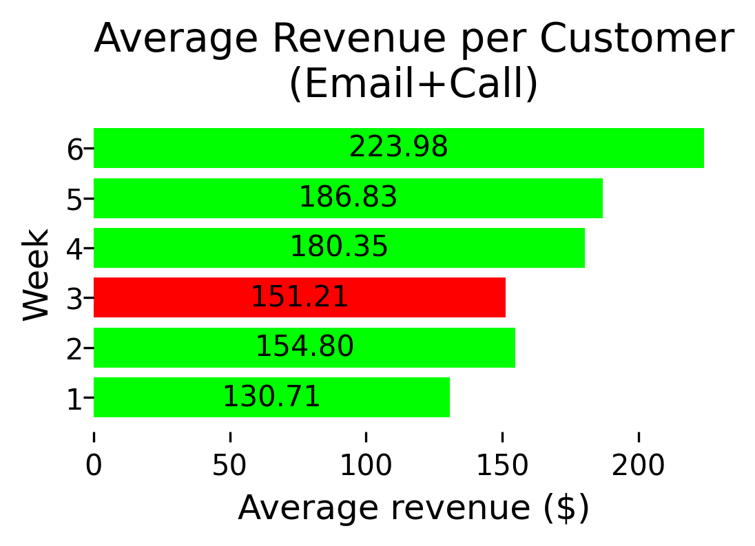
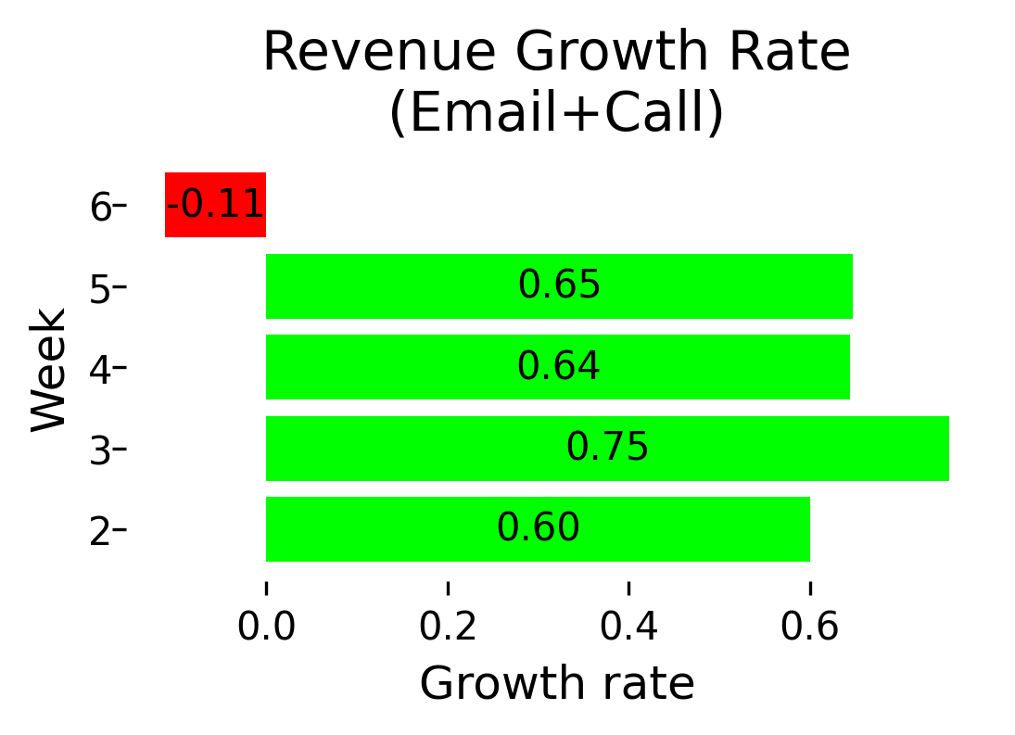
Metrics for Monitoring
1. Average Revenue per Customer:
Email Only: $129.38
Call Only: $66.31
Email + Call: $223.98
2. Revenue Growth Rate:
Email Only: -0.69
Call Only: -0.47
Email + Call: -0.11
Purpose: To track customer value and revenue trends over time.

