Slide 1
PHASE 4 REVIEW
Integrated Application Review — Phase 4
Mini Project Final Review
What we built: a gate-level logic simulator for Yosys netlists, with an FSM synthesizer, a testbench and assertion engine, waveform export (table, ASCII, JSON, VCD) and a web GUI. Simulator checked row by row against Icarus Verilog; every synthesized netlist checked against its own FSM table.
Overview · Integrated demo (live) · Integrated testing · Core principles · NFRs · Future scope
SLMS — Sequential Logic Multi-worklet Simulator
[ Team / Group No. ] · [ Team Members ]
[ Guide Name ] · [ Review Date ]
Notes:
Total 15–20 min: Overview 2, Demo 5 (live), Testing 5.5, Principles 1.5, NFRs 3.5, Future scope 1, Q&A.
One line pitch: Verilog or an FSM table goes in, a verified waveform comes out, and every number on these slides can be reproduced from scripts in the repository.

Slide 2
SECTION 1
Overview — Overall Functionality
EXPECTED SYSTEM — AS PLANNED
INTEGRATED SYSTEM — AS OF TODAY
What it should do: simulate and verify synthesized digital circuits, cycle by cycle.
Users & problem: students checking a netlist or FSM without a commercial simulator.
Core capabilities planned: parsing · simulation · FSM synthesis · assertions · waveforms · GUI
Out of scope: X/Z values, gate delays, async reset.
What it does today: Verilog (via Yosys) or an FSM table → parser → simulator → testbench → report and waveforms, from CLI or browser.
Capabilities working end to end: 9 gates · 6 flip-flops · FSM synthesis · VCD/JSON · GUI
Gaps vs. plan: Icarus faster on small circuits and long stimuli; no logic minimization in the synthesizer.
11
10
1
91 %
TOTAL REQUIREMENTS
IMPLEMENTED (DONE)
PARTIAL / NOT DONE
COMPLETION
KEY POINT 10 of 11 requirements fully done (91 %). 1 partial: performance against Icarus on small circuits and long stimuli.
Notes:
~2 min. Planned vs. working today. The three worklets: W1 netlist and combinational, W2 sequential and FSM, W3 testbench, assertions, waveforms, CLI and GUI.
NOTE: requirement list derived from the code. Align the IDs and wording with the Phase 3 requirement list before presenting.

Slide 3
SECTION 1
Overview — Requirements Implemented
Req ID | Description | Type | Status | Evidence (demo / test ID)
REQ-01 | Parse Yosys netlists, validate, detect cycles | Functional | Done | Demo 2 · UT parser
REQ-02 | Simulate 9 gate types and 6 flip-flop types | Functional | Done | Demo 2, 3 · UT-1, UT-2
REQ-03 | Synthesize FSM table into gates and DFFs | Functional | Done | Demo 1 · IT-1, IT-4
REQ-04 | Report dead and unreachable FSM states | Functional | Done | Demo 1 · UT-3
REQ-05 | Testbench: clock, stimuli, assertions | Functional | Done | Demo 1, 5 · System
REQ-06 | Export results table, ASCII, JSON and VCD | Functional | Done | Demo 1, 3 · System
REQ-07 | Terminal and vector-file input, truth tables | Functional | Done | Demo 2
REQ-08 | Web GUI driven by the real simulator | Functional | Done | Demo 3
REQ-09 | Same outputs as a reference simulator | NFR | Done | Demo 4 · IT-3 · slide 8
REQ-10 | Run time and memory at 256k cells | NFR | Partial | Benchmarks (slide 12)
REQ-11 | Validate and benchmark the synthesizer | NFR | Done | Demo 4 · IT-4 · slide 13
Total: 11 Done: 10 Partial: 1 Not done: 0 Completion: 91 %
KEY POINT REQ-10 is partial because Icarus wins on small circuits and long stimuli. REQ-11: 2,139 FSMs match their tables, 12/12 injected bugs caught.
Notes:
~1 min. Do not read the table. Call out REQ-10 (partial: we are faster from 16k cells but not on small or long runs, and memory grows with stimulus length) and REQ-11 (synthesizer validated on 2,139 FSMs and benchmarked up to 262,144 rows).

Slide 4
SECTION 2
Integrated Demo — Key Scenarios (Maximum 5)
# | Scenario | Goal | Modules integrated | Requirements covered | Backup
Demo 1 | FSM to verified waveform | Synthesize an FSM, find dead states, run a testbench with 31 assertions | W2 → W1 → W3 | REQ-03, 04, 05, 06 | Live: terminal
Demo 2 | Verilog to simulation | Yosys netlist driven by a vectors file with expected outputs; one wrong value is caught | Yosys → W1 → W2 → W3 | REQ-01, 02, 07 | Live: terminal
Demo 3 | Web GUI | Live traffic light, any bundled circuit, vending machine, VCD download | W3 GUI → W1 + W2 | REQ-02, 06, 08 | Live: browser
Demo 4 | Validation | 26 circuits vs. Icarus in 2 Yosys flows; synthesized netlists vs. their FSM tables | Yosys → W1 + W2 + W3 → Icarus; W2 → script | REQ-09, 11 | Live: terminal
Demo 5 | Tests and failure handling | 30 tests in 7 categories; bad input fails loudly, with exit code 1 | All worklets | REQ-05 + all | Live: terminal
KEY POINT Every demo runs live on the current build. None is a recording, and each crosses at least two worklets.
Notes:
~1 min. All five demos are shown live. Run sheet with exact commands on the next slide.

Slide 5
SECTION 2
Integrated Demo — Live Run Sheet
# | Shows | Command / action | Expected on screen | Time | If it fails
Demo 1 | FSM analysis and testbench | ./simulator --fsm docs/fsm_example/dead_unreachable_fsm.net ./simulator --fsm docs/fsm_example/traffic_light_fsm.net --synth ./simulator --testbench examples/traffic_light/traffic_light.tb | Dead T V H · unreachable U V H · netlist · 31/31 PASSED | 1 min | make, rerun
Demo 2 | Verilog → vectors with expected outputs | yosys -p "… write_table counter.table" ./simulator --interactive (netlist, vectors file) | PASSED; one edited value → FAILED, exit 1 | 1.5 min | dff_negative input
Demo 3 | Browser GUI | ./simulator --gui 8080 Step Clock · Workbench (JK FF) · Insert 5, 5 · VCD | Lamps advance · PASSED · vend = 1 | 1.5 min | Hard refresh
Demo 4 | Icarus and FSM-table validation | python3 validation/icarus/validate.py [--flow techmap] python3 validation/synthesizer/validate.py edge | 26 passed, 62,676 rows · 15 groups passed, 0 missed | 1 min | docs/validation.md
Demo 5 | Tests and negative tests | ./simulator --test all ./simulator --testbench wrong_assert.tb; echo $? | 30/30 PASSED · VIOLATIONS DETECTED · 1 | 0.5 min | —
KEY POINT Run from the project root after make. Keep the terminal and the browser side by side.
Notes:
Presenter run sheet. Build once before the review (make). Demo 4 needs yosys and iverilog on the machine. validate.py edge takes under a second; the full synthesizer run (2,139 FSMs) takes about a minute. Demo folders demoandppt/demo1..demo5 will hold the exact input files for each step.

Slide 6
SECTION 3
Integrated Testing — Methodology & Framework
METHODOLOGY & ENVIRONMENT
INTEGRATION STRATEGY & WHY
Approach: requirement- and risk-driven: every requirement maps to a test or demo.
Environment & test data: Ubuntu, g++ C++17, Yosys 0.68, Icarus 12.0; 26 Verilog circuits; 2,139 FSMs.
Test oracle: hand-written tables; Icarus on the same netlist; the FSM table, read by an independent script.
Strategy used: bottom-up.
Why: W1 came first, W2 builds on it, W3 drives both; each layer tested before use.
Stubs / mocks / drivers: hand-built circuits in standalone drivers, later replaced by parsed netlists.
TECHNIQUES
REUSABLE TESTING FRAMEWORK / UTILITIES
Test framework: 7-category C++ suite run by ./simulator --test.
Techniques: partitions, boundary values, negative tests, differential testing vs. Icarus, damaged netlists and injected bugs.
Structure: tests/<category>/Test<Category>.cpp + TestSuite::record(); validate.py.
How to reuse: tb.loadCircuit(p); tb.addStimulus(t, "a", 1); tb.addAssertion(t, "y", 1); tb.run();
Evidence: docs/testing.md, docs/validation.md
KEY POINT Both validators are reusable: drop a test.v in validation/circuits/, or an FSM .net in validation/synthesizer/fsms/.
Notes:
~1.5 min. Bottom-up because the worklets depend on each other in that order. The strongest oracle is differential: Yosys writes one netlist in two formats, both simulators run the same gates, so a difference can only come from simulation. For the synthesizer, the FSM table is the reference, and the checks are shown to fail by damaging netlists and injecting 12 real bugs.

Slide 7
SECTION 3
Integrated Testing — How We Validate Against Icarus Verilog
OUR SIMULATOR
netlist.table
same gates
4
Our simulator
--interactive
Our outputs
one per row
1
2
5
Verilog circuit
test.v
26 circuits
Yosys
synthesizes it
once
vectors file
Same output
on every row?
3
Same input rows
generated once · 3 seeds
tb.v
REFERENCE: ICARUS VERILOG
netlist.v
same gates
Icarus Verilog
iverilog + vvp
Icarus outputs
one per row
Yes: 26 / 26 circuits
0 mismatches
Why it is fair: both simulators run the same gates from one Yosys netlist, so a difference can only come from our simulator.
What goes in: every input combination (up to 12 inputs) + 300 random rows. Clocked circuits: 300 cycles, data changes only while the clock is low.
How much: 26 circuits (gates to FSMs and gated clocks) × 3 seeds × 2 Yosys flows (abc, techmap): 62,676 rows per flow.
KEY POINT Same netlist, same inputs, two independent simulators: every output row matched Icarus, in both Yosys flows.
Notes:
~1.5 min. Walk the numbers left to right. (1) One Verilog circuit. (2) Yosys synthesizes it once and writes the same gate netlist in two formats: one for us, one for Icarus. (3) One set of input rows is generated and written for each simulator. (4) Both simulators run. (5) A script compares every output on every row. Because the gates are identical, a mismatch could only be a bug in our simulator. Result: 26 of 26 circuits, 62,676 rows per flow, 0 mismatches, in both flows. The Verilog source itself is not simulated: that would test Yosys, not us. Live in Demo 4: python3 validation/icarus/validate.py. Details: docs/validation.md.

Slide 8
SECTION 3
Integrated Testing — Unit & Integration Test Evidence
UNIT TESTS
INTEGRATION TESTS
What was tested: gates, flip-flops, FSM analysis, parser errors (13 suite tests + 52 parser tests).
What was tested: FSM → synthesizer → parser → simulator → assertions; vs. Icarus and FSM tables.
ID | Test → expected result | Result
UT-1 | AND, OR, NOT, XOR on every input row → correct output | P
UT-2 | JK flip-flop: set, reset, hold, toggle on the edge | P
UT-3 | dead_unreachable_fsm → dead T V H, unreachable U V H | P
ID | Test → expected result | Result
IT-1 | Traffic-light FSM: synthesize, simulate, assert | P
IT-2 | Shift register: one stage per clock edge | P
IT-3 | 26 circuits vs. Icarus: 0 mismatches | P
IT-4 | 2,139 FSMs vs. their tables: 0 mismatches | P
Coverage: not measured · 13/13 unit tests pass · Evidence: ./simulator --test unit (Demo 5)
Evidence: ./simulator --test integration · validation/ (Demo 4)
KEY POINT UT and IT IDs trace to REQ-02, 03, 04, 09 and 11 on slide 3.
Notes:
~1.5 min. The parser regression suite (make parser-test) adds 52 tests and 203 checks: every error message, every flip-flop type, buses, constants and cycle detection; all pass. Line coverage was not measured.

Slide 9
SECTION 3
Integrated Testing — Regression Plan & Results
REGRESSION PLAN — ENTIRE BUILD
RESULTS SUMMARY
Suite selection: make test (30 suite tests + 52 parser tests), the 3 example testbenches, the Icarus and synthesizer validations, and 28 CLI checks.
Triggers: before every merge to main and after any engine, parser or testbench change. Run by hand; no CI yet.
Pass criteria: 30/30 and 52/52 tests, every example assertion, 0 mismatches against Icarus or the FSM tables, 12/12 bugs caught.
Level | Executed | Passed | Failed | Defects found / fixed | Coverage
Unit | 13 | 13 | 0 | — | —
Integration | 3 | 3 | 0 | — | —
System / end-to-end | 3 | 3 | 0 | — | —
Regression | 5 | 5 | 0 | 3 / 3 | —
Validation, black / white box | 6 | 6 | 0 | — | —
Total | 30 | 30 | 0 | 3 / 3 | n/m
Live: ./simulator --test all → TOTAL TESTS : 30 | PASSED : 30 | FAILED : 0. Defects pinned by regression tests: asymmetric clock edges, unknown signal read as 0, bad bit index read as 0.
KEY POINT Regression covers the whole build. Examples: AND gate 4/4, traffic light 31/31, vending machine 50/50 assertions.
Notes:
~1 min. n/m = coverage not measured. The 3 defects are the ones with dedicated regression tests (AsymmetricClock_10_3, UnknownSignalAssertionFails, InvalidBitIndexAssertionFails).

Slide 10
SECTION 4
Core Principles Applied
Principle | Brief summary (what it means here) | Concrete example from the project
Separation of concerns / modularity | Engine, front ends and verification are separate layers; the engine knows nothing about time or files | src/simulation/Simulator.cpp vs. src/testbench/Testbench.cpp
Single responsibility & loose coupling | One class per gate or flip-flop; work items are small Operation objects in queues | src/operations/, src/combinational/AND.cpp
DRY / reuse | One engine behind --testbench, --interactive, --truthtable, the tests and the GUI | gui/server.py: run_generated_testbench()
Error handling & defensive coding | Every netlist line is validated; an unknown signal fails the run instead of reading 0 | Parser::parse, Testbench::readSignalValue
Open / closed | A new cell type is one class plus one table entry; nothing else changes | compTypeTable in src/parser/Parser.cpp
KEY POINT Each example names a file that can be opened in the editor during the review.
Notes:
~1.5 min. Open Parser.cpp at compTypeTable and Simulator::run() if the panel asks.

Slide 11
SECTION 5
Non-Functional Requirements — Targets vs. Actuals
NFR | Target (from Phase 3) | Actual | Met? | How measured
Correctness | [ Phase 3 target ] | 26/26 circuits, 0 mismatched rows; 2,139 FSMs, 0 mismatches; 30/30 tests | [ Yes / No ] | vs. Icarus (3 seeds, 2 flows); vs. FSM tables
Performance | [ Phase 3 target ] | 2.4× faster than Icarus at 256k; up to 3.0× slower below 16k | [ Yes / No ] | median of 3, one core, 900 rows
Scalability | [ Phase 3 target ] | Sim: time ∝ cells¹ (slope 0.89–1.09). Synth: 4× rows → 4.4× time | [ Yes / No ] | 1k–256k cells; FSMs up to 262,144 rows
Memory efficiency | [ Phase 3 target ] | 1.2–1.7× less than Icarus from 16k; 1.28 GB at 90k rows; synth 1,053 MB at 262k rows | [ Yes / No ] | peak RSS, same runs
Evaluability | [ Phase 3 target ] | Report, table, VCD, JSON, exit codes, GUI verdicts | [ Yes / No ] | every run, every mode
Maintainability | [ Phase 3 target ] | Layered modules; new cell = 1 class + 1 entry | [ Yes / No ] | code structure review
Portability | [ Phase 3 target ] | Linux, g++ C++17, Python standard library | [ Yes / No ] | built and run on Ubuntu only
KEY POINT Missed: memory on long stimuli. Cause: every waveform snapshot is kept in memory. Fix planned: stream to disk.
Notes:
~1.5 min. FILL IN the Phase 3 targets and the Met? column before presenting. Actuals come from docs/validation.md and docs/benchmarks.md (committed scripts and CSVs).

Slide 12
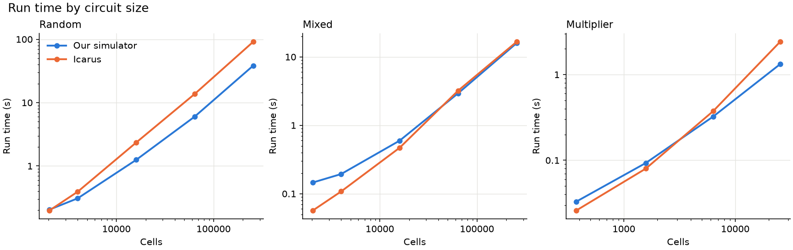
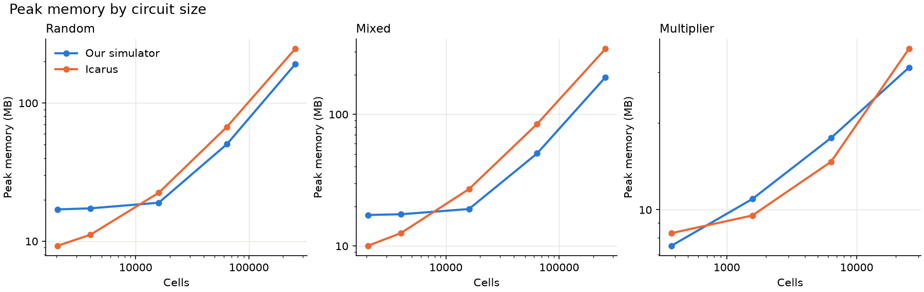
SECTION 5
NFR Measurement — Evidence
NFR | Methods | Test conditions | Raw numbers
Correctness | Differential test vs. Icarus | 26 circuits × 3 seeds × 2 flows | 62,676 rows per flow, 0 mismatches
Performance | Wall time of the whole process | random, mixed, multiplier; 1k–256k cells; 900 rows | 256k random: 38.3 s vs. 91.1 s
Memory | Peak RSS | same runs; mixed 16k at 900–90k rows | 256k mixed: 191 vs. 314 MB; 90k rows: 1,280 vs. 84 MB
Synthesizer | Wall time, peak RSS of --fsm --synth | 51 FSMs, up to 262,144 rows (slide 13) | 65,536 states: 4.16 s, 1,053 MB
Run time and peak memory vs. circuit size (ours in blue, Icarus in orange)
Median of 3 runs (2 from 100k cells or rows), one core. Simulator: i5-12450HX, benchmark/simulation/*/results.csv. Synthesizer: Core Ultra 5 125H, benchmark/synthesizer/results/current/.
KEY POINT Plots and CSVs are committed: python3 benchmark/simulation/plot.py redraws them from the raw results.
Notes:
~1 min. Point at the random panel (we pull ahead from 16k cells) and the mixed panel (about equal at 256k). Be clear that Icarus is faster on small circuits and on long stimuli.

Slide 13
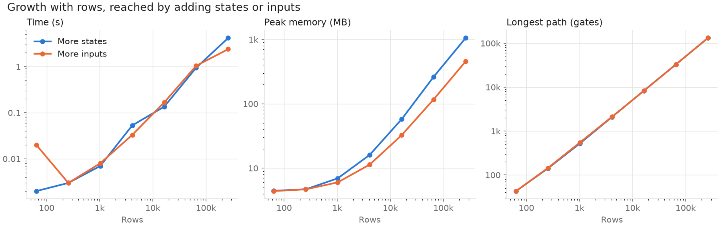
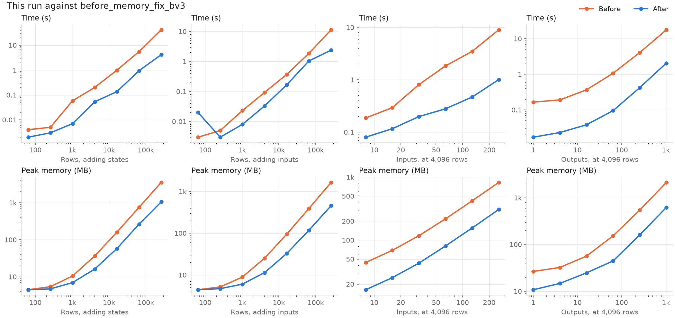
SECTION 5
NFR Measurement — Synthesizer Scalability
FSM | Rows | Time · memory | Gates · depth
256 states, 2 inputs | 1,024 | 0.007 s · 7 MB | 7,930 · 525
4,096 states, 2 inputs | 16,384 | 0.135 s · 58 MB | 160,831 · 8,330
16,384 states, 2 inputs | 65,536 | 0.943 s · 263 MB | 710,241 · 32,970
65,536 states, 2 inputs | 262,144 | 4.16 s · 1,053 MB | 3,103,349 · 131,504
16 states, 14 inputs | 262,144 | 2.38 s · 456 MB | 1,571,225 · 131,472
256 states, 256 inputs | 4,096 | 1.01 s · 306 MB | 1,061,211 · 2,391
256 states, 1,024 outputs | 4,096 | 2.06 s · 620 MB | 2,116,456 · 2,155
Top: growth with rows. Bottom: before (orange) and after (blue) the memory fix
simulator --fsm <file> --synth, median of 3 runs (2 from 100k rows), one core, 6 GB limit. Core Ultra 5 125H, not the simulator machine. Times under 0.1 s are noisy. Data: benchmark/synthesizer/results/current/results.csv.
More state bits cost more per row: 262,144 rows take 4.16 s with 65,536 states, 2.38 s with 16.
No minimization: a counter costs as many gates as a random table; with 75% of states unreachable, removing them would cut gates from 35,196 to 8,090.
KEY POINT 4× rows → 4.4× time and 4.0× memory: a little above linear. Depth ≈ rows ÷ 2 (chained ORs). The memory fix cut memory 2.6–3.6×.
Notes:
~1 min. Rows = states × 2^inputs for a full table, so each family changes one thing. Time and memory grow a little faster than linearly in rows; with more state bits each row feeds more next-state lines, so 262,144 rows cost 4.16 s with 65,536 states but 2.38 s with 16 states. Depth grows linearly because OR gates are chained (fine for a zero-delay simulator, slow as hardware). No minimization: a counter costs as many gates as a random table, and unreachable states are kept (removing 75% of them by hand cuts gates from 35,196 to 8,090). Times vary between sessions, memory does not; compare times only within one run. Data and plots: benchmark/synthesizer/results/current/; python3 benchmark/synthesizer/plot.py redraws them. More detail: docs/benchmarks.md#synthesizer.

Slide 14
SECTION 6
Future Scope — Possibilities and Learnings
FEATURE EXTENSIONS
TECHNICAL IMPROVEMENTS
Deferred functionality: single-bit bus stimulus in .tb files; asynchronous reset; validating the dead and unreachable state finder.
New capabilities: X/Z values · optional gate delays and hold-time warnings · logic minimization and removal of unreachable states in the synthesizer
NFR tuning: stream waveform snapshots to disk (1.28 GB at 90k rows today); index assertions by time; balanced OR trees to cut synthesized depth.
Scalability / architecture: bucket queue by priority instead of std::set; a persistent simulator process for the live GUI.
LEARNINGS CARRIED FORWARD
OPEN RISKS / QUESTIONS FOR THE PANEL
Reuse: Testbench driver, both validators and the benchmark scripts work for any netlist simulator or FSM synthesizer.
Process: compare with an independent reference early; prove the checks can fail; quote only numbers a committed script reproduces.
Risk: no CI, so regressions are caught only when someone runs make test; no line-coverage measurement yet.
Question: should same-time data and clock changes warn (slower) or keep sampling the new value?
KEY POINT Each item comes from an observed gap: REQ-10, or a limitation listed in docs/limitations.md.
Notes:
~1 min. Then Q&A.

