Slide 1
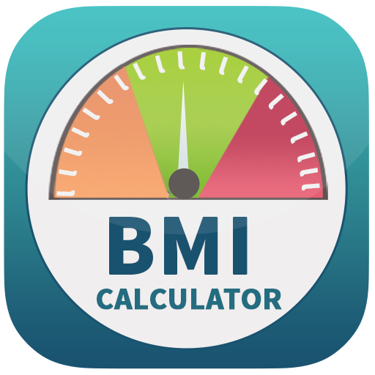
BMI (BODY MASS INDEX) CALCULATOR)
WEB APPLICATION IN R

Slide 2
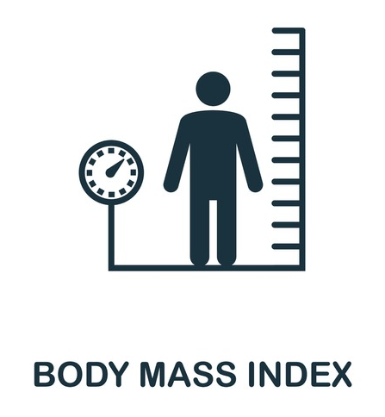
Introduction
BMI (BODY MASS INDEX) is a measurement that takes into account your height, and weight to produce a calculation that is a measurement of your body size.
It can be a starting point for understanding the way your body fat may impact your overall health.
It is a method of determining whether you may be underweight, average weight, overweight, or obese.

Slide 3

How is BMI Measured?
Your BMI is calculated using your height and weight.
Formula: weight (kg) / [height (m)]²
Example: weight = 68 kg, height = 165 cm (1.65 m)
BMI calculation: 68 / (1.65)2 = 24.98

Slide 4
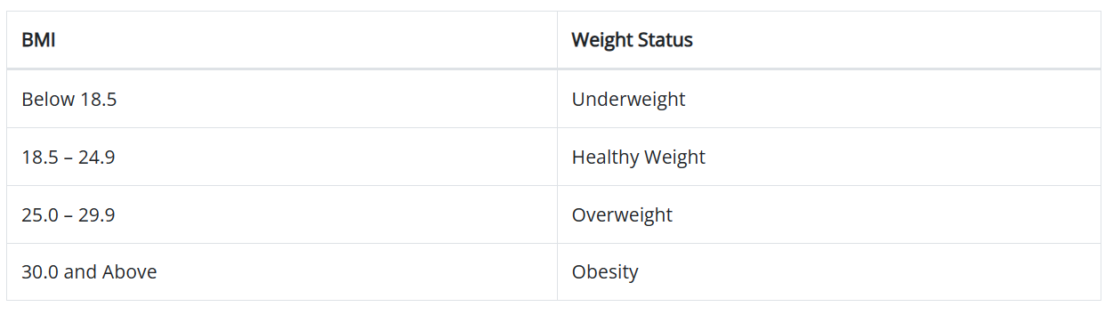
How is BMI interpreted for adults?
For adults 20 years old and older, BMI is interpreted using standard weight status categories. These categories are the same for men and women of all body types and ages.

Slide 5

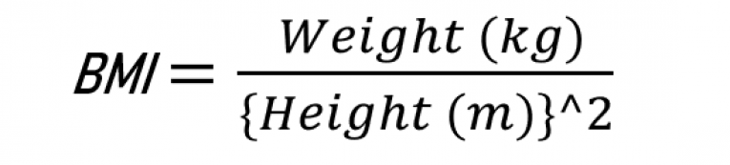
ABOUT CODE
R Environment Used: RStudio
Libraries Used:
^{Shiny}
^{ShinyThemes}
^{Markdown}

Slide 6
How to calculate your BMI?
How does our BMI calculator work?
The height and the weight values are taken in using the slider inputs present in the sidebar panel
The input gets accepted using action button named submit and then sent to a server function
BMI is then calculated using the formula present in a dataframe
The calculated BMI is sent to the output textbox and shown
Enter your height and weight using the slider in input parameters
^{Click on “Submit” button}
Get your calculated BMI in the Main Output Textbox

Slide 7
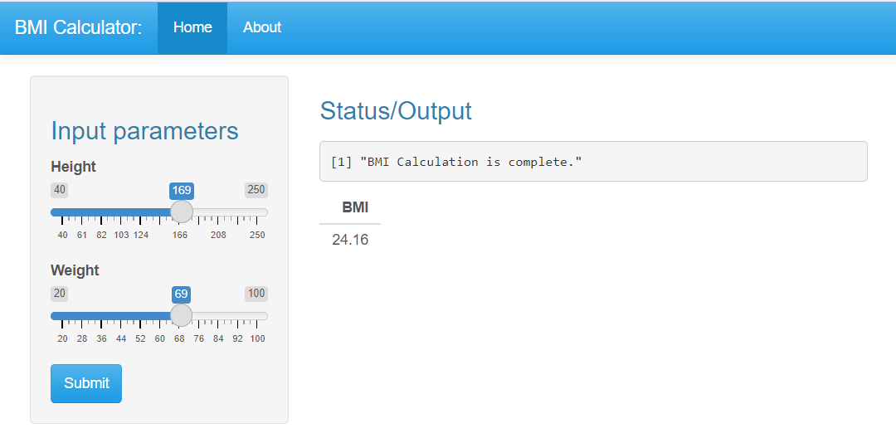
OUR PROJECT

Slide 8
Conclusion
In conclusion, a R programmed BMI calculator provides valuable insights into health assessment and intervention strategies. The web application being mobile friendly also helps in the wide range of implementations. By understanding and addressing its limitations, we can pave the way for personalized healthcare and improved population health outcomes.

Slide 9
THANK YOU
Kevin Jonathan 22911A0532
Samiksha Salunke 22911A0553
Sk. Md. Abdus Samee 22911A0555
Thakur Ujasvi Singh 22911A0559

