Slide 1


NextHikes IT Solutions
At NextHike IT Solution, we offer cutting-edge digital and web solutions to help you take your business to the next level. Whether you need a stunning website, a powerful app, or a custom software, we have the expertise and experience to deliver it.

Slide 2
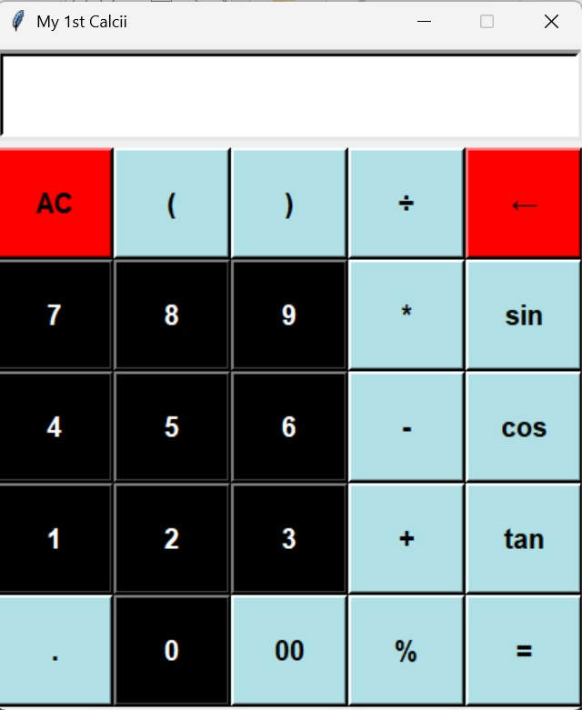
About The Project
GUI CALCULATOR IS A CALCULATOR THAT CAN BE USED BY CLICKING BUTTONS. IN THIS CALCULATOR, ALL ITS NUMBERS AND OPERATORS ARE REPRESENTED GRAPHICALLY AND CAN BE USED WITH ONE CLICK.
GUI IS A VISUAL AND MORE EASY WAY TO INTERACT WITH THE COMPUTER.IT INCLUDES GRAPHICAL REPRESENTATION LIKEBUTTONS AND ICONS AND WE CAN INTERACT WITH THESE ICONS RATHER THAN TEXT BASED INTERACTION.
TKINTER IS A LIBRARY WHICH PROVIDES GUI API TO WORK WITH AND MANAGE ALL ERRORS IN THE BACKGROUND.

Slide 3

Project Goals
The goal of this project is to create a functional and user-friendly calculator using Python’s Tkinter library for the graphical user interface (GUI), and Handle mathematical expressions and operation efficiently.
A simple Scienctific Python calculator using Tkinter
This is a simple sciencetific calculator built using python’s Tkinter library
It can perform basic mathematical oprations like addition, subtraction, multiplication, division and trigonometric function like sine, cosine, tangent.
The user interface (GUI) is designed with button for each operation.

Slide 4



Software Used
Visual Studio Code: commonly referred to as VS Code is an integrated development environment developed by Microsoft for Windows, Linux, macOS and web browsers. Features include support for debugging, syntax highlighting, intelligent code completion, snippets, code refactoring, and embedded version control with Git. Users can change the theme, keyboard shortcuts, preferences, and install extensions that add functionality.
Python: Python is a high-level, general-purpose programming language. Its design philosophy emphasizes code readability with the use of significant indentation.

Slide 5
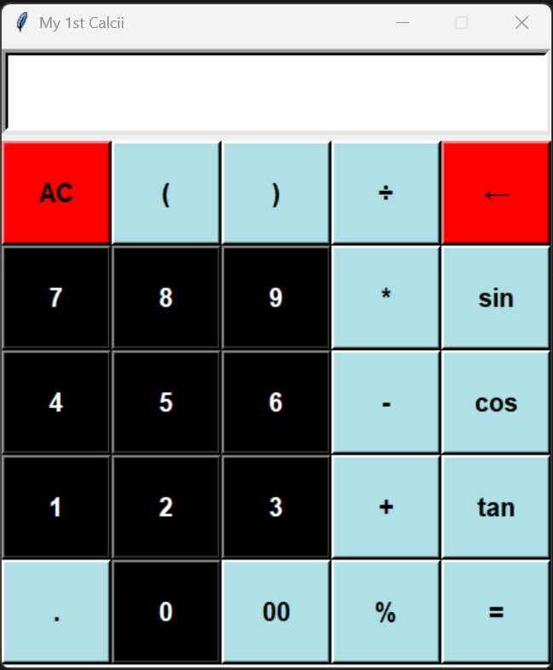
Core Mathematical Operations: Addition, subtraction, multiplication, and division.
Project Architecture & Design :
Equation Display Area (Screen): To show mathematical expressions and results.
Clickable Buttons: Representing numbers (0-9) and operators (+, -, *, ÷, etc.).
Result Calculation & Clear Functionality: Displaying results after calculations and providing a "Clear" button for resetting the screen.

Slide 6
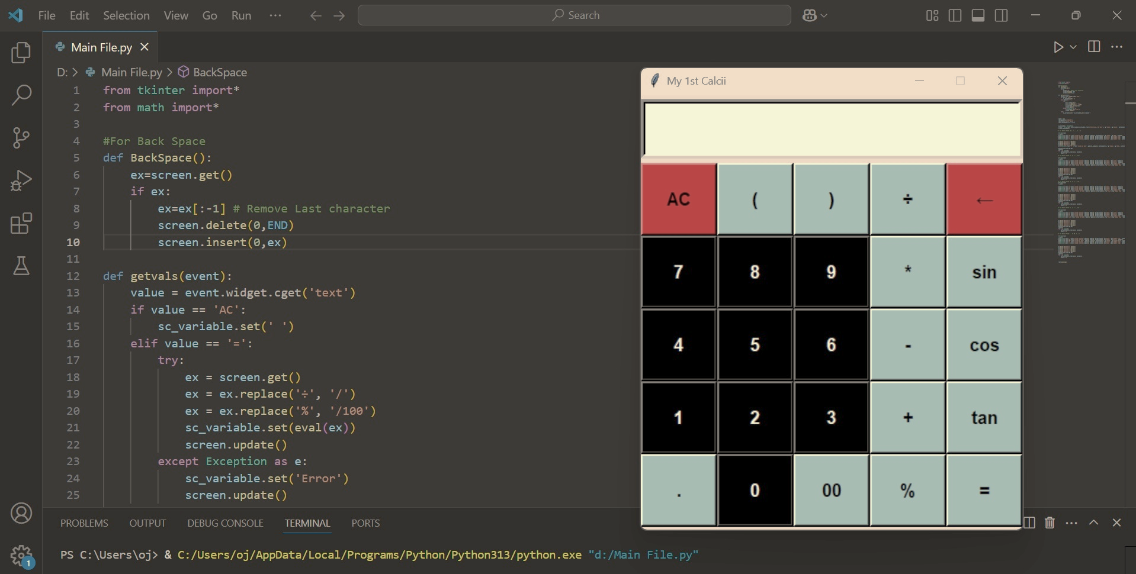
Main components :
Display (Screen): An entry widget to show inputs and results.
Buttons: Created using Tkinter Button widget, each representing a number or operator.
Backspace and Clear Function: The calculator can remove the last character or reset
the screen.
Output Field: Displays the result of the calculation.
Tools & Technologies Used :
Core Python: I gained experience with core Python programming constructs like functions, variables, control structures, and error handling.
Tkinter Library: Learned how to build a GUI using Tkinter, adding interactive buttons, entry fields, and event handling.
Visual Studio Code (IDE): Used Visual Studio Code for writing and debugging the code.
GitHub: Version-controlled the project and learned to manage code on GitHub.

Slide 7

Challenges Faced :
Understanding Tkinter Layout: Designing the layout of the calculator and arranging buttons and screens correctly was initially tricky.
Handling Math Operations Safely: Ensuring the proper handling of mathematical expressions (like division by zero, invalid characters, etc.).
Error Handling: Adding exception handling to avoid crashes when invalid input is provided.

Slide 8
Conclusion: “Through this project, I developed a functional calculator that leverages core Python and Tkinter skills, meeting the project requirements effectively.”

Slide 9

References or Resources
Python Documentation & Download:
Official Python documentation for syntax, functions, and libraries.
Link:- https://docs.python.org/3/
Link:- https://www.python.org/downloads/release/python-3132/
Tkinter Library for GUI:
Link:- https://docs.python.org/3/library/tkinter.html
Link:- https://www.geeksforgeeks.org/python-simple-gui-calculator-using-tkinter/
Visual Studio Code:
Link:- https://code.visualstudio.com/docs

Slide 10
Thanks!

