Slide 1
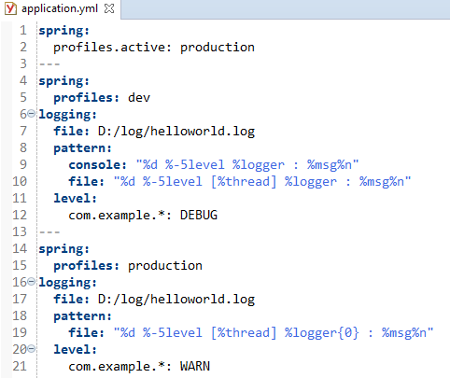
Spring Active Profile Properties in YAML
Spring Profiles are commonly used to configure Spring for different deployment environments.
For example, while developing in your local machine, it is common to set the log level to DEBUG. This will give you detailed log messages for your development use.
While on production, its typical set the log level to WARN or above. This is to avoid filling your logs with excessive debug information and incurring the overhead of excessive logging.
You can segregate a YAML configuration into separate profiles with a spring.profiles key for each profile. Then, add the required logging configuration code to each profile and ensure that the profile lists are separated by the --- lines. In the same file, you can use the spring.profiles.active key to set the active profile. However, this is not mandatory. You can also set the active profile to use programmatically or passing it as a system property or JVM argument while running the application.

Slide 2
Spring Active Profile Properties in YAML
https://springframework.guru/using-yaml-in-spring-boot-to-configure-logback/

