Slide 1
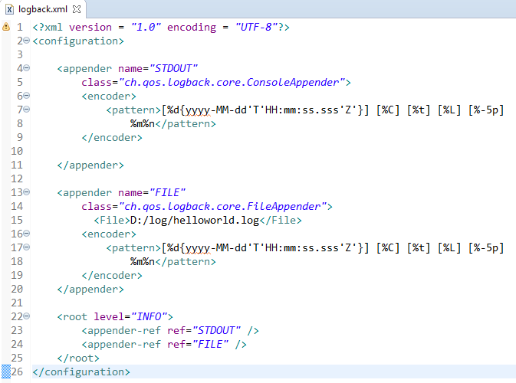
Spring Boot - Configure Logback
We can configure the Console and file appender in Logback.xml file. Note that you need to specify the Log file path insider the file appender.
We can also define the set of supported log patterns inside the console or file log appender

