Slide 1
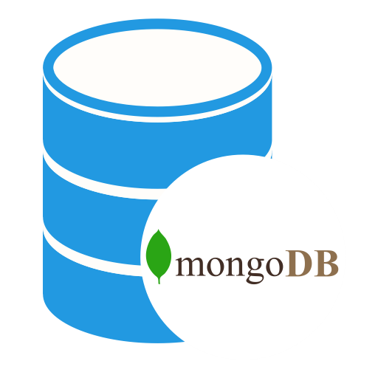
MongoDB - Introduction
MongoDB is an open-source document database and leading NoSQL database.
MongoDB is written in C++.
MongoDB is a document database designed for ease of development and scaling.
MongoDB is a cross-platform, document oriented database that provides, high performance, high availability, and easy scalability. MongoDB works on concept of collection and document.

Slide 2
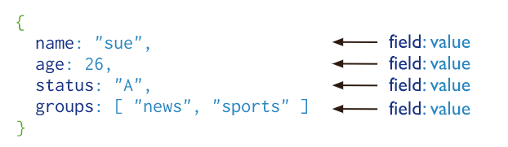
MongoDB - Introduction
A record in MongoDB is a document, which is a data structure composed of field and value pairs.
MongoDB documents are similar to JSON objects.
The values of fields may include other documents, arrays, and arrays of documents.
Document Database
The advantages of using documents are:
Documents (i.e. objects) correspond to native data types in many programming languages.
Embedded documents and arrays reduce need for expensive joins.
Dynamic schema supports fluent polymorphism.

Slide 3
MongoDB - Introduction
MongoDB stores documents in collections. Collections are analogous to tables in relational databases.
Collection is a group of MongoDB documents. It is the equivalent of an RDBMS table.
A collection exists within a single database. Collections do not enforce a schema. Documents within a collection can have different fields. Typically, all documents in a collection are of similar or related purpose.
Collections

