Slide 1
Spring Boot - Batch Service
Spring Batch is a lightweight batch framework which can be used by enterprise systems to develop robust batch applications for the daily operations.
Consider an environment where users have to do a lot of batch processing. This will be quite different from a typical web application which has to work 24/7.
But in classic environments it's not unusual to do the heavy lifting for example during the night when there are no regular users using your system. Batch processing includes typical tasks like reading and writing to files, transforming data, reading from or writing to databases, create reports, import and export data and things like that.
Often these steps have to be chained together or you have to create more complex workflows where you have to define which job steps can be run in parallel or have to be run sequentially etc. That's where a framework like Spring Batch can be very handy.
Spring Boot Batch provides reusable functions that are essential in processing large volumes of records, including logging/tracing, transaction management, job processing statistics, job restart, skip, and resource management. It also provides more advanced technical services and features that will enable extremely high-volume and high performance batch jobs though optimization and partitioning techniques. Simple as well as complex, high-volume batch jobs can leverage the framework in a highly scalable manner to process significant volumes of information

Slide 2
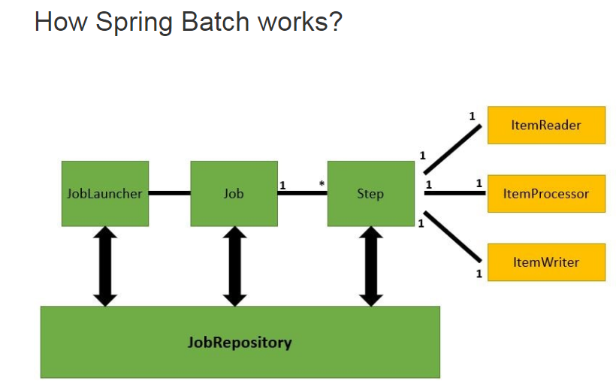
Spring Boot - Batch Service

Slide 3
Spring Boot - Batch Service
Any Spring Batch job has 2 main components, Job, and Steps. A job may have multiple steps. Each step has a compulsory reader and writer routines and an optional processor unit.
Step
A Step is a fundamental unit of any Job. It is a domain object that encapsulates an independent, sequential phase of a batch job. A Step defines necessary information to define and control the actual batch processing.
Item Reader
ItemReader is an abstract representation of how data is provided as input to a Step. When the inputs are exhausted, the ItemReader returns null.
Item Processor
ItemProcessor represents the business processing of an item. The data read by ItemReader can be passed on to ItemProcessor. In this unit, the data is transformed and sent for writing. If, while processing the item, it becomes invalid for further processing, you can return null. The nulls are not written by ItemWriter.
Item Writer
ItemWriter is the output of a Step. The writer writes one batch or chunk of items at a time to the target system. ItemWriter has no knowledge of the input it will receive next, only the item that was passed in its current invocation.

Slide 4

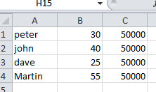
Spring Boot - Batch Service
Batch Service is a process to execute more than one command in a single task.
Batch Service
Item Reader
Read the CSV file
Item Processor
Intermediate processor(Transform the data if needed)
After job completed notify
Item Writer
Persist the data in the database
JobCompletionNotificationListener

Slide 5
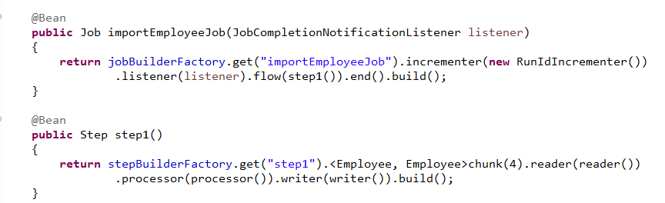
Spring Boot - Batch Service
The first method defines the job, and the second one defines a single step. Jobs are built from steps, where each step can involve a reader, a processor, and a writer.
In this job definition, you need an incrementer, because jobs use a database to maintain execution state. You then list each step, (though this job has only one step). The job ends, and the Java API produces a perfectly configured job.
In the step definition, you define how much data to write at a time. In this case, it writes up to 4 records at a time. Next, you configure the reader, processor, and writer by using the beans injected earlier.

Slide 6
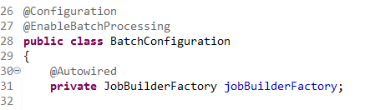
Spring Boot - Batch Service
The @EnableBatchProcessing annotation is used to enable the batch operations for your Spring Boot application.

Slide 7
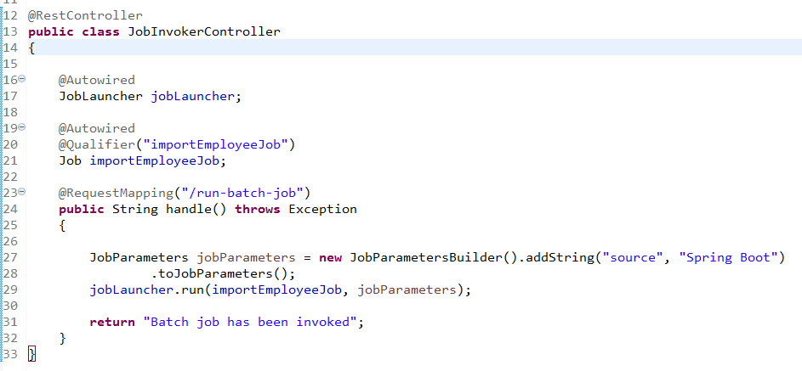
Spring Boot - Batch Service
By default, Spring boot runs all the job as soon as it has started its context. If you want to disable that you can define below the property
spring.batch.job.enabled=false
As we want to run the job manually, we will define a controller and we will call the job when that end point is loaded.
Invoking the Job

