Slide 1
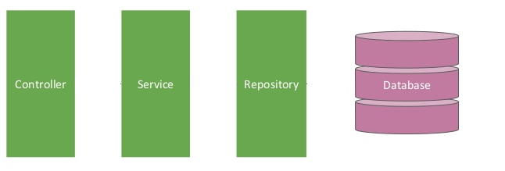

Spring boot [Controller -- Service -- Repository] – Create Employee
Postman client
Create Employee Request
Create Employee Response
EmployeeServiceController.java
EmployeeServiceImpl.java
EmployeeRepository.java
@RestController
@Service
@Repository

Slide 2
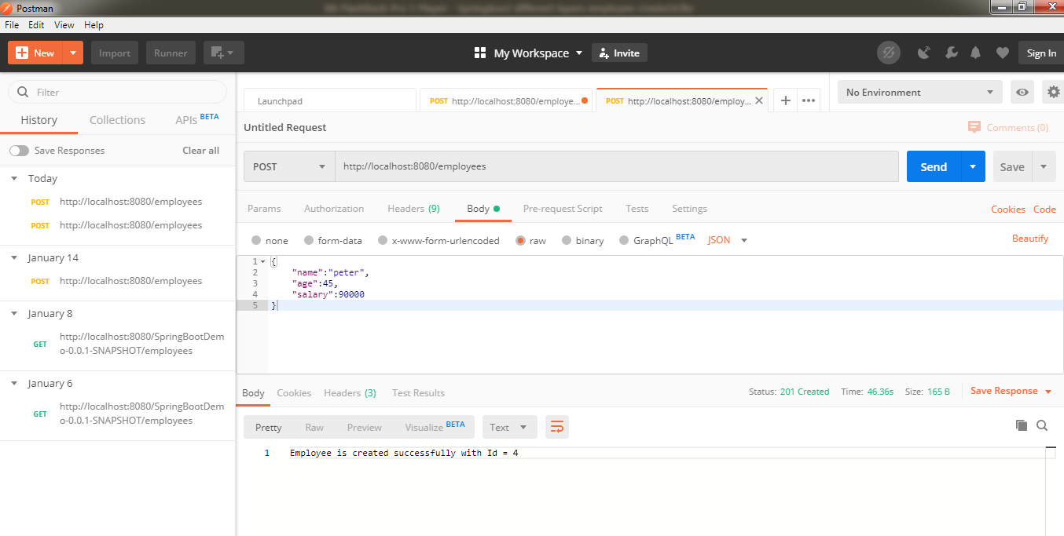
Spring boot [Controller -- Service -- Repository] – Create Employee

Slide 3
Spring boot [Controller -- Service -- Repository] – Create Employee
{
"name":"peter",
"age":45,
"salary":90000
}

