Slide 1
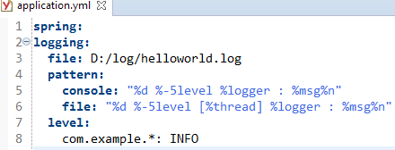
Spring Boot - Configure Logback (YAML)
If you wish to use YAML for your Spring configuration, you simply need to create a YAML file. Spring Boot will look for a application.yml file on the classpath.
In the default structure of a Spring Boot web application, you can place the file under the Resources directory. To parse YAML files, you need a YAML parser. Out of the box, Spring Boot uses SankeYAML, an YAML parser. There is nothing you need to do to enable YAML support in Spring Boot. By default under Spring Boot, YAML is ready to go.
We can configure Spring Boot to additionally log messages to log files. We can also set the patterns of log messages both for console and file separately, like below.

