Slide 1
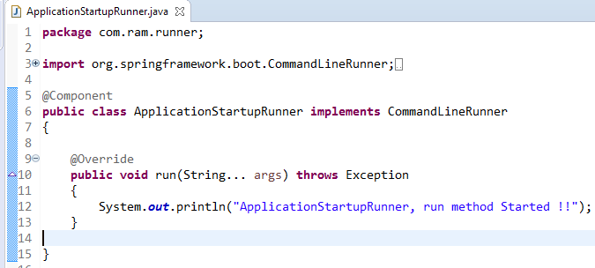
Using CommandLineRunner as @Component
Spring boot’s CommandLineRunner interface is used to run a code block only once in application’s lifetime – after application is initialized.

