Slide 1
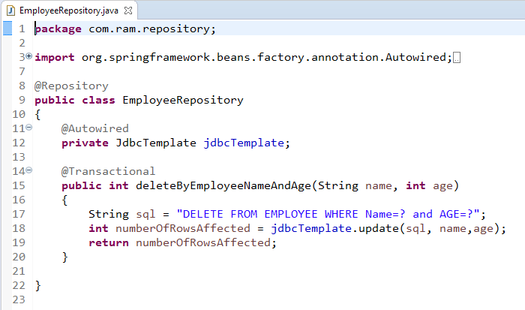
How to delete the record using JdbcTemplate with SpringBoot?

