Slide 1
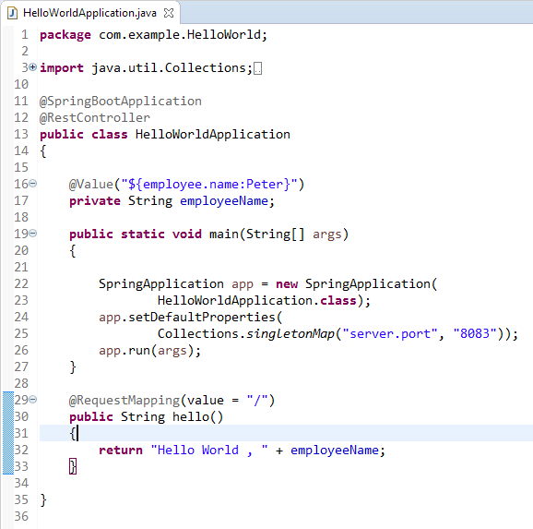
How to configure the port programmatically
We can configure the port programmatically by either setting the specific property when starting the application.

