Slide 1
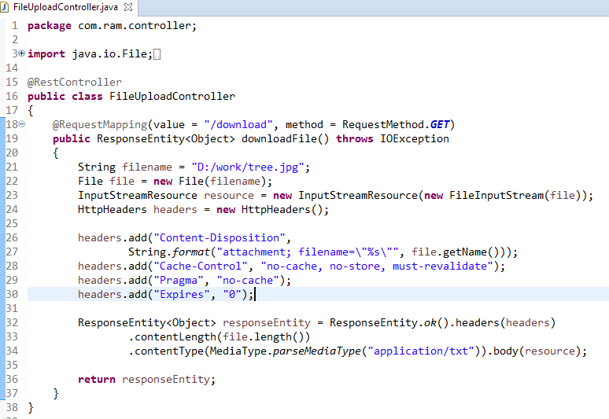
Spring Boot - File Download
We need to set the HttpHeader Content-Disposition in Response and need to specify the response Media Type of the application.

