Slide 1
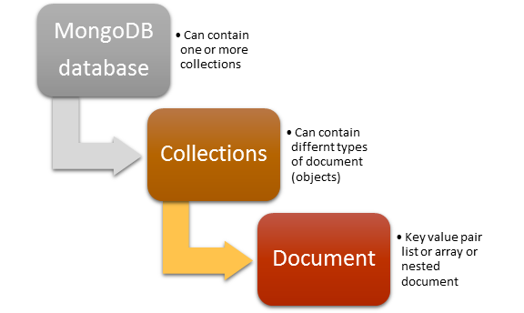
MongoDB - Overview
MongoDB is an open source document oriented database. MongoDB falls in the category of the NoSQL – Database which means it doesn’t follow fixed schema structure like in relational databases.
MongoDB can be installed on Windows, Linux and MAC so it is a cross platform database. It doesn’t support joins but it can represent rich, hierarchical data structures. And of the best feature the like the most is that it is easily scalable and can give high performance.
A single MongoDB server typically has multiple databases. Database is a physical container for collections. MongoDB is schema-less what it means is that every collection can contain different types of object. Every object is also called document which is represented as a JSON (JavaScript Object Notation) structure: a list of key-value pairs. The value can be of three types: a primitive value, an array of documents or again a list of key-value pairs.
MongoDB Server

Slide 2
MongoDB - Overview
The following table shows the relationship of RDBMS terminology with MongoDB
RDBMS | MongoDB
Database | Database
Table | Collection
Tuple/Row | Document
column | Field
Table Join | Embedded Documents
Primary Key | Primary Key (Default key _id provided by MongoDB itself)
Database Server and Client
RDBMS | MongoDB
Mysqld/Oracle | mongod
mysql/sqlplus | mongo

Slide 3
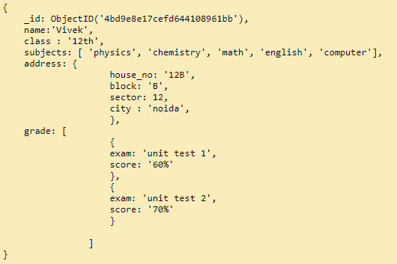
MongoDB - Overview
This document contains information of a student in the key-value pair.
It contains unique _id for the record, name and its value, class and its value, subjects and its value is in the form of array, address contains its value in form of another in-document and grade contains its value in form of arrays of documents.
If we have to represent the same record in Relational world then we would require at least three tables. One to store basic information like _id, name, class, address and another to store subjects and another one to store grades etc. But here we stored the whole relational information in one complete document this is how we managed the deficiency of joins and constraints in MongoDB. In MongoDB we do not have joins but it’s up to us the developers how we are designing our schema to manage relations.
Sample Document

Slide 4
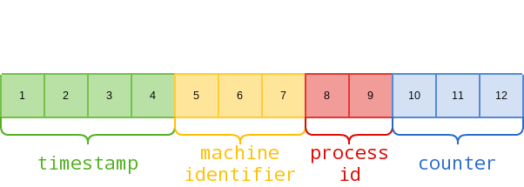
MongoDB - Overview
_id is a 12 bytes hexadecimal number which assures the uniqueness of every document.
We can provide _id while inserting the document. If you don’t provide then MongoDB provides a unique id for every document.
These 12 bytes first 4 bytes for the current timestamp, next 3 bytes for machine id, next 2 bytes for process id of MongoDB server and remaining 3 bytes are simple incremental VALUE.
Sample Document
ObjectID

