Slide 1
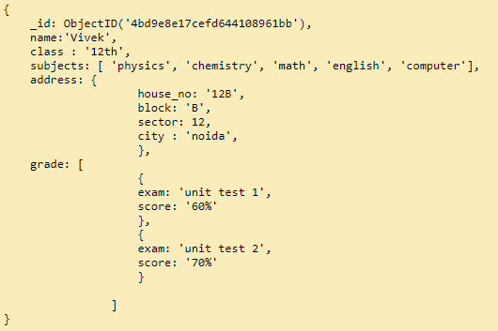
MongoDB - ObjectId
In MongoDB, each document stored in a collection requires a unique _id field that acts as a primary key. If an inserted document omits the _id field, the MongoDB driver automatically generates an ObjectId for the _id field.
This also applies to documents inserted through update operations with upsert: true.
By default, MongoDB creates a unique index on the _id field during the creation of a collection.
The _id field is always the first field in the documents. If the server receives a document that does not have the _id field first, then the server will move the field to the beginning.
Sample Document

Slide 2
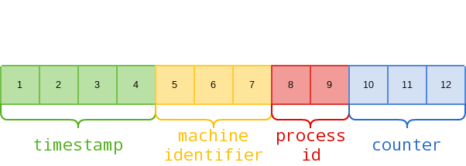
MongoDB - ObjectId
An ObjectId is a 12-byte BSON type having the following structure −
The first 4 bytes representing the seconds since the unix epoch
The next 3 bytes are the machine identifier
The next 2 bytes consists of process id
The last 3 bytes are a random counter value
MongoDB uses ObjectIds as the default value of _id field of each document, which is generated while the creation of any document. The complex combination of ObjectId makes all the _id fields unique.
ObjectID

