Slide 1

Spring Boot + Spring Security – RESTful Web Service with Database Authentication
We will see how to secure REST API using Spring Boot Database Authentication. All the user who tries to access the secured resource will be authenticated and authorized using the Database Authentication.

Slide 2
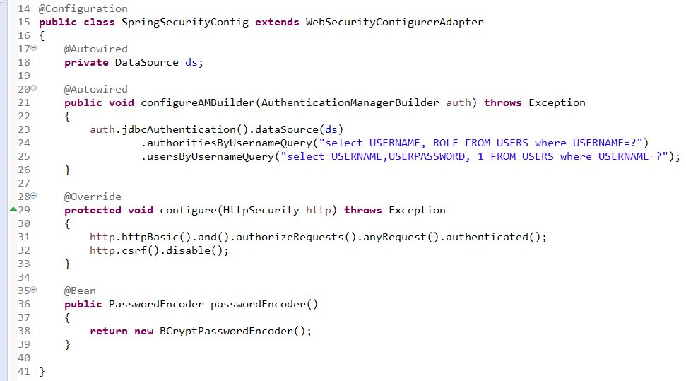
Spring Boot + Spring Security – RESTful Web Service with Database Authentication
We have extended WebSecurityConfigurerAdapter, it allows us to override spring’s security default feature. In our example we will be enabling HTTP Basic authentication which authenticates all the incoming request
configureAMBuilder() method configures the AuthenticationManagerBuilder class with the valid user credentials and the allowed roles.
We have configured JDBC Authentication and set up two queries for AuthenticationManagerBuilder
usersByUsernameQuery –> Authenticating the user
authoritiesByUsernameQuery –> Authorizing the user

Slide 3
Spring Boot + Spring Security – RESTful Web Service with Database Authentication
The configure() method configures the HttpSecurity class which authorizes each HTTP request which has been made. In our example all the request will be authenticated and allowed access only when the user has USER or ADMIN role
.httpBasic() –> Makes spring to use the HTTP Basic Authentication method to authenticate the user
authorizeRequests() .anyRequest().authenticated() –> All requests to the endpoint must be authorized or else they should be rejected.
.csrf().disable() –> Disables CSRF protection
In Spring Boot 2, we need to pass the encoded password, We have registered our passwordEncoder as BCryptPasswordEncoder. While saving the password in the database we need to save it in a Bcrypt encoded format, which will be decoded while authenticating.
Whenever we have not mapped any PasswordEncoder then SpringBoot will throw the “There is no PasswordEncoder mapped for the id \”null\” error

Slide 4
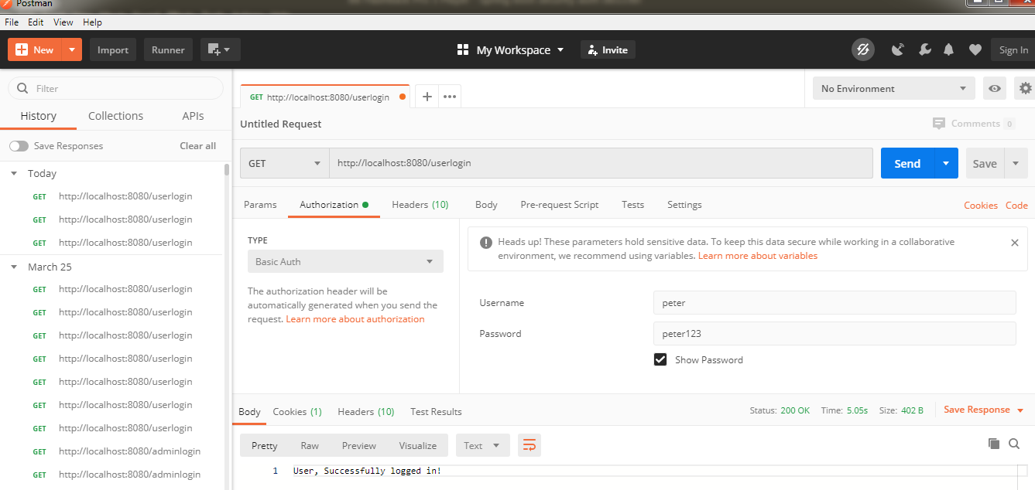
Spring Boot + Spring Security – RESTful Web Service with Database Authentication

Slide 5
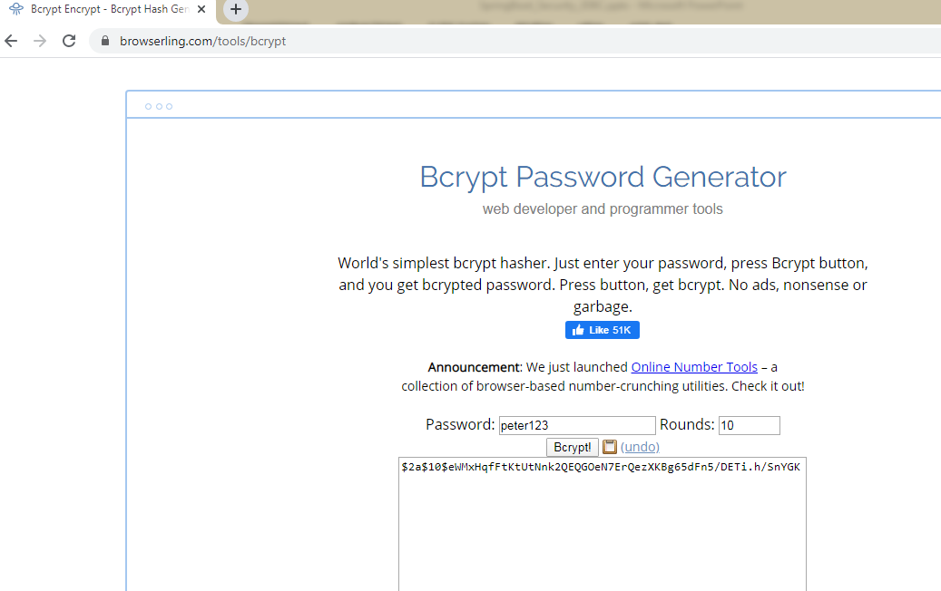
Spring Boot + Spring Security – RESTful Web Service with Database Authentication
https://www.browserling.com/tools/bcrypt

