Slide 1
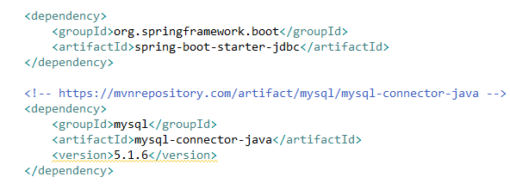
Using JdbcTemplate with SpringBoot (Insert a record)
By using SpringBoot we can take advantage of auto configuration feature and eliminate the need to configure beans by ourselves.
The spring-boot-starter-jdbc module transitively pulls tomcat-jdbc-{version}.jar which is used to configure the DataSource bean.
If you have not defined any DataSource bean explicitly and if you have any embedded database driver in classpath such as H2, HSQL or Derby then SpringBoot will automatically registers DataSource bean using in-memory database settings.
If you haven’t registered any of the following type beans then SpringBoot will register them automatically.
PlatformTransactionManager (DataSourceTransactionManager)
JdbcTemplate
NamedParameterJdbcTemplate

Slide 2
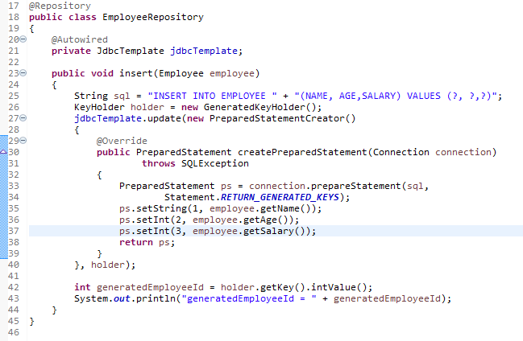
Using JdbcTemplate with SpringBoot (Insert a record)

Slide 3

Using JdbcTemplate with SpringBoot (Insert a record)
We can configure the database properties in application.properties file so that SpringBoot will use those jdbc parameters to configure DataSource bean.

