Slide 1
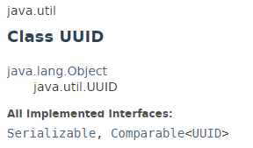
UUID
The java.util.UUID class represents an immutable universally unique identifier (UUID).
A UUID represents a 128-bit value.
UUID is used for creating random file names, session id in web application, transaction id etc.
There are four different basic types of UUIDs: time-based, DCE security, name-based, and randomly generated UUIDs.

Slide 2
UUID
https://docs.oracle.com/javase/8/docs/api/index.html?java/util/UUID.html

