Slide 1
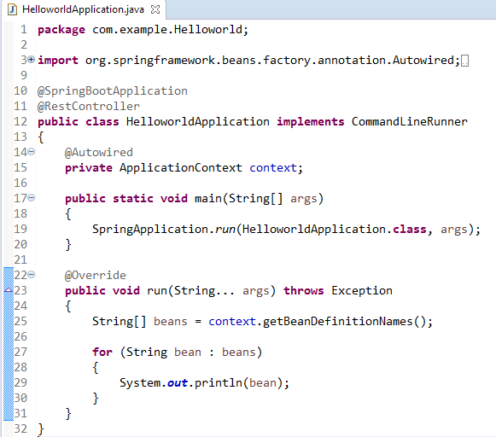
Spring Boot – Display All Beans Available in ApplicationContext
CommandLineRunner/ApplicationRunner’s run() method will get execute right after ApplicationContext is created and before Spring Boot application initialized. This run() method will execute only once in an application’s life cycle.
So what’s the difference between CommandLineRunner/ApplicationRunner? Basically, both will do the same trick, the only difference is CommandLineRunner’s run() method will accept String array and ApplicationRunner’s run() will accept Application Arguments as arguments.

