Slide 1
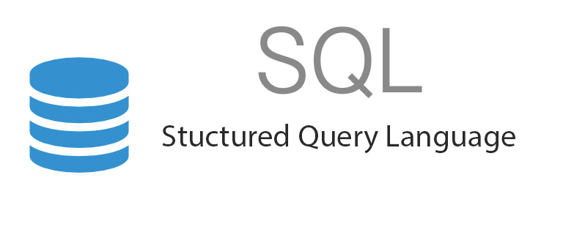
SQL - Introduction
What is SQL?
SQL stands for Structured Query Language
SQL lets you access and manipulate databases
SQL is a standard language for storing, manipulating and retrieving data in databases.
We can use SQL in: MySQL, SQL Server, MS Access, Oracle, Sybase, Informix, Postgres, and other database systems

Slide 2

SQL - Introduction
What we can do using SQL?
SQL can execute queries against a database
SQL can retrieve data from a database
SQL can insert records in a database
SQL can update records in a database
SQL can delete records from a database
SQL can create new databases
SQL can create new tables in a database
SQL can create stored procedures in a database
SQL can create views in a database
SQL can set permissions on tables, procedures, and views

Slide 3
SQL - Introduction
SELECT * FROM employee

