Slide 1
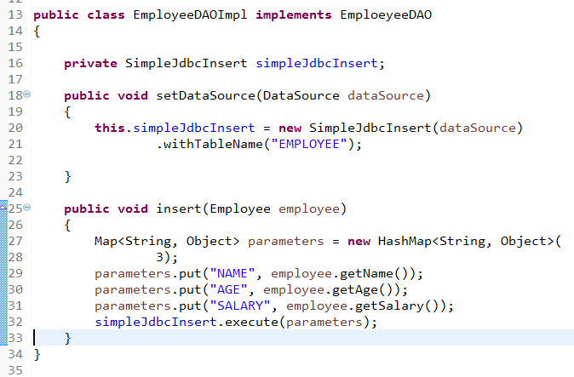
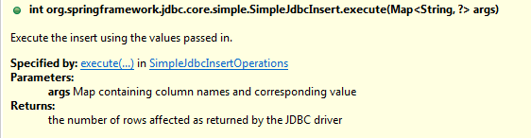
Inserting data using SimpleJdbcInsert
Let’s start by looking at the SimpleJdbcInsert class with the minimal amount of configuration options. You should instantiate the SimpleJdbcInsert in the data access layer’s initialization method. For this example, the initializing method is the setDataSource method. You do not need to subclass the SimpleJdbcInsert class; simply create a new instance and set the table name using the withTableName method. Configuration methods for this class follow the "fluid" style that returns the instance of the SimpleJdbcInsert, which allows you to chain all configuration methods. This example uses only one configuration method.
The execute method used here takes a plain java.utils.Map as its only parameter. The important thing to note here is that the keys used for the Map must match the column names of the table as defined in the database. This is because we read the metadata in order to construct the actual insert statement.

