Slide 1
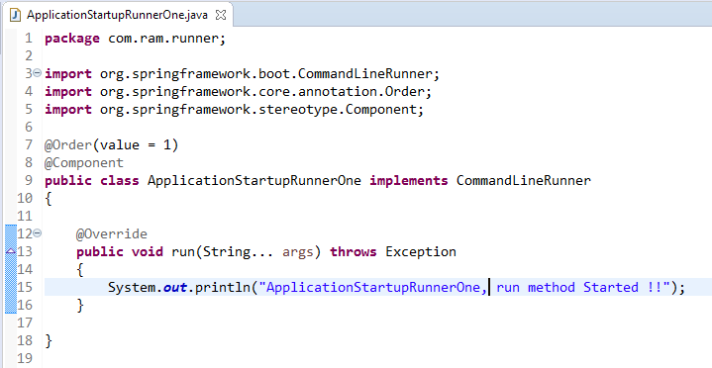
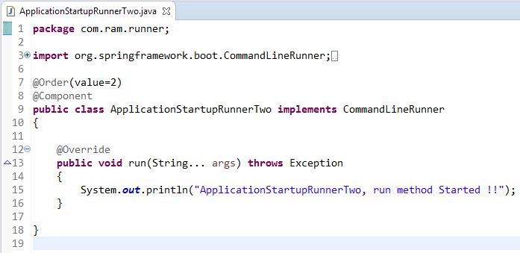
Using @Order if multiple CommandLineRunner interface implementations
You may have multiple implementations of CommandLineRunner interface. By default, spring boot to scan all its run() methods and execute it. But if you want to force some ordering in them, use @Order annotation.

Slide 2
Using @Order if multiple CommandLineRunner interface implementations
It is important to note that if any exceptions are thrown inside the run(String… args) method, this will cause the context to close and an application to shut down. So put risky code in try-catch block – ALWAYS.
Why use CommandLineRunner interface
Command line runners are a useful functionality to execute the various types of code that only have to be run once, right after application startup.
FYI, Spring Batch relies on these runners in order to trigger the execution of the jobs.
We can use the dependency injection to our advantage in order to wire in whatever dependencies that we need and in whatever way we want – in run() method implementation.

