Slide 1
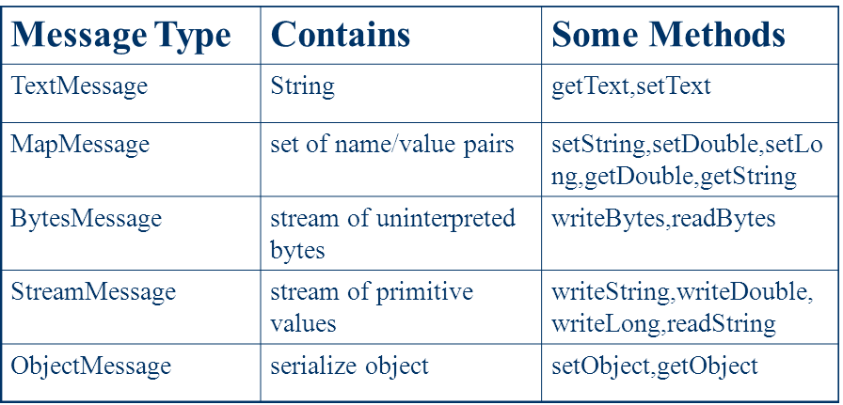
Java Messaging Service(JMS) Core Components
Create/Send
Handling Routing and Delivery of the messages
JMS Client
Producer
/Publisher
Message
Messaging Server [e.g. Jboss Server ]
JMS Provider
JMS Client
JBossMQ
Listening Queue/Topic
Message
Producer and Receiver
Queue
Topic
JMS Client
Receiver
/Subscriber
Message
JMS Providers
Active MQ
RabbitMQ
JbossMQ
HornetQ
IBM Websphere MQ
Consumes
JMS is all about sending and receiving messages between two or more clients

Slide 2
Point - to - Point Messaging
In PTP for each message has only one consumer
Listening
Producer/Publisher
Receiver/Consumer
Messaging Server [e.g. Jboss Server ]
Producer/Publisher
Message
JMS Provider
Receiver/Consumer
JBossMQ
Queue
Message
Producer/Publisher
Receiver/Consumer
Acknowledges
Queue’s are based on point-to-point messaging model where messages are sent to a queue. Each message has exactly one sender and one receiver. Message is guaranteed to be delivered to only one receiver.

Slide 3
Publish/Subscribe Messaging
In Publish/Subscribe each message has multiple consumers
Listening
Producer/Publisher
Receiver/Consumer
Messaging Server [e.g. Jboss Server ]
JMS Provider
Producer/Publisher
JBossMQ
Message
Receiver/Consumer
Message
Topic
Producer/Publisher
Receiver/Consumer
Topic’s are based on publish-subscribe model where messages are sent to a topic. N subscribers can be subscribed on a topic, and when a message arrives, each will get a copy of that message.

Slide 4
JMS API
Mysql DB
JDBC API
Oracle DB
postgresql
Jboss MQ
JMS API
ActiveMQ
IBM WebSphere MQ

